Slide 1
Hands-on perfSONAR
Jose Gomez, Jorge Crichigno
University of South Carolina
http://ce.sc.edu/cyberinfra
NSF CC* Workshop - Online
April 15, 2021

Slide 2
Lab Series: perfSONAR
Lab 1: Configuring Admin. Information Using perfSONAR Toolkit GUI
Lab 2: PerfSONAR Metrics and Tools
Lab 3: Configuring Regular Tests Using perfSONAR GUI
Lab 4: Configuring Regular Tests Using pScheduler CLI Part I
Lab 5: Configuring Regular Tests Using pScheduler CLI Part II
Lab 6: Bandwidth-delay Product and TCP Buffer Size
Lab 7: Configuring Regular Tests Using a pSConfig Template
Lab 8: perfSONAR Monitoring and Debugging Dashboard
Lab 9: pSConfig Web Administrator
Lab 10: Configuring pScheduler Limits

Slide 3
Organization of Lab Manuals
Each lab starts with a section Overview
Objectives
Lab topology
Lab settings: passwords, device names
Roadmap: organization of the lab
Section 1
Background information of the topic being covered (e.g., fundamentals of TCP congestion control)
Section 1 is optional (i.e., the reader can skip this section and move to lab directions)
Section 2… n
Step-by-step directions

Slide 4
Exercise 1 Config. Regular Tests using perfSONAR GUI
Lab activities are described in Lab 3, perfSONAR Lab Series

Slide 5
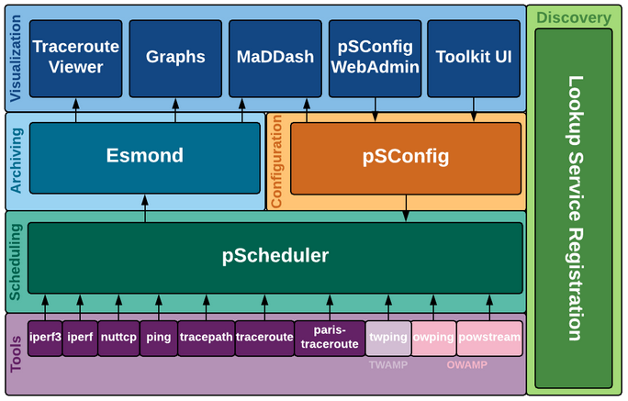
perfSONAR Toolkit UI
perfSONAR Toolkit UI facilitates the configuration of regular test (e.g., throughput, loss, latency)
Adding administrative information about the node
Lab topology
perfSONAR layers

Slide 6
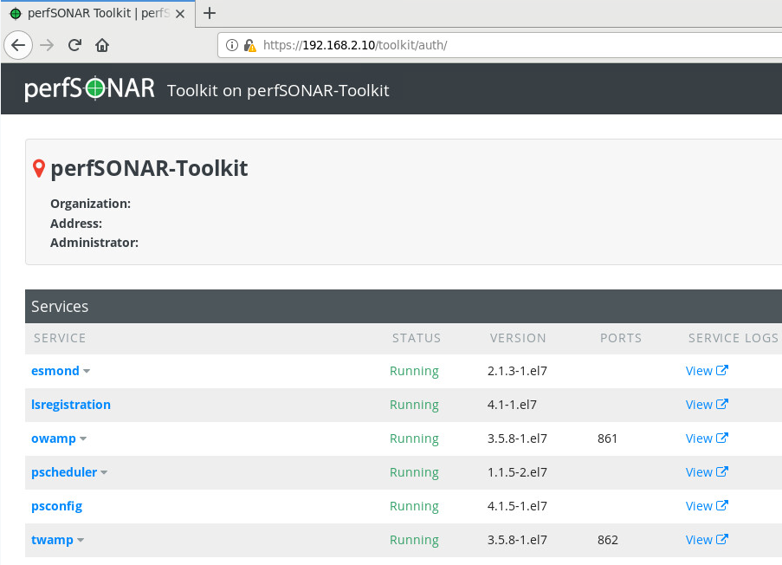
perfSONAR Toolkit UI
Access to perfSONAR Toolkit UI via the Client host
Credentials:
URL: 192.168.2.10
Username: admin
Password: admin
Lab topology
perfSONAR toolkit UI

Slide 7
Exercise 2 Config. Regular Tests using perfSONAR CLI
Lab activities are described in Lab 4, 5, perfSONAR Lab Series

Slide 8
pScheduler CLI
pScheduler manages the execution of network measurements (e.g., tasks) such as throughput, latency and loss
The user invokes pScheduler tasks using the CLI
pScheduler allows submitting remote task executions
Lab topology
perfSONAR layers

Slide 9
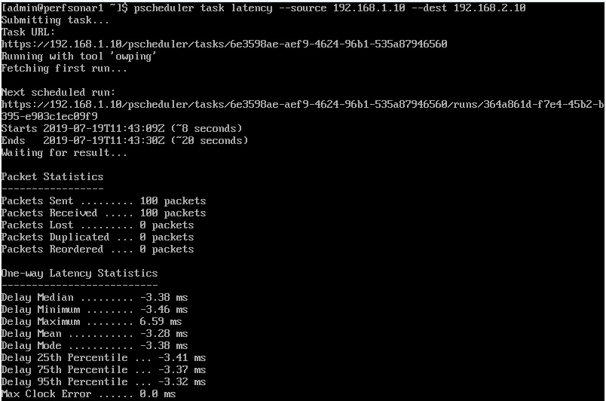
pScheduler CLI
Run a latency task between perfSONAR1 (192.168.1.10) and perfSONAR2 (192.168.2.10)
pscheduler task latency --source 192.168.1.10 --dest 192.168.2.10
Lab topology
Latency task

Slide 10
Exercise 3 Visualizing Performance Metrics on MaDDash
Lab activity is described in Lab 8, perfSONAR Lab Series

Slide 11
MaDDash
MaDDash collects and presents two-dimensional monitoring data as a set of grids referred to as a dashboard
perfSONAR-central-management
pScheduler Agent
Lab topology
perfSONAR layers

Slide 12
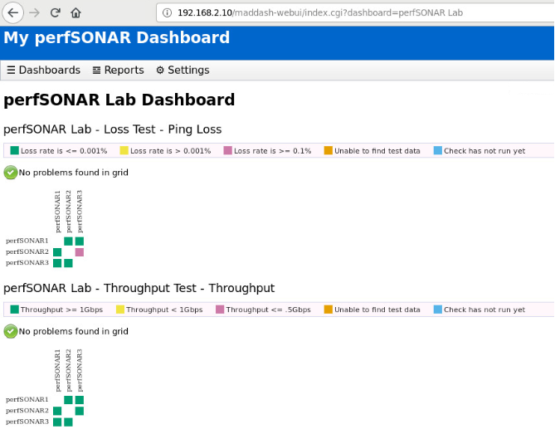
MaDDash
Access to MaDDash web interface via the Client host
Credentials:
URL: 192.168.2.10/maddash-webui
Username: admin
Password: admin
Lab topology
perfSONAR layers

Slide 13
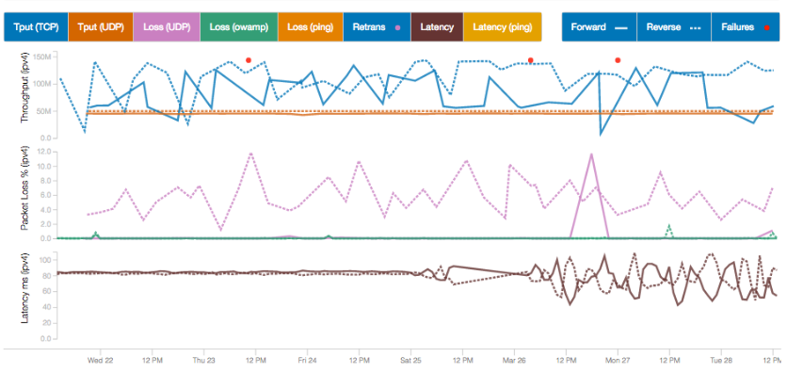
MaDDash
Access to MaDDash web interface via the Client host
Credentials:
URL: 192.168.2.10/maddash-webui
Username: admin
Password: admin
Lab topology
perfSONAR layers

