Slide 1


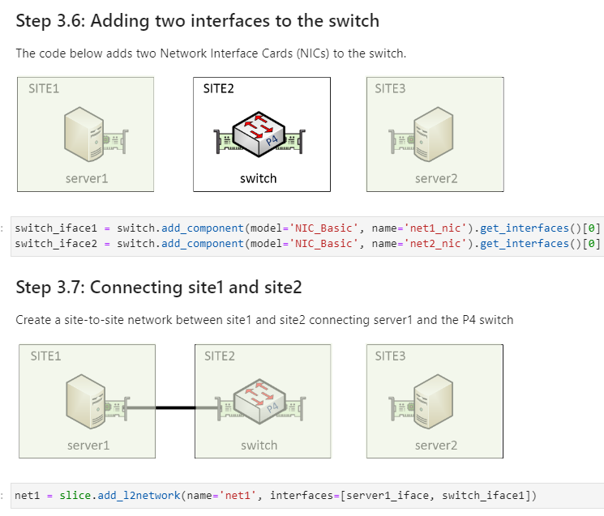
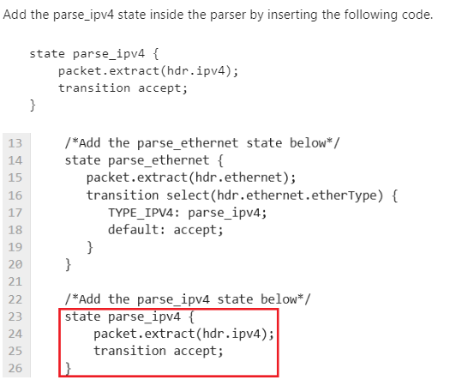


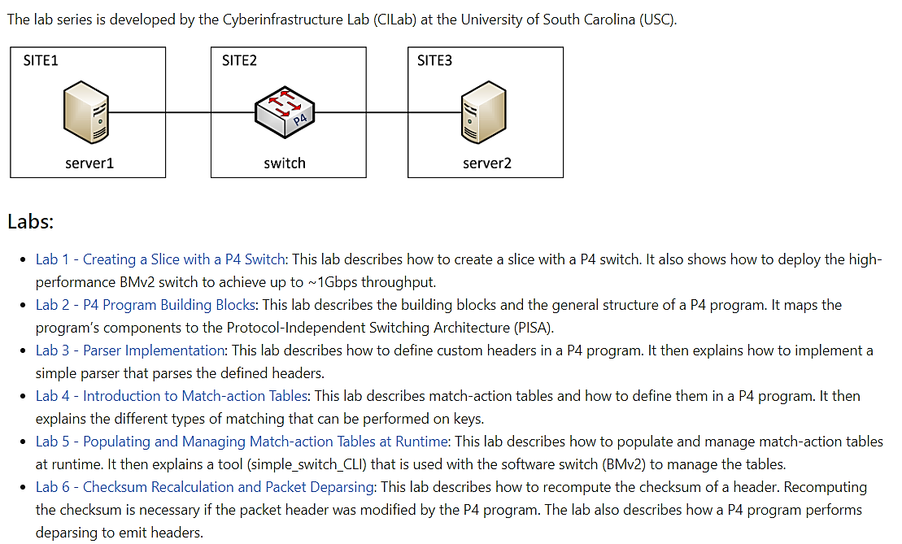
Using FABRIC for Cybertraining on
P4 Programmable Data Planes
Elie Kfoury, Jorge Crichigno
Integrated Information Technology Department, College of Engineering and Computing
University of South Carolina, Columbia, South Carolina
Abstract
Sample Lab: Parser Implementation
Getting Started
Recently, data plane programmability has attracted significant attention from both the research community and the industry, permitting programmers to run customized packet processing functions in the data plane.
The Cyberinfrastructure Lab (CILab) at the University of South Carolina (USC) has developed step-by-step hands-on lab experiments on data plane programming using the P4 language.
The labs use the Behavioral Model version 2 (BMv2) as the software switch.
Topics include fundamentals of P4, P4 building blocks, parser implementation in the data plane, populating match-action tables, and others.
The learner will acquire expertise to create, test, and deploy P4 applications on custom topologies in FABRIC.
More advanced laboratories are being developed, covering topics such as advanced P4 constructs, advanced parsing, stateful processing, data plane/control plane communication protocols, fine-grained measurements, cybersecurity applications, etc.
The labs are available to the community through FABRIC’s examples repository.
The labs are integrated with FABRIC’s examples
start_here.ipynb -> Complex Recipes -> P4 Labs (BMv2)
Feedback and contributions to additional labs are welcome.
Acknowledgements
This work is in part funded by NSF grant #2118311 and ONR grant #N00014-23-1-2245.
P4 Lab Library
Fine-grained Queue Measurement with P4 on FABRIC

