Slide 1
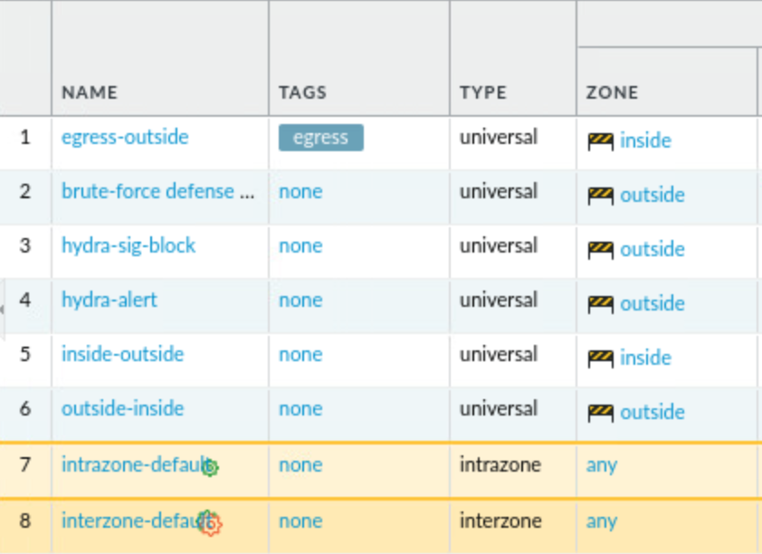
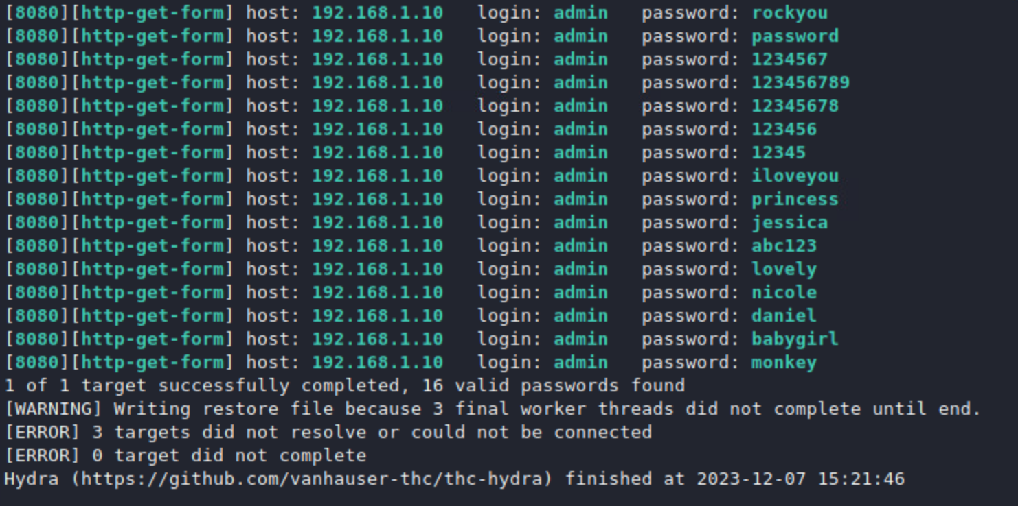
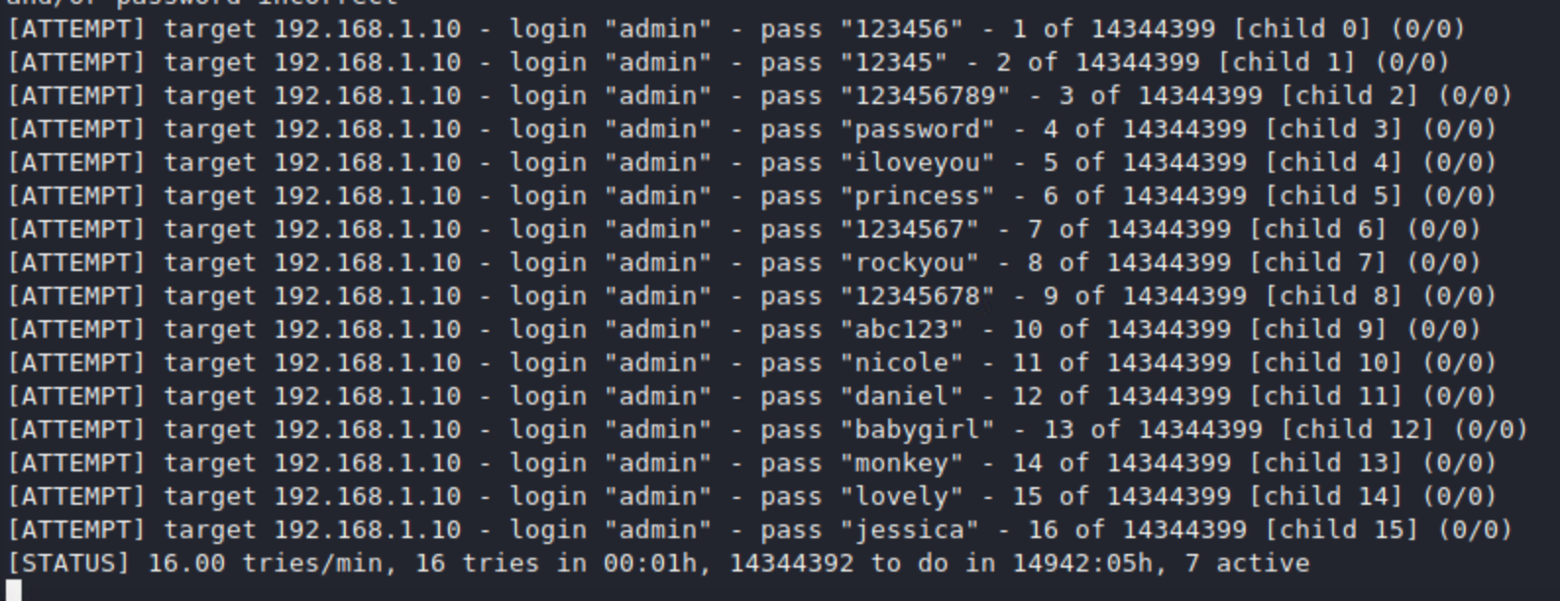
Protecting a Web Application
Against Brute-force Attacks
Yousef Afshar, Chasey Kilcrease
Advisors: Jose Gomez, Jorge Crichigno
Integrated Information Technology Department, University of South Carolina, Columbia, South Carolina
Abstract
Test System
Results
This project aims to protect a web server against an online brute-force attack.
The experimental scenario entails an external attacker attempting unauthorized access to the web server by systematically trying to guess the login credentials of legitimate users.
To prevent the attack, this project employs a Next Generation Firewall (NGFW) to protect a web server by enforcing security policies.
A NGFW is an advanced network security firewall that provides such as stateful inspection and utilizes layer 7 application filtering, integrated intrusion prevention, and an active threat intelligence source.
The experimental topology consists of a web server and an attacker with an NGFW in the middle acting as the sole defense for network traffic on the border.
Results show that successful implementation of granular security policies in the NGFW prevents a brute-force attack from occurring on the web-application.
This project implements security policies in a NGFW to protect a web server from a brute-force attack.
The topology comprises a web server, an attacker, and a NGFW in between the two.
Note that the NGFW is an edge device on the internal network's border in the topology which this test will be run.
The web application is hosted on a web server.
The attacker is located on the external network.
A brute-force attack is executed from the attacker’s machine on the web application.
The NGFW needs to be configured with security policies that can defend the web application from the attacker’s brute-force attack.
In this test environment, we will demonstrate two policies utilizing our NGFW (virtualized instance of a Palo Alto managed through Panorama)
An attack signature-based alert (akin to an IDS system)
An attack signature-based block to stop the flow of traffic.
Our web server will specifically be a free PHP/MySQL web application in DVWA while our attacker will perform the attack on a Kali Linux system.
In the first scenario, a successful brute-force attack was executed using hydra.
The NGFW logs show that the session was logged and not blocked.
Alerting such as this can be useful in obtaining more information about attacks and allows for a variety of use cases for a NGFW to be applied to.
In the second scenario, the security policies are implemented in the NGFW.
The policies are specifically created and ordered to handle the attack based on its signature, in our test instance, specifically the hydra password cracking tool.
Finally, the third scenario was tested using the hydra tool.
The NGFW logs show that the session trigged the brute-force-defense-policy and therefore the session was ended due to a threat.
Not only this, but the regular traffic to access the webpage from the attacker's machine can go through (only hydra is blocked, not just the attacker's IP).
Project Description
Understand and execute brute-force attacks.
How an attacker will execute these attacks in a production environment network.
What reasons an attacker would have to utilize these methods.
How IT administrators can leverage NGFW's to secure their network.
Configure a NGFW to detect and block brute-force attacks.
The NGFW must implement a brute-force attack protection policy, so that any attack from the external network (Internet) will be detected and blocked.
The best practices to enhance the security of web applications.
Mitigation techniques can be followed to prevent a brute-force attack on a web application.
Background on Next Generation Firewalls
A NGFW is a network security tool that provides more security aspects than a basic firewall.
Traditional stateful firewalls inspect traffic solely based on the destination and not what data is being transported.
NGFW expands those capabilities of a traditional firewall and inspect the data being transferred in a more sophisticated manner.
Simply speaking, NGFW filters or blocks traffic between networks.
These firewalls have become increasingly granular and allow for finer levels of policy administration and enforcement.
Referring to the topology below, the traffic between the web server and attacker must first go through the NGFW.
NGFW utilize deep packet inspection, known as DPI to inspect the content of data packets.
DPI allows the admin to create more granular policies based on specific types of data, applications, users, or devices.
For this project, we utilized the NGFW from the vendor Palo Alto.
Some other NGFW vendors include Barracuda, Fortinet, and Forcepoint.
There are many different NGFW for many different cases depending on organizational needs, scope, etc.
Software-based NGFW are utilized like any other application and need to be installed on each network device.
Hardware-based NGFW are physical devices that inspect incoming traffic. These devices can be deployed in a variety of use cases whether as a border device or specifically for core traffic.
Cloud-based NGFWs are deployed on the off-site data center. The company itself or service provider could have the responsibility for managing it.
Experimentation
The following scenarios were implemented using the Netlab platform.
Scenario 1: A successful execution of a brute force attack on the web server from the attacker’s machine without any security policy implemented in the NGFW.
This attack was executed using the hydra tool within Kali Linux.
Scenario 2: The implementation of the brute force attack policy in the NGFW.
These security policies are tailored to not only a brute force attack, but a specific brute force attack in hydra based on the policy signature.
Scenario 3: An unsuccessful brute force attack attempt on the web server from the attacker's machine mitigated due to the security policies implemented in NGFW.
The NGFW policy will actively stop the attacker's brute force attempt.
In the configuration, it will block the IP of traffic specifically from the attack signature.
Lessons Learned
Learned how to execute a brute-force attack from the attacker view.
How to properly configure a NGFW to both detect and block brute-force attacks.
Established the best practices to enhance the security of web applications
Validated the implementation of the security policies in the Netlab environment.
The usage of security policies based on ability to leverage NGFW features.
Conclusion
This project implemented a security policy that mitigated a brute force attack on a web server utilizing a NGFW.
NGFW provide many features that standard stateful firewalls cannot regarding layer 7 application filtering and a more granular inspection of traffic.
Leveraging NGFW’s, a network can defend against even the most advanced network related attacks.
Future works could inclusion of targeted using more difficult to mitigate attacks.
Acknowledgement
This work was supported by the Office of Naval Research (ONR), grant N00014-20-1-2797: “Enhancing the Preparation of Next-generation Cyber Professionals”

