Slide 1
Cyberinfrastructure Lab
University of South Carolina
http://ce.sc.edu/cyberinfra/
Department of Integrated Information Technology (IIT)
College of Engineering and Computing (CEC)
Jorge Crichigno, Elie Kfoury
Monday June 13, 2022 – IIT Conference Room

Slide 2
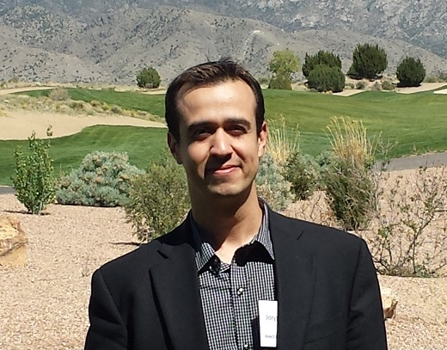
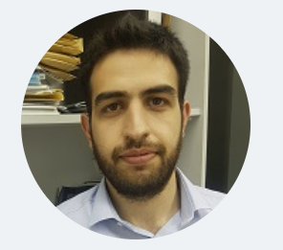
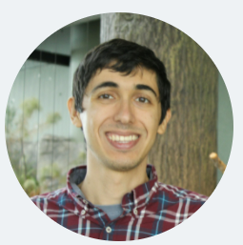
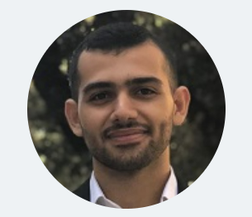
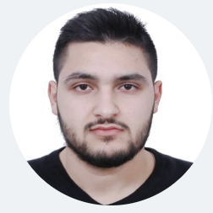
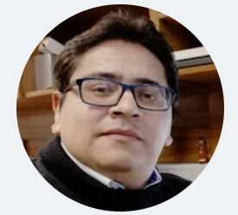

Members
Dr. Jorge Crichigno
Faculty Member, IIT
Elie Kfoury
PhD Student
Jose Gomez
PhD Student
Ali AlSabeh
PhD Student
Ali Mazloum
PhD Student
Christian Vega
PhD Student

Slide 3
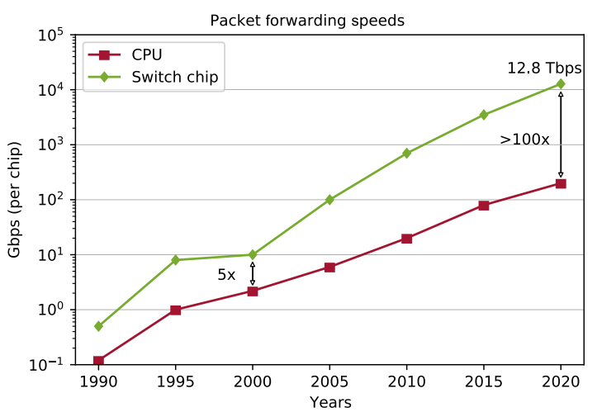
Project 1 – P4 Programmable Data Planes
NSF funded project, 2021-2025. URL: https://tinyurl.com/2ew277rs
It supports training and research on P4 programmable data planes –hardware-level network appliances–, recently developed by Intel
USC is developing applications on networking and cybersecurity that exploit the performance advantages of programmable data planes (agreement with Intel)

Slide 4
Project 1 – P4 Programmable Data Planes
Analogy, networks (programmable data planes) and other computing domains
Domain | Year | Processing Unit | Main Language/s
General computing | 1971 | Central Processing Unit (CPU) | C, Java, Phyton, etc.
Signal processing | 1979 | Digital Signal Processor (DSP) | Matlab
Graphics | 1994 | Graphics Processing Unit (GPU) | Open Computing Language
Machine learning | 2015 | Tensor Processing Unit (TPU) | Tensor Flow
Computer networks | 2017 | Protocol Independent Switch Architecture (PISA) (programmable data plane) | P4

Slide 5
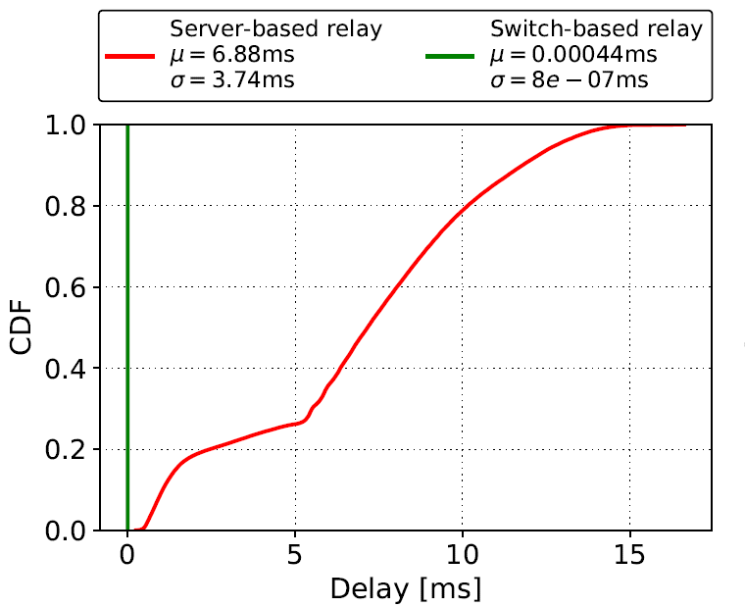
Project 1 – P4 Programmable Data Planes
E.g., Offloading media relay tasks to switch’s data plane
  Orders of magnitude faster than general-purpose CPU
  Limited instruction set (e.g., no multiplication, no division, simple operations)
Application example: media (voice) relay server
 | Programmable Switch | General-purpose CPU
Cost | $6,000 | $ 10,000 - 25,000
Capacity | ~35,000,000 connections/switch | ~500 connections/core
Latency | 400 nanoseconds | Tens-hundreds of msec

Slide 6
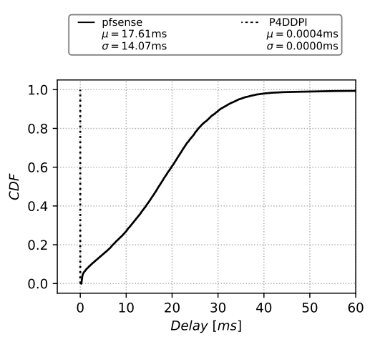
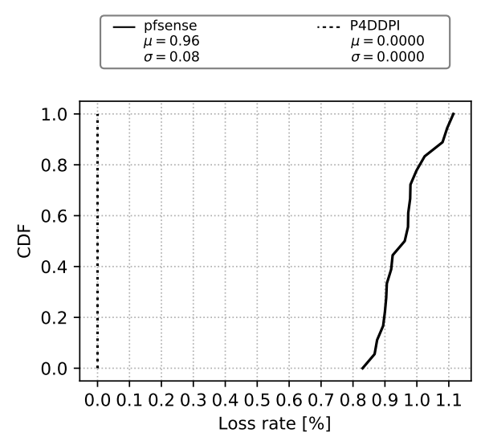
Project 2 – DNS and Internet-scale IoT Security
NSF funded project, 2019-2023. URL: https://tinyurl.com/3a48wvtu
Remove the software-based ‘bottlenecks’ by offloading functionality to switch ASIC
  Parse and analyze DNS traffic solely in the data plane
  Extract domain names and apply filtering rules

Slide 7
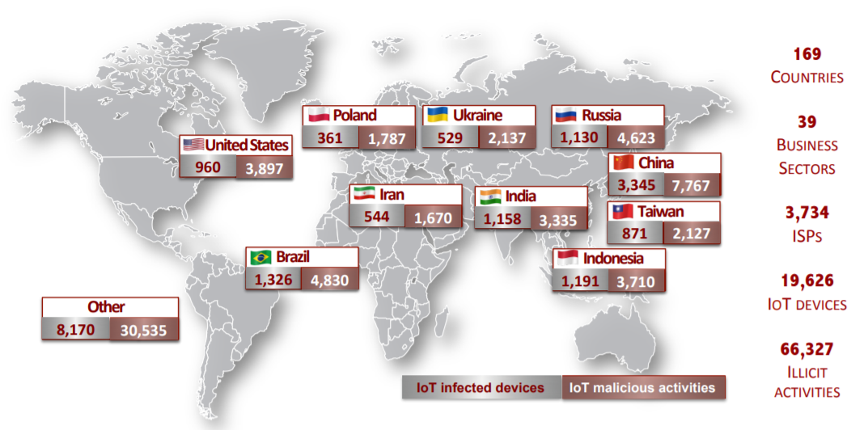
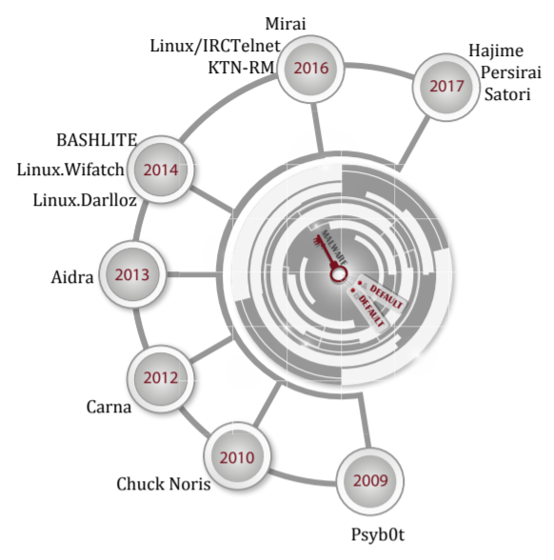
Project 2 – DNS and Internet-scale IoT Security
NSF funded project, 2019-2023. URL: https://tinyurl.com/3a48wvtu
Analyze IoT data worldwide from the Darknet; E.g.,
  Global distribution of exploited IoT devices
  Malware behavior
Global distribution of exploited IoT devices
Malware exploiting default credentials

Slide 8
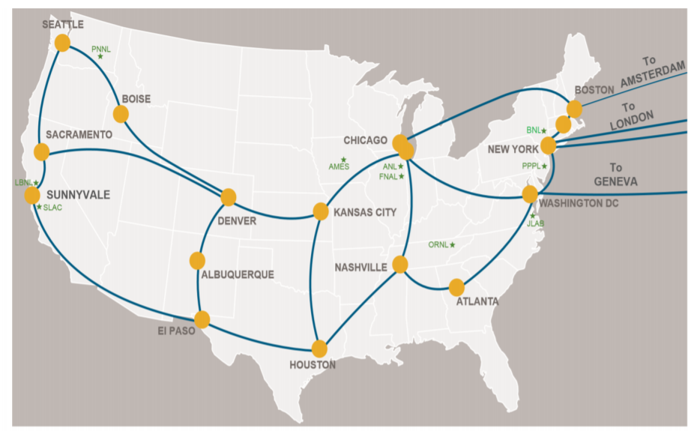
Project 3 – Cybertraining High-Speed Networks
NSF funded project, 2019-2023. URL: https://tinyurl.com/mw6dv8ma
  Online training platform for high-speed networks and cybersecurity
  Cooperation with LBNL, Internet2, Research and Education Networks (RENs)
  (TX’s LEARN, NY’s NYSERNET, CO’s Front Range GigaPop, GA’s SOX,
  Midwest’s Great Plain Network, etc.)
  Training approximately between 500-1,000 IT professionals per year
  –engineers, system admins, PhD students –nationwide
Platform enables ESnet-type network in the cloud

Slide 9
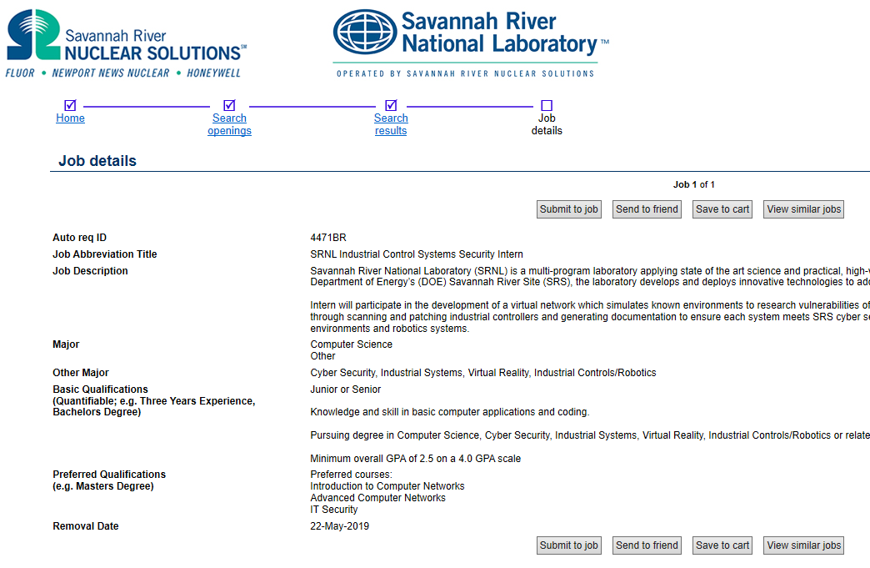
Project 3 – Cybertraining High-Speed Networks
NSF funded project, 2019-2023. URL: https://tinyurl.com/mw6dv8ma
  Established internships related to IT and cybersecurity with SRNL
Steve Tibrea, former CIO, SRNL; interns; Jorge Crichigno

Slide 10
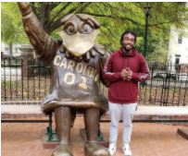
Project 3 – Cybertraining High-Speed Networks
NSF funded project, 2019-2023. URL: https://tinyurl.com/mw6dv8ma
  Approximately 100 internships per year
Internship examples
Name | Position
Ty Love-Baker | 2nd Lt. at United States Marine Corps, DC
Dakota McDaniel | Information Security Analyst at Lowe's
Lauren Waddell | IT Specialist, SC Department of Insurance
Josue Hernandez | Technical Solution Specialist at IBM
Kyle Radzak | IT Specialist at Lowe's Companies
Nathan Bohmer | Project Coordinator at Black Box Networks
Brad Wilson | IT Intern Savannah River National Lab
Zach Fowler | IT Intern at Blue Cross Blue Shield
Nathan Long | Technology Analyst at AIG
Brad Wilson, IT student
“I learned vital cybersecurity skills, such as creating policies with Application Identification rules, generating traffic to ensure security policies are operating appropriately, and reading logs to understand where traffic is traversing the network. The skills I learned during my ONR project were very similar to those skills needed to become part of the Networking/Perimeter team at Savanna River National Laboratory (SRNL)… as a result of my experience and previous internship at SRNL I was offered a full-time position contingent upon my graduation in May 2022”.

Slide 11
Project 4 – Advanced Tech Education
NSF funded project, 2019-2023. URL: https://tinyurl.com/4f9wfbuc
  Develop a multi-state distributed cloud to support teaching, research, and training
  2+2+2 program (HS + College + University)
  The distributed cloud seamlessly pools resources from four data centers: University of South Carolina (SC), Network Development Group (IL), Stanly Community College (NC), Idaho National Lab (ID)
  The platform supports hundreds of organizations

Slide 12
Project 4 – Advanced Tech Education
NSF funded project, 2019-2023. URL: https://tinyurl.com/4f9wfbuc
  A platform tailored for research and education
Feature | Comments
Allocation of resources | Pod granularity
Custom pods | Easy to create custom pods
Cost | Cost-effective when used extensively
Presentation layer | Topology is graphically presented to the learner using a regular browser
Time sharing | We control who can access resources; easy to implement time-sharing policies
IP addresses | Pods (and learners) can have the same topology and IP addresses (overlapping)
Functional realism | Virtual labs have the same functionality as hardware and execute the same code
Traffic realism | Devices generate/receive real, interactive network traffic to/from the Internet

Slide 13
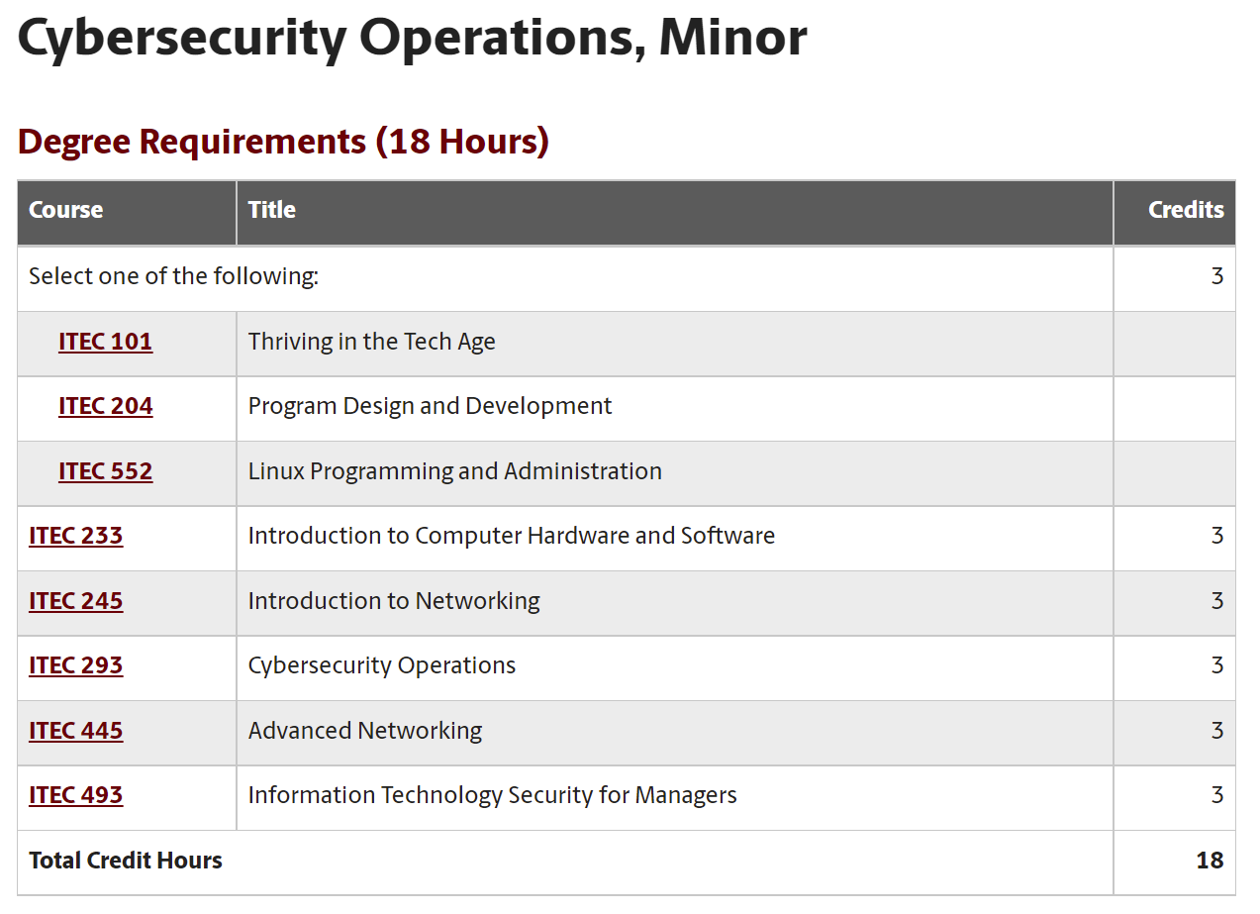
Project 5 – Workforce Development Cybersecurity
ONR funded project, 2020-2022 (potential extension to 2026)
  Develop a cybersecurity concentration
https://tinyurl.com/4mbj3z4k

Slide 14
Project 5 – Workforce Development Cybersecurity
ONR funded project, 2020-2022 (potential extension to 2026)
  Establish an Undergraduate Research Program in Applied Cybersecurity
Participants include ROTC cadets (Navy, Army, Air Force), Veterans, and students from CS, IT, IS, Cyber Intelligence
Name | Project Examples
Christian S | Application ID
Brendan C | Protection against Bruteforce Attacks with NGFW
Jack S | Mitigating Routing Hijacking Attacks
Matthew D | Mitigating Routing Hijacking Attacks
Chris N | Protection against Reconnaissance and Scan Attacks
Jack S | Policy-based Forwarding
Matthew D | Policy-based Forwarding
Keegan S | An open-source library for computer networks and cybersecurity
Dakota M | Distributed Denial of Service (DDoS) Protection
Lauren W | Protection against Bruteforce Attacks with NGFW
Josue H | Site to site VPN with NGFWs
Brian N | Distributed Denial of Service (DDoS) Protection
…

Slide 15
Project 5 – Workforce Development Cybersecurity
ONR funded project, 2020-2022 (potential extension to 2026)
  Deploy virtual equipment pods on a virtual platform
  Lawrence Berkeley National Lab
  SANS institute (“girlsgocyber”)
  Multiple higher-ed institutions
  International Networks at Indiana
  Fort Gordon
  Texas’ Lonestart REN
  Great Plains Network REN
  New York State REN
  U.S. Army Cyber Center of Excellence (CCoE) (Signal School)

Slide 16
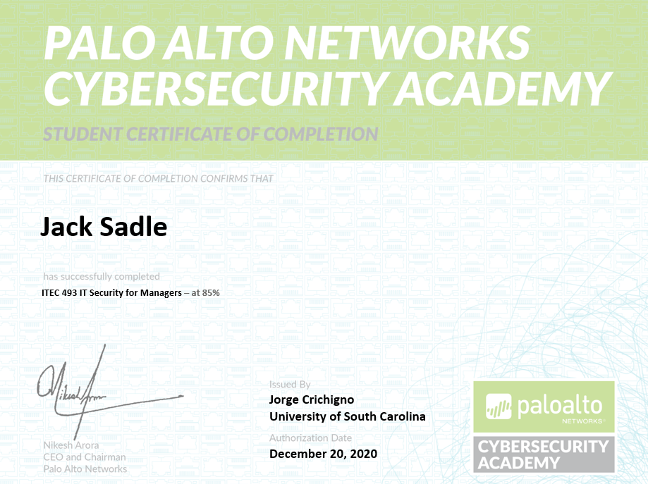
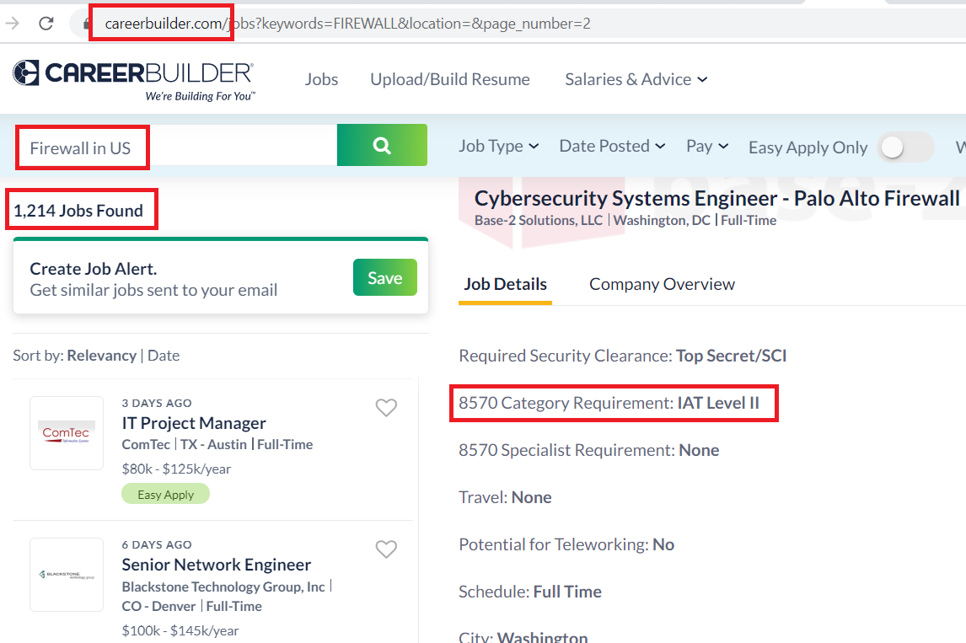
Project 5 – Workforce Development Cybersecurity
ONR funded project, 2020-2022 (potential extension to 2026)
  Develop cooperation among industry, government, higher-ed institutions
  Internships, research experience, certs, professional platforms and tools: Palo Alto Networks, Cisco Systems, VMware, Intel, SRNL, LBNL, and others
Next-generation Firewall Virtual Machine + licenses

Slide 17
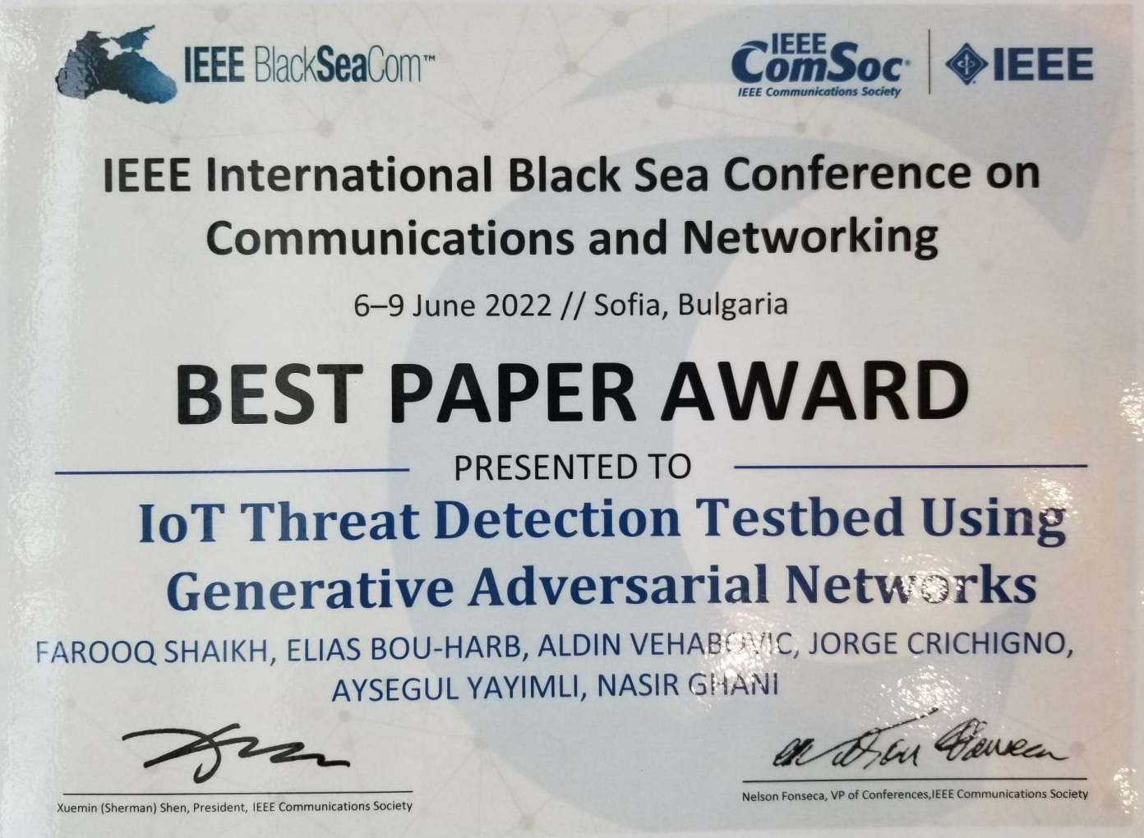
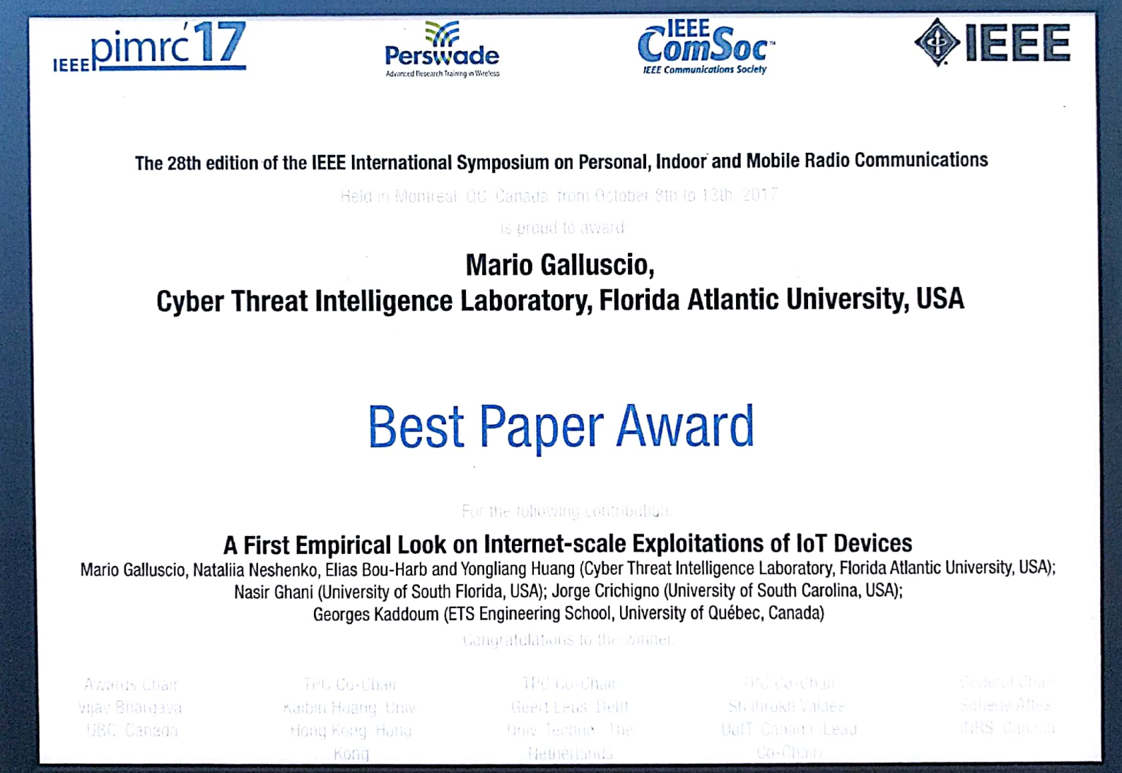

Cyberinfrastructure Lab - Impact

Slide 18
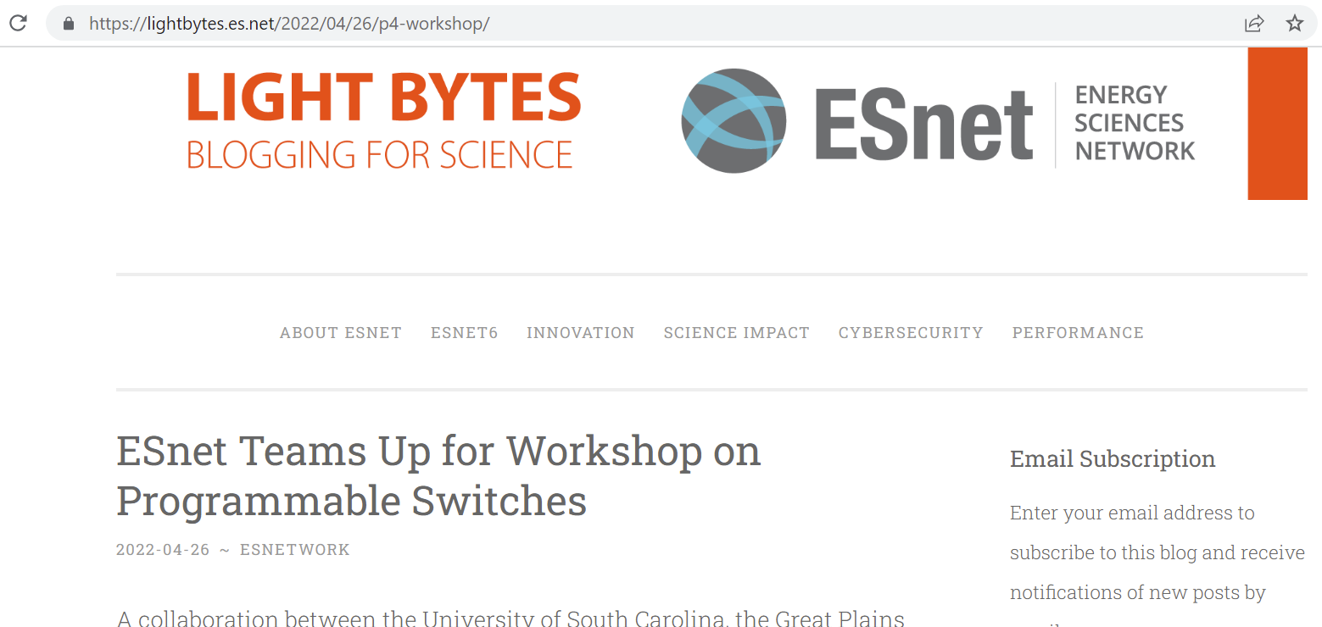
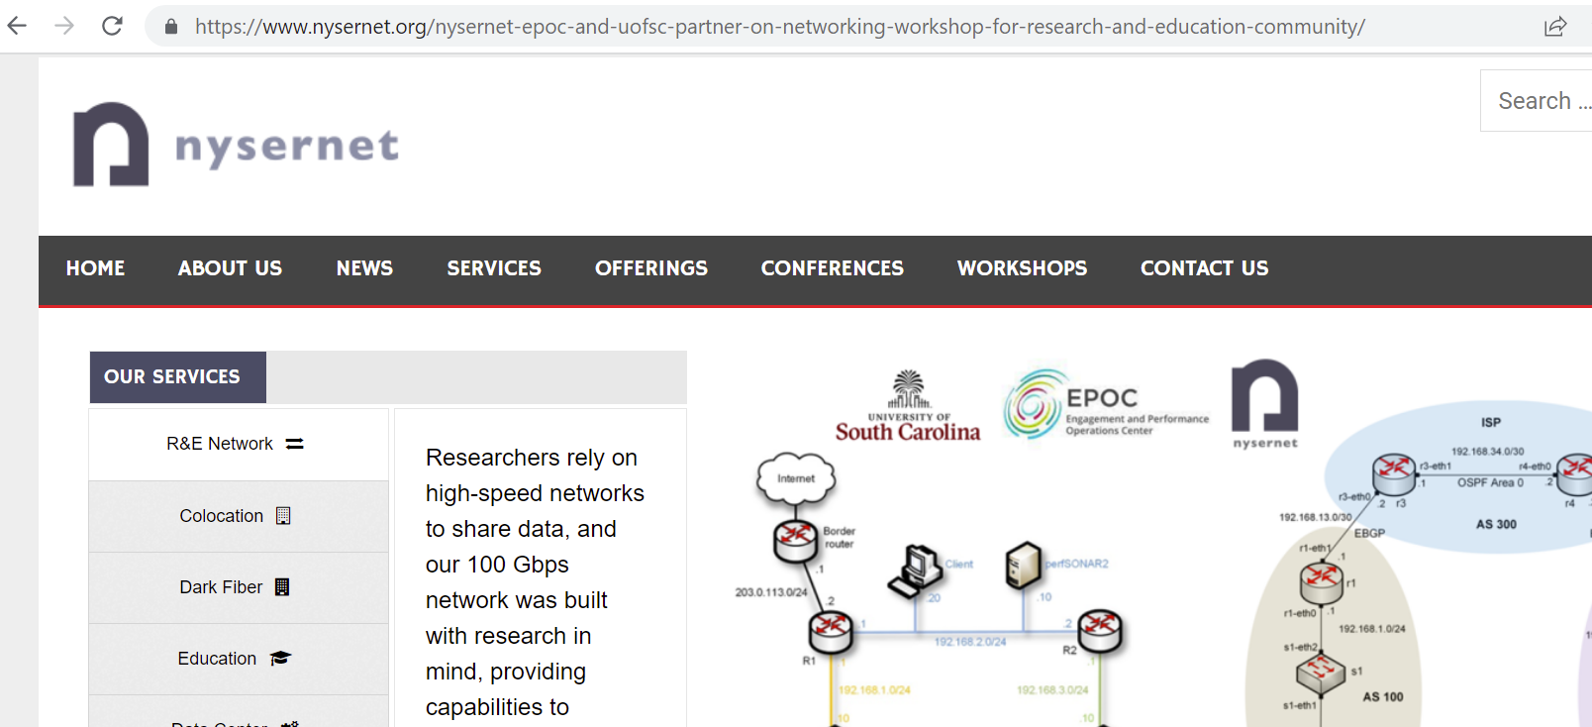
Cyberinfrastructure Lab - Impact

Slide 19

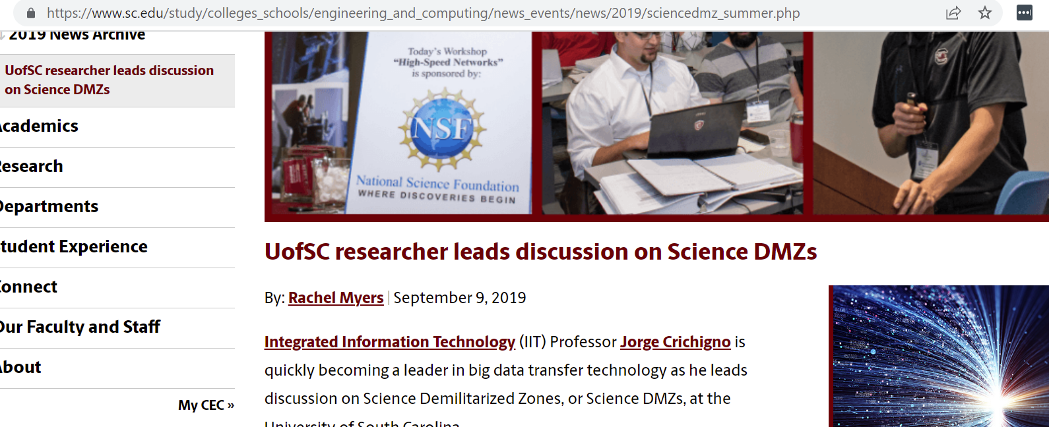
Cyberinfrastructure Lab - Impact

Slide 20


