Slide 1

An Overview of P4 Programmable Switches
and Applications
Jorge Crichigno
College of Engineering and Computing
University of South Carolina
http://ce.sc.edu/cyberinfra/
American University of Beirut
Online – Thursday April 6, 2023

Slide 2
Agenda
Motivation
Overview of P4 programmable switches
Application examples
  Offloading an application to the data plane
  DGA classification
PhD opportunities at the University of South Carolina (USC)

Slide 3
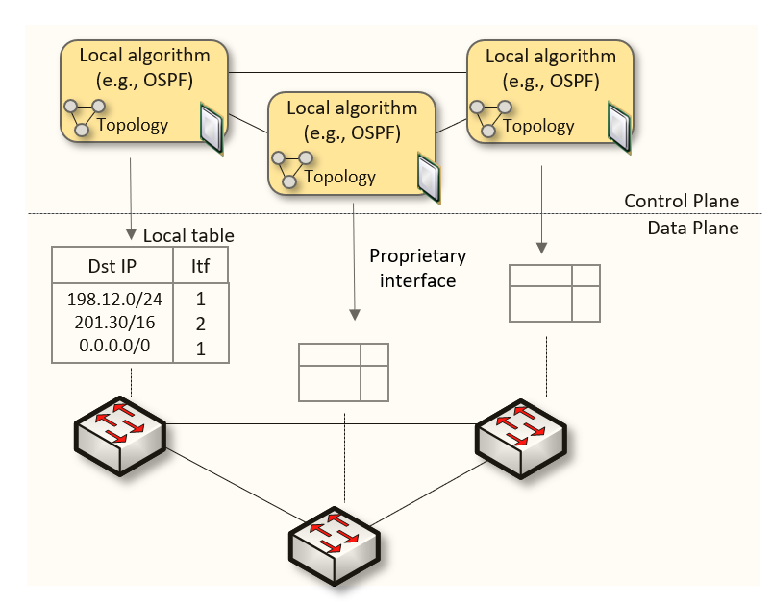
Traditional (Legacy) Networking
Since the explosive growth of the Internet in the 1990s, the networking industry has been dominated by closed and proprietary hardware and software
The interface between control and data planes has been historically proprietary
  Vendor dependence: slow product cycles of vendor equipment, no innovation from network owners
  A router is a monolithic unit built and internally accessed by the manufacturer only

Slide 4
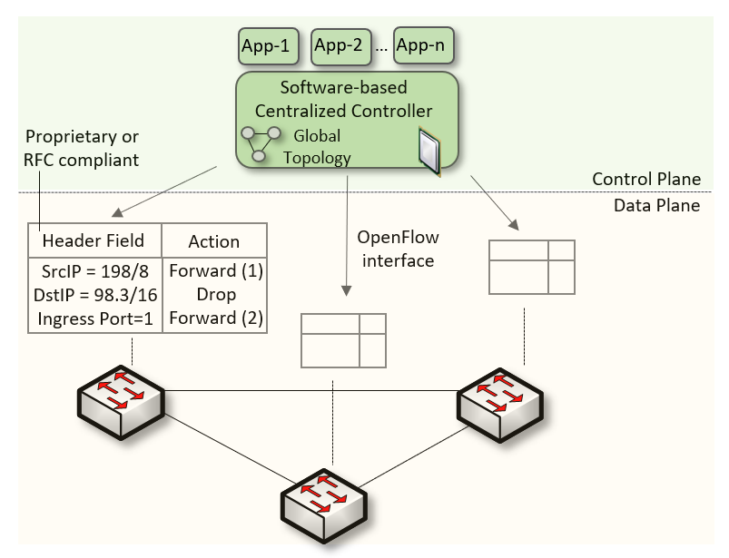
SDN
Protocol ossification has been challenged first by SDN
SDN explicitly separates the control and data planes, and implements the control plane intelligence as a software outside the switches
The function of populating the forwarding table is now performed by the controller

Slide 5
SDN Limitation
SDN is limited to the OpenFlow specifications
  Forwarding rules are based on a fixed number of protocols / header fields (e.g., IP, Ethernet)
The data plane is designed with fixed functions (hard-coded)
  Functions are implemented by the chip designer

Slide 6
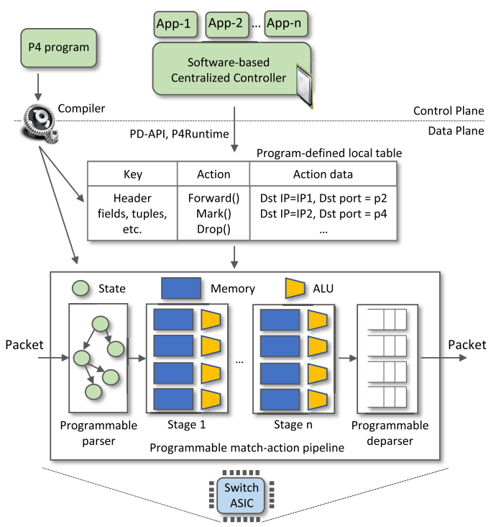
P4 Programmable Switches
P4¹ programmable switches permit a programmer to program the data plane
  Define and parse new protocols
  Customize packet processing functions
  Measure events occurring in the data plane with
  high precision
  Offload applications to the data plane
1. P4 stands for stands for Programming Protocol-independent Packet Processors

Slide 7
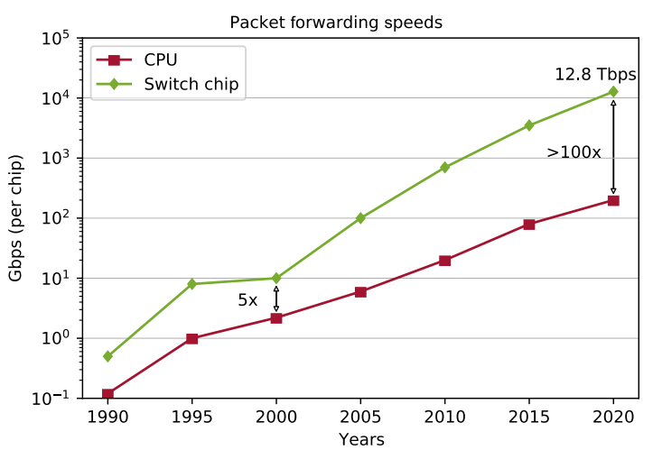
P4 Programmable Switches
P4¹ programmable switches permit a programmer to program the data plane
  Define and parse new protocols
  Customize packet processing functions
  Measure events occurring in the data plane with
  high precision
  Offload applications to the data plane
Reproduced from N. McKeown. Creating an End-to-End Programming Model for Packet Forwarding. Available: https://www.youtube.com/watch?v=fiBuao6YZl0&t=4216s

Slide 8
PISA: Protocol Independent Switch Architecture
Match+Action
Stage
Memory
ALU
Programmable
Parser
Programmable Match-Action Pipeline
Reproduced from N. McKeown. Creating an End-to-End Programming Model for Packet Forwarding. Available: https://www.youtube.com/watch?v=fiBuao6YZl0&t=4216s

Slide 9
PISA: Protocol Independent Switch Architecture
Reproduced from N. McKeown. Creating an End-to-End Programming Model for Packet Forwarding. Available: https://www.youtube.com/watch?v=fiBuao6YZl0&t=4216s
9

Slide 10
Example P4 Program
Parser Program
Header and Data Declarations
Tables and Control Flow
parser parse_ethernet {
extract(ethernet);
return switch(ethernet.ethertype) {
0x8100 : parse_vlan_tag;
0x0800 : parse_ipv4;
0x8847 : parse_mpls;
default: ingress;
}
header_type ethernet_t { … }
header_type l2_metadata_t { … }
header ethernet_t ethernet;
header vlan_tag_t vlan_tag[2];
metadata l2_metadata_t l2_meta;
table port_table { … }
control ingress {
apply(port_table);
if (l2_meta.vlan_tags == 0) {
process_assign_vlan();
}
}
Memory
ALU
Programmable
Parser
Programmable Match-Action Pipeline
Reproduced from N. McKeown. Creating an End-to-End Programming Model for Packet Forwarding. Available: https://www.youtube.com/watch?v=fiBuao6YZl0&t=4216s
10

Slide 11

Effective DGA Family Classification using a Hybrid Shallow and Deep Packet Inspection Technique on P4 Programmable Switches
Ali AlSabeh¹, Kurt Friday², Jorge Crichigno¹, Elias Bou-Harb ²
¹ University of South Carolina, SC
² The University of Texas at San Antonio, TX
IEEE International Conference on Communications (ICC)
Rome, Italy - June 2023

Slide 12
Agenda
Introduction
Motivation
Contribution
Related Work
Programmable switches
Proposed system
Implementation and Evaluation
Conclusion and Discussion

Slide 13
Introduction
Attackers often use a Command and Control (C2) server to establish communication and send commands to infected machines for malicious acts
Communication with the C2 server can either be static or dynamic
  Static communication: the C2 server has a fixed IP address and domain name
  Dynamic communication: the C2 server’s IP and/or domain name change frequently
Domain Generation Algorithms (DGAs) are the de facto dynamic C2 communication method used by malware, including botnets, ransomware, and many others¹
¹ “Dynamic Resolution: Domain Generation Algorithms.” [Online]. Available: https://tinyurl.com/44hz9hpm.

Slide 14
DGA Attacks
DGAs evade domain-based firewall controls by frequently changing the domain name selected from a large pool of candidates
The malware makes Domain Name System (DNS) queries in an attempt to resolve the IP addresses of these generated domains
Only a few IPs will typically be registered and associated with the C2
Non-Existent Domain (NXD) responses will coincide with the remainder of the DNS queries, denoting that the domain is not registered or the DNS server could not resolve it

Slide 15
Existing Mitigation Strategies
Most research efforts focus on DGA detection, i.e., they perform binary classification in order to segregate DGAs from benign traffic
Approaches rely on contextual network traffic analysis (context-aware) or domain name analysis, without considering network traffic (context-less)
In addition to DGA detection, it is helpful to classify DGA malware based on the family (Trojan, Backdoor, etc.)
  The multiclass classification of DGA families allows security professionals to assess the severity of the exploit and apply the appropriate remediation policies in the network¹
¹ A. Drichel, N. Faerber, and U. Meyer, “First Step Towards Explainable DGA Multiclass Classification,” in The 16th International Conference on Availability, Reliability and Security, pp. 1–13, 2021.

Slide 16
Motivation
Context-aware approaches analyze the network traffic behavior to fingerprint DGAs
  Slow since they typically analyze batches of traffic offline
Context-less approaches obtain high accuracy with advanced ML models
There is a need for a system that uses context-aware and context-less features to classify DGAs without degrading high-throughput networks

Slide 17
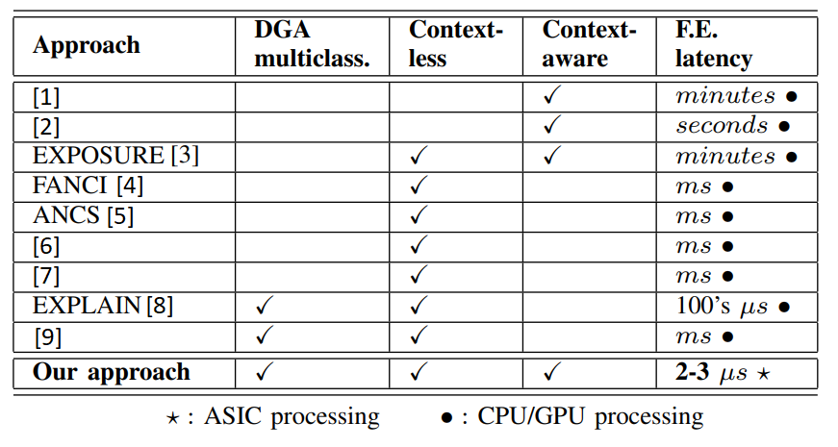
Related Work
DGA binary and multiclass classification
  [1, 2] use NetFlow and an SDN controller to collect context-aware features
  [3] uses ML models on context-aware and context-less features on batches of DNS traffic
  [4-7] use machine learning trained on features of the domain name (statistical, structural, linguistic, etc.)
DGA multiclass classification
  EXPLAIN [8] and [9] extract numerous features from a domain name to classify DGAs

Slide 18
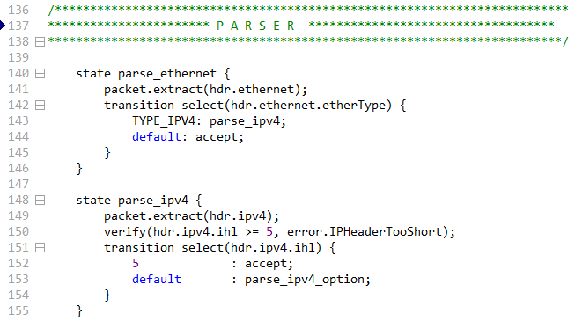
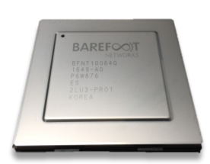
Overview P4 Switches
P4 switches permit programmer to program the data plane
Customized packet processing
High granularity in measurements
Per-packet traffic analysis and inspection
Stateful memory processing
If the P4 program compiles, it runs on the chip at line rate
P4 code
Programmable chip

Slide 19
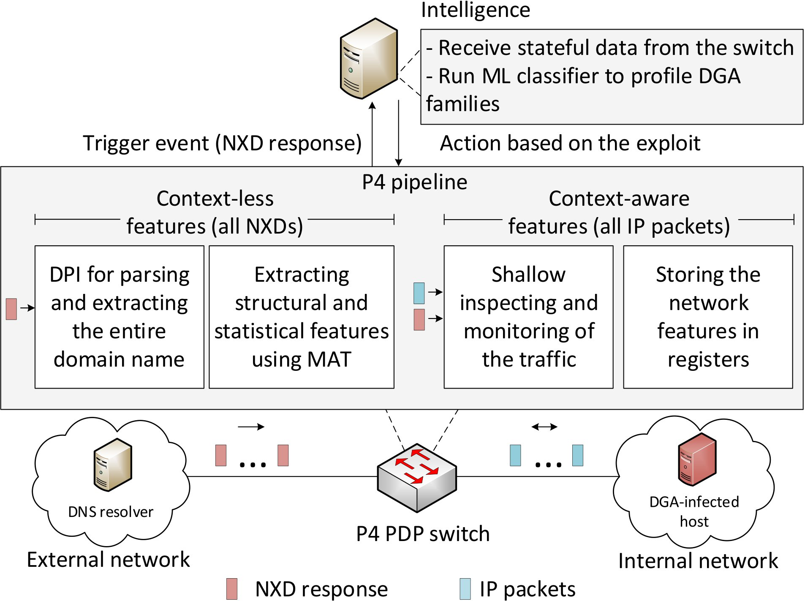
Proposed System
The P4 PDP switch collects and stores the context-aware features of the hosts
When an NXD response is received, the switch performs DPI on the domain name to extract its context-less features
The switch sends the collected features to the control plane
The control plane runs the intelligence to classify the DGA family and initiate the appropriate incidence response

Slide 20
Proposed System
Context-aware features
  It characterizes the network behavior of DGAs while they attempt to contact the C2 server
  For each host in the network, the following features are stored in the data plane:
    Number of IPs contacted
    Inter-arrival Time (IAT) between such IP packets
    Number of DNS requests made
    Time it takes to for the first NXD response to arrive
    IAT between subsequent NXD responses
  Collected in the data plane without involving the control plane (until an NXD response is received)

Slide 21
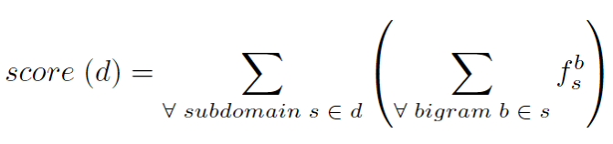

Proposed System
Context-less features
  It computes the bigram of the domain name; a bigram model may suffice to predict whether a domain name is a legitimate human readable domain
  Otherwise, if a domain is comprised nearly entirely of low frequency bigrams, then the domain would likely be random
  For each NXD response, the data plane computes the score of the domain name:
    Randomness of a domain name d according to its bigram frequency
      Example: bigrams of “google” are: “$g”, “go”, “oo”, “og”, “gl”, “le”, “e$”
Where is the frequency of the bigram b in the subdomain s
$$f_{s}^{b}$$

Slide 22
P4 Implementation
The parser parses DNS packets in the data plane
  Packet recirculation may be required for certain domain names
  To compute the randomness of a domain, each bigram b will be applied to a Match-Action Table (MAT)
  The frequencies of the bigrams are computed offline using the English dictionary; thus, the lower the score the more random the domain name
  The MATs are pre-populated by the control plane with the frequency of each bigram

Slide 23
Evaluation
Dataset
  Hundreds of GB of malware samples from cyber security websites were crawled
  The resulting dataset includes 1,311 samples containing 50 DGA families
Experimental setup
  The collected dataset was used to train ML models offline on a general-purpose CPU
  80% of data was used for training and 20% for testing
  5-fold Cross Validation (CV) was used to avoid overfitting the model
¹ D. P LOHMANN, “DGArchive.” [Online]. Available: https://tinyurl. com/yc6whwrc.

Slide 24
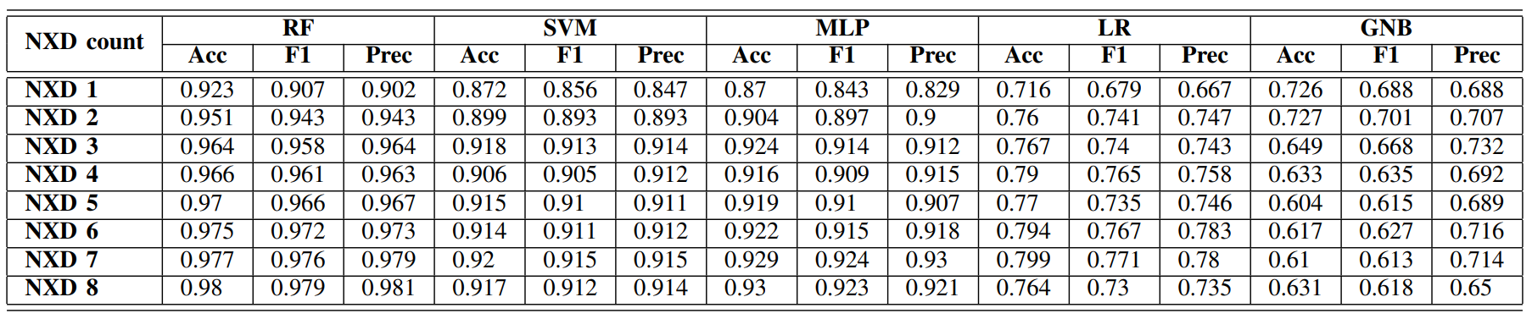
Evaluation
Accuracy (Acc), F1 score, and Precision (Prec) of different ML classifiers during the first 8 NXD responses received were reported
The Random Forest (RF) model performed best
  The Accuracy (Acc) starts at 92% from the first NXD response received and reaches 95% by the 8th NXD response
RF: Random Forest; SVM: Support Vector Machine; MLP: Multilayer perceptron; LR: Logistic Regression; GNB: Gaussian Naive Bayes
Notes:
MLP: Multilayer perceptron; LR: Logistic Regression; GNB: Gaussian Naive Bayes

Slide 25
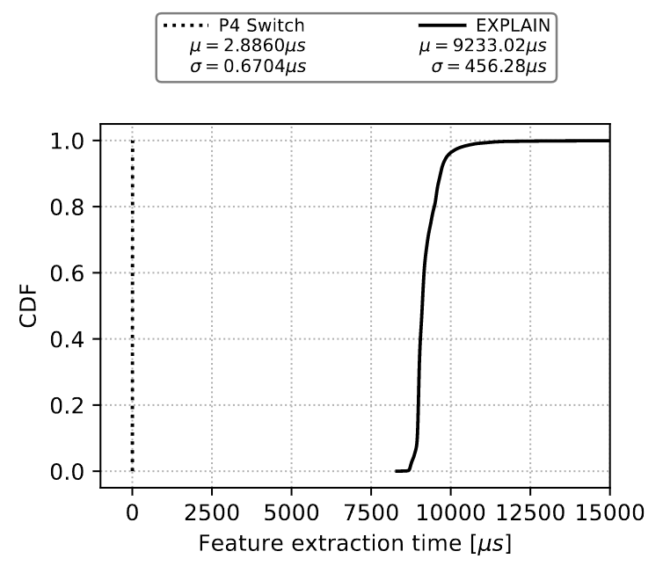
Evaluation
Feature extraction time of our work and EXPLAIN
EXPLAIN’s available source code was tested on a general-purposed CPU with 64 GB RAM, 2.9 GHz processor with 8 cores

Slide 26
Conclusion and Discussion
In this work, we propose a hybrid feature extraction technique relying on context-aware and context-less features to classify DGA families
Context-aware features characterize the network traffic behavior of the DGAs and require shallow packet inspection (no degradation to the throughput)
Context-less features study the statistical and structural characteristics of the domain names relating to NXDs using DPI
With 50 DGA families analyzed, the proposed approach achieves 92% accuracy with RF classifier from the first NXD response and reaches up to 98% by the 8th NXD response
In the future, we aim to explore other techniques that are robust against encrypted DNS traffic, in addition to collecting more DGA families

Slide 27
Offloading Media Traffic to
P4 Programmable Data Plane Switches
E. Kfoury, J. Crichigno, E. Bou-Harb
IEEE International Conference on Communications (ICC)
June 2020

Slide 28
Voice and Video
Supporting protocols are divided into two main categories
  Signaling protocols: establish and manage the session; e.g., Session Initiation Protocol (SIP)
  Media protocols: transfer actual audio and video streams; e.g., Real Time Protocol (RTP)
Desirable Quality-of-Service (QoS) characteristics
  Delay- and jitter-sensitive, low values
  Occasional losses are tolerated
SIP server, registrar
SIP
SIP
Media (RTP)
User agent client (UAC)
User agent server (UAS)

Slide 29
Network Address Translation (NAT)
NAT maps ports and private IP addresses to ephemeral ports and public IP addresses
  Used in campus / enterprise networks, operators¹
NAT introduces various issues
  NAT prevents a user from outside from initiating a session
  If both users are behind NAT, then cannot communicate
Campus network

Slide 30
Relay Server for Media Traffic
Intermediary device
RTP Information at relay server
SIP server
Relay server
 | Device IP - port | Allocated IP - port
A
B
A
B

Slide 31
Relay Server for Media Traffic
Intermediary device
SIP establishes the session
  RTP ports are unknown
  The relay server allocates a port on behalf of each end user
RTP Information at relay server
SIP server
Relay server
 | Device IP - port | Allocated IP - port
A |  | IP_{R} - P_{RA}
B |  | IP_{R} - P_{RB}
A
B

Slide 32
Relay Server for Media Traffic
Intermediary device
SIP establishes the session
  RTP ports are unknown
  The relay server allocates a port on behalf of each end user
The relay server receives and relays the RTP traffic
RTP Information at relay server
SIP server
Relay server
 | Device IP - port | Allocated IP - port
A | IP_{A’} - P_{A’} | IP_{R} - P_{RA}
B | IP_{B’} - P_{B’} | IP_{R} - P_{RB}
IP_{A’} - p_{A’}
IP_{B’} - p_{B’}
A
B

Slide 33
Relay Server for Media Traffic
Intermediary device
SIP establishes the session
  RTP ports are unknown
  The relay server allocates a port on behalf of each end user
The relay server receives and relays the RTP traffic
RTP Information at relay server
SIP server
Relay server
 | Device IP - port | Allocated IP - port
A | IP_{A’} - P_{A’} | IP_{R} - P_{RA}
B | IP_{B’} - P_{B’} | IP_{R} - P_{RB}
IP_{A’} - p_{A’}
IP_{B’} - p_{B’}
A
B

Slide 34
Implementation and Evaluation
OpenSIPS, an open-source implementation of a SIP server
RTPProxy, a high-performance relay server for RTP streams
SIPp: an open-source SIP traffic generator that can establish multiple concurrent sessions and generate media (RTP) traffic
Iperf3: traffic generator used to generate background UDP traffic
Edgecore Wedge100BF-32X: programmable switch
Edgecore w/
Tofino Chip
Intel Xeon
4 cores, 2.20GHz
Intel Xeon
4 cores, 2.20GHz

Slide 35
Implementation and Evaluation
Two scenarios are considered:
  “Server-based relay”: relay server is used to relay media between end devices
  “Switch-based relay”: the switch is used to relay media
UAC (SIPp) generates 900 media sessions, 30 per second
The test lasts for 300 seconds
G.711 media encoding codec (160 bytes every 20ms)

Slide 36
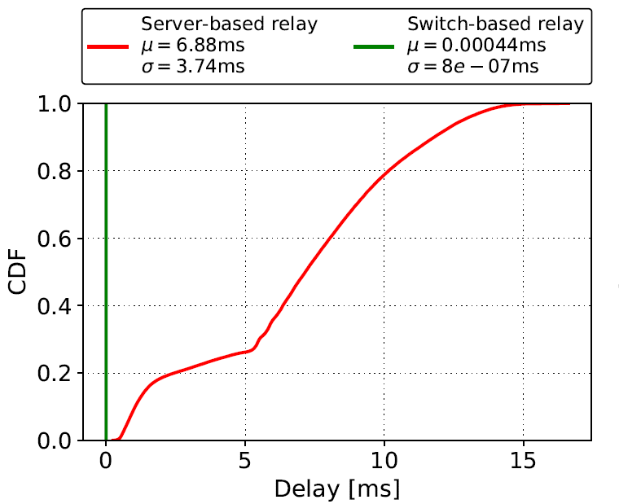
Results
Delay: time interval starting when a packet is received from the UAC by the switch’s ingress port and ending when the packet is forwarded by the switch’s egress port to the UAS
  Delay contributions of the switch and the relay server

Slide 37
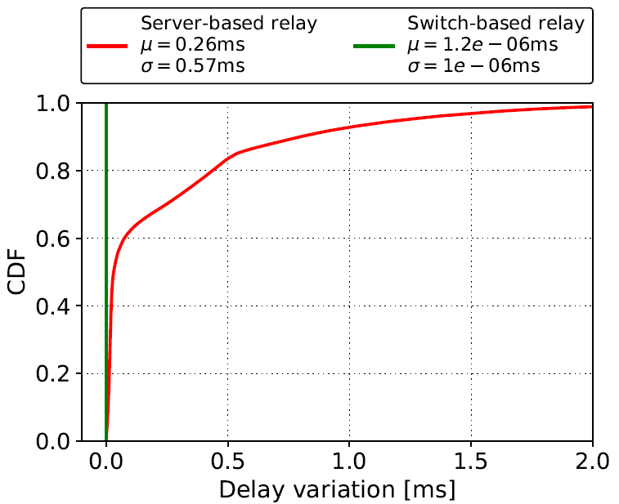
Results
Delay variation: the absolute value of the difference between the delay of two consecutive packets
  Analogous to jitter, as defined by RFC 4689

Slide 38
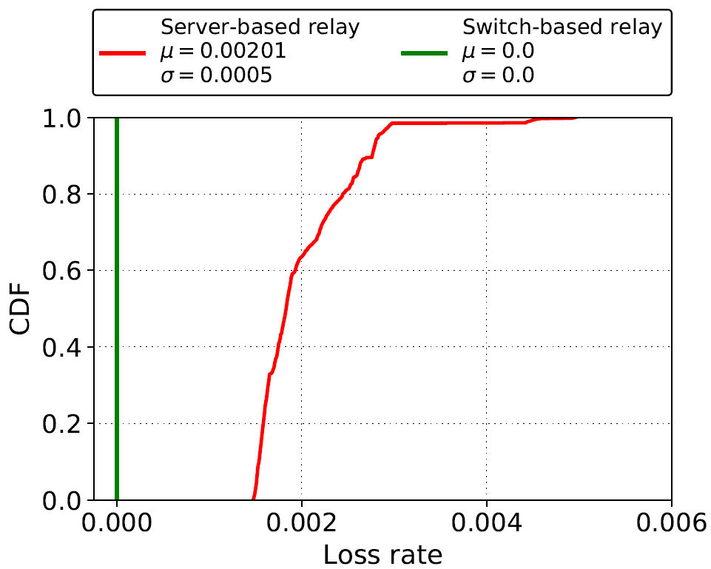
Results
Loss rate: number of packets that fail to reach the destination
  Calculation is based on the sequence number of the RTP header

Slide 39
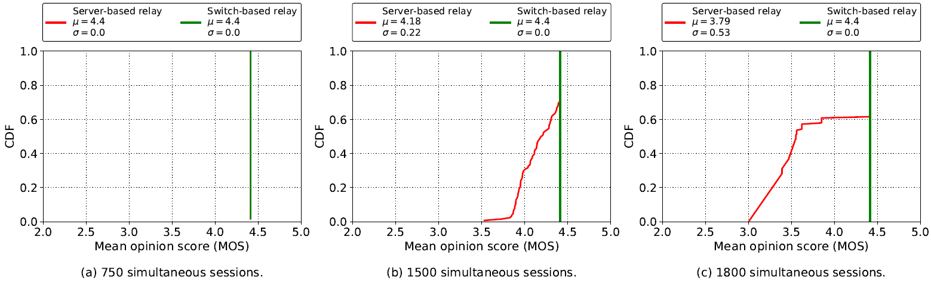
Results
Mean Opinion Score (MOS): estimation of the quality of the media session
  A reference quality indicator standardized by ITU-T
  Maximum for G.711 is ~4.4

Slide 40
Lessons Learned
Advantages of offloading relay application to the data plane:
  Performance: ~1,000,000 sessions vs ~1,000 sessions per core
  Optimal QoS parameters: delay, delay variation, packet loss rate
Limited resources
Avoid complex application logic

Slide 41
Opportunities at the University of South Carolina

Slide 42
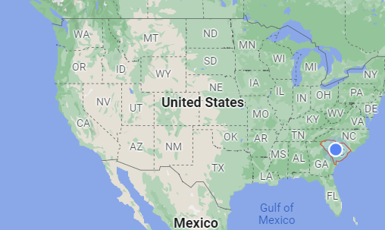
USC
Founded in 1801, University of South Carolina (USC) is the flagship institution of the University of South Carolina System
More than 350 programs of study, leading to bachelor’s, master’s, and doctoral degrees
Total enrollment of approximately 50,000 students, with over 33,000 on the main Columbia campus

Slide 43
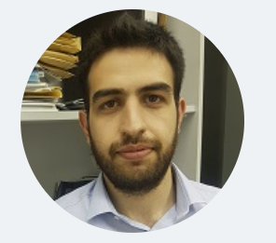



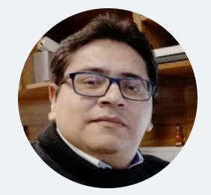

Cyberinfrastructure Lab at USC
http://ce.sc.edu/cyberinfra/
Currently 5 PhD students, 1 Master student, 8-12 undergraduate students
Elie Kfoury
Jose Gomez
Ali AlSabeh
Ali Mazloum
Christian Vega
Shahrin Sharif

Slide 44
Cyberinfrastructure Lab at USC
Students are supported via funded projects (salary, tuition, insurance)
Typical student life
  Two courses per semester (6 credits)
  Work consists of 20 hours per week on funded projects / research
  Other extra-curricular activities

Slide 45
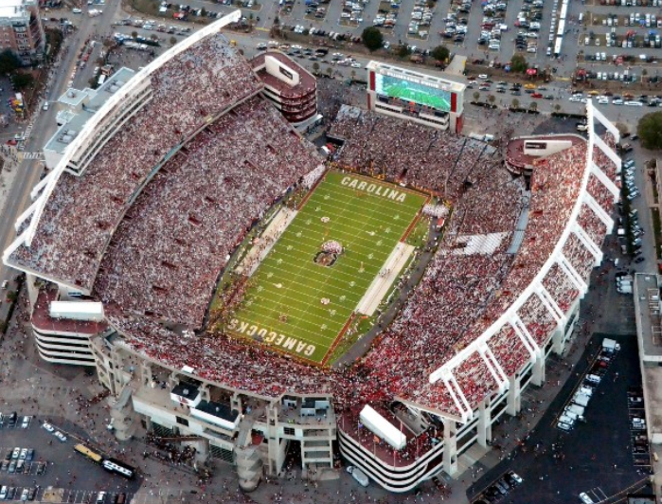
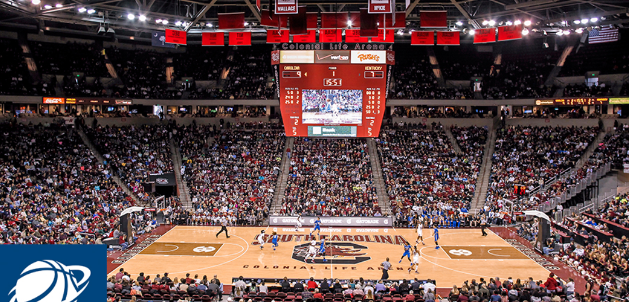
Cyberinfrastructure Lab at USC
Students are supported via funded projects (salary, tuition, insurance)
Typical student life
  Two courses per semester (6 credits)
  Work consists of 20 hours per week on funded projects / research
  Other extra-curricular activities

Slide 46
PhD in Informatics
Information available at https://tinyurl.com/2pnnzpu4
A total of 60 credit-hours beyond the bachelor’s degree, or 48 credit-hours beyond the masters, is required for the Ph.D. in Informatics
Currently there are positions available to work in the Cyberinfrastructure Lab
Applications are accepted throughout the year
Required documents: CV, GRE or GMAT scores (optional for admissions through Fall 2023), official transcripts, personal statement, 2 letters of recommendation

Slide 47


