Slide 1

An Overview of P4 Programmable Switches
and Applications
Jorge Crichigno
College of Engineering and Computing
University of South Carolina
http://ce.sc.edu/cyberinfra/
EECE 797 Graduate Webinar
American University of Beirut
Tuesday March 1st, 2022
Notes:
Session time: 12:15-1:45pm

Slide 2
Agenda
Motivation
Overview of P4 programmable switches
Application examples
  Offloading an application to the data plane
  Router’s buffer sizing in real time
PhD opportunities at the University of South Carolina (USC)

Slide 3
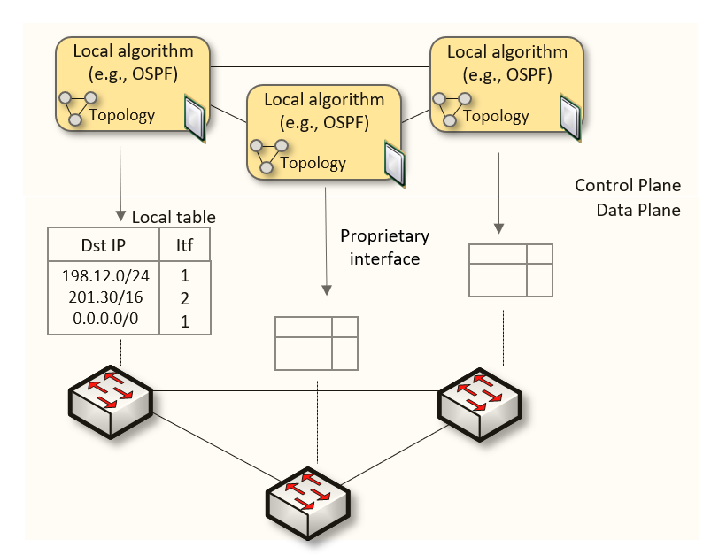
Traditional (Legacy) Networking
Since the explosive growth of the Internet in the 1990s, the networking industry has been dominated by closed and proprietary hardware and software
The interface between control and data planes has been historically proprietary
  Vendor dependence: slow product cycles of vendor equipment, no innovation from network owners
  A router is a monolithic unit built and internally accessed by the manufacturer only

Slide 4
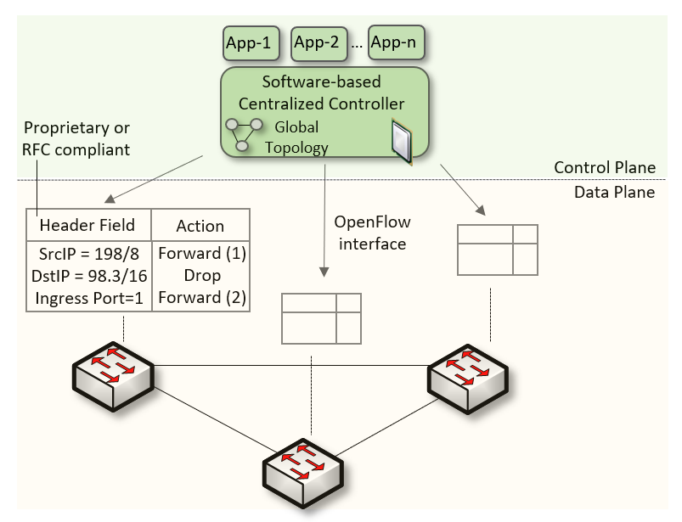
SDN
Protocol ossification has been challenged first by SDN
SDN explicitly separates the control and data planes, and implements the control plane intelligence as a software outside the switches
The function of populating the forwarding table is now performed by the controller

Slide 5
SDN Limitation
SDN is limited to the OpenFlow specifications
  Forwarding rules are based on a fixed number of protocols / header fields (e.g., IP, Ethernet)
The data plane is designed with fixed functions (hard-coded)
  Functions are implemented by the chip designer

Slide 6
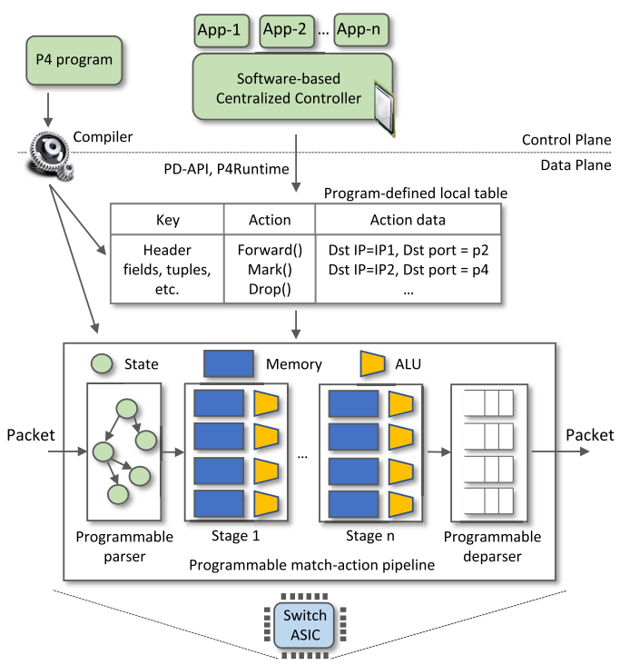
P4 Programmable Switches
P4¹ programmable switches permit a programmer to program the data plane
  Define and parse new protocols
  Customize packet processing functions
  Measure events occurring in the data plane with
  high precision
  Offload applications to the data plane
1. P4 stands for stands for Programming Protocol-independent Packet Processors

Slide 7
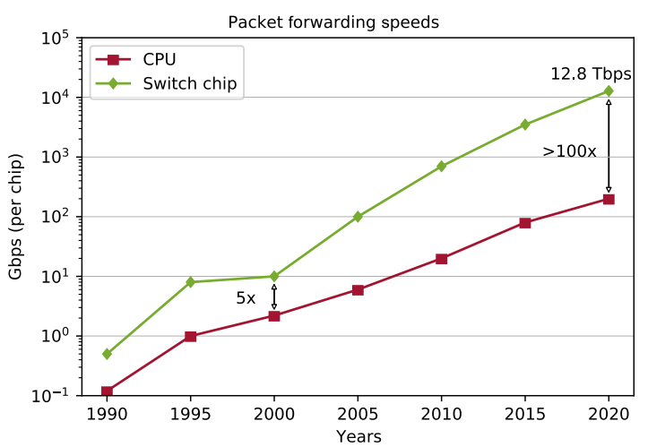
P4 Programmable Switches
P4¹ programmable switches permit a programmer to program the data plane
  Define and parse new protocols
  Customize packet processing functions
  Measure events occurring in the data plane with
  high precision
  Offload applications to the data plane
Reproduced from N. McKeown. Creating an End-to-End Programming Model for Packet Forwarding. Available: https://www.youtube.com/watch?v=fiBuao6YZl0&t=4216s

Slide 8
PISA: Protocol Independent Switch Architecture
Match+Action
Stage
Memory
ALU
Programmable
Parser
Programmable Match-Action Pipeline
Reproduced from N. McKeown. Creating an End-to-End Programming Model for Packet Forwarding. Available: https://www.youtube.com/watch?v=fiBuao6YZl0&t=4216s

Slide 9
PISA: Protocol Independent Switch Architecture
Reproduced from N. McKeown. Creating an End-to-End Programming Model for Packet Forwarding. Available: https://www.youtube.com/watch?v=fiBuao6YZl0&t=4216s
9

Slide 10
Example P4 Program
Parser Program
Header and Data Declarations
Tables and Control Flow
parser parse_ethernet {
extract(ethernet);
return switch(ethernet.ethertype) {
0x8100 : parse_vlan_tag;
0x0800 : parse_ipv4;
0x8847 : parse_mpls;
default: ingress;
}
header_type ethernet_t { … }
header_type l2_metadata_t { … }
header ethernet_t ethernet;
header vlan_tag_t vlan_tag[2];
metadata l2_metadata_t l2_meta;
table port_table { … }
control ingress {
apply(port_table);
if (l2_meta.vlan_tags == 0) {
process_assign_vlan();
}
}
Memory
ALU
Programmable
Parser
Programmable Match-Action Pipeline
Reproduced from N. McKeown. Creating an End-to-End Programming Model for Packet Forwarding. Available: https://www.youtube.com/watch?v=fiBuao6YZl0&t=4216s
10

Slide 11
Offloading Media Traffic to
P4 Programmable Data Plane Switches
E. Kfoury, J. Crichigno, E. Bou-Harb
IEEE International Conference on Communications (ICC)
June 2020

Slide 12
Voice and Video
Supporting protocols are divided into two main categories
  Signaling protocols: establish and manage the session; e.g., Session Initiation Protocol (SIP)
  Media protocols: transfer actual audio and video streams; e.g., Real Time Protocol (RTP)
Desirable Quality-of-Service (QoS) characteristics
  Delay- and jitter-sensitive, low values
  Occasional losses are tolerated
SIP server, registrar
SIP
SIP
Media (RTP)
User agent client (UAC)
User agent server (UAS)

Slide 13
Network Address Translation (NAT)
NAT maps ports and private IP addresses to ephemeral ports and public IP addresses
  Used in campus / enterprise networks, operators¹
NAT introduces various issues
  NAT prevents a user from outside from initiating a session
  If both users are behind NAT, then cannot communicate
Campus network

Slide 14
Relay Server for Media Traffic
Intermediary device
RTP Information at relay server
SIP server
Relay server
 | Device IP - port | Allocated IP - port
A
B
A
B

Slide 15
Relay Server for Media Traffic
Intermediary device
SIP establishes the session
  RTP ports are unknown
  The relay server allocates a port on behalf of each end user
RTP Information at relay server
SIP server
Relay server
 | Device IP - port | Allocated IP - port
A |  | IP_{R} - P_{RA}
B |  | IP_{R} - P_{RB}
A
B

Slide 16
Relay Server for Media Traffic
Intermediary device
SIP establishes the session
  RTP ports are unknown
  The relay server allocates a port on behalf of each end user
The relay server receives and relays the RTP traffic
RTP Information at relay server
SIP server
Relay server
 | Device IP - port | Allocated IP - port
A | IP_{A’} - P_{A’} | IP_{R} - P_{RA}
B | IP_{B’} - P_{B’} | IP_{R} - P_{RB}
IP_{A’} - p_{A’}
IP_{B’} - p_{B’}
A
B

Slide 17
Relay Server for Media Traffic
Intermediary device
SIP establishes the session
  RTP ports are unknown
  The relay server allocates a port on behalf of each end user
The relay server receives and relays the RTP traffic
RTP Information at relay server
SIP server
Relay server
 | Device IP - port | Allocated IP - port
A | IP_{A’} - P_{A’} | IP_{R} - P_{RA}
B | IP_{B’} - P_{B’} | IP_{R} - P_{RB}
IP_{A’} - p_{A’}
IP_{B’} - p_{B’}
A
B

Slide 18
Implementation and Evaluation
OpenSIPS, an open-source implementation of a SIP server
RTPProxy, a high-performance relay server for RTP streams
SIPp: an open-source SIP traffic generator that can establish multiple concurrent sessions and generate media (RTP) traffic
Iperf3: traffic generator used to generate background UDP traffic
Edgecore Wedge100BF-32X: programmable switch
Edgecore w/
Tofino Chip
Intel Xeon
4 cores, 2.20GHz
Intel Xeon
4 cores, 2.20GHz

Slide 19
Implementation and Evaluation
Two scenarios are considered:
  “Server-based relay”: relay server is used to relay media between end devices
  “Switch-based relay”: the switch is used to relay media
UAC (SIPp) generates 900 media sessions, 30 per second
The test lasts for 300 seconds
G.711 media encoding codec (160 bytes every 20ms)

Slide 20
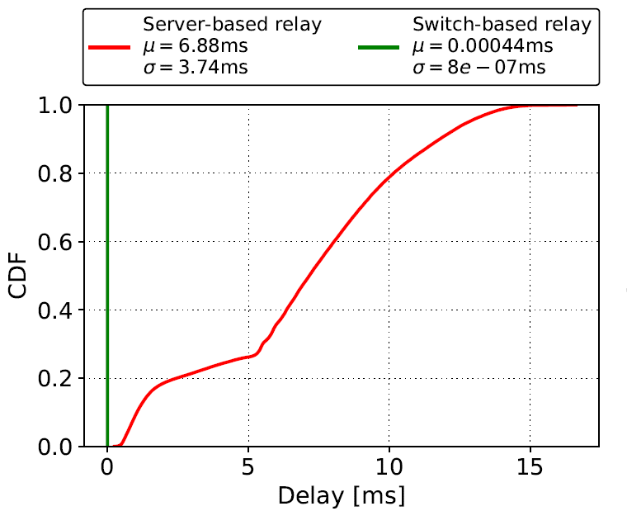
Results
Delay: time interval starting when a packet is received from the UAC by the switch’s ingress port and ending when the packet is forwarded by the switch’s egress port to the UAS
  Delay contributions of the switch and the relay server

Slide 21
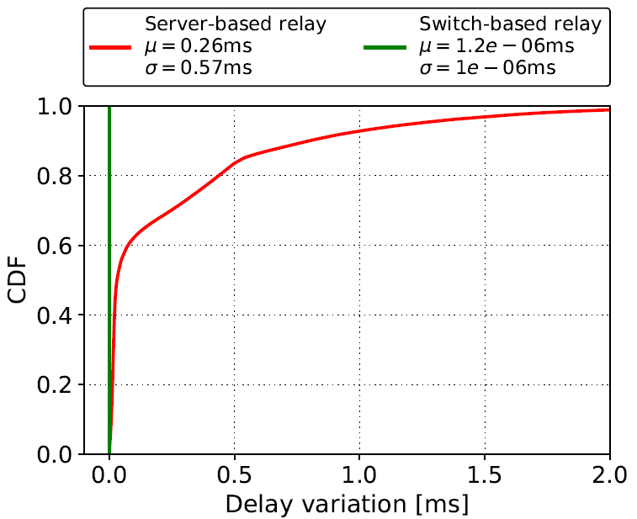
Results
Delay variation: the absolute value of the difference between the delay of two consecutive packets
  Analogous to jitter, as defined by RFC 4689

Slide 22
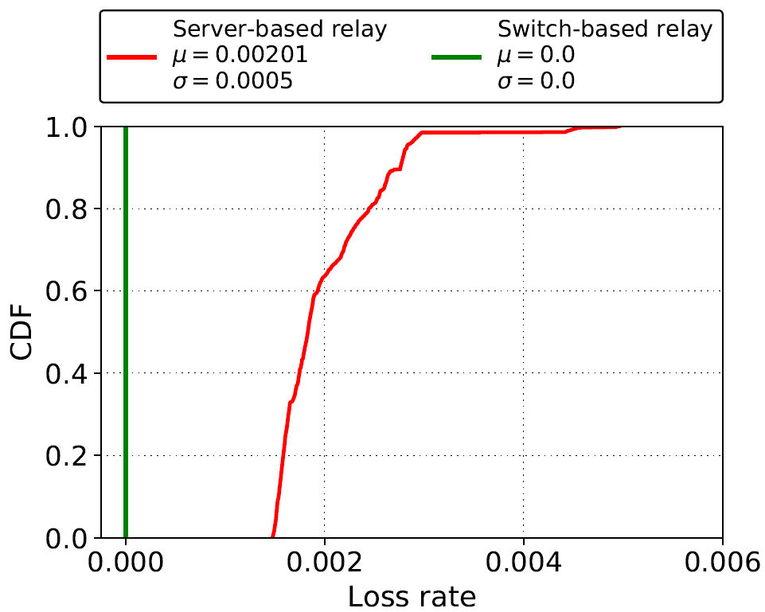
Results
Loss rate: number of packets that fail to reach the destination
  Calculation is based on the sequence number of the RTP header

Slide 23
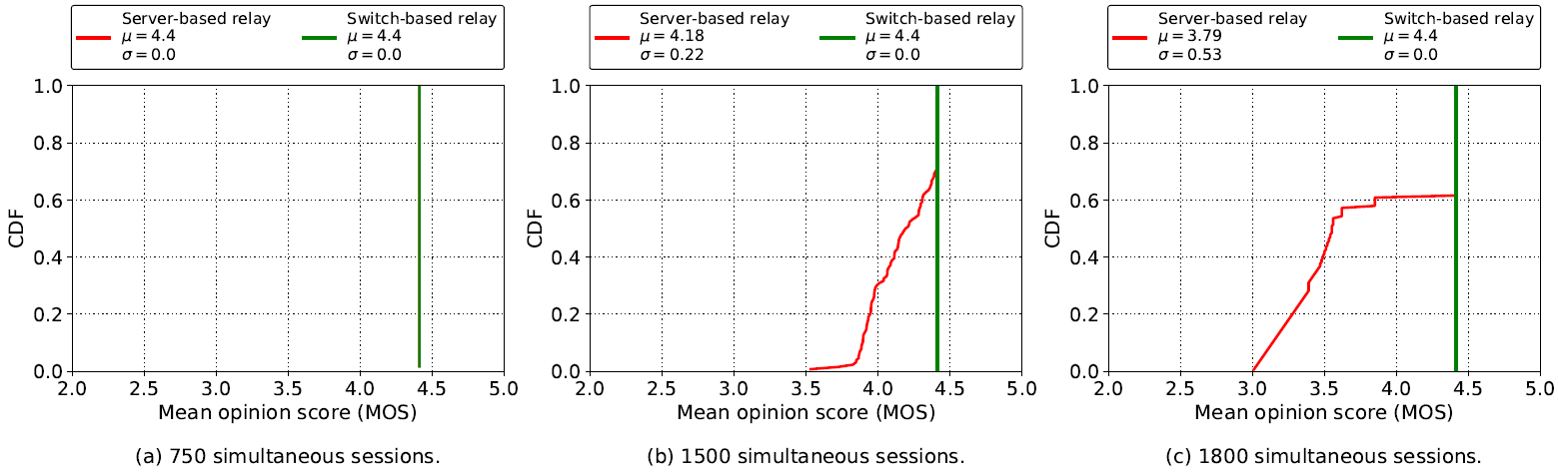
Results
Mean Opinion Score (MOS): estimation of the quality of the media session
  A reference quality indicator standardized by ITU-T
  Maximum for G.711 is ~4.4

Slide 24
Lessons Learned
Advantages of offloading relay application to the data plane:
  Performance: ~1,000,000 sessions vs ~1,000 sessions per core
  Optimal QoS parameters: delay, delay variation, packet loss rate
Limited resources
Avoid complex application logic

Slide 25
Dynamic Router's Buffer Sizing using Passive Measurements and P4 Programmable Switches
E. Kfoury, J. Crichigno, E. Bou-Harb, G. Srivastava
IEEE Global Communications Conference (Globecom)
December 2021, Madrid - Spain

Slide 26
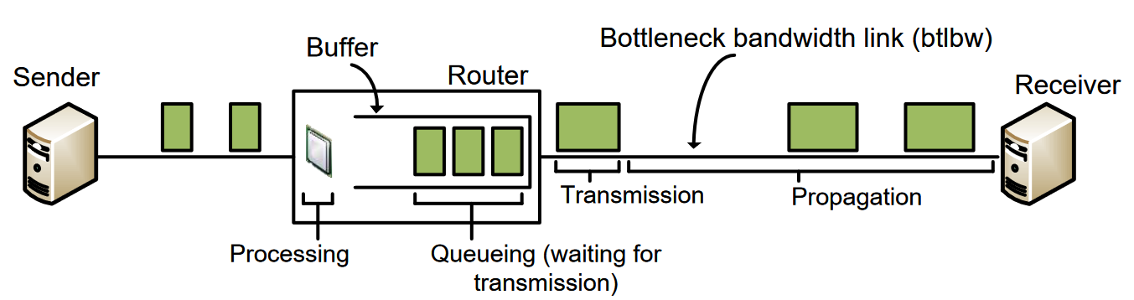
Buffer Sizing Problem
Routers and switches have a memory referred to as packet buffer
The size of the buffer impacts the network performance
  Large buffers -> excessive delays, bufferbloat
  Small buffers -> packet drops, potential low link utilization

Slide 27
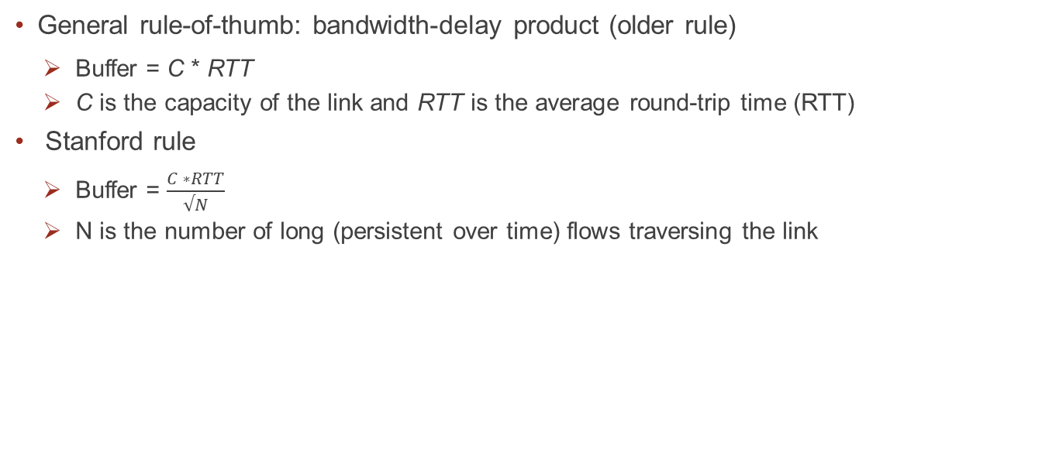
Buffer Sizing Rules
General rule-of-thumb: bandwidth-delay product (older rule)
  Buffer = C * RTT
  C is the capacity of the link and RTT is the average round-trip time (RTT)
Stanford rule
  Buffer = $\frac{C ∗RTT}{√N}$
  N is the number of long (persistent over time) flows traversing the link

Slide 28
Stanford Rule Applicability
Setting the router’s buffer size to BDP/√N would require determining the current average RTT and the number of flows
A general-purpose CPU cannot cope with high traffic rates
Sampling techniques (e.g., NetFlow) are not accurate enough¹
¹Spang, Bruce, and Nick McKeown. "On estimating the number of flows." Stanford Workshop on Buffer Sizing. 2019.

Slide 29
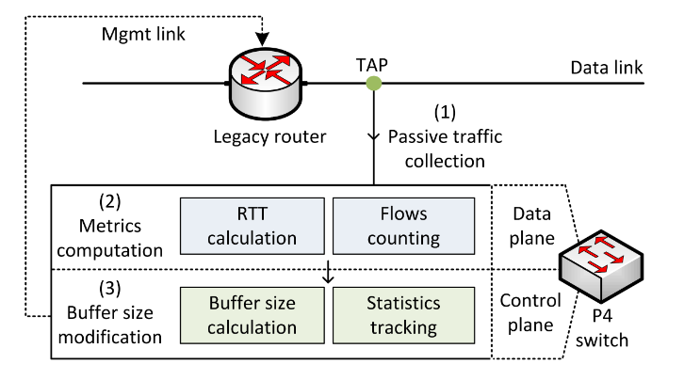
Proposed System
Dynamically modify the buffer size of routers based on measurements collected on programmable switches
  Copy of the traffic is forwarded to a programmable switch by passively tapping router’s ports
  The programmable switch identifies, tracks, and computes the RTT of long flows
  The programmable switch modifies the legacy router’s buffer size

Slide 30
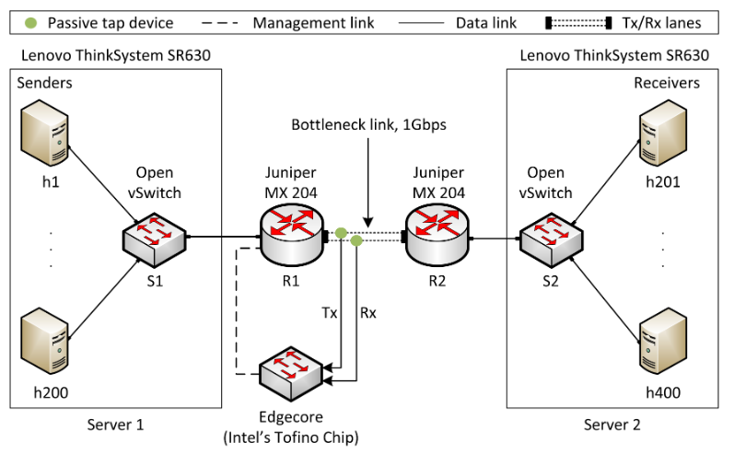
Implementation and Evaluation
Different congestion control algorithms¹
iPerf3
Default buffer size of the router is 200ms²
¹Mishra et al. “The great Internet TCP congestion control census,” ACM on Measurement and Analysis of Computing Systems, 2019
²N. McKeown et al. “Sizing router buffers (redux),” ACM SIGCOMM Computer Communication Review, vol. 49, no. 5

Slide 31
Implementation and Evaluation
Two scenarios are considered:
    Default buffer size on the router, without any dynamic modification
    P4 switch measures and modifies the buffer size of the router

Slide 32
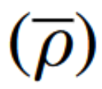


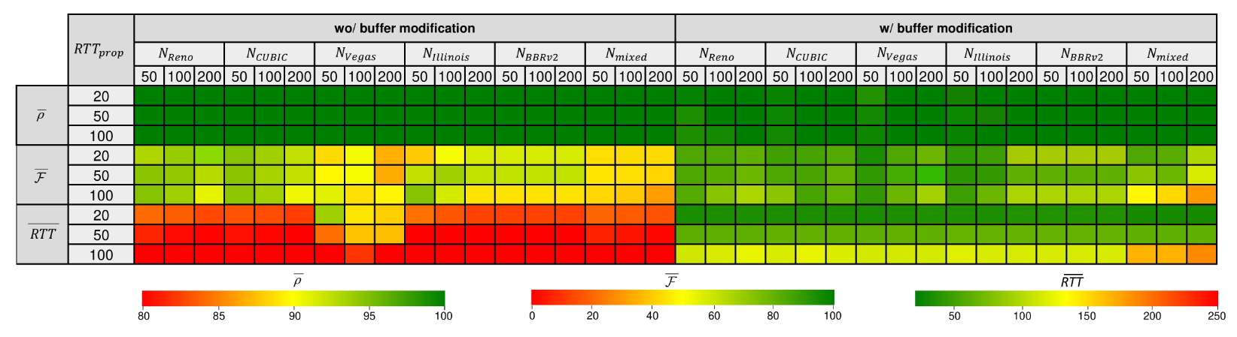
Results
Multiple long flows, CCAs, and propagation delays
Average link utilization
Average fairness index
Average RTT

Slide 33
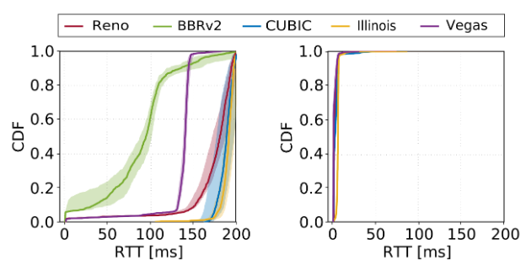
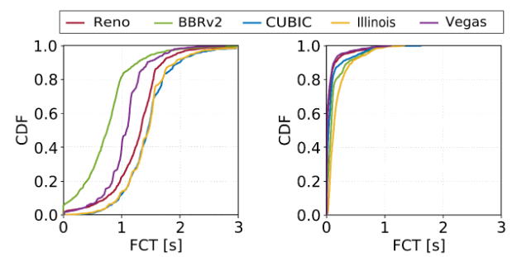
Results
Performance of short flows sharing the bottleneck with long flows
1000 short flows are arriving according to a Poisson process
Flow size distribution resembles a web search workload (10KB to 1MB)
Background traffic: 200 long flows, propagation delay = 50ms

Slide 34
Lessons Learned
The data plane can precisely measure flow information at line rate (e.g., RTT, number of flows)
Measurements are used to close the control loop and modify the network (e.g., buffer size)
  Better performance is obtained in terms of RTT, packet loss rate, fairness, FCT
Limited resources
Avoid complex application logic

Slide 35
Opportunities at the University of South Carolina

Slide 36
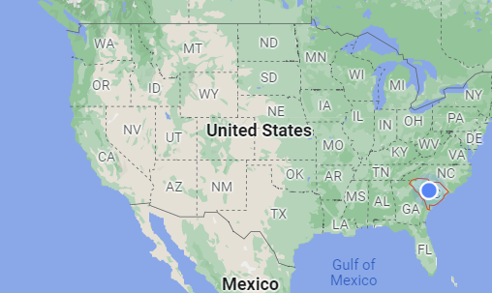
Lessons Learned
Founded in 1801, University of South Carolina (USC) is the flagship institution of the University of South Carolina System
More than 350 programs of study, leading to bachelor’s, master’s, and doctoral degrees
Total enrollment of approximately 50,000 students, with over 33,000 on the main Columbia campus

Slide 37
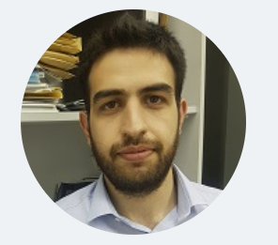

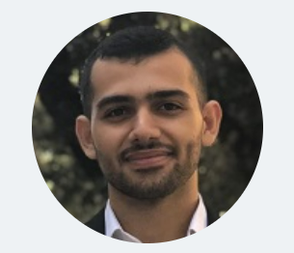



Cyberinfrastructure Lab at USC
http://ce.sc.edu/cyberinfra/
Currently 5 PhD students, 1 Master student, 8-12 undergraduate students
Elie Kfoury
Jose Gomez
Ali AlSabeh
Ali Mazloum
Christian Vega
Shahrin Sharif

Slide 38
Cyberinfrastructure Lab at USC
Students are supported via funded projects (salary, tuition, insurance)
Typical student life
  Two courses per semester (6 credits)
  Work consists of 20 hours per week on funded projects / research
  Other extra-curricular activities

Slide 39
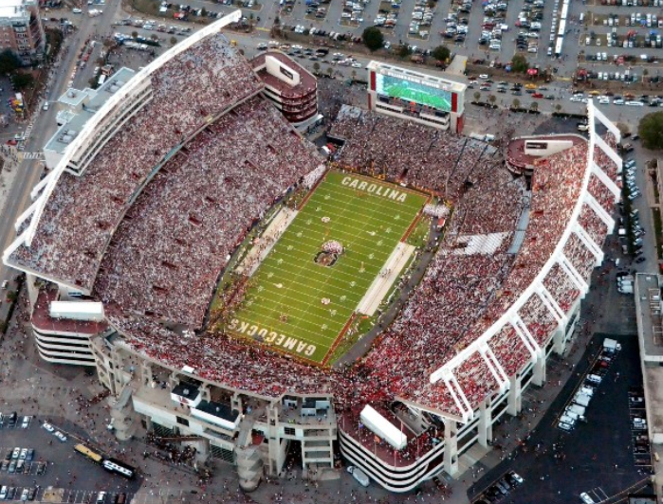

Cyberinfrastructure Lab at USC
Students are supported via funded projects (salary, tuition, insurance)
Typical student life
  Two courses per semester (6 credits)
  Work consists of 20 hours per week on funded projects / research
  Other extra-curricular activities

Slide 40
PhD in Informatics
Information available at https://tinyurl.com/2pnnzpu4
A total of 60 credit-hours beyond the bachelor’s degree, or 48 credit-hours beyond the masters, is required for the Ph.D. in Informatics
Currently there are positions available to work in the Cyberinfrastructure Lab
Applications are accepted throughout the year
Required documents: CV, GRE or GMAT scores (optional for admissions through Fall 2023), official transcripts, personal statement, 2 letters of recommendation

Slide 41


Slide 42
Domain-specific Processor
Analogy between networks and other computing domains
Domain | Year | Processing Unit | Main Language/s
General computing | 1971 | Central Processing Unit (CPU) | C, Java, Phyton, etc.
Signal processing | 1979 | Digital Signal Processor (DSP) | Matlab
Graphics | 1994 | Graphics Processing Unit (GPU) | Open Computing Language
Machine learning | 2015 | Tensor Processing Unit (TPU) | Tensor Flow
Computer networks | 2016 | Protocol Independent Switch Architecture (PISA) | P4

