Slide 1
Science DMZs and Networking for All
Jorge Crichigno, Elie Kfoury, Jose Gomez
Cyberinfrastructure Lab
College of Engineering and Computing, University of South Carolina
http://ce.sc.edu/cyberinfra
Nikunja Swain
South Carolina State University
MS-CC All Hands Meeting
July 27, 2023 – Online

Slide 2
Tutorial on Science DMZs and Networking for All
We are organizing a tutorial on Science DMZs and other network-related topics
The tutorial will be co-located to Internet2 Technology Exchange Conference, September 18-22, 2023
  https://internet2.edu/2023-internet2-technology-exchange/

Slide 3
Tutorial on Science DMZs and Networking for All
Goals
Understand the network elements required for high-performance data transfers
Describe the key elements of a Science DMZ
Measure the performance of different TCP congestion control algorithms on high-throughput high-latency networks
Describe the operation of perfSONAR and use perfSONAR GUI to configure tests
Use pScheduler’s command-line interface (CLI) to schedule tests
Visualize end-to-end performance using Grafana
Understand FABRIC

Slide 4
Tutorial on Science DMZs and Networking for All
Intended Audience
IT professionals
CI Engineers
High-Performance computing specialists
Research systems administrators
Security professionals
IT educators
Pre-requisites
Basic knowledge of computer networks

Slide 5
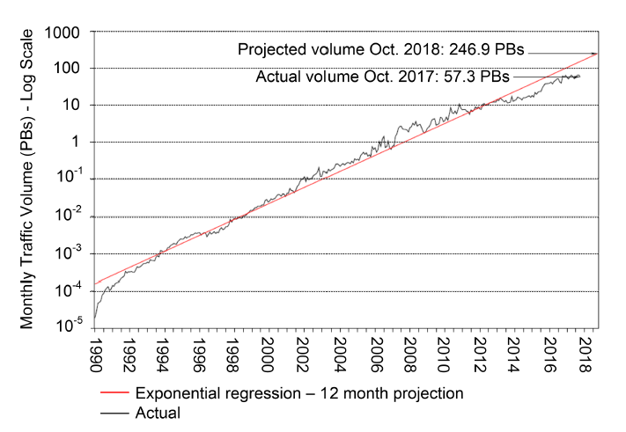
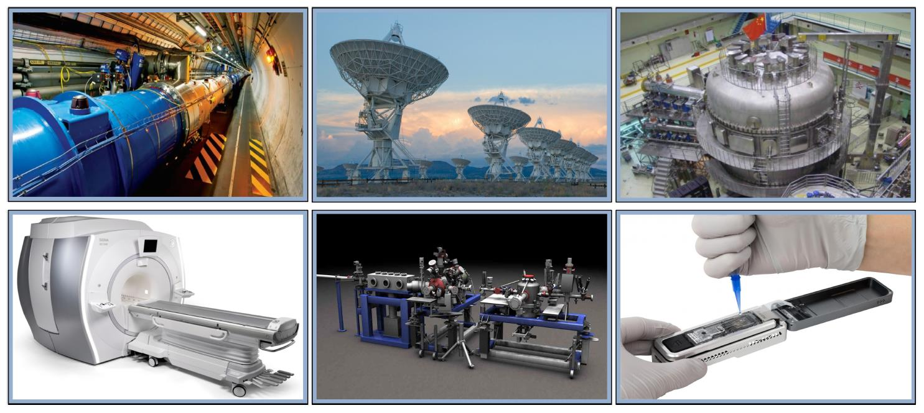
Motivation for a High-Speed Science Architecture
Science and engineering applications are generating data at an unprecedented rate
Instruments produce hundreds of terabytes in short time periods (“big science data”)
Data must be typically transferred across high-bandwidth high-latency Wide Area Networks (WANs)
The Energy Science Network (ESnet) is the backbone connecting U.S. national laboratories and research centers

Slide 6
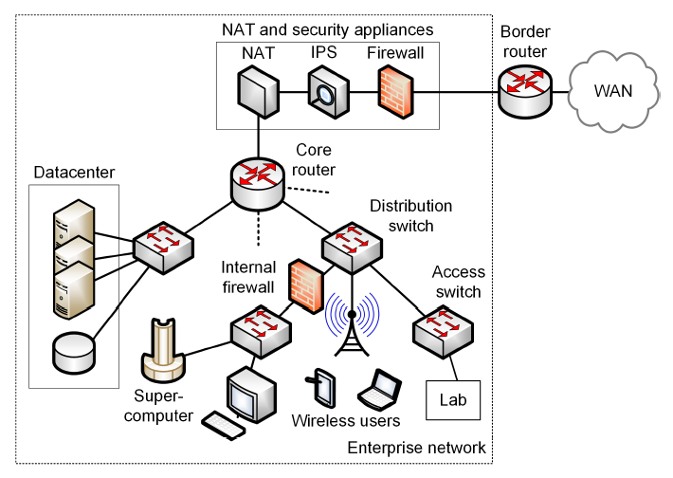
Enterprise Network Limitations
Security appliances (IPS, firewalls, etc.) are CPU-intensive
Inability of small-buffer routers/switches to absorb traffic bursts
End devices incapable of sending/receiving data at high rates
Lack of data transfer applications to exploit available bandwidth
Many of the issues above relate to TCP

Slide 7
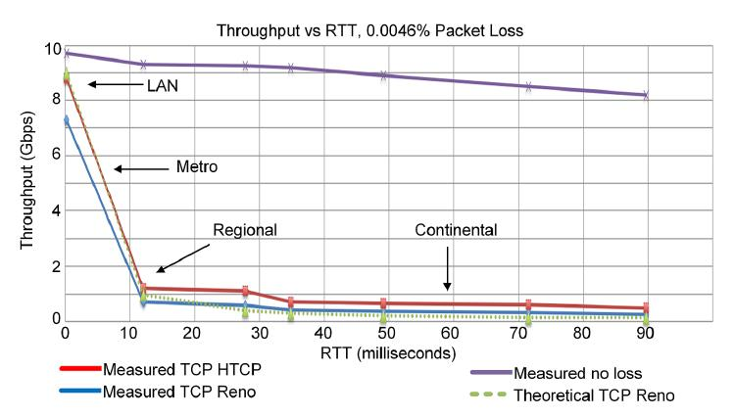
Enterprise Network Limitations
Effect of packet loss and latency on TCP throughput
Data transfer between two devices
10 Gbps network
Throughput as a function of the distance (milliseconds) between the two devices
Performance without (purple curve) and with packet loss (1/22,000 packet loss rate)
E. Dart, L. Rotman, B. Tierney, M. Hester, J. Zurawski, “The science dmz: a network design pattern for data-intensive science,” International Conference on High Performance Computing, Networking, Storage and Analysis, Nov. 2013.

Slide 8
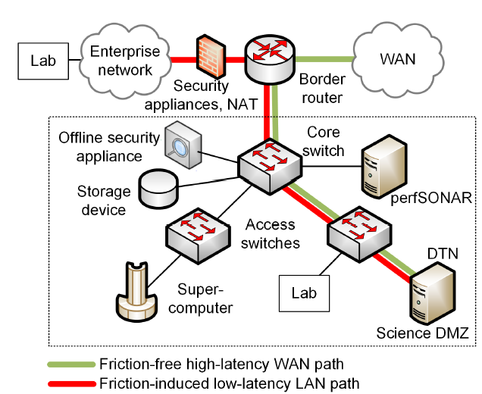
Science DMZ
The Science DMZ is a network designed for big science data
Main elements
  High throughput, friction free WAN paths
  Data Transfer Nodes (DTNs)
  End-to-end monitoring = perfSONAR
  Security tailored for high speeds

Slide 9
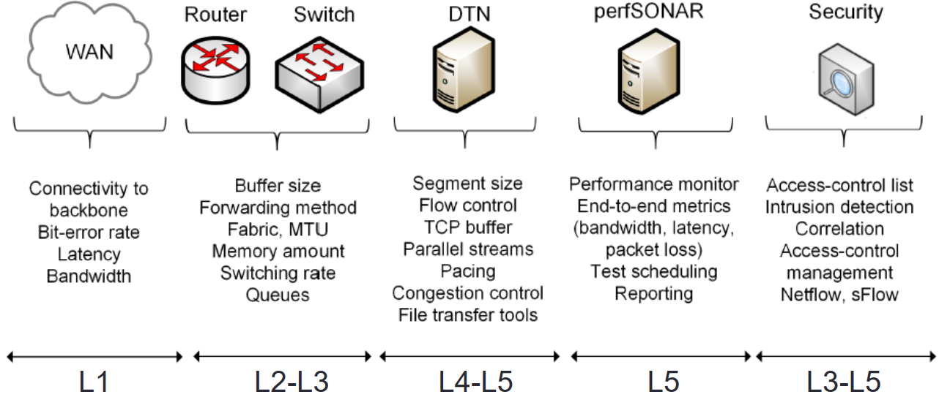
Science DMZ
The Science DMZ is a network designed for big science data
Main elements
  High throughput, friction free WAN paths
  Data Transfer Nodes (DTNs)
  End-to-end monitoring = perfSONAR
  Security tailored for high speeds

Slide 10
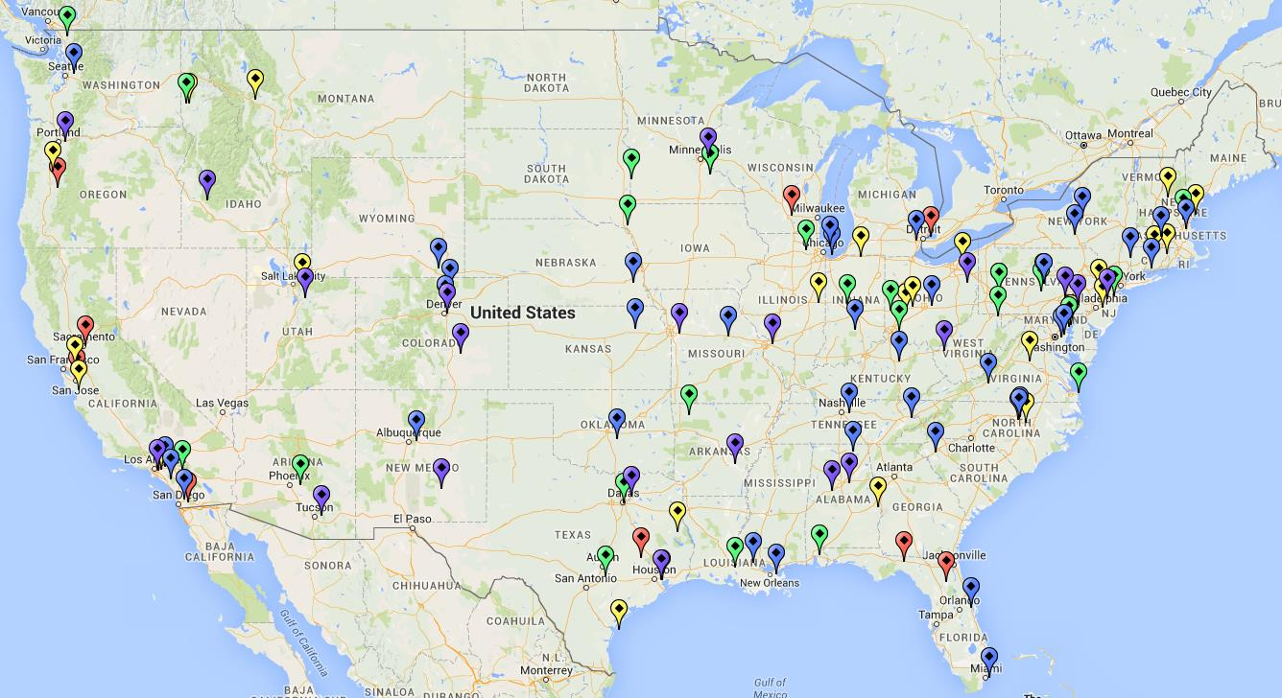
Science DMZ
Science DMZ deployments, U.S.

Slide 11
TCP Congestion Control, Parallel Streams,
Maximum Segment Size (MSS), TCP buffers

Slide 12
TCP Traditional Congestion Control
The principles of window-based CC were described in the 1980s¹
Traditional CC algorithms follow the additive-increase multiplicative-decrease (AIMD) form of congestion control
1. V. Jacobson, M. Karels, Congestion avoidance and control, ACM SIGCOMM Computer Communication Review 18 (4) (1988).

Slide 13
TCP Traditional Congestion Control
The principles of window-based CC were described in the 1980s¹
Traditional CC algorithms follow the additive-increase multiplicative-decrease (AIMD) form of congestion control
1. V. Jacobson, M. Karels, Congestion avoidance and control, ACM SIGCOMM Computer Communication Review 18 (4) (1988).

Slide 14
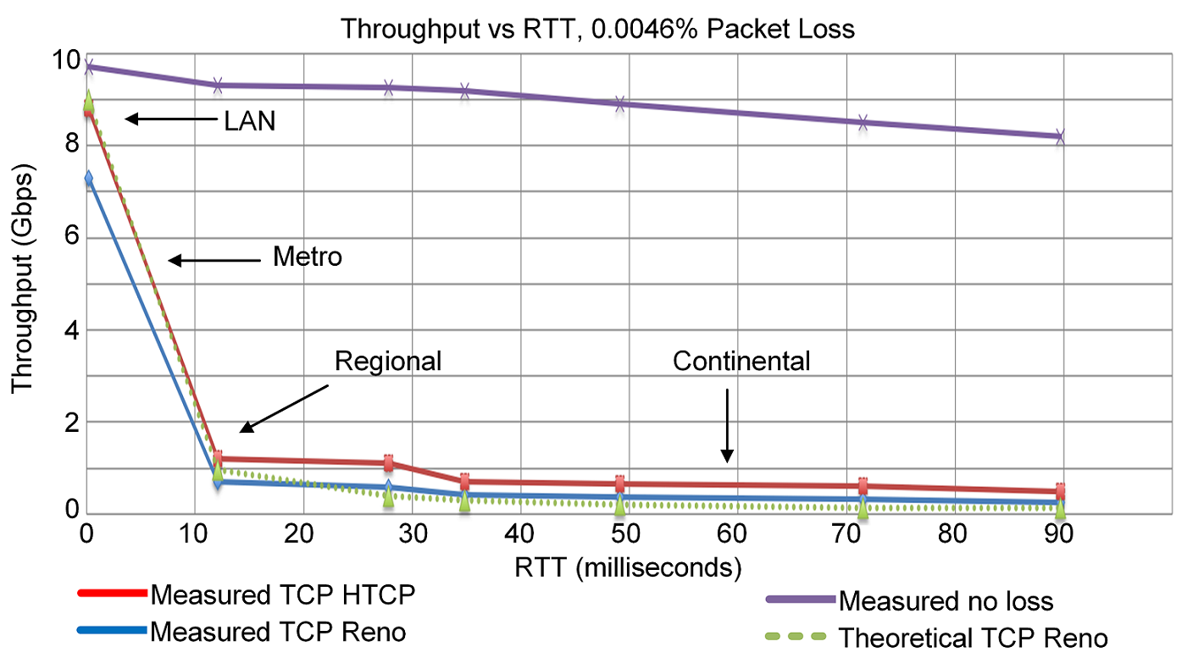
TCP Traditional Congestion Control
The principles of window-based CC were described in the 1980s¹
Traditional CC algorithms follow the additive-increase multiplicative-decrease (AIMD) form of congestion control
1. V. Jacobson, M. Karels, Congestion avoidance and control, ACM SIGCOMM Computer Communication Review 18 (4) (1988).

Slide 15
BBR: Model-based CC
TCP Bottleneck Bandwidth and RTT (BBR) is a rate-based congestion-control algorithm¹
BBR represented a disruption to the traditional CC algorithms:
  is not governed by AIMD control law
  does not use packet loss as a signal of congestion
At any time, a TCP connection has one slowest link bottleneck bandwidth (btlbw)
1. N. Cardwell et al. "BBR v2, A Model-based Congestion Control." IETF 104, March 2019.

Slide 16
BBR: Model-based CC
TCP Bottleneck Bandwidth and RTT (BBR) is a rate-based congestion-control algorithm¹
BBR represented a disruption to the traditional CC algorithms:
  is not governed by AIMD control law
  does not use packet loss as a signal of congestion
At any time, a TCP connection has one slowest link bottleneck bandwidth (btlbw)
1. N. Cardwell et al. "BBR v2, A Model-based Congestion Control." IETF 104, March 2019.

Slide 17
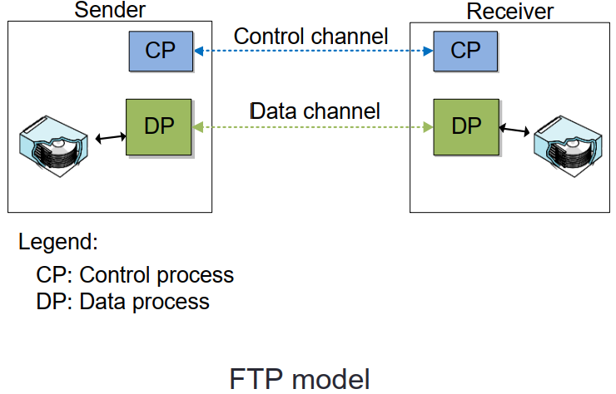
Parallel Streams
Conventional file transfer protocols use a control channel and a (single) data channel (FTP model)

Slide 18
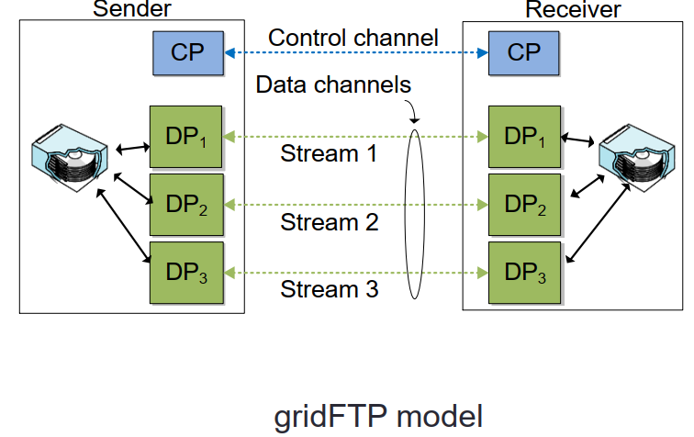
Parallel Streams
Conventional file transfer protocols use a control channel and a (single) data channel (FTP model)
gridFTP is an extension of the FTP protocol
A feature of gridFTP is the use of parallel streams

Slide 19
Advantages of Parallel Streams
Combat random packet loss not due congestion
  Parallel streams increase the recovery speed after the multiplicative decrease

Slide 20
Advantages of Parallel Streams
Combat random packet loss not due congestion
  Parallel streams increase the recovery speed after the multiplicative decrease
Mitigate TCP round-trip time (RTT) bias
  A low-RTT flow gets a higher share of the bandwidth than that of a high-RTT flow
  Increase bandwidth allocated to big science flows

Slide 21
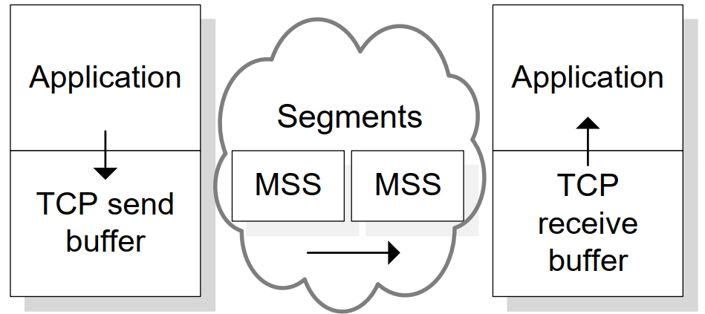
Maximum Segment Size (MSS)
TCP receives data from application layer and places it in send buffer
Data is typically broken into MSS units
A typical MSS is 1,500 bytes, but it can be as large as 9,000 bytes

Slide 22
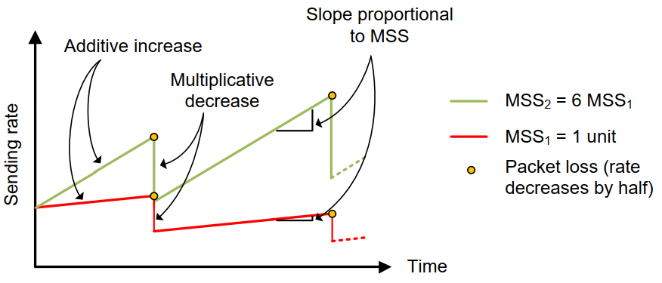
Advantages of Large MSS
Less overhead
The recovery after a packet loss is proportional to the MSS
  During the additive increase phase, TCP increases the congestion window by approximately one MSS every RTT
  By using a 9,000-byte MSS instead of a 1,500-byte MSS, the throughput increases six times faster

Slide 23
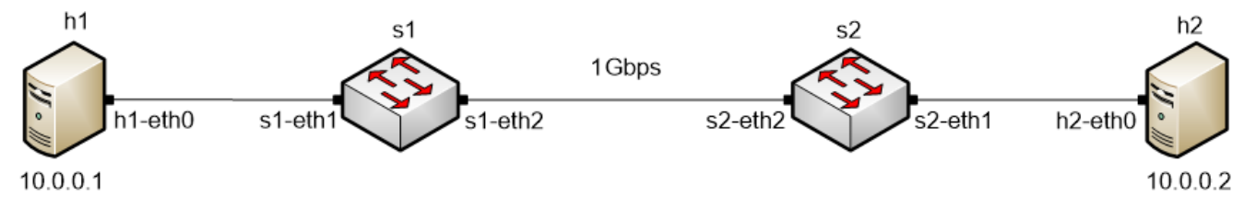
TCP Buffer Size
In many WANs, the round-trip time (RTT) is dominated by the propagation delay
To keep the sender busy while ACKs are received, the TCP buffer must be:
Traditional congestion controls:
BBRv1 and BBRv2:
TCP buffer size ≥ 2BDP
TCP buffer size must be considerable larger than 2BDP

Slide 24
perfSONAR

Slide 25
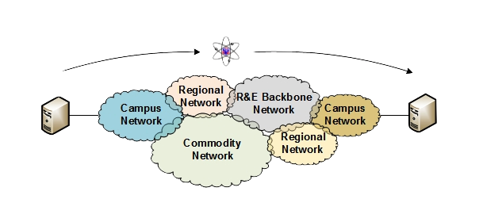
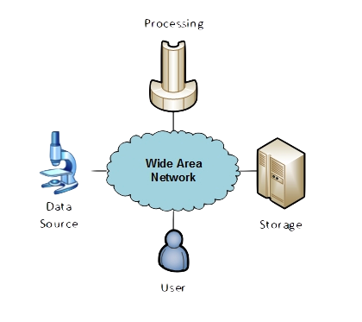
Motivation
The global Research & Education network ecosystem is comprised of hundreds of international, national, regional, and local-scale resources
Each of them is owned and operated independently
This complex, heterogeneous set of networks must operate seamlessly from “end to end” to support science and research collaborations
Typically, this type of collaboration is distributed globally
Source: ESNet, “Monitoring end-to-end systems”, [Online]. Available: https://tinyurl.com/4tppsccv

Slide 26
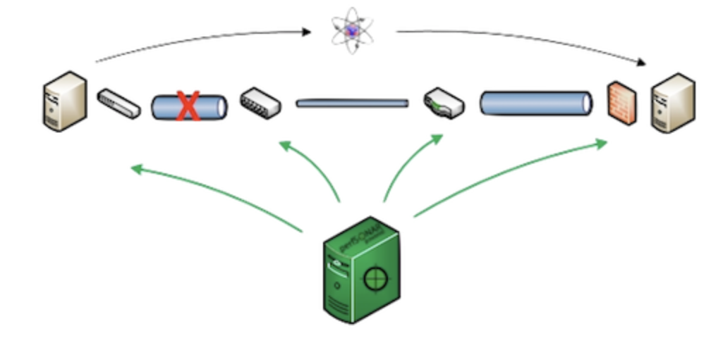
Motivation
Organizations must understand the behavior of their network by monitoring the performance metrics to ensure that the underlying system is functional
Source: ESNet, “Monitoring end-to-end systems”, [Online]. Available: https://tinyurl.com/4tppsccv

Slide 27
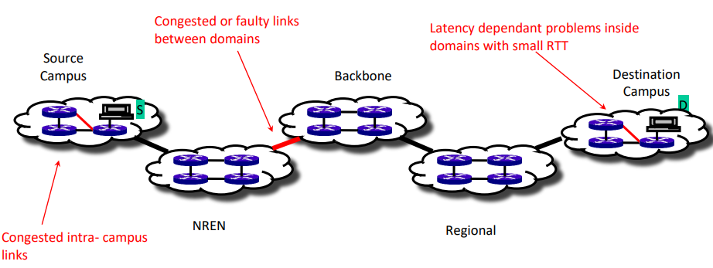
Motivation
Network issues can have different sources and locations
Performing local testing will not find the cause of these problems
Source: ESNet, “Monitoring end-to-end systems”, [Online]. Available: https://tinyurl.com/4tppsccv

Slide 28
Soft Network Failures
Soft failures affect basic connectivity functions (e.g., long delays, packet losses)
Some soft failures may only affect high bandwidth long RTT flows
TCP was intentionally designed to hide transmission errors from the user
Soft failures are difficult to detect and fix
They can be hidden for years and cause resource underutilization

Slide 29
Hard Network Failures
On the other hand, hard failures are easier to detect and fix
These types of failures are easy to understand
  Fiber cut
  Power failure takes down routers
  Hardware malfunction
Classic monitoring systems are good at alerting hard failures
For example, the network operator visualizes an alert in the system’s dashboard

Slide 30
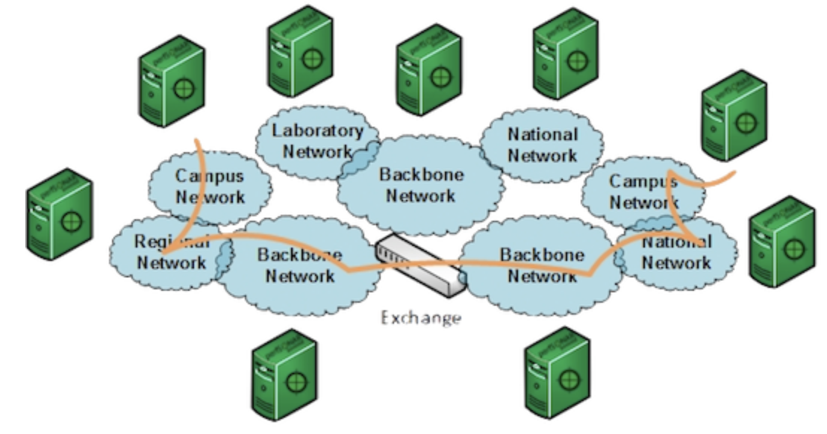
perfSONAR
perfSONAR is a network measurement tool designed to provide federated coverage of paths and help to achieve end-to-end usage expectations
The tool facilitates diagnosing, visualizing, and troubleshooting network performance issues
perfSONAR can collect metrics such as throughput, latency, and packet losses
Source: ESNet, “Monitoring end-to-end systems”, [Online]. Available: https://tinyurl.com/4tppsccv

Slide 31
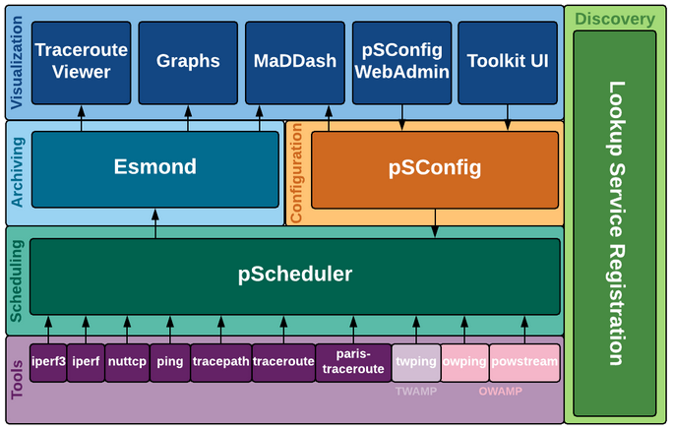
perfSONAR
perfSONAR provides a set of resources to orchestrate regular tests using open-source tools such as ping, traceroute, iperf3, and others
perfSONAR layers

Slide 32
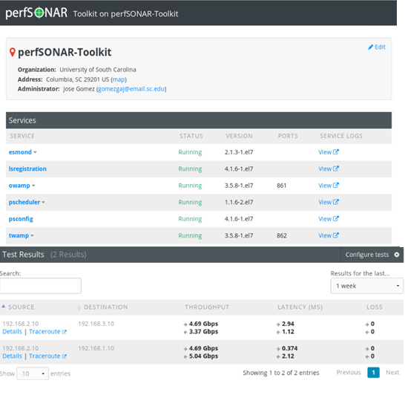
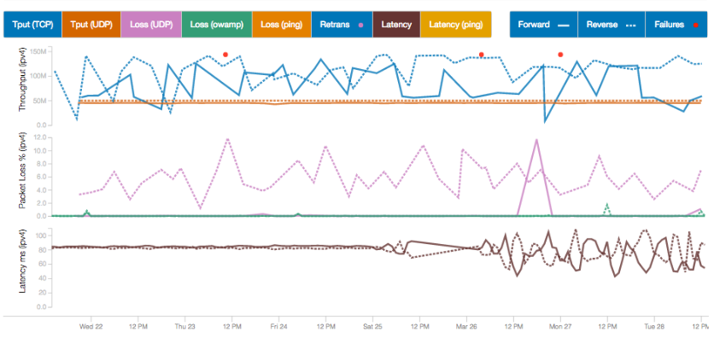
perfSONAR
perfSONAR allows scheduling measurements, storage of data in uniform formats, and methods to retrieve data and generate visualizations
perfSONAR test results
perfSONAR Toolkit GUI

Slide 33
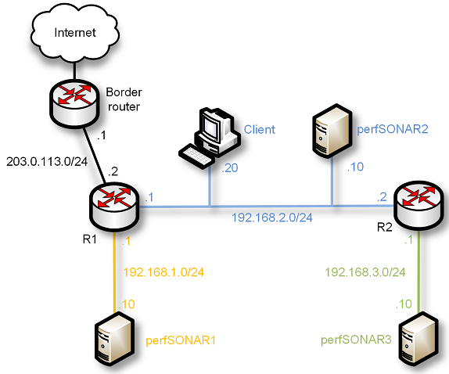
Getting Started with perfSONAR
The CI-Lab at the University of South Carolina (USC) developed a set of hands-on labs that navigate through the components of perfSONAR
perfSONAR Toolkit + Central Management
PWA
perfSONAR Toolkit
perfSONAR installation options

Slide 34
Useful Resources
perfSONAR official website
  URL: https://www.perfsonar.net/gtk_whatis.html
perfSONAR documentation
  URL: https://docs.perfsonar.net/
ESNet website
  URL: https://www.es.net/network-r-and-d/perfsonar/
The CI-Lab website
  URL: http://ce.sc.edu/cyberinfra/cybertraining.html

Slide 35
FABRIC

Slide 36
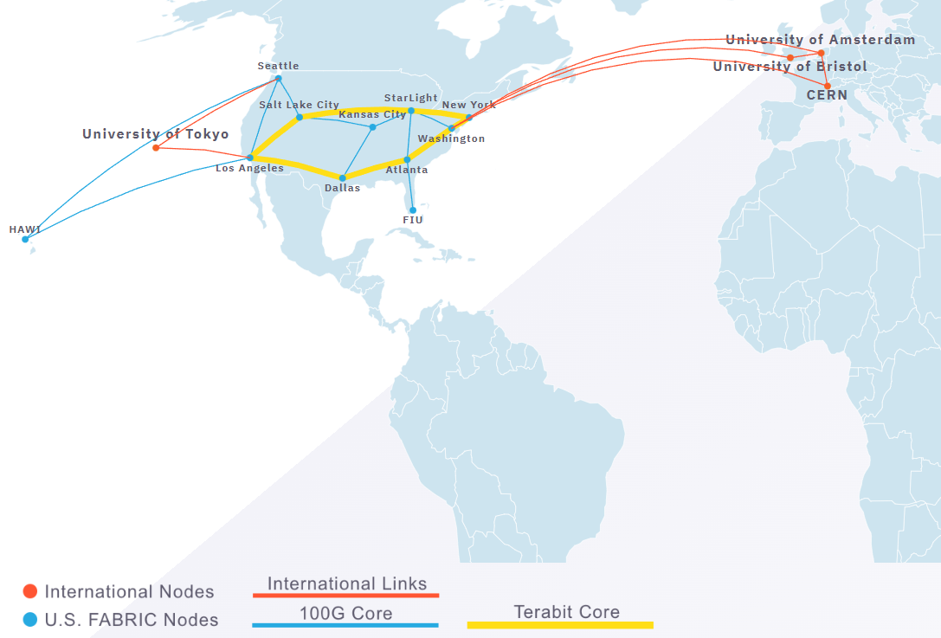
FABRIC Testbed
FABRIC is an NSF-funded international infrastructure for at-scale experimentation and research
Areas include networking, cyber, distributed computing, storage, 5G, ML, etc.
Equipment is located at commercial collocation spaces, U.S. national labs, and campuses – 29 FABRIC sites

Slide 37
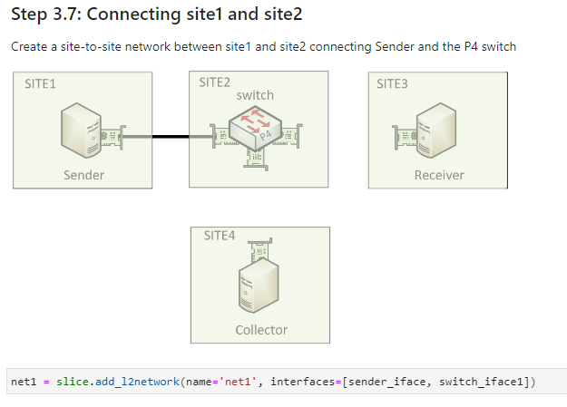
Cybertraining on FABRIC
FABRIC is a real network with physical propagation delays and high-speed links
With its integrated JupyterHub, it can be ideal for cybertraining:
  P4 programmable switches/NICs
  High-speed networks (SDMZ)
  PerfSONAR
  Measurement and telemetry
  Cybersecurity (Zeek, Suricata, etc.)
  Etc.

Slide 38
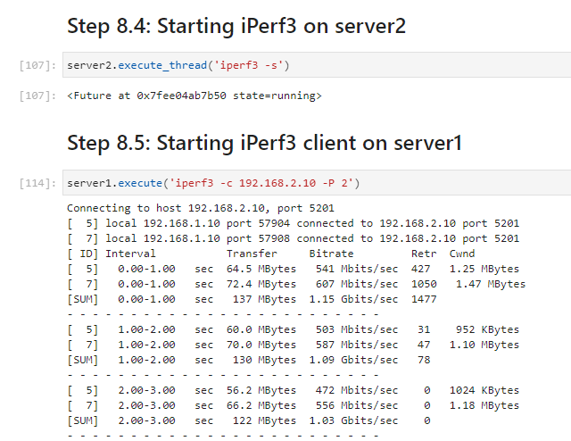
Cybertraining on FABRIC
FABRIC is a real network with physical propagation delays and high-speed links
With its integrated JupyterHub, it can be ideal for cybertraining:
  P4 programmable switches/NICs
  High-speed networks (SDMZ)
  PerfSONAR
  Measurement and telemetry
  Cybersecurity (Zeek, Suricata, etc.)
  Etc.

Slide 39
Organization of the labs
Each lab starts with a section Overview
  Objectives
  Lab topology
  Roadmap: organization of the lab
Part 1
  Background information of the topic being covered
  Section 1 is optional (i.e., the reader can skip this section and move to lab directions)
Part 2… n
  Step-by-step directions

Slide 40
Labs on P4 Programmable Data Planes over FABRIC
The following labs have been developed:
  Lab 1 – Preparing the Environment
  Lab 2 – P4 Program Building Blocks
  Lab 3 – Parser Implementation
  Lab 4 – Introduction to Match-action Tables
  Lab 5 – Populating Match-action Tables from the Control Plane
  Lab 6 – Checksum Calculation and Packet Deparsing
  Lab 7 – Fine-grained Queue Measurement

Slide 41
Upcoming Lab Libraries over FABRIC
Advanced P4 Programmable Data Planes: Applications, Stateful Elements, and Custom Packet Processing
Writing Cybersecurity Applications on P4 Programmable Data Planes
PerfSONAR 5 (perfSONAR’s components, Measurements with Grafana Dashboard)
High Speed Networks (TCP Congestion Control, Buffer Size, BDP, TCP Fairness, etc.)
Software-defined Networking and Open vSwitch (OVS)
Introduction to SmartNICs

