Slide 1
“Enhancing the Preparation of
Next-generation Cyber Professionals”
July 22, 2020 – June 30, 2022
PI: Jorge Crichigno
FY19 Funding Opportunity Announcement (FOA) for the Office of Naval Research (ONR) Navy ROTC Cybersecurity Training Program
McNair Center
February 2, 2022

Slide 2

FOA Scope
Expand the technical skills taught to university students, ROTC programs…
Develop the research capacity of participants…
Establish meetings of stakeholders… connect relevant people and organizations…

Slide 3
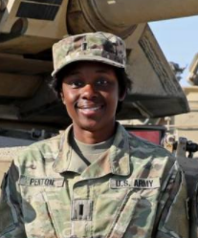
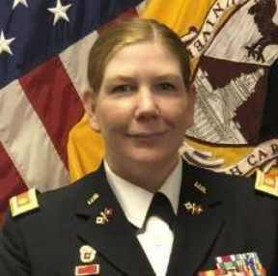
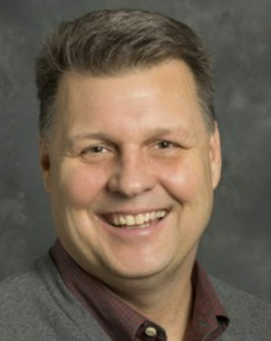
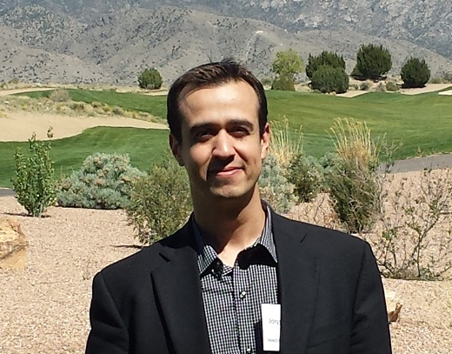

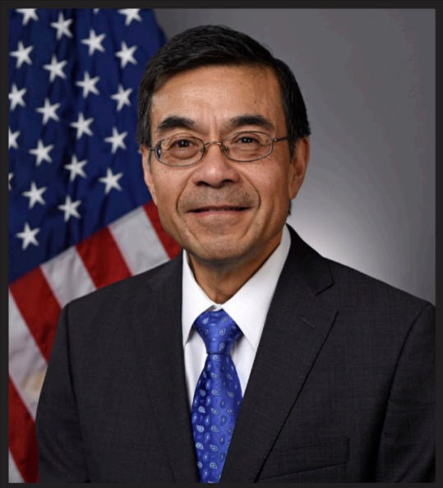
USC Team
Dr. Jorge Crichigno
(College of Engr. and Comp.)
Jodi Salter
(ROTC, Walker Institute)
1LT Ebony Penton
(ROTC Command)
MAJ Christina Knight
(Former ROTC Command, Co-PI)
Anthony Dillon
(Internships)
ONR Education and Workforce
Dr. Michael Simpson
Director of Education and Workforce at Office of Naval Research
Notes:
The Walker Institute is the center for global research and outreach on the University of South Carolina’s Columbia campus.
It hosts the ROTC programs

Slide 4
Project Goals
Develop a cybersecurity concentration
Establish an undergraduate research program in cybersecurity
Deploy virtual equipment pods on a virtual platform
Establish meetings among industry, government, high schools, and higher-education institutions to enhance cybersecurity preparation

Slide 5
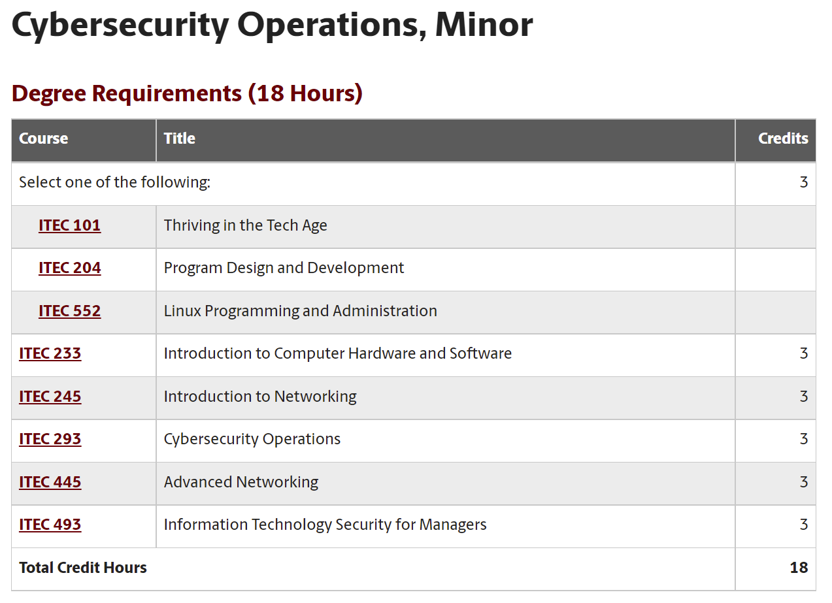
Project Goals
Develop a cybersecurity concentration
https://tinyurl.com/4mbj3z4k

Slide 6
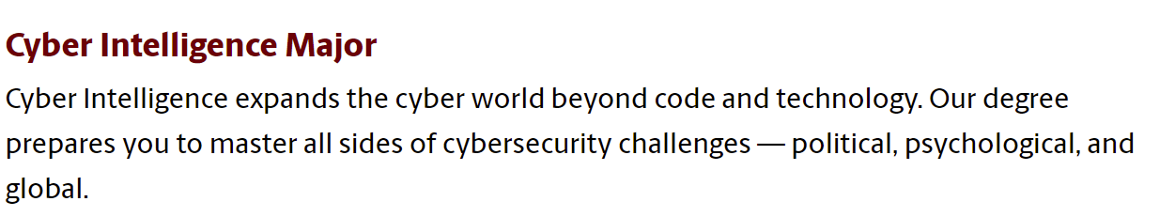
Project Goals
Develop a cybersecurity concentration
https://tinyurl.com/4x566mpu
https://tinyurl.com/4mbj3z4k

Slide 7
Project Goals
Establish an undergraduate research program in cybersecurity
Participants include ROTC cadets (Navy, Army, Air Force), Veterans, and students from CS, IT, IS, Cyber Intelligence
Name | Project
Christian S | Application ID
Brendan C | Protection against Bruteforce Attacks with NGFW
Jack S | Mitigating Routing Hijacking Attacks
Matthew D | Mitigating Routing Hijacking Attacks
Chris N | Protection against Reconnaissance and Scan Attacks
Jack S | Policy-based Forwarding
Matthew D | Policy-based Forwarding
Keegan S | An open-source library for computer networks and cybersecurity
Dakota M | Distributed Denial of Service (DDoS) Protection
Lauren W | Protection against Bruteforce Attacks with NGFW
Josue H | Site to site VPN with NGFWs
Brian N | Distributed Denial of Service (DDoS) Protection

Slide 8
Project Goals
Establish an undergraduate research program in cybersecurity
Participants include ROTC cadets (Navy, Army, Air Force), Veterans, and students from CS, IT, IS, Cyber Intelligence
Name | Project
Kyle R | Protection against Reconnaissance and Scan Attacks
Ryan T | IPsec VPN with Routers
Nathan B | Site to site VPN with NGFWs
Bryson L | External Dynamic List
Ryan T | IPsec VPN with Next Generation Firewalls
Brad W | Application ID
Zach F | External Dynamic List
Nathan L | Geolocation and Geoblocking
Ty L | Geolocation and Geoblocking
Gabriella P | Access-control List in a Data Plane Switch
Avery S | Access-control List in a Data Plane Switch
Dillon Barnhardt | Hardening Routing Protocols
Notes:
Geolocation: estimation of the real-world geographic location

Slide 9
Project Goals
Establish an undergraduate research program in cybersecurity
Participants include ROTC cadets (Navy, Army, Air Force), Veterans, and students from CS, IT, IS, Cyber Intelligence
Name | Project
Samuel D | Hardening Routing Protocols
Talha G | Implementing VPN with Next-generation Firewalls
Mark-Anthony B | Implementing VPN with Next-generation Firewalls
Andrew C | Preventing DoS and DDoS Attacks
Sam K | NAT in a P4 Programmable Data Plane Switch
Timothy D | Preventing DoS and DDoS Attacks
Cameron M | NAT in a P4 Programmable Data Plane Switch
Tucker B | Preventing Brute-force attacks using Custom Signatures
David Williams | Preventing Brute-force attacks using Custom Signatures
Notes:
Preventing bruteforce attacks using Custom Signatures
https://knowledgebase.paloaltonetworks.com/KCSArticleDetail?id=kA10g000000ClSTCA0

Slide 10
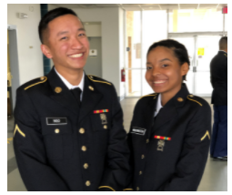
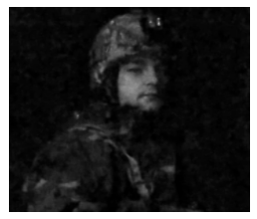
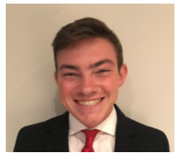
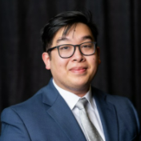
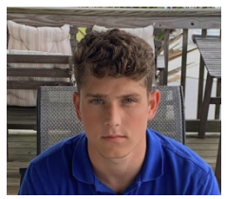
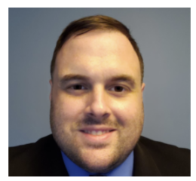
Project Goals
Establish an undergraduate research program in cybersecurity
Participants include ROTC cadets (Navy, Army, Air Force), Veterans, and students from CS, IT, IS, Cyber Intelligence
Chris Ngo
Jack Sadle
Brendan Curran
Christian Tsirlis
Ryan Tallent
Tim Dao
Notes:
ROTC cadets and veterans.
In his former role as a Gunner’s Mate Second Class in the US Navy, he deployed with the Constellation Battle Group, in 2003, is support of Operation Iraqi Freedom.

Slide 11

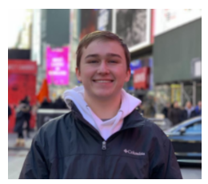
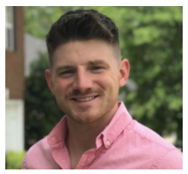
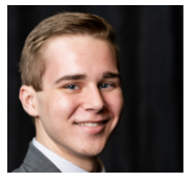
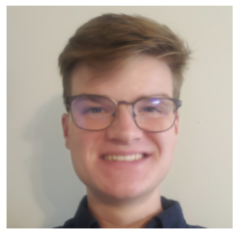
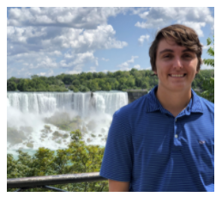
Project Goals
Establish an undergraduate research program in cybersecurity
Participants include ROTC cadets (Navy, Army, Air Force), Veterans, and students from CS, IT, IS, Cyber Intelligence
Dakota McDaniels
David Williams
Brian Nelson
Keegan Sprankle
Zach Fowler
Bryson Livingston
Notes:
David: national defense service medal, global war on terrorism service medal, and

Slide 12
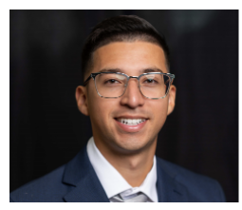
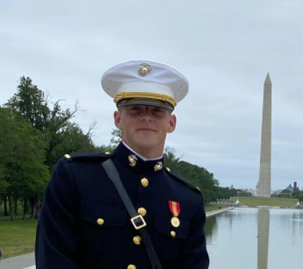
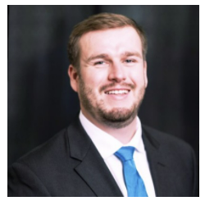
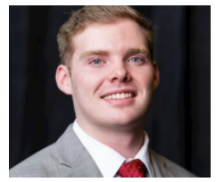
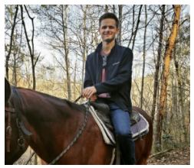
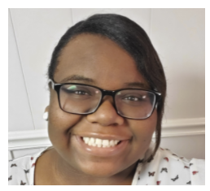
Project Goals
Establish an undergraduate research program in cybersecurity
Participants include ROTC cadets (Navy, Army, Air Force), Veterans, and students from CS, IT, IS, Cyber Intelligence
Josue Hernandez
Ty Love-Baker
Nate Bohmer
Kyle Radzak
Lauren Waddell
Nathan Long

Slide 13
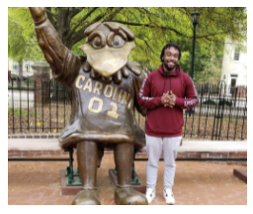

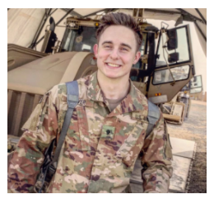

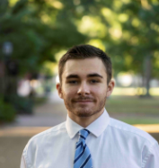
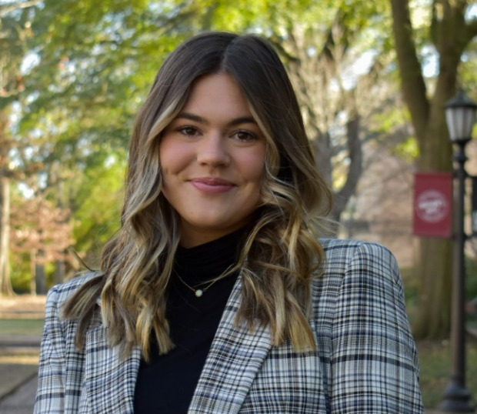
Project Goals
Establish an undergraduate research program in cybersecurity
Participants include ROTC cadets (Navy, Army, Air Force), Veterans, and students from CS, IT, IS, Cyber Intelligence
Brad Wilson
Matt Driver
Gabriella Pinto
Dillon Barnhardt
Avery Schiro
Samuel Kelley
Notes:
Brad: SRNL
Matt: U.S. Army
Dillon: South Carolina National Guard

Slide 14
Project Goals
Establish an undergraduate research program in cybersecurity
Participants include ROTC cadets (Navy, Army, Air Force), Veterans, and students from CS, IT, IS, Cyber Intelligence
Jack Sadle, ROTC
Name | Position
Ty Love-Baker | 2nd Lt. at United States Marine Corps, DC
Dakota McDaniel | Information Security Analyst at Lowe's
Lauren Waddell | IT Specialist, SC Department of Insurance
Josue Hernandez | Technical Solution Specialist at IBM
Kyle Radzak | IT Specialist at Lowe's Companies
Nathan Bohmer | Project Coordinator at Black Box Networks
Brad Wilson | Savannah River National Lab
Zach Fowler | IT Specialist at Blue Cross Blue Shield
Nathan Long | Technology Analyst at AIG
“During my semesters conducting research under ONR, I learned many valuable skills that would help me improve my chances at becoming a Cyber Operations Officer in the United States Army. The skills I learned during this period carried over into internships with 3rd Special Forces Group Cyber Effects Cell, as well as the Army Cyber Institute at West Point. Understanding the vulnerabilities with routing protocols greatly improved my value as a member of a research team examining malware and phishing attacks…”
Currently senior student, employed with UofSC’s IT and at the 359th Theater Tactical Signal Brigade, Headquarters Company.
…

Slide 15
Project Goals
Deploy virtual equipment pods on a virtual platform

Slide 16
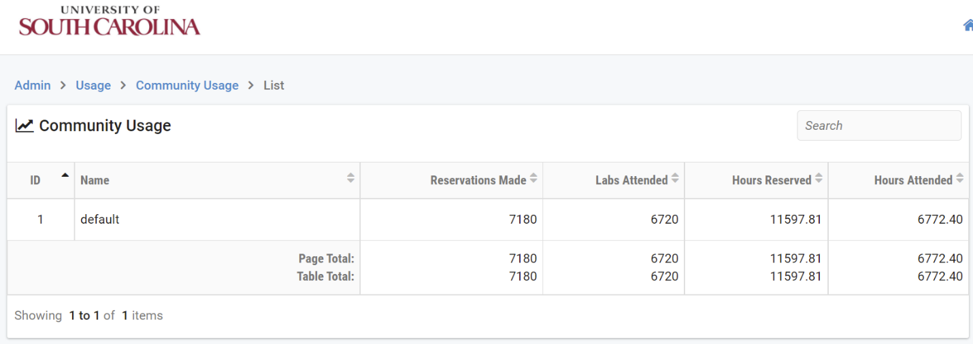
Project Goals
Deploy virtual equipment pods on a virtual platform
Use of the platform by USC students, 2021

Slide 17
Project Goals
Establish meetings among industry, government, high schools, and higher-education institutions to enhance cybersecurity preparation
  Program incorporates preparation for DoD’s approved baseline credentials for Information Assurance Technical (IAT) positions, Cybersecurity Service Provider (CSSP) Analyst, and CSSP Incident Responder¹
Cybersecurity courses with content for DoD’s Approved 8750 baseline certifications
Course | IAT 1-2 | CSSP Analyst | CSSP Incident Responder | Security Plus | NICE Framework Objectives
Intro to Computer Security |  |  |  | P | P
Cybersecurity Operations |  | P | P |  | P
Intro to Networks | P | P | P |  | P
IT Security for Managers |  |  |  | P | P
Advanced Networks | P | P | P |  | P
NICE: National Initiative for Cybersecurity Education
¹Department of Defense (DoD) Cyber Workforce Management Program Website. https://tinyurl.com/55t7sdnm

Slide 18
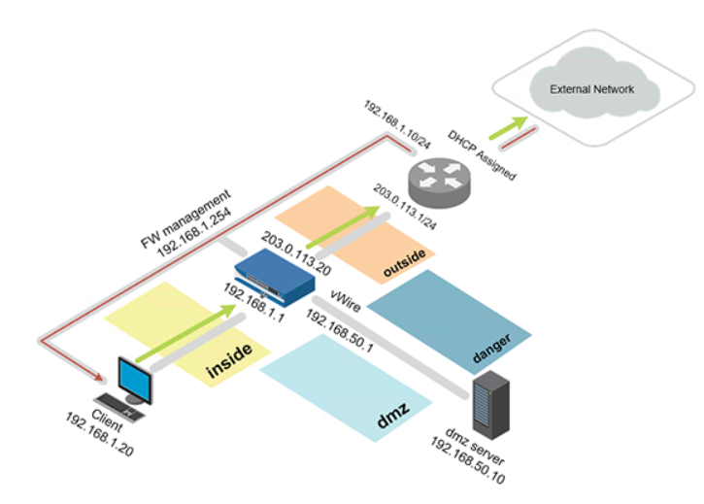
Project Goals
Establish meetings among industry, government, high schools, and higher-education institutions to enhance cybersecurity preparation
  Industry partners enrich the academic curriculum and undergraduate research experience with their tools and platforms: Palo Alto Networks, Cisco Systems, VMware, Intel
Next-generation Firewall Virtual Machine + licenses

Slide 19
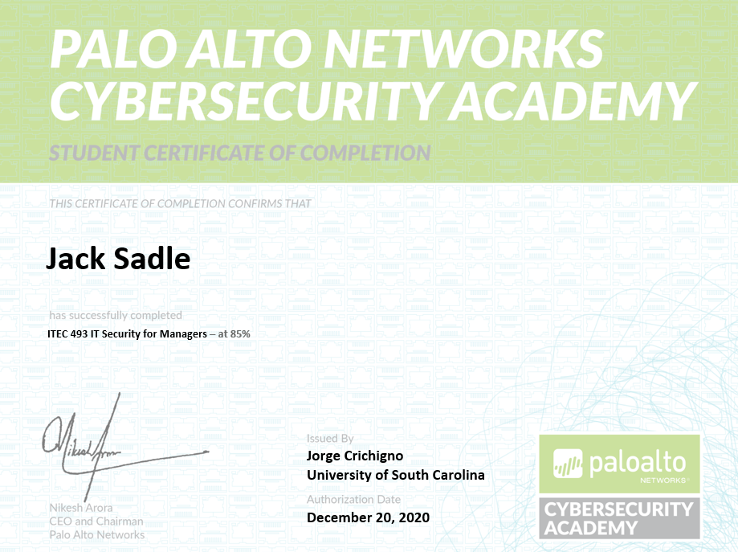
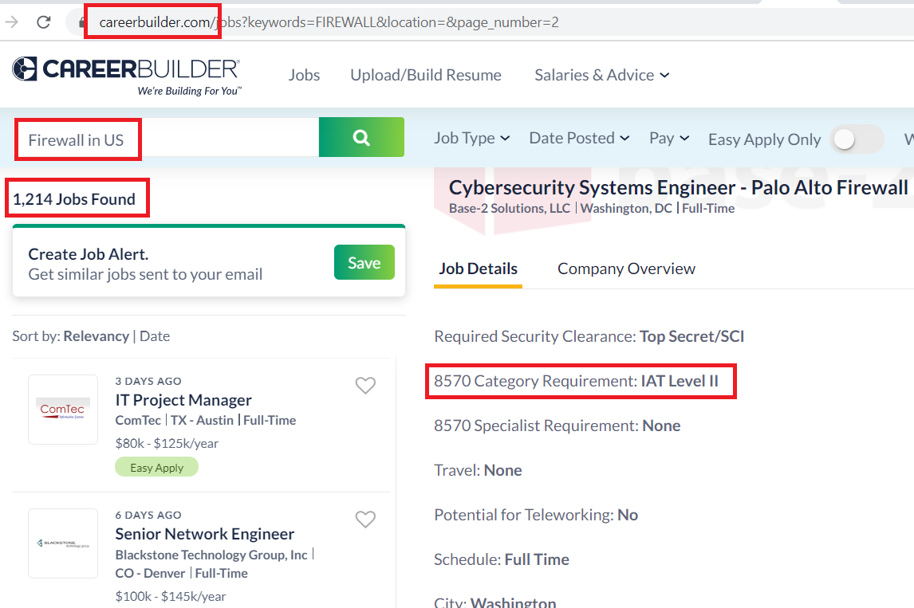
Project Goals
Establish meetings among industry, government, high schools, and higher-education institutions to enhance cybersecurity preparation
  Industry partners enrich the academic curriculum and undergraduate research experience with their tools and platforms: Palo Alto Networks, Cisco Systems, VMware, Intel
Next-generation Firewall Virtual Machine + licenses
Job search

Slide 20
Project Goals
Establish meetings among industry, government, high schools, and higher-education institutions to enhance cybersecurity preparation
  Industry partners enrich the academic curriculum and undergraduate research experience with their tools and platforms: Palo Alto Networks, Cisco Systems, VMware, Intel
Two examples of employment categories:
Demand of certificates for Information Security Analyst is over 95% (345,000 job listings studied in¹)
Demand of certificates for Computer Network Architect is over 52% (38,000 job listings studied in¹)
1. M. Tannian, W. Coston, “The Role of Professional Certifications in Computer Occupations,” Communications of the ACM, Vol. 64, No. 10, October 2021.

Slide 21
Project Goals
Establish meetings among industry, government, high schools, and higher-education institutions to enhance cybersecurity preparation
Platform and material are available to other organizations
  Lawrence Berkeley National Lab
  SANS institute (“girlsgocyber”)
  Multiple higher-ed institutions
  International Networks at Indiana
  Fort Gordon (~2 cyber courses per semester)
  Texas’ Lonestart Education and Research
  Great Plains Network
  New York State Education and Research Network
  U.S. Army Cyber Center of Excellence (CCoE) (Signal School)

Slide 22
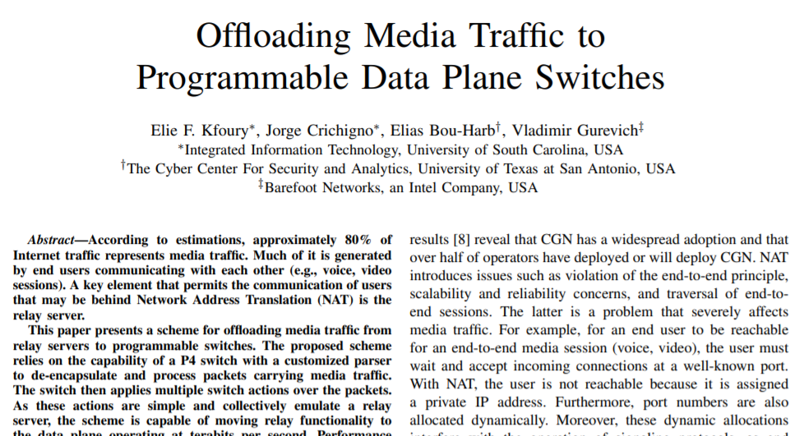
Project Goals
Establish meetings among industry, government, high schools, and higher-education institutions to enhance cybersecurity preparation
  Industry partners enrich the academic curriculum and undergraduate research experience with their tools and platforms: Palo Alto Networks, Cisco Systems, VMware, Intel
Improving system’s performance w/ NG switches
Offloading computational tasks to network switches
Agreement with Intel (chips, software development environment)
Application example: media (voice) relay server
 | Programmable Switch | General-purpose CPU
Cost | $6,000 | $ 10,000 - 25,000
Capacity | ~35,000,000 connections per switch | ~500 connections per core
Latency | 400 nanoseconds | Tens to hundreds of milliseconds

Slide 23
Next Steps - FOA N00014-22-S-F003
Leverage the technologies and facilities developed at USC, to strengthen the education and research capacity of regional communities
Implement an inter-institutional undergraduate research program
  40 students trained on cybersecurity from the previous FOA are from USC
  Extend program to partner institutions to address diversity-equity-inclusion: HBCUs, HSIs, and tribal colleges
Expand the collaboration with industry and agencies, to continue adding tools, professional development opportunities, access to credentials, and internships
  Increase the number of professionals with high-demand skills / credentials for the workforce, and for military occupation specialties (MOS)
Notes:
FOA N00014-22-S-F003 was released on Jan. 24, 2022

