Slide 1
Network Security
Research at the University of South Carolina
Jorge Crichigno
College of Engineering and Computing
University of South Carolina
http://ce.sc.edu/cyberinfra/
VICEROY Workshop
Friday February 10, 2023
Online

Slide 2
Agenda
Motivation – Limitations of traditional devices
Data plane programmability – Evolution
Essentials of P4 programmable switches
Applications
New national infrastructures

Slide 3
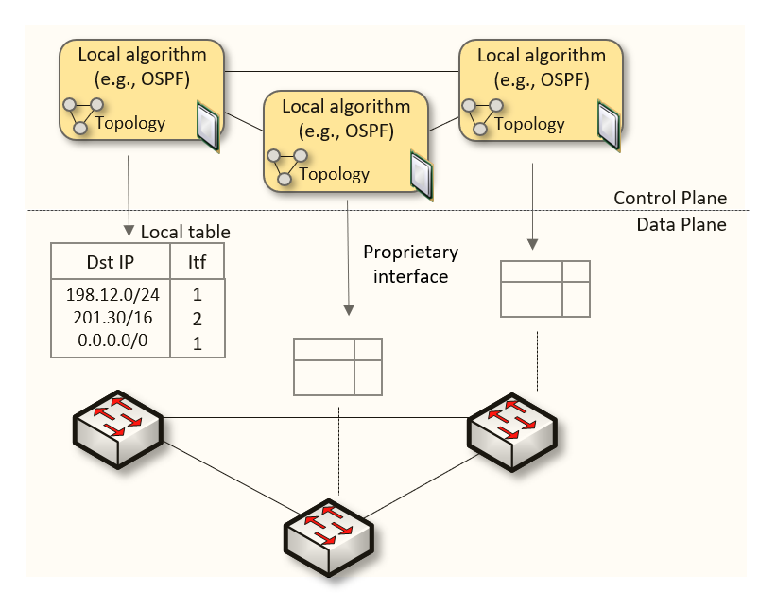
Traditional (Legacy) Networking
Since the explosive growth of the Internet in the 1990s, the networking industry has been dominated by closed and proprietary hardware and software
The interface between control and data planes has been historically proprietary
Vendor dependence: slow product cycles of vendor equipment, no innovation from network owners
A router is a monolithic unit built and internally accessed by the manufacturer only

Slide 4
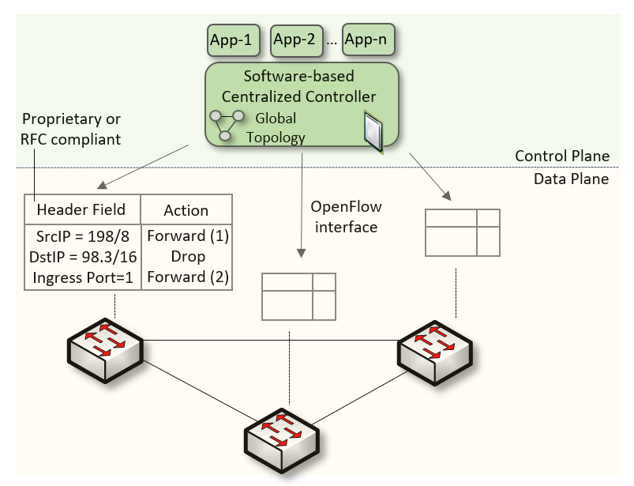
SDN
Protocol ossification has been challenged first by SDN
SDN (1) explicitly separates the control and data planes, and (2) enables the control plane intelligence to be implemented as a software outside the switches
The function of populating the forwarding table is now performed by the controller

Slide 5
SDN Limitation
SDN is limited to the OpenFlow specifications
Forwarding rules are based on a fixed number of protocols / header fields (e.g., IP, Ethernet)
The data plane is designed with fixed functions (hard-coded)
Functions are implemented by the chip designer

Slide 6
Can the Data Plane be Programmable?
“Programmable switches are 10-100 times slower than non-programmable ones. They are more expensive and consume more power”¹
1. Vladimir Gurevich, “Introduction to P4 and Data Plane Programmability,” https://tinyurl.com/2p978tm9.

Slide 7
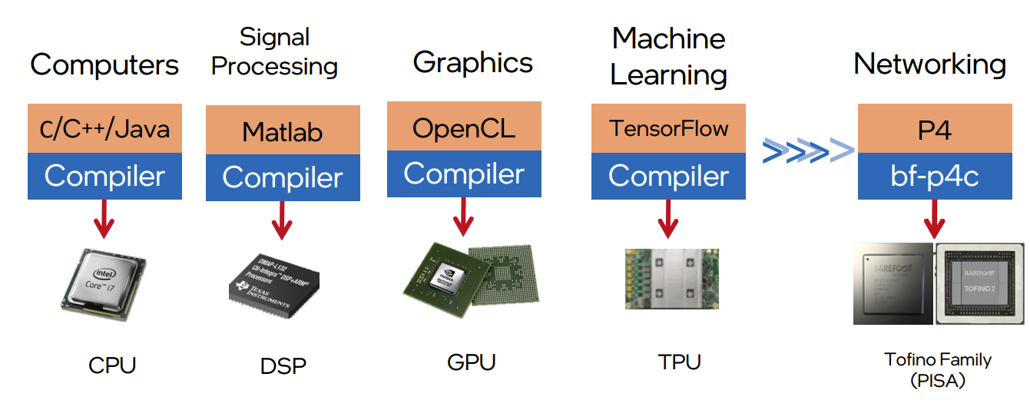
Can the Data Plane be Programmable?
Evolution of the computing industry
1970s 1970s-80s 1990s-2000s 2010s 2017
1. Vladimir Gurevich, “Introduction to P4 and Data Plane Programmability,” https://tinyurl.com/2p978tm9.

Slide 8
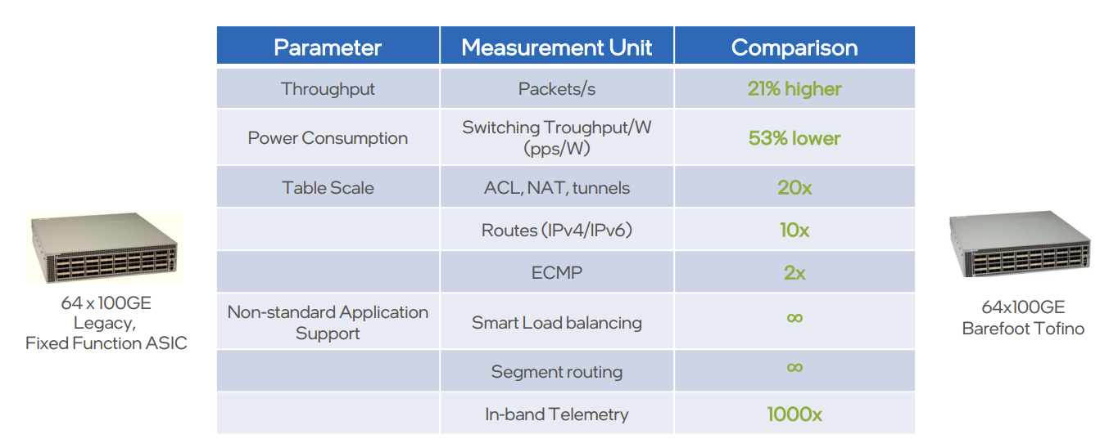
Can the Data Plane be Programmable?
Data plane comparison: fixed-function vs P4 programmable
1. Vladimir Gurevich, “Introduction to P4 and Data Plane Programmability,” https://tinyurl.com/2p978tm9.

Slide 9
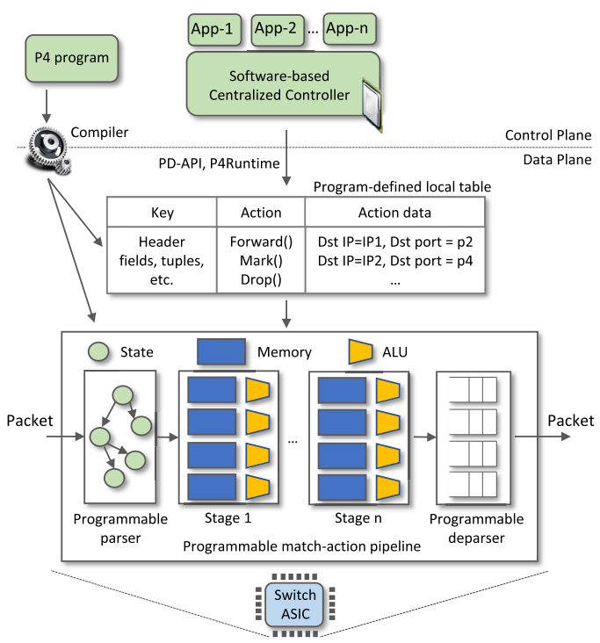
P4 Programmable Switches
P4¹ programmable switches permit a programmer to program the data plane
Define and parse new protocols
Customize packet processing functions
Measure events occurring in the data plane with
high precision
Offload applications to the data plane
1. P4 stands for stands for Programming Protocol-independent Packet Processors

Slide 10
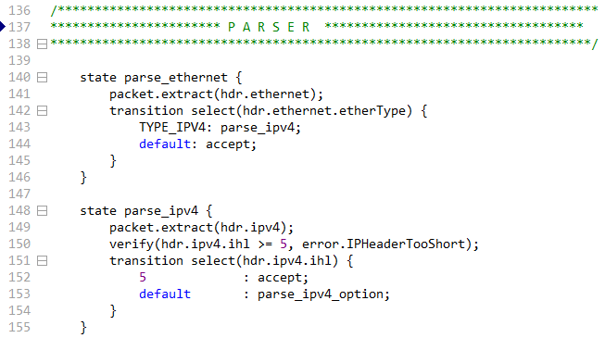
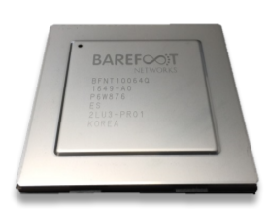
P4 Programmable Switches
P4¹ programmable switches permit a programmer to program the data plane
Define and parse new protocols
Customize packet processing functions
Measure events occurring in the data plane with
high precision
Offload applications to the data plane
Programmable chip
P4 code

Slide 11
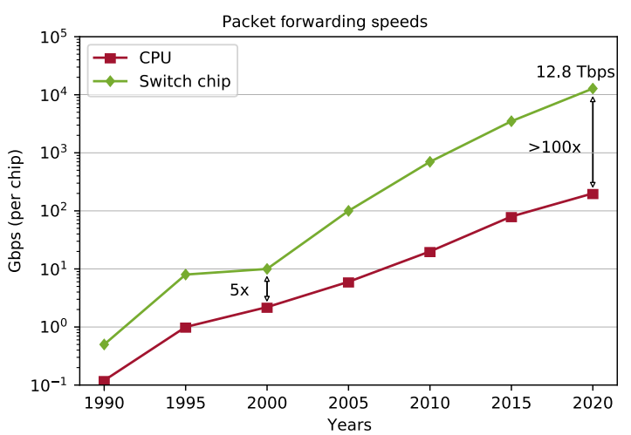
P4 Programmable Switches
P4¹ programmable switches permit a programmer to program the data plane
Define and parse new protocols
Customize packet processing functions
Measure events occurring in the data plane with
high precision
Offload applications to the data plane
If the P4 program compiles, it runs on the
chip at line rate
Reproduced from N. McKeown. Creating an End-to-End Programming Model for Packet Forwarding. Available: https://www.youtube.com/watch?v=fiBuao6YZl0&t=4216s

Slide 12
Generalized forwarding: Match + Action
Each switch contains table/s
Match bits in arriving packet (match phase)
Take action - Many header fields can determine action (action phase)
Drop
Copy
Modify
Log packet
Forward out a link (destination-based forwarding is just a particular case)

Slide 13
PISA: Protocol Independent Switch Architecture
Match+Action Stage
Memory
ALU
Programmable Parser
Programmable Match-Action Pipeline
Reproduced from N. McKeown. Creating an End-to-End Programming Model for Packet Forwarding. Available: https://www.youtube.com/watch?v=fiBuao6YZl0&t=4216s

Slide 14
PISA: Protocol Independent Switch Architecture
Reproduced from N. McKeown. Creating an End-to-End Programming Model for Packet Forwarding. Available: https://www.youtube.com/watch?v=fiBuao6YZl0&t=4216s
14

Slide 15
Examples of Applications

Slide 16
Real Time RTT Calculation
Detecting hijacking attacks, reflected on larger round-trip times (RTTs)
Autonomous System (AS) A
AS B
Traffic

Slide 17
Real Time RTT Calculation
Detecting hijacking attacks, reflected on larger round-trip times (RTTs)
Autonomous System (AS) A
AS B
Traffic
AS X (Bad actor)

Slide 18
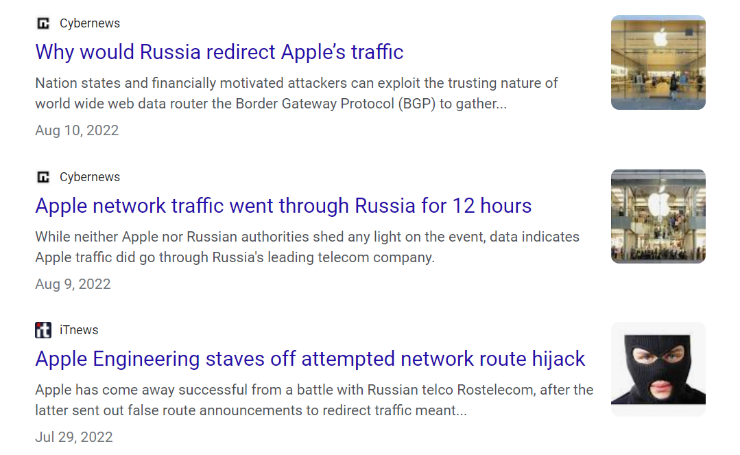
Real Time RTT Calculation
Detecting hijacking attacks, reflected in larger round-trip times (RTTs)

Slide 19
Real Time RTT Calculation

Slide 20
Customized Firewall
Customized firewall, without adding any additional middle boxes
NOTE: legacy CPU-based appliances (e.g., firewalls, Intrusion Detection Systems) cannot process packets fast enough when flows are large

Slide 21
Customized Firewall

Slide 22
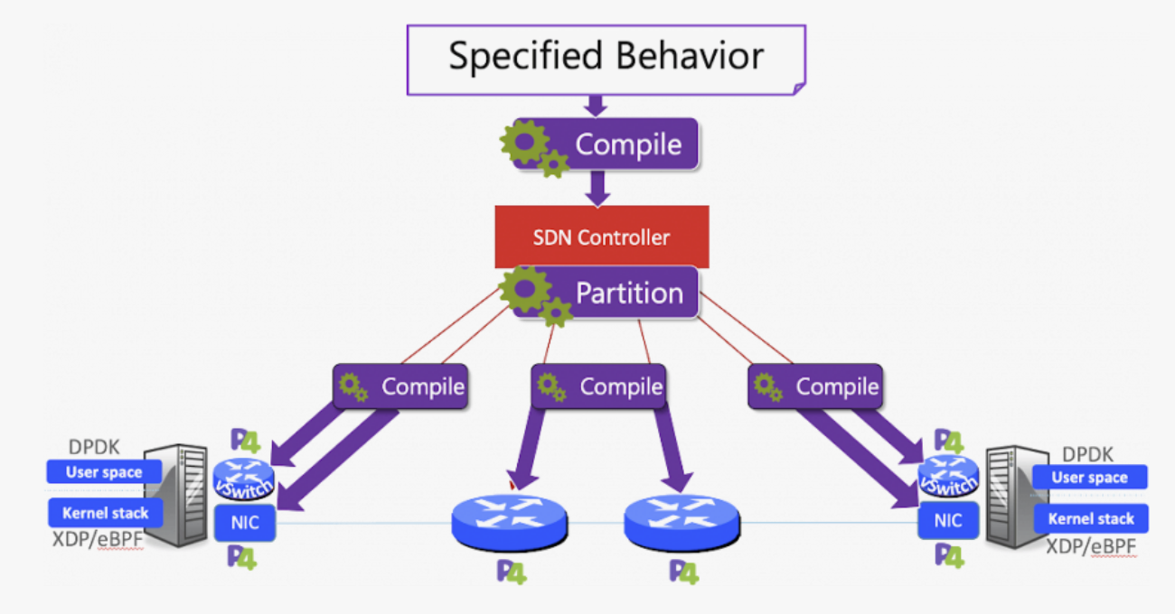
DOD’s Pronto Project
https://prontoproject.org/
Project Pronto is building and deploying a beta-production end-to-end 5G connected edge cloud leveraging a fully programmable network…

Slide 23
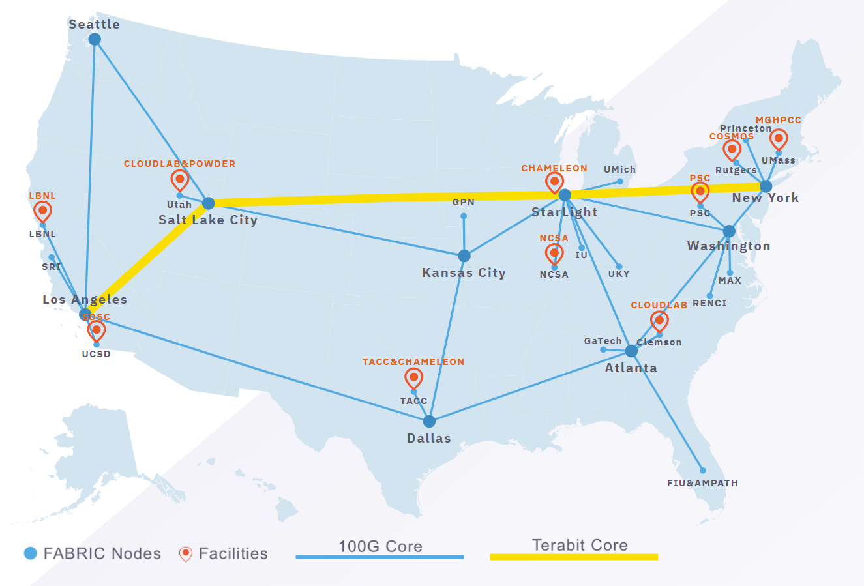
NSF’s FABRIC Project
https://whatisfabric.net/
FABRIC is an International infrastructure that enables cutting-edge experimentation and research…

Slide 25
Can the Data Plane be Programmable?
“Programmable switches are 10-100 times slower than non-programmable ones. They are more expensive and consume more power”
The above assumption was challenged by a group of researchers at Stanford and Texas Instruments that led to “Barefoot Networks” in 2013
1. Vladimir Gurevich, “Introduction to P4 and Data Plane Programmability,” https://tinyurl.com/2p978tm9.

Slide 26
Example P4 Program
Parser Program
Header and Data Declarations
Tables and Control Flow
parser parse_ethernet { extract(ethernet); return switch(ethernet.ethertype) { 0x8100 : parse_vlan_tag; 0x0800 : parse_ipv4; 0x8847 : parse_mpls; default: ingress; }
header_type ethernet_t { … }
header_type l2_metadata_t { … }
header ethernet_t ethernet;
header vlan_tag_t vlan_tag[2];
metadata l2_metadata_t l2_meta;
table port_table { … }
control ingress { apply(port_table); if (l2_meta.vlan_tags == 0) { process_assign_vlan();
} }
Memory
ALU
Programmable Parser
Programmable Match-Action Pipeline
Reproduced from N. McKeown. Creating an End-to-End Programming Model for Packet Forwarding. Available: https://www.youtube.com/watch?v=fiBuao6YZl0&t=4216s
26

