Slide 1

A Science DMZ for Data-intensive Research and
Computation at the University of South Carolina
Jorge Crichigno (Presenter), Paul Sagona
College of Engineering and Computing
University of South Carolina
http://ce.sc.edu/cyberinfra
BSRA Computing Exchange
March 30, 2023
Online

Slide 2
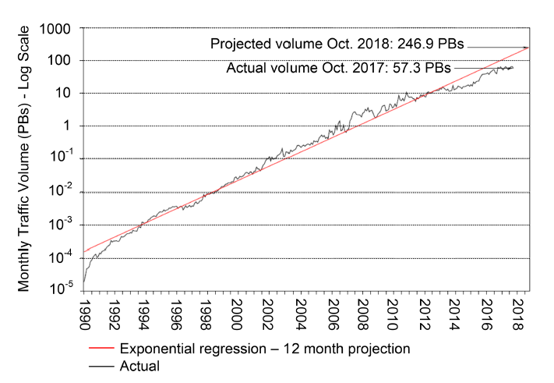
Motivation for a High-Speed Science Architecture
Science and engineering applications are generating data at an unprecedented rate
Instruments produce hundreds of terabytes in short time periods (“big science data”)
Data must be typically transferred across high-bandwidth high-latency Wide Area Networks
The Energy Science Network (ESnet) is the backbone connecting U.S. national laboratories and research centers

Slide 3
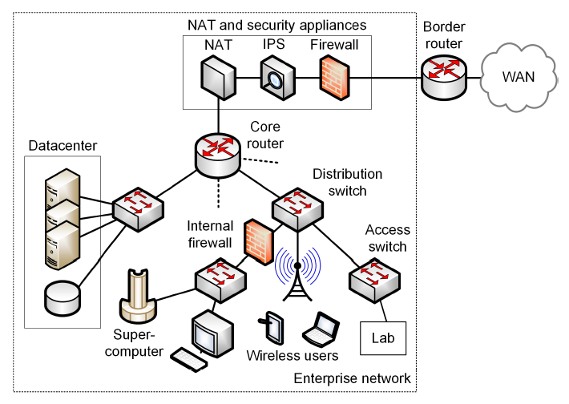
Enterprise Network Limitations
Security appliances are CPU-intensive
Inability of small-buffer switches to absorb bursts
Lack of data transfer apps to exploit available bandwidth

Slide 4
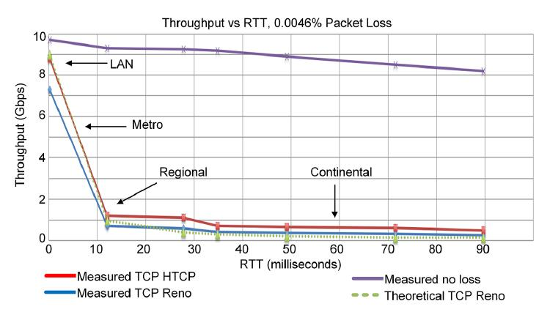
Enterprise Network Limitations
Security appliances are CPU-intensive
Inability of small-buffer switches to absorb bursts
Lack of data transfer apps to exploit available bandwidth
E. Dart, L. Rotman, B. Tierney, M. Hester, J. Zurawski, “The science dmz: a network design pattern for data-intensive science,” International Conference on High Performance Computing, Networking, Storage and Analysis, Nov. 2013.

Slide 5
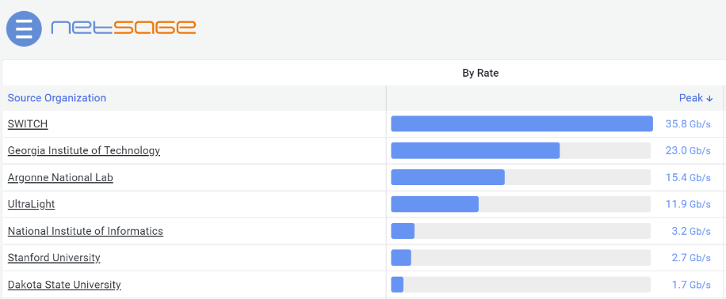
Solution
USC applied to the NSF Campus Cyberinfrastructure program (2019) ($500K)
It deployed a 100 Gbps Science DMZ (SDMZ), co-located to the campus network
It increased the bandwidth to Internet2 from ~10 Gbps to 100 Gbps
It increased bandwidth from key research laboratories on campus to Science DMZ

Slide 6
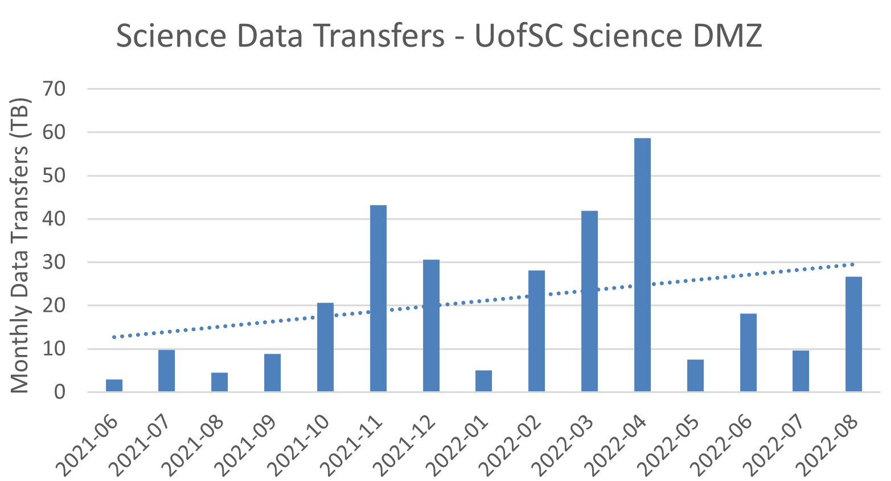

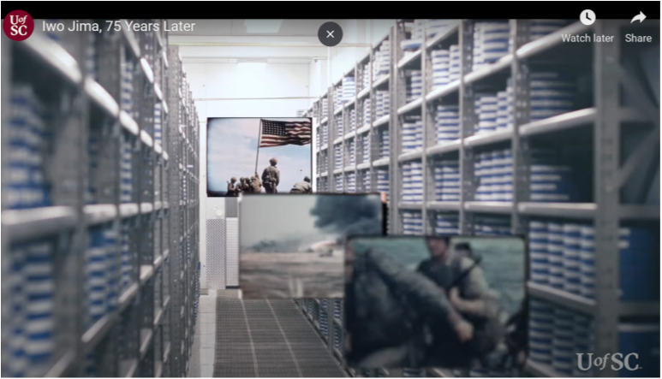
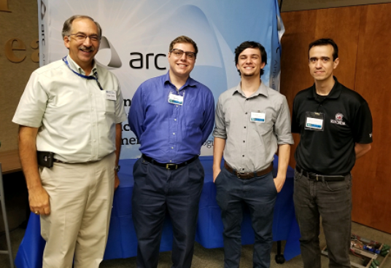
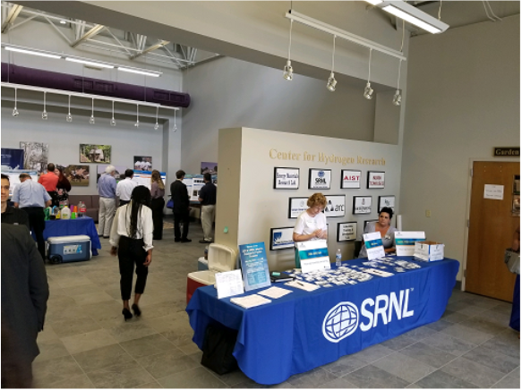
Outcomes
Increased number of science data transfers
Research activities on areas including cognitive
processes, WWII film digitization, chemical
engineering, nuclear physics, and others
Campus infrastructure suitable for an R1 institution
  100 Gbps Science DMZ
  100 Gbps connection to Internet2
  Direct connection to providers (AWS)
Strengthened collaboration between IT and faculty
Partnership with agencies and businesses
  Training on high-speed networks, Science DMZs in collaboration
  with ESnet / LBNL
  Internships
WWII film digitization 14,000+ cans of film
https://tinyurl.com/59cwtbs3
CIO SRNL, interns, PI

Slide 7
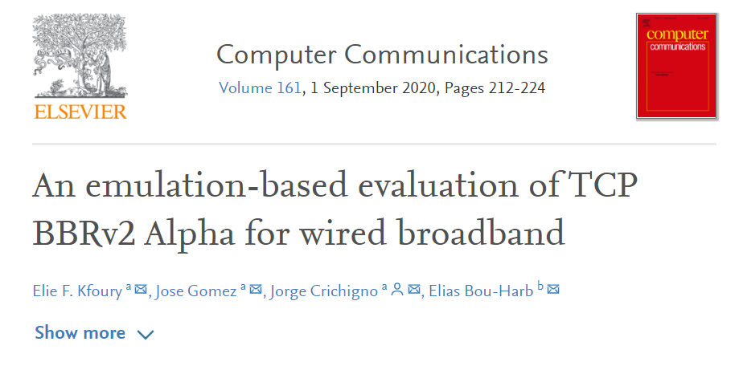
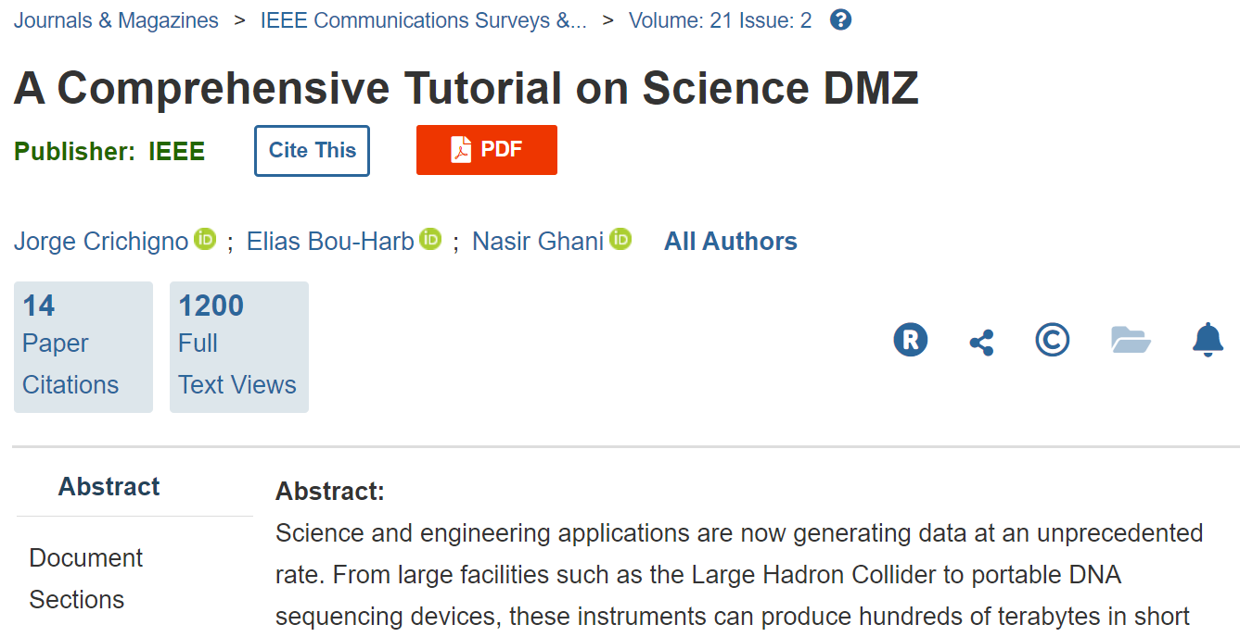
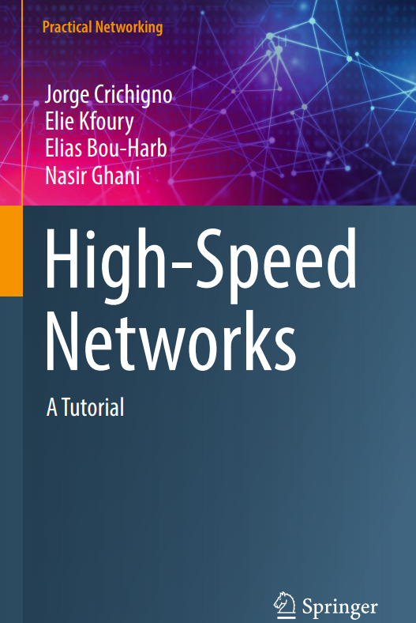

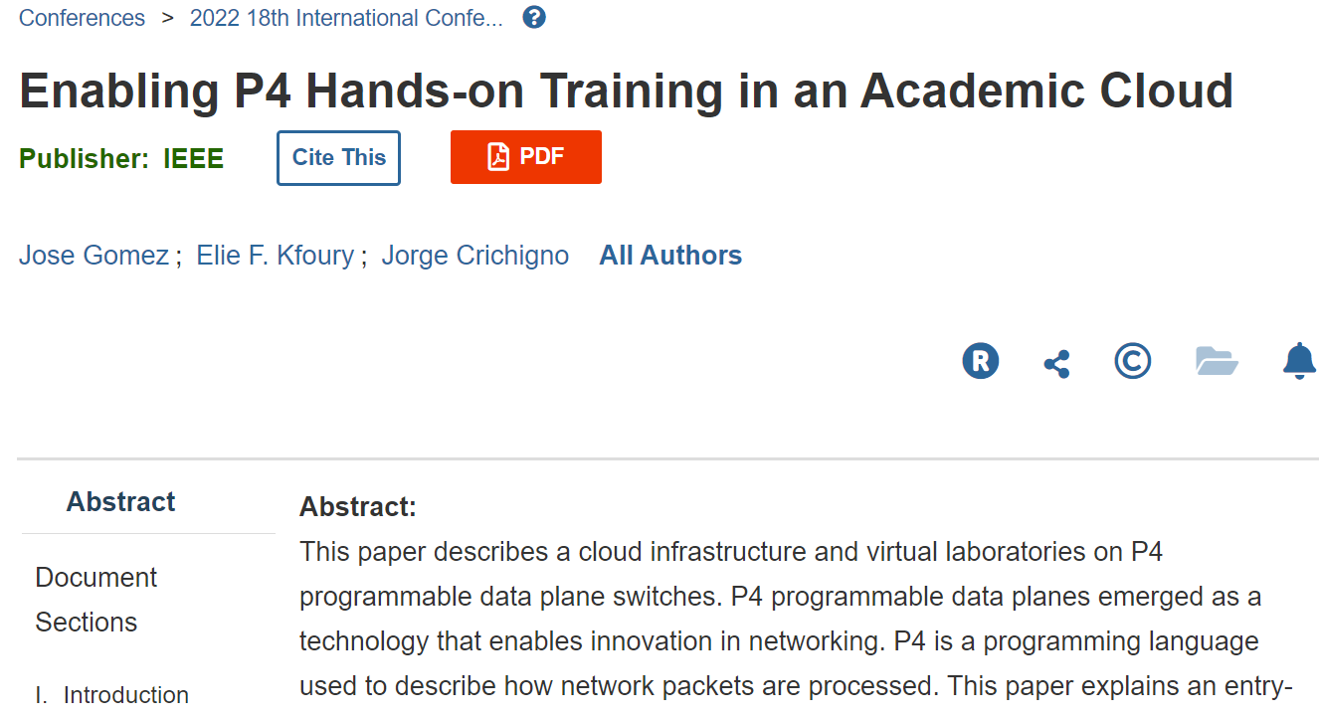
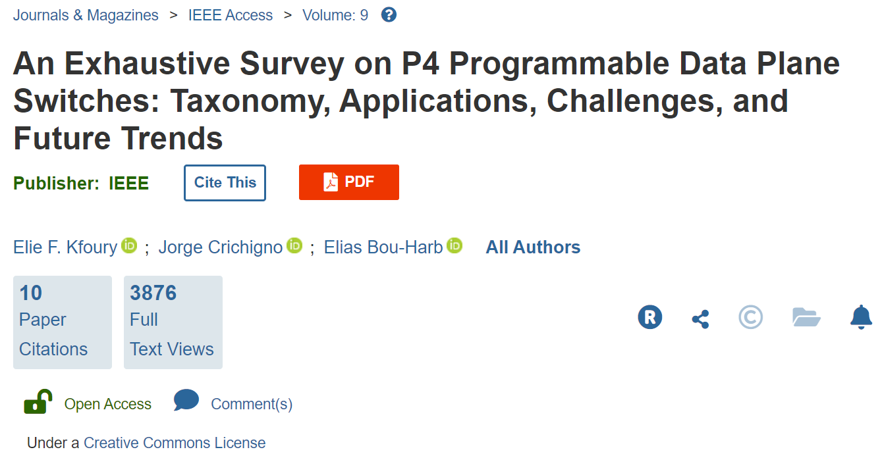
Outcomes
Graduate research on cyberinfrastructure: conference papers,
journal articles, and one book were published during the
3-year project
New relations were established
  Amazon – AWS “Direct Connect” to resources (via I2)
  Barefoot Networks / Intel
  Juniper Networks
  VMware

