Slide 1
Implementing a Packet Filter using a P4 Programmable Switch
Anaia Prather, Camila Pereira and Caroline Boozer
Advisors: Ali Mazloum and Jose Gomez
Department of Integrated Information Technology
University of South Carolina
June 30th, 2022
Notes:
Hello! We will be presenting on behalf of the Department of Integrated information Technology at the University of South Carolina. Our project is implementing a packet filter using a p4 programmable switch. Team members include Anaia Prather, Camila Pereira, Caroline Boozer, and Advisors Ali Mazloum and Jose Gomez

Slide 2
Agenda
Project Description
Objectives
Background on P4
Experimentation scenario
Hands-on demo in Netlab
Lessons Learned

Slide 3
Project Description
Implementing a packet filter on a programmable switch, using P4
Block and filter traffic based on certain security policies
Examples of the security policies are:
Blocking packets based on the destination IPv4 address
Dropping segments going to an UDP and/or TCP port
Restricting ICMP requests to a security zone
Applying a combination of security policies to different security zones
Notes:
The goal of this project is to implement a packet filter on a programmable switch, using the P4 language.
The packet filter will enable the administrator of the network to block packets based on physical ingress and/or egress interfaces, IP source or destination address, protocol type in IP datagram field (TCP, UDP, ICMP, OSPF), and TCP or UDP source and destination port. With this project, we were able to use P4's capabilities to essentially create a firewall.

Slide 4
Objectives
Construct a packet filter using a P4-programmable switch
Implement security policies using the P4 language
Apply the concept of security zones
Validate the implementation using open-source tools
Notes:
After we worked through the labs and learned the basics of P4, we were provided with the objectives for the project.
Those objectives are to first demonstrate the connectivity between a certain number of hosts as well as demonstrating the ability to access the internet, filtering packets based on certain criteria, and then finally implement policies between the hosts that replicate Palo Alto's security zone. The criteria for which we learned to filter were based on IP source or destination addresses, protocol types in IP datagram field, TCP/UDP source or destination port, TCP flag bits (like SYN or ACK), and the ICMP message type. In doing this, we are essentially able to create a firewall, all by using the P4 language.

Slide 5
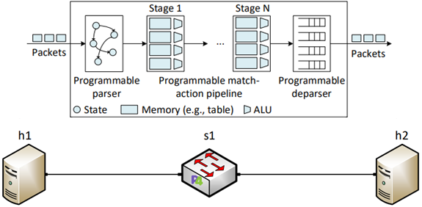
Background on P4
Programming Protocol-independent Packet Processors (P4)
The P4 language specify how packets are processed through a pipeline
The pipeline consists of different stages comprising a programmable parser, match-
action stages, and a programable deparser
Notes:
P4 stands for Programming Protocol-independent Packet Processors. It is an open source, domain specific programming language that is used specifically on network devices.
P4 specifies how devices such as switches, routers, NICs, filters, and more process packets.
By using P4, network functionality is no longer controlled by the vendors, it can be customized for various and differing company needs.

Slide 6
Experimentation scenario
The scenario consists of three security zones where hosts h1,
h2, and h3 represent the headquarters, the branch office, and the
outside zone
Switch s1 applies different security policies to each zone
The security policies are implemented in P4 using match-action
tables
Notes:
To showcase all the networking skills we have learned this summer, we worked as a team to create a topology that also highlights the benefits of using P4. Because P4 can be used on programmable switches, it is a great way to customize a switch and modify a network's abilities. We decided to implement a 3 zone topology, where zone 1 is the organization, zone 2 is the headquarter, and zone 3 is the outside zone. This topology is a prime example of a network setup that we may see within a large business or organization. We will now demonstrate a variety of different security policies that we created to show personalization and control of the network.

Slide 7
Hands-on Demo in Netlab
Demo 1: Filtering packets based on the destination IP address
Demo 2: Dropping segments going to the TCP port 80
Demo 3: Restricting ICMP request from Zone 3 (Danger) to
Zone 1 (Headquarters) but allowing requests from Zone 2
(Branch Office)
Notes:
Demo 1: Use ping
Demo 2: hping3 and wireshark
Demo 3: ping

Slide 8
Lessons Learned
Learned how to implement a packet filter using P4
Leveraged match-action tables to implement security policies
Applied the concept of security zones using a P4 switch
Validated the implementation of the security policies in the Netlab environment
Understood the flexibility of P4 programmable switches on implementing security
features
Notes:
- P4 is extremely customizable to any sort of needs a company would like to implement for security reasons. For example, it can keep certain types of packets of information out, and it can prevent outside traffic from being able to talk to inside hosts.
- There are certain commands you will be using frequently, so having a list available or creating a script is extremely beneficial, and could save time.
- P4 is a pretty simple language with which you can easily implement company security policies. As seen from our demo, once you learn a way to do one thing it can be easily applied to other similar situations.
- The best way we found to debug was through commenting out sections of code, trying different things, compiling and testing. You can use nanolog to see what is actually happening so that you can see what it is or isn't doing correctly to pinpoint the issue.

Slide 9
THANK YOU!
Notes:
Hello! We will be presenting on behalf of the Department of Integrated information Technology at the University of South Carolina. Our project is implementing a packet filter using a p4 programmable switch. Team members include Anaia Prather, Camila Pereira, Caroline Boozer, and Advisors Ali Mazloum and Jose Gomez

