Slide 1


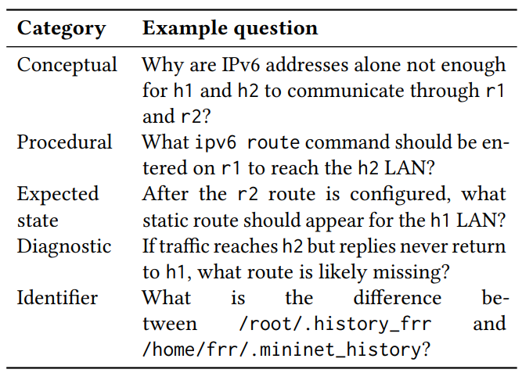
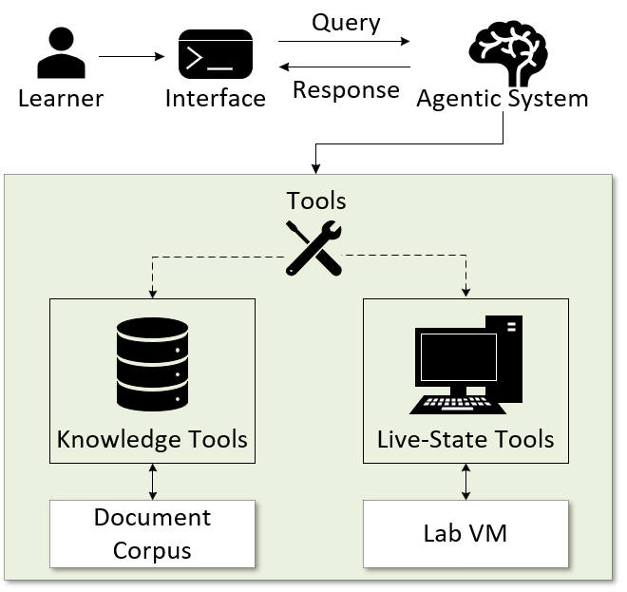
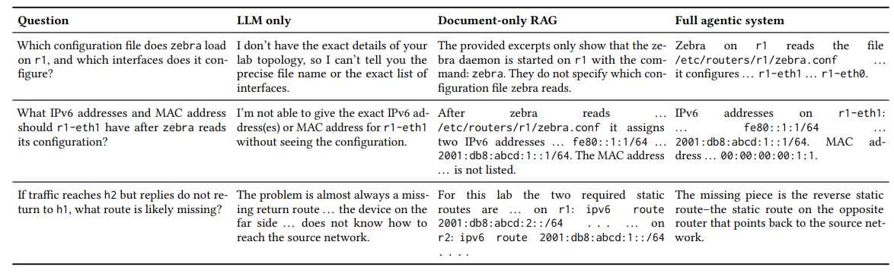
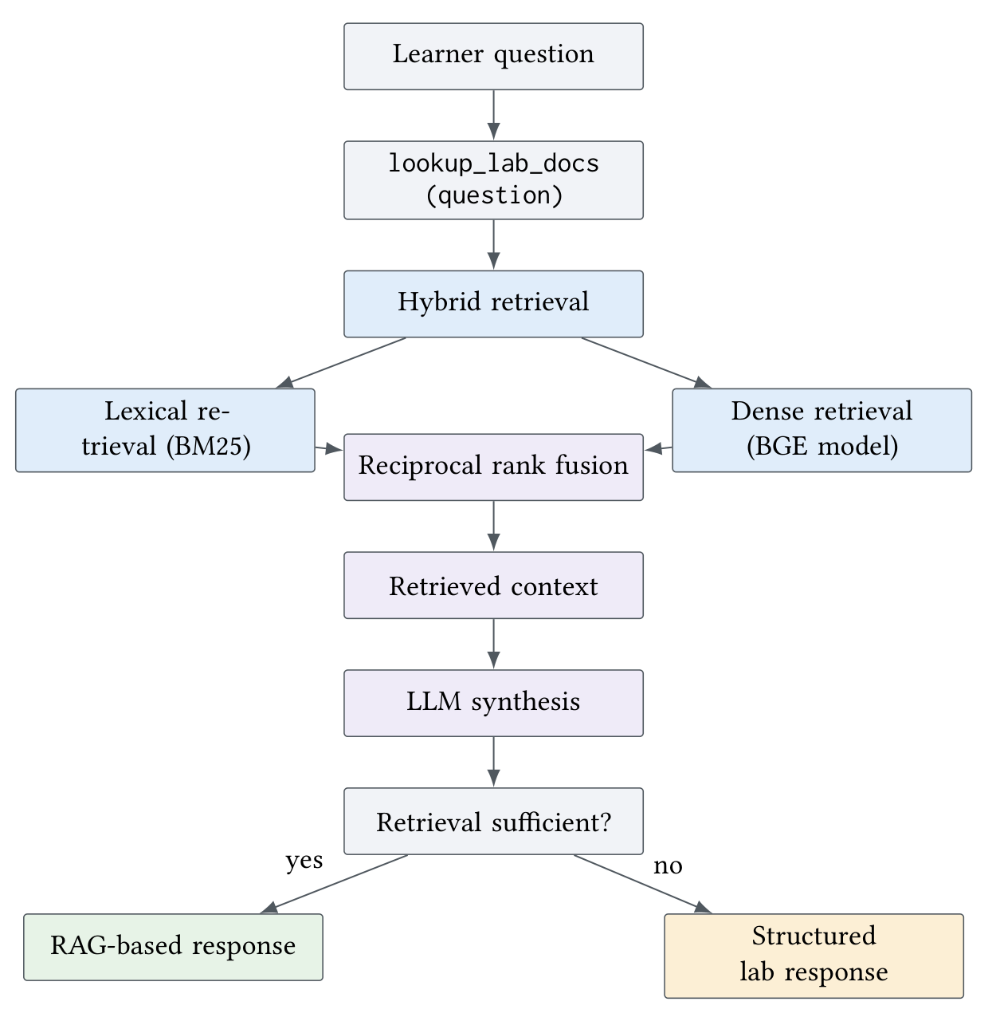
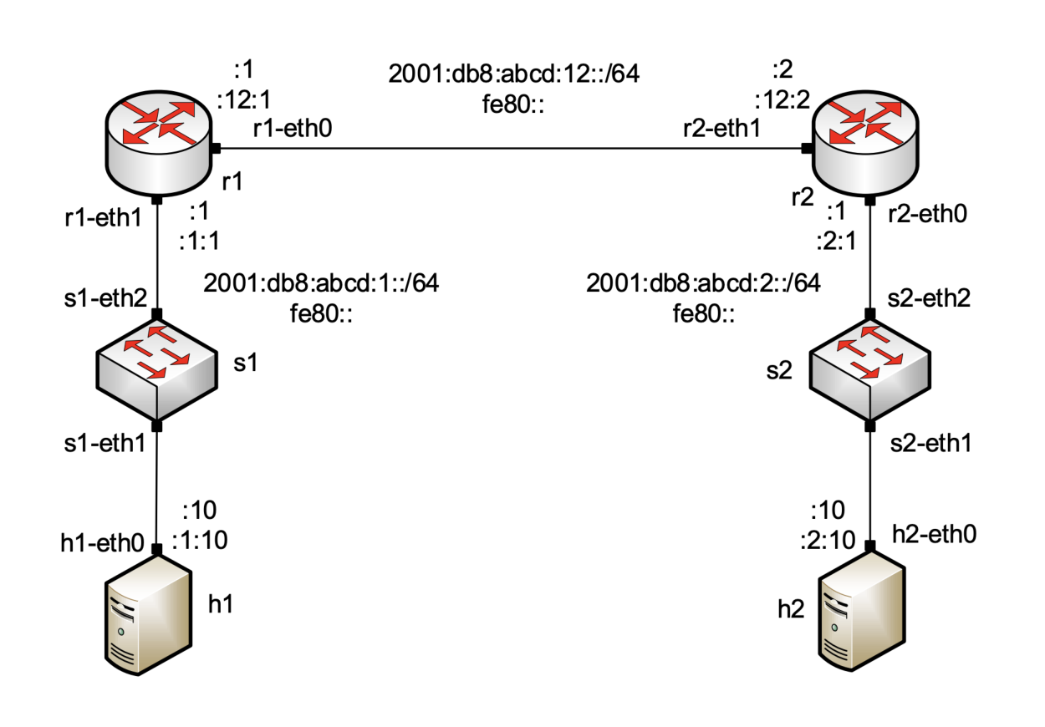
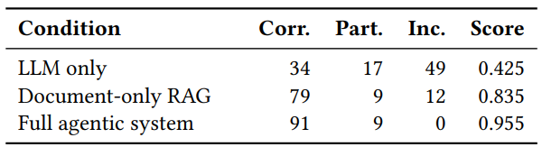
An Agentic AI Approach for
Hands-on Networking Education
Akhil GBS, Ali Mazloum, Jose Gomez, Samia Choueiri, Amith GSPN,
Elie Kfoury, Jorge Crichigno
University of South Carolina, Columbia, South Carolina
Abstract
System Overview
Question Type
Retrieval Results
Virtual networking labs scale hands-on education, but lack scalable
real-time support.
Static manuals cannot inspect live configuration errors, while general
LLMs lack lab grounding and pedagogical pacing.
We introduce an agentic AI system for IPv6 static-routing labs, designed for usability in virtual networking environments.
The system bridges manual instructions with live execution by building a lab-specific knowledge base through structured notes.
The agent combines Retrieval-Augmented Generation (RAG) for procedural context with read-only live-state tools to inspect learner’s
specific lab environment.
It preserves the learning process by avoiding premature answers, encouraging students to reason through debugging.
A human-audited evaluation compared three conditions: LLM-only, document-only RAG, and the full agentic system across 100 questions.
The full agentic system achieved 91 correct and 9 partial answers, significantly outperforming document-only RAG (79 correct, 9 partial) and LLM-only (34 correct, 17 partial).
Results suggest that grounded agentic AI provides a scalable and effective solution for hands-on networking education support.
Learners submit natural-language queries through the interface, while the agent determines the context needed to generate the response.
Knowledge tools retrieve lab-specific procedures, commands, expected outputs, and diagnostic context from the document corpus.
Live-state tools inspect the running Lab VM to capture current interfaces, routes, forwarding state and network reachability.
The agent combines both to provide evidence-grounded guidance while preserving the leaner’s reasoning process.
BM25 performs best overall because networking questions often contain exact identifiers such as commands, interfaces and paths.
Question categories used in the evaluation dataset
Hit@5 per category (20 questions each)
Qualitative Evaluation Results
Related Work
LLMs for network configuration & troubleshooting explore automated configuration and fault diagnosis but still face challenges in fault localization and root-cause identification [21].
Document-grounded LLMs use RAG methods such as BM25, dense retrieval, and hybrid retrieval to provide responses grounded in technical documentation [15].
Tool-augmented LLM agents can inspect external environments and gather live context, but existing approaches are not specifically designed for hands-on networking education [17].
LLM-based education systems support learners with hints, feedback, and natural-language interaction, while raising concerns about factual errors, overreliance, and bypassing the learning process [10].
Overview of the proposed Agentic-support system
Knowledge Lookup
The agent first uses hybrid retrieval by combining BM25, dense retrieval, and RRF to retrieve relevant lab-specific documentation.
Falls back to structured expected-state information when retrieved documentation is insufficient for answering lab-specific questions.
Representative qualitative examples from the answer-accuracy evaluation. Cells show short excerpts
Experiment Topology
Answer Accuracy
Conclusion and Future Work
The proposed agentic system combines lab-specific documentation, RAG, and live-state inspection to provide context-aware support for hands-on networking labs. Evaluation on 100 questions achieved 91 correct and 9 partially correct responses, outperforming document-only RAG (79 correct) and LLM-only (34 correct), while preserving opportunities for learner reasoning.
Future Work: The system will be expanded beyond IPv6 routing to traffic measurement, congestion control, programmable networks, and intrusion detection. Evaluation will also incorporate systematic fault injection, real learner interactions, and learning-outcome measures to assess effectiveness in realistic educational environments.
End-to-end answer accuracy over 100 lab-specific questions
Acknowledgement
Topology used in IPv6 example
Knowledge lookup workflow
This work was supported by the National Science Foundation (NSF), Award 2400729, and 2417823.

