Slide 1


Real-Time Detection of Encrypted DGA and DNS Tunneling
Using DPDK on SmartNICs
Sergio Elizalde, Ali AlSabeh, Samia Choueiri, Jaime Galán-Jiménez, Elie Kfoury, Jorge Crichigno
University of South Carolina
https://research.cec.sc.edu/cyberinfra/
IEEE International Black Sea Conference on Communications and Networking
June 11, 2026
Bucharest, Romania
Notes:
Encrypted DNS traffic -> DNS over HTTPS

Slide 2
Motivation
DNS over HTTPS (DoH) improves privacy by encrypting DNS queries
The same encryption hides malicious DNS activity from defenders
Attackers can use DoH for command-and-control and data exfiltration
ML can classify encrypted traffic using observable flow metadata
Real-time deployment requires packet processing close to the network interface
Goal: detect encrypted DNS threats without decrypting packets
Notes:
Example of feature relationship: minimum packet size should be smaller than maximum packet size within a flow

Slide 3
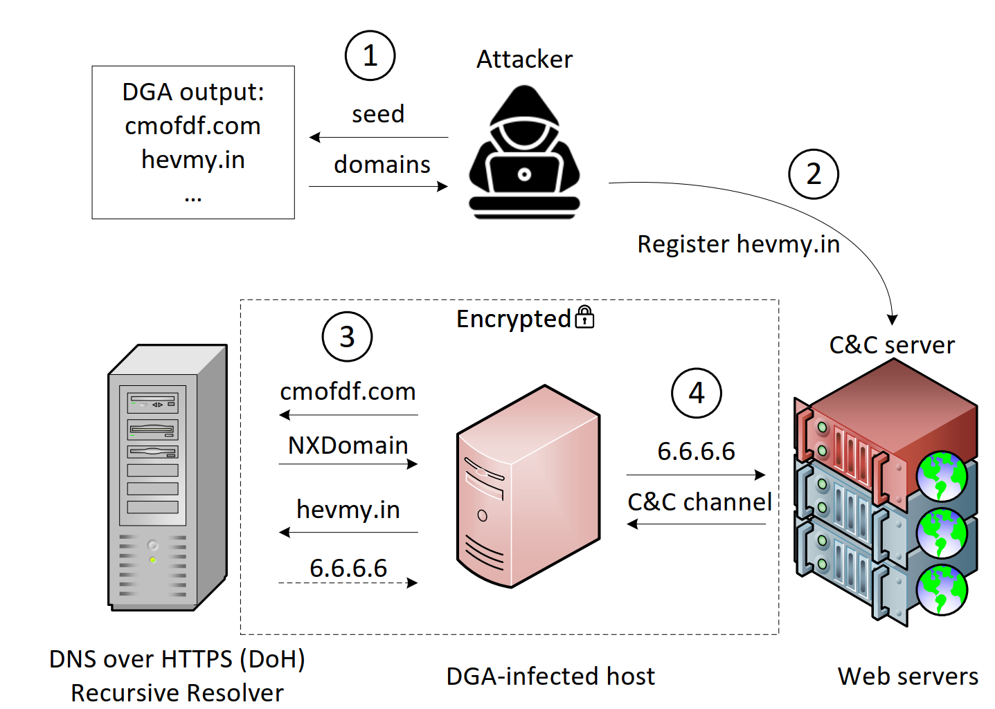
Encrypted DNS threats
We considered DNS tunneling and DGA-based malware
Notes:
The DNS queries are encrypted using HTTPS, therefore ML is needed to detect the attack

Slide 4
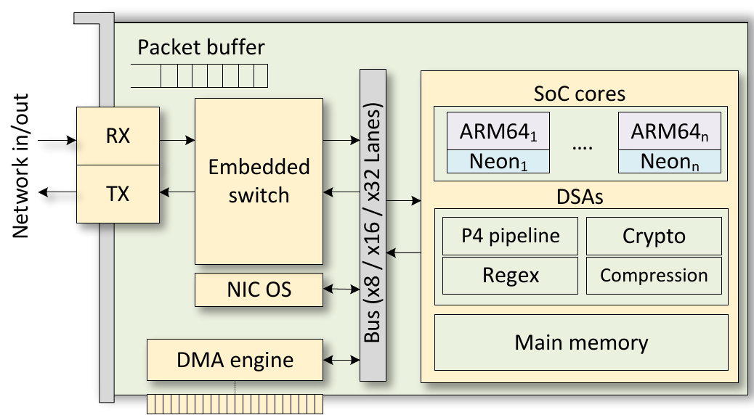
SmartNICs
SmartNICs include domain-specific accelerators (DSAs) and CPU cores
Offload infrastructure workload from the host CPU
Provide isolation when monitored host may be compromised
SmartNIC architecture

Slide 5
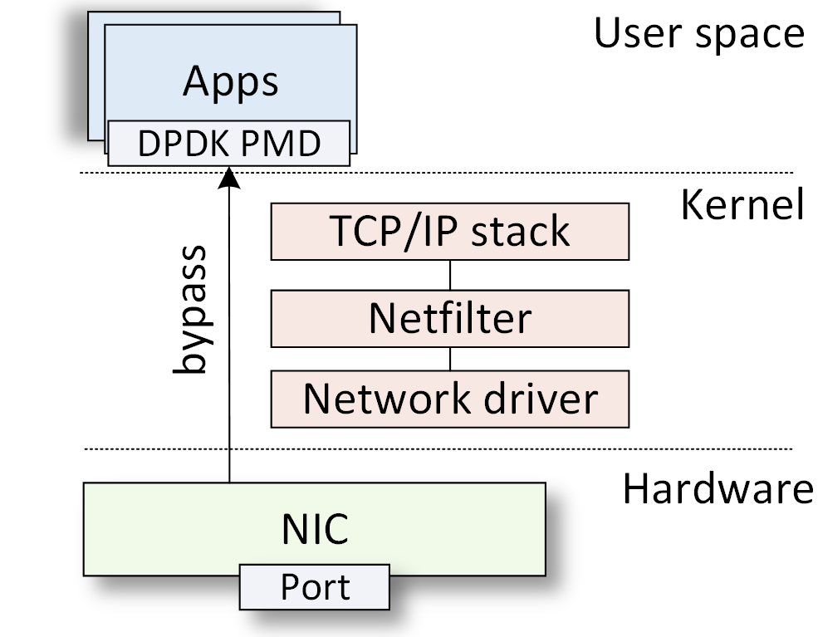
Data Plane Development Kit (DPDK)
Data Plane Development Kit (DPDK) is a software-based acceleration technique
DPDK applications can run directly on the computing units of Smart Network Interface Cards (SmartNICs)

Slide 6
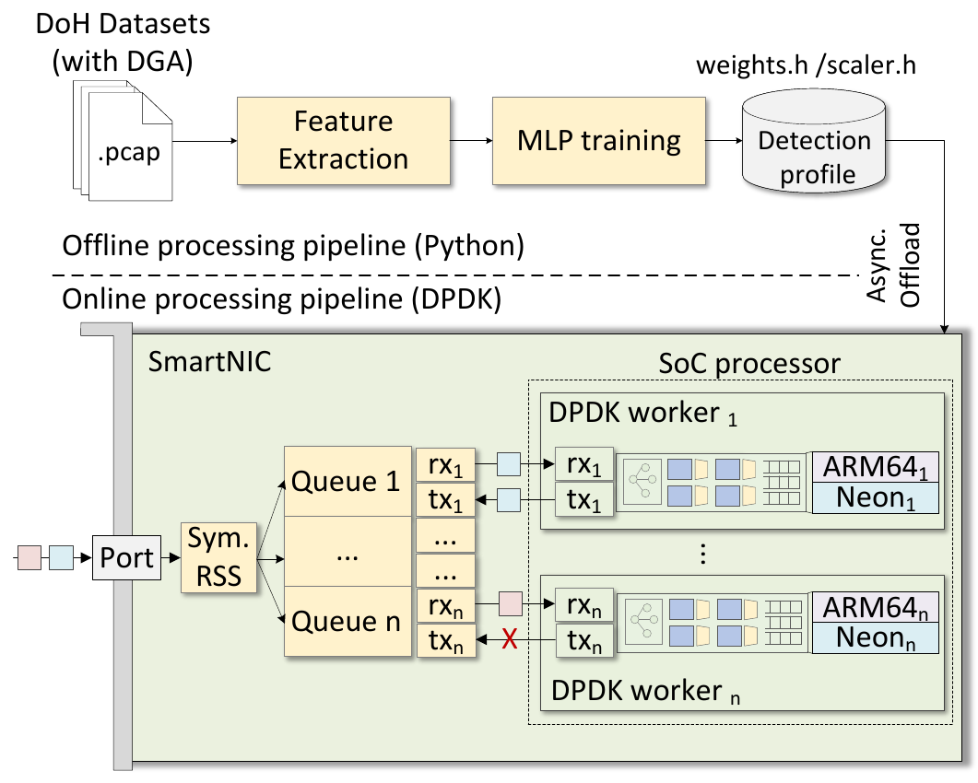
Proposed system
Offline stage
  Extract flow-level features from DoH and Non-DoH traces
  Train the multiclass MLP and export weights/scalers as header files
Online stage
  DPDK workers process packets on ARM64 cores
  Symmetric RSS keeps each bidirectional flow on the same core
  MLP inference runs after the first N packets of each flow

Slide 7
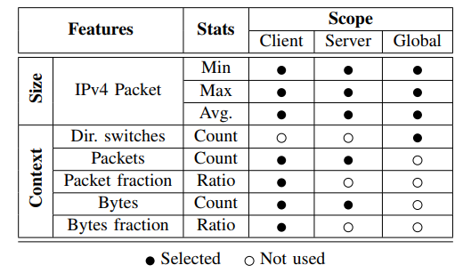
Feature Set
Each flow is summarized using the first N packets (e.g., N=16)
Size features: minimum, maximum, and average IPv4 packet size
Context features: packet counts, byte counts, direction switches, packet fractions, and byte fractions
Direction switches refer to the number of times the communication changes direction between Client and Server in a sequence of packets

Slide 8
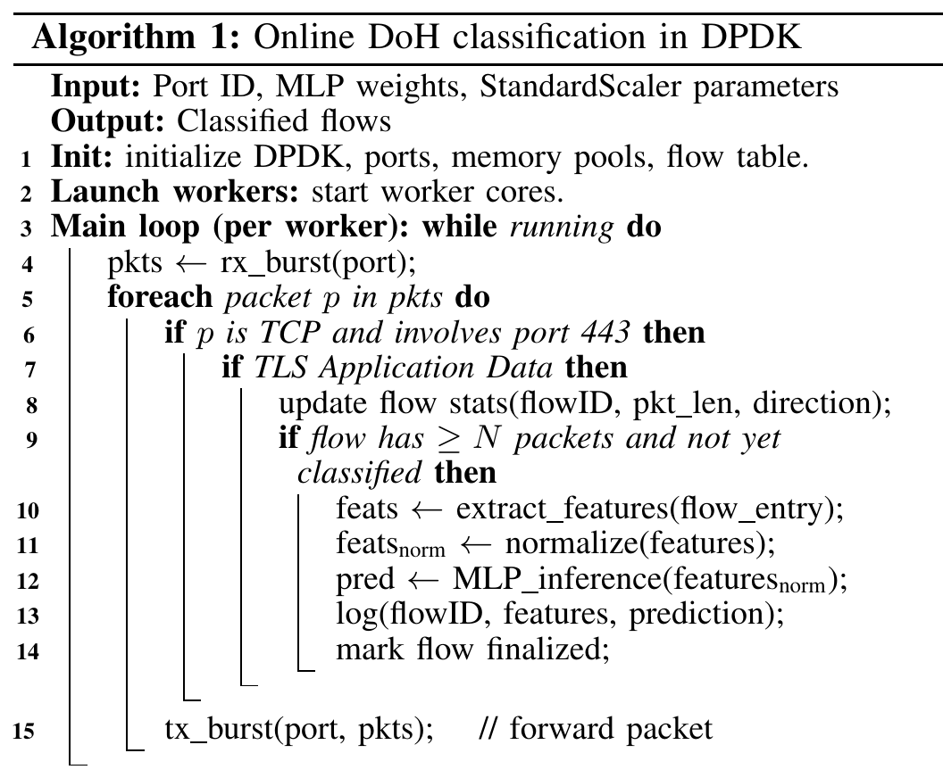
DPDK implementation
Initialization:
  DPDK ports, memory pools, workers, MLP model, and flow table
Loop:
  Poll packets in bursts
  Inspect TCP flows on port 443
  Use only TLS Application Data records for feature updates
  Normalize features and classify once a flow reaches N packets
  Forward traffic while logging per-flow predictions

Slide 9
DPDK implementation
Initialization:
  DPDK ports, memory pools, workers, MLP model, and flow table
Loop:
  Poll packets in bursts
  Inspect TCP flows on port 443
  Use only TLS Application Data records for feature updates
  Normalize features and classify once a flow reaches N packets
  Forward traffic while logging per-flow predictions

Slide 10
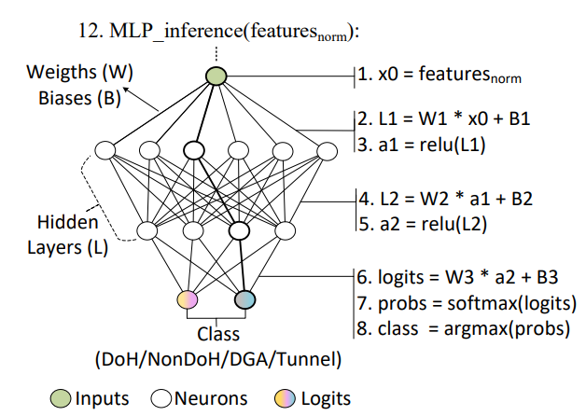
NEON Acceleration
ARM’s NEON is a parallel arithmetic accelerator
  Single Instruction Multiple Data (SIMD) architecture
NEON can process 4 32-bit words per instruction (i.e., 128bit registers)
Multilayer Perceptron (MLP) can be implemented with matrix–vector operations
Inference with 16 inputs, 4 outputs, and hidden layers whose sizes are multiples of 4
Notes:
Using multiple of 4 neuron count in each hidden layer avoids falling back to scalar for tail multiplications and pollute execution (e.g., branch misprediction)
multilayer perceptron (MLP)
NEON:
Single Instruction, Multiple Data (SIMD) Processing
To accelerate machine learning inference, this paper employs ARM’s NEON technology, a 128-bit SIMD extension that enables parallel arithmetic on data vectors. NEON is a coprocessor subsystem integrated into each ARM core and uses a pipelined architecture to operate on vector registers, supporting operations such as comparisons and multiplications on data up to 128 bits wide. NEON intrinsics are low-level C functions mapped directly to SIMD instructions and are used in this work to implement an MLP model, which is a feedforward neural network composed of an input layer, one or more hidden layers, and an output layer. Each layer performs weighted sums of its inputs, adds bias terms, and applies nonlinear activation functions.

Slide 11
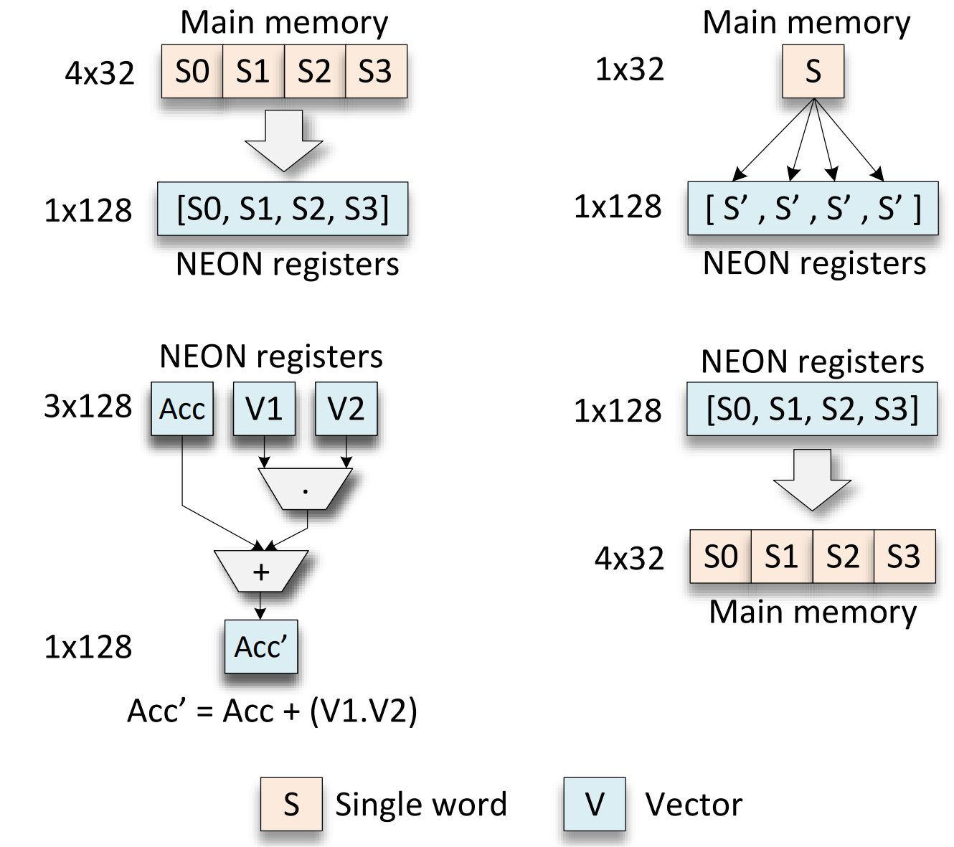
NEON Acceleration
NEON intrinsic operations:
  load_operand(): vld1q_f32()

Slide 12
NEON Acceleration
NEON intrinsic operations:
  load_operand(): vld1q_f32()
  vector_duplicate(): vdupq_n_f32()

Slide 13
NEON Acceleration
NEON intrinsic operations:
  load_operand(): vld1q_f32()
  vector_duplicate(): vdupq_n_f32()
  vector_multiply(): vfmaq_f32()

Slide 14
NEON Acceleration
NEON intrinsic operations:
  load_operand(): vld1q_f32()
  vector_duplicate(): vdupq_n_f32()
  vector_multiply(): vfmaq_f32()
  vector_store(): vst1q_f32()

Slide 15
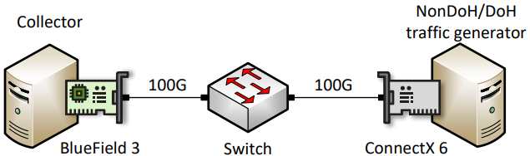
Experimental Setup
Datasets:
  CIRA-CIC-DoHBrw-2020¹
  DoH-DGA-Malware-Traffic-HKD²
  Augmented DoH DGA dataset: plaintext DNS PCAPs replayed as DoH
M. MontazeriShatoori, L. Davidson, G. Kaur, and A. H. Lashkari, “Detection of doh tunnels using time-series classification of encrypted traffic,” in IEEE DASC/PiCom/CBDCom/CyberSciTech Conference, 2020.
R. Mitsuhashi, Y. Jin, K. Iida, T. Shinagawa, and Y. Takai, “Detection of DGA-based malware communications from doh traffic using machine learning analysis,” in 2023 IEEE 20th Consumer Communications & Networking Conference (CCNC), 2023.
Notes:
We use two public datasets for DGAs (Malware traffic HKD) and DoH tunneling (DoHBrw-2020)

Slide 16
OFFLINE RESULTS

Slide 17
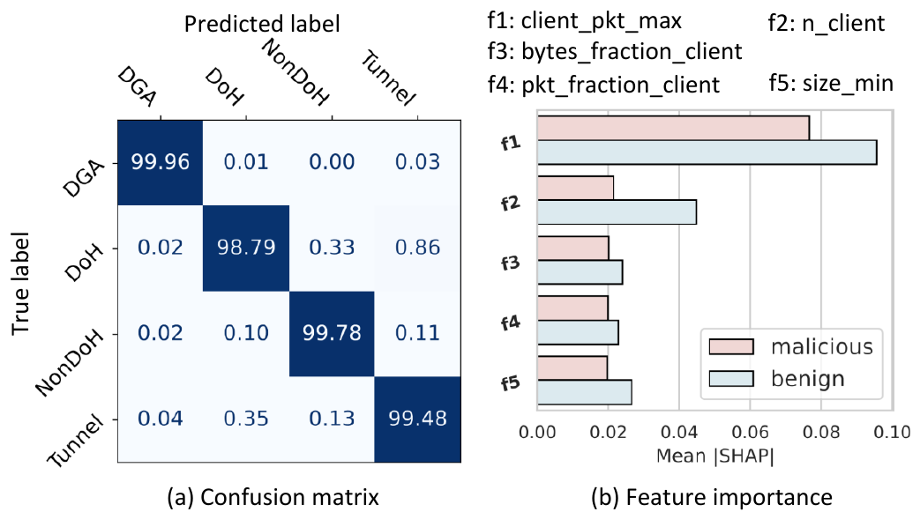
Result 1: Multiclass detection
Four-class task: DGA, DoH, Non-DoH, Tunnel
MLP with hidden layers of 64 and 32 neurons
Most confusion occurs between DoH and Tunnel traffic
Notes:
Hit: converting malicious flow to benign flow
Epsilon: perturbation budget → the higher the epsilon, the more different the created flow will be w.r.t. the original flow. However, feature violations increase
No encoder/decoder used here

Slide 18
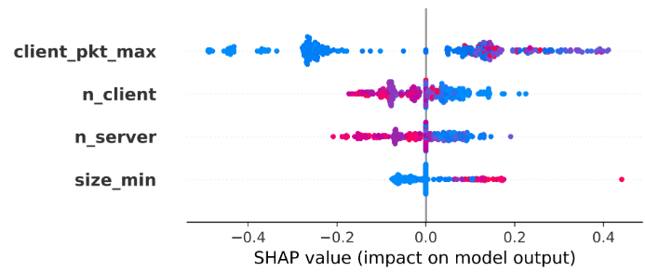

Result 2: Explainability via SHAP
Benign case: NonDoH
Features ordered by importance
Negative SHAP values push the prediction away
Positive SHAP values push the prediction towards the selected class
Low feature value, positive SHAP value
Notes:
Transferability: Train in a differentiable model (MLP), test in a non-differentiable model (Random Forest)
Both models are trained with the same data
Adversarial samples generated using MLP are tested in the RF model
Hit rate is the ability of deceiving the RF model using MLP adversarial samples
No encoder/decoder used here

Slide 19
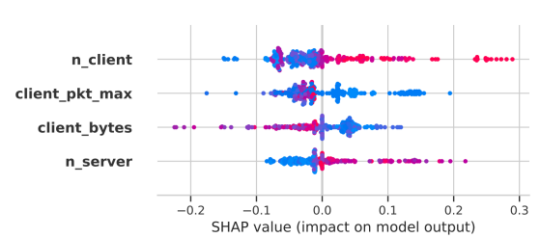
Result 2: Explainability via SHAP
Malicious case: DGA
Features ordered by importance
Negative SHAP values push the prediction away
Positive SHAP values push the prediction towards the selected class
High feature value, positive SHAP value
Notes:
Transferability: Train in a differentiable model (MLP), test in a non-differentiable model (Random Forest)
Both models are trained with the same data
Adversarial samples generated using MLP are tested in the RF model
Hit rate is the ability of deceiving the RF model using MLP adversarial samples
No encoder/decoder used here

Slide 20
ONLINE RESULTS

Slide 21
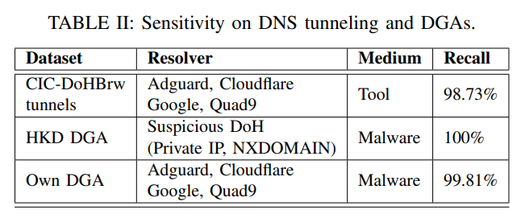
Result 4: Threat sensitivity
Malicious PCAP files replayed using tcpreplay
Recall measures how well we catch all the malicious flows
98.73%
100%
99.81%
CIC DoH tunnels
HKD DGA malware
augmented DGA dataset
Notes:
ASR: Attack success rate (same as hit rate)
Epsilon here is 0.3 (maximum budget allowed in our experiments)
Vanilla means no VAE used (so more violations will occur)
VAE means using the encoder to guide the search of adversarial samples
Takeaway: VAE has less success, but reduces violations

Slide 22
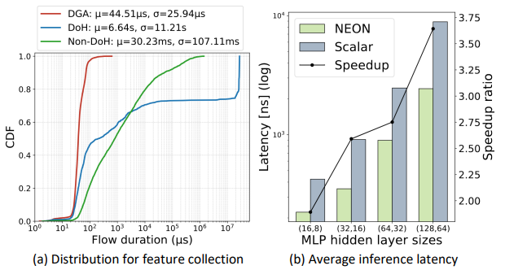
Result 5: ML latency
(a) Feature collection latency is measured from packet 1 to packet 16 of each flow
(b) NEON reduces inference latency compared with scalar processing
Notes:
ASR: Attack success rate (same as hit rate)
Epsilon here is 0.3 (maximum budget allowed in our experiments)
Vanilla means no VAE used (so more violations will occur)
VAE means using the encoder to guide the search of adversarial samples
Takeaway: VAE has less success, but reduces violations

Slide 23
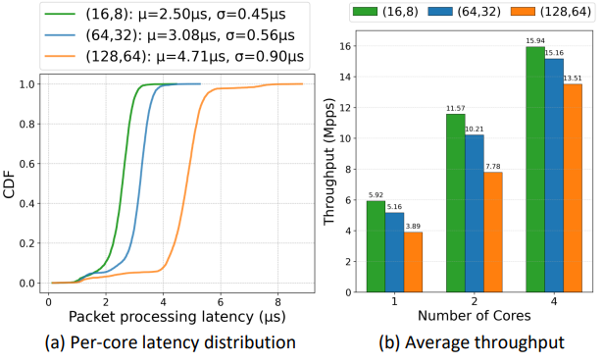
Result 6: End-to-End latency
Larger MLPs increase per-core latency and heavier tails
Throughput scales as additional ARM cores are used
More cores reduce the impact of model size on throughput
16 Mpps
2.5 us
maximum throughput
average packet latecy

Slide 24
Conclusion
Presented a SmartNIC-based framework for encrypted DNS threat detection
Classifies DoH, Non-DoH, DGA-based DoH, and tunneling DoH traffic
Achieves over 98% offline accuracy and over 98.5% online threat recall
Maintains real-time performance with 1 us inference latency and up to 16 Mpps
Future work includes:
  Collaborative offloading across switches, SmartNICs, and hosts
  Analysis of machine-learning model vulnerabilities

Slide 25



This work was supported by the U.S. National Science Foundation (NSF), under awards 2346726, 2417823, and 2403360
For additional information, please refer to
https://research.cec.sc.edu/cyberinfra
Email: elizalds@email.sc.edu

Slide 26


Cybertraining Material
Information about lab libraries is available at https://research.cec.sc.edu/cyberinfra/cybertraining
Programmable data plane devices
P4-DPDK Security
Introduction to P4-DPDK
Cybersecurity Apps with P4 Programmable Data Planes
P4 Programmable Data Planes: Applications, Stateful Elements, Custom Packet Processing
Intro to P4 Programmable Switches
Intro to P4 Programmable Switches with Intel’s Tofino
P4 Monitoring Applications
Traditional Protocols
Software-defined Networking (SDN)
Open vSwitch
Network Tools and Protocols
Introduction to IPv6
Open Shortest Path First (OSPF)
Introduction to BGP
MPLS and Advanced BGP
Cybersecurity, Management, and Science DMZs
Zeek IDS/IPS
Cybersecurity Fundamentals
perfSONAR 5
P4-perfSONAR
Network Management Tools
High-speed Networks: A Tutorial

