Slide 1




Hands-on Workshop on Network Technologies
Hands-on Session 1: Virtual Routing and Forwarding
Lab 6 - MPLS and Advanced BGP Topics Series
Ali AlSabeh
University of South Carolina Aiken (USCA)
https://research.cec.sc.edu/cyberinfra/
Tuesday, Aug. 25, 2026
Online

Slide 2
Lab Series: MPLS and Advanced BGP Topics
Lab experiments
  Lab 1 Configuring Multiprotocol BGP
  Lab 2 IP Spoofing and Mitigation Techniques
  Lab 3 BGP Hijacking
  Lab 4 Introduction to MPLS
  Lab 5 Label Distribution Protocol (LDP)
  Lab 6 Virtual Routing and Forwarding (VRF)
  Lab 7 MPLS Layer 3 VPN using MP-BGP
  Lab 8 Ethernet VPN (EVPN) using MP-BGP
  Lab 9 Introduction to Segment Routing over IPv6 (SRv6)

Slide 3
Organization of the labs
Each lab starts with a section Overview
  Objectives
  Lab topology
  Lab settings: passwords, device names
  Roadmap: organization of the lab
Section 1
  Background information of the topic being covered (e.g., fundamentals of MPLS)
  Section 1 is optional (i.e., the reader can skip this section and move to lab directions)
Section 2… n
  Step-by-step directions

Slide 4
Virtual Routing and Forwarding (VRF)
Lab activities are described in Lab 6, MPLS and Advanced BGP Topics Lab Series

Slide 5
Hands-on Labs on MPLS and Advanced BGP Topics
Webpage with PowerPoint presentations:
https://research.cec.sc.edu/cyberinfra/NT_2026
Hands-on session 2 (1:45PM-2:30PM): to access labs for Session 2 (Virtual Routing and Forwarding).
The virtual platform (Netlab) is reachable through the following link:
https://netlab.cec.sc.edu

Slide 6
Lab Scenario
Two organizations are connected through a Provider Edge (PE) router that configures VRF to implement routing tables serving its Customer Edge (CE) routers.
Each Virtual Router (VR) implements its routing table to provide traffic isolation.
Physical topology
Virtual topology

Slide 7
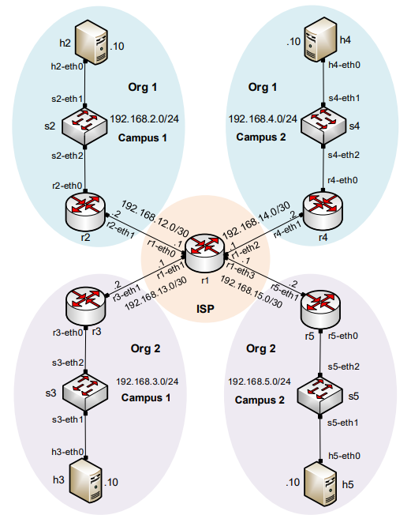
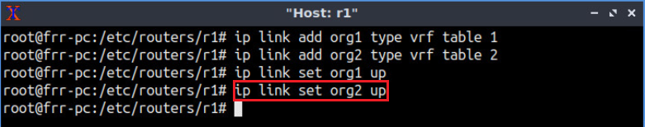
Lab Topology
Configure VRF in the ISP router.
Creating VRF tables

Slide 8
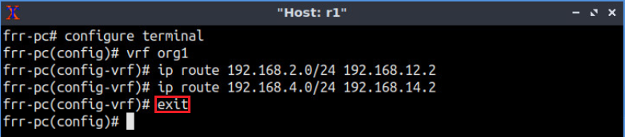
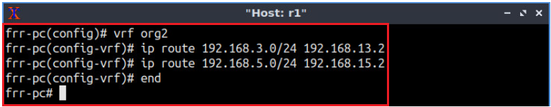
Lab Topology
Configure static routes in the virtual routers.
Configuring static routes in the VRF table for org1
Configuring static routes in the VRF table for org2

Slide 9
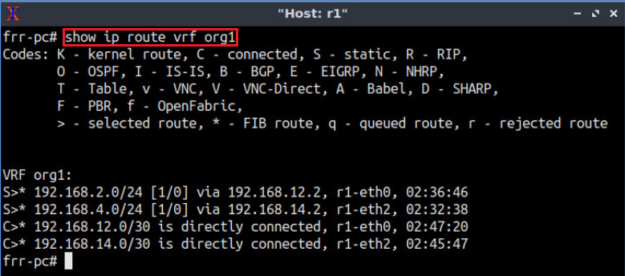
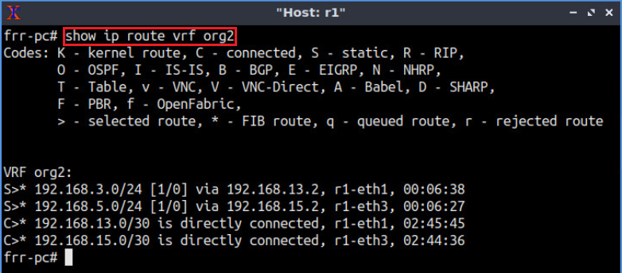
Lab Topology
Verifying the routing tables in router r1.
Verifying the VRF table for org1
Verifying the VRF table for org2

Slide 10
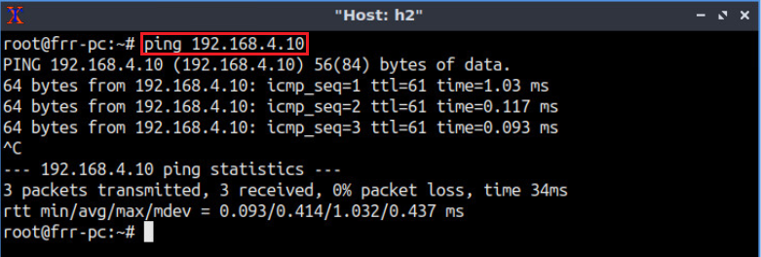
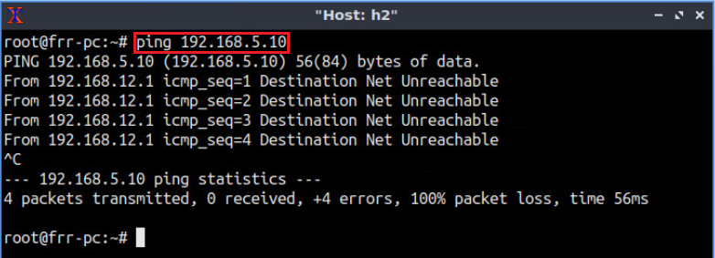
Lab Topology
Verifying traffic isolation between organizations.
Verifying connectivity between h2 and h4
Verifying isolation between h2 and h5

Slide 11
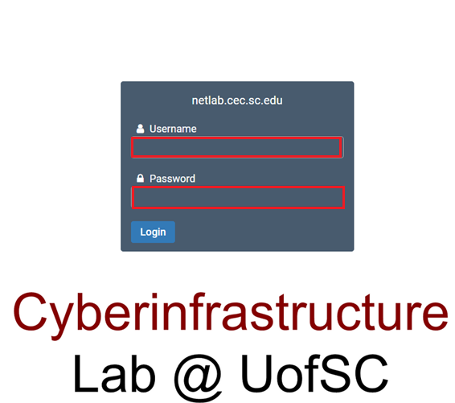
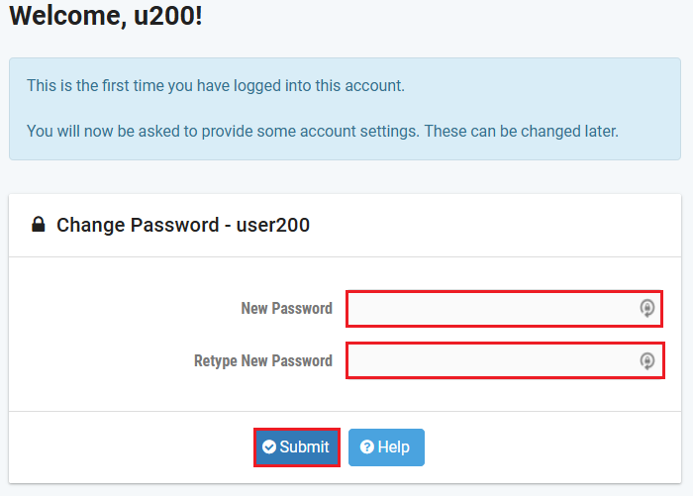
Accessing the Platform
Please use the following link to access the platform:
  https://netlab.cec.sc.edu/
Login using your credentials
Username: <email address used for the registration>
Temporary Password: nsf-2026

Slide 12
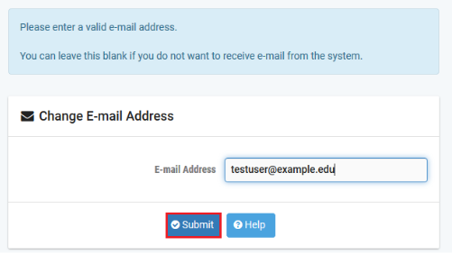
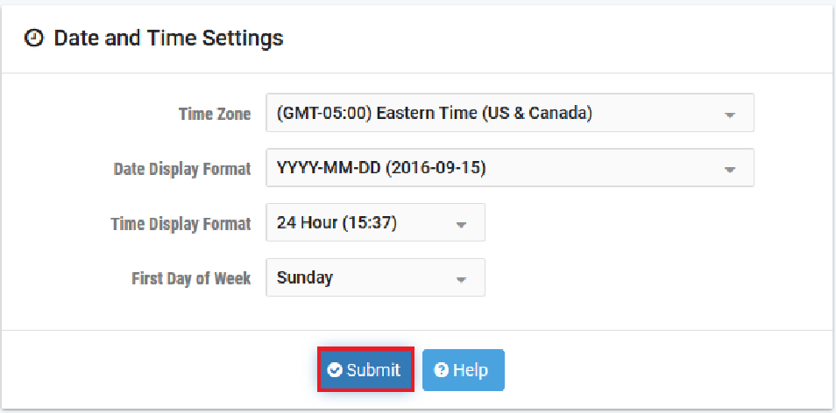
Accessing the Platform
Please use the following link to access the platform:
  https://netlab.cec.sc.edu/
Login using your credentials
Username: <email address used for the registration>
Temporary Password: nsf-2026

Slide 13
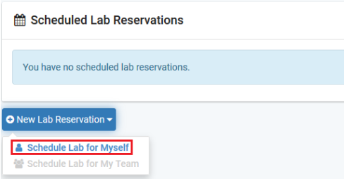
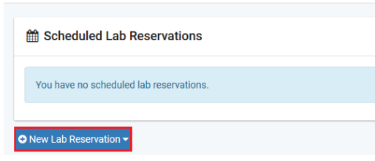
Accessing the Platform
Click on New Lab Reservation
Click on Schedule Lab for Myself

Slide 14
Accessing the Platform
Select the course
For this session, we will use “MPLS and Advanced BGP Topics Lab Series”

Slide 15
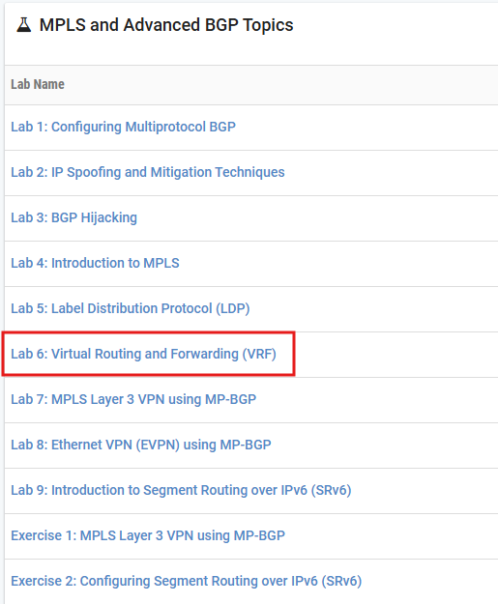
Accessing the Platform
Select the Lab
For this session, we will run:
  Lab 6: Virtual Routing and Forwarding (VRF)

Slide 16
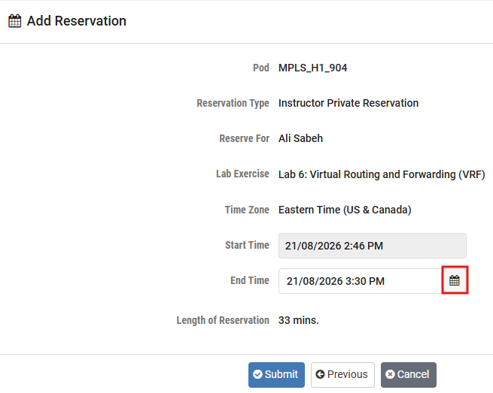
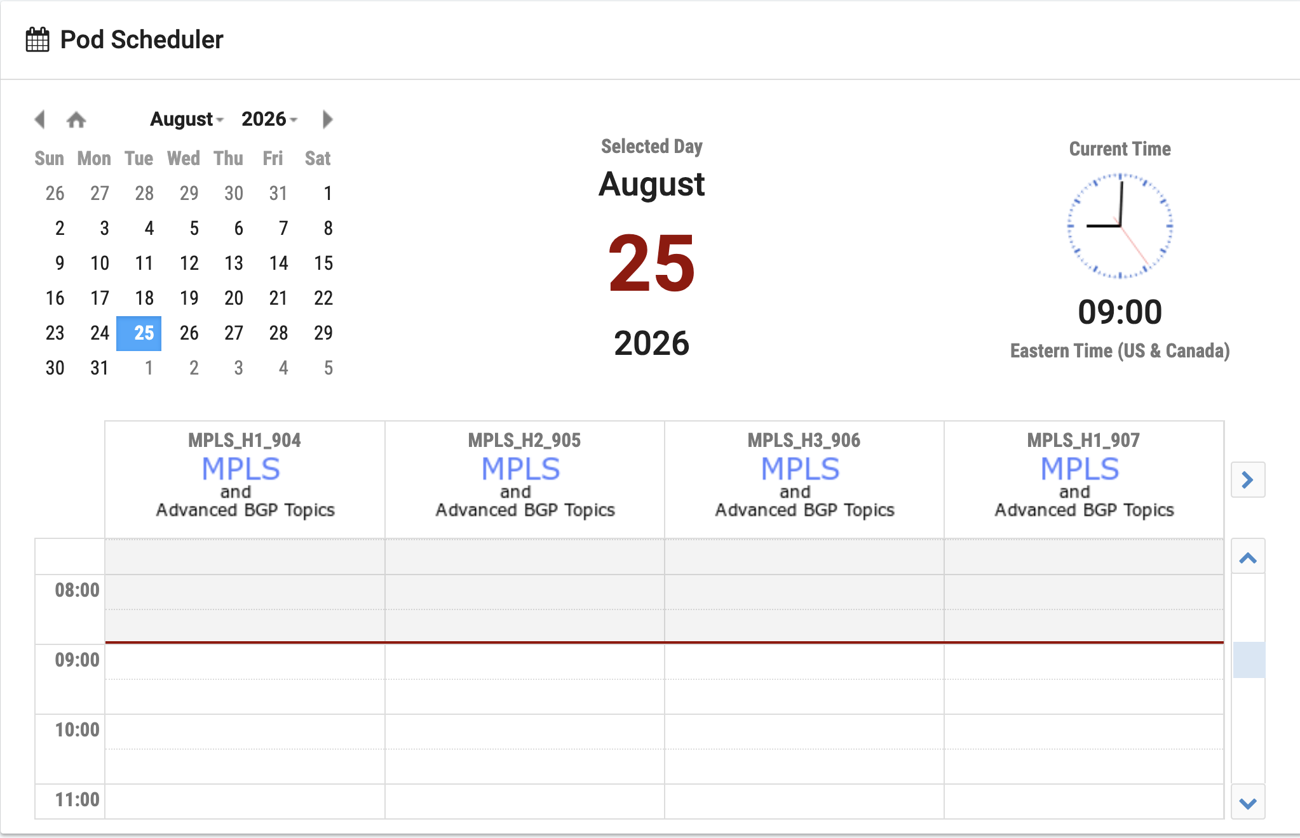
Accessing the Platform
Select the next available POD and allocate time

Slide 17
Accessing the Platform
We will use the NETLAB virtual platform:
URL: https://netlab.cec.sc.edu/
Username: <email address used for the registration>
Temporary Password: nsf-2026

