Slide 1
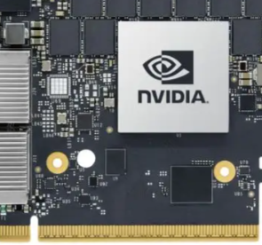
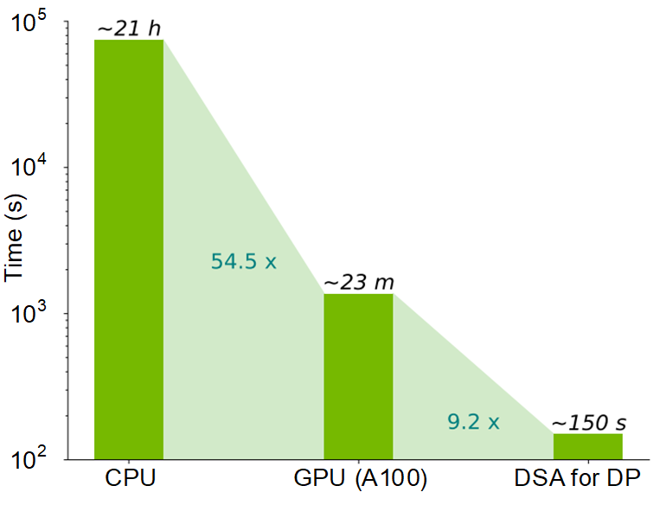
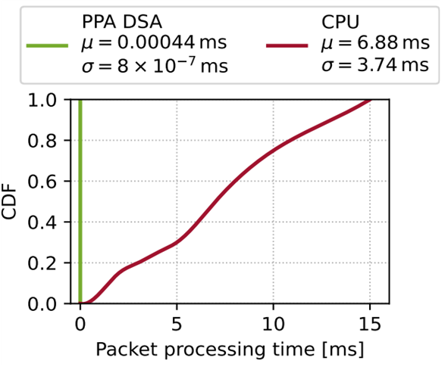
DSAs for OT Network Monitoring and Workload Processing
Elie Kfoury, Ali Mazloum, Sergio Elizalde, Jorge Crichigno
General-purpose CPUs are flexible but offer only moderate performance
Domain-Specific Accelerators (DSAs) deliver higher efficiency by specializing in specific domains
USC Operation Technology (OT) network testbed includes:
  Dynamic Programming Accelerators (DPAs) for DP workloads – fuel reload / reactor-core planning
  Graphic Processing Units (GPUs) for AI/ML models execution
  Packet Processing Accelerators (PPAs) for nanoscale-resolution network monitoring
  Encryption Processing Accelerators (EPAs) for real-time secure data movement
Chip with multiple DSAs
Execution time of a Dynamic Programming (DP) workload on CPU, GPU, and DSA for DP
Real-time traffic inspection within an OT network: PPA-based DSA vs CPU
Lab website: https://research.cec.sc.edu/cyberinfra

Slide 2
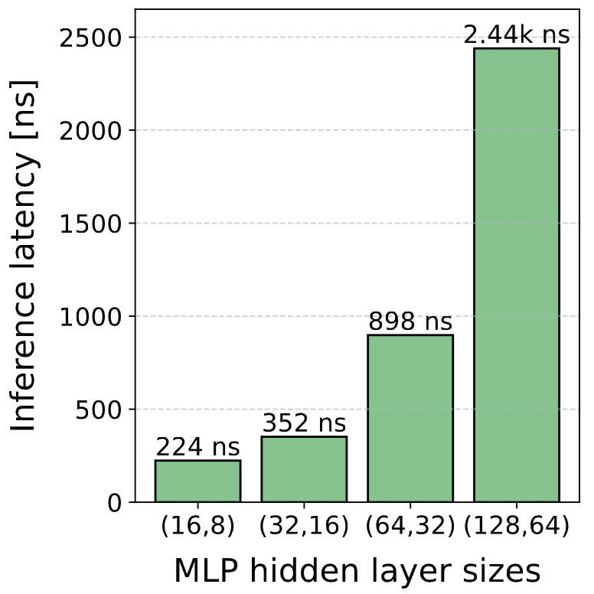
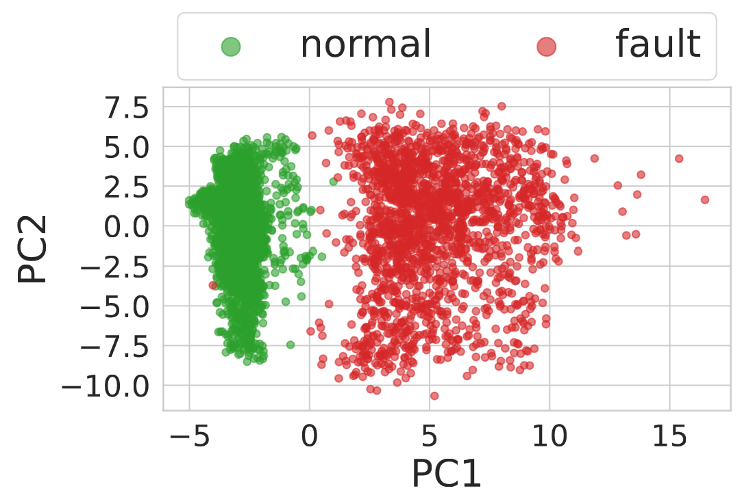
Use Case: Detecting anomalies within ot networks
USC OT Network Testbed
Elie Kfoury, Ali Mazloum, Sergio Elizalde, Jorge Crichigno
Cybersecurity Challenge
Servers run control apps to manage critical nuclear functions
A compromise could disrupt and manipulate these functions
CPU-based Limitations
CPU-based tools incur high latency to analyze packets and detect anomalies
Detection latency allows attacks to perform harmful actions before mitigation
Key Idea
Leverage SmartNICs for low-latency monitoring, anomaly detection
SmartNICs include DSAs for AI/ML and packet processing
Deploy models powered by AI/ML on the SmartNIC DSAs
Mitigate cyberattacks upon detection of anomalies
Isolate infected devices in a timely manner
Key Advantages
Nanosecond-level anomaly detection on live network traffic
Detect anomalous communication before harmful actions by the attack
Results
Lab website: https://research.cec.sc.edu/cyberinfra

