Slide 1


Overview of CILab’s Current Projects on Accelerated
Computing for Networks and Cybersecurity
Elie Kfoury
College of Engineering and Computing
University of South Carolina
REU Mentor Research Talk
June 5, 2026
https://research.cec.sc.edu/cyberinfra

Slide 2
Agenda
Need for accelerated computing
Introduction to domain-specific accelerators (DSAs)
Performance Bottleneck #1: Slowdown in processor performance
Performance Bottleneck #2: Packet processing overhead on OS stacks
Applications
Available resources for learning and research with DSAs
Conclusion

Slide 3
Need for Accelerated Computing

Slide 4
Performance Bottleneck #1:
Slowdown in Processor Performance

Slide 5
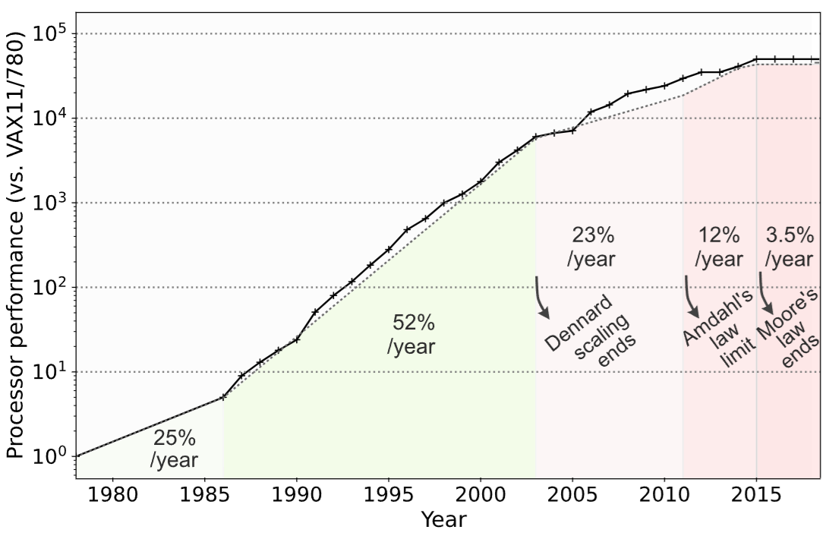
Growth of CPU Performance
End of Moore’s Law and Dennard Scaling, and the limit of Amdahl’s Law
Moore’s Law: number of transistors per chip would double every two years
Dennard Scaling: power density was constant for a given silicon area
Amdahl’s Law: there is a maximum performance benefit from CPU parallelism
Notes:
Dennard Scaling: As transistors became smaller, their power usage dropped proportionally, allowing designers to pack more of them into a chip and run them at higher speeds without increasing overall power consumption
However, when this scaling broke down due to physical and thermal limits, the industry shifted toward multi-core processors and parallelism as an alternative path to improved performance
Yet, this new approach introduced its own limitations: according to Amdahl’s Law, the speedup achieved from parallelizing a task is constrained by the portion of the task that cannot be parallelized
Moore’s Law, which predicted that the number of transistors on a chip would double approximately every two years, has ended

Slide 6
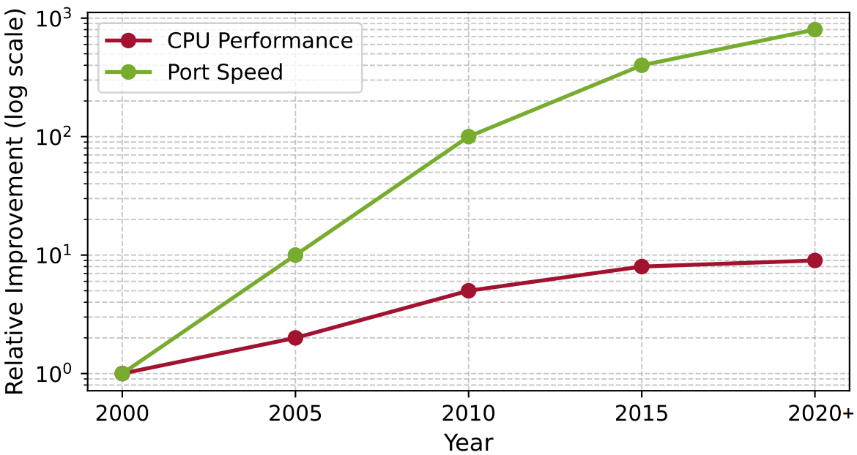
Growth of CPU Performance
Link speeds continue to rise exponentially
CPU performance has plateaued
Notes:
Dennard Scaling: As transistors became smaller, their power usage dropped proportionally, allowing designers to pack more of them into a chip and run them at higher speeds without increasing overall power consumption
However, when this scaling broke down due to physical and thermal limits, the industry shifted toward multi-core processors and parallelism as an alternative path to improved performance
Yet, this new approach introduced its own limitations: according to Amdahl’s Law, the speedup achieved from parallelizing a task is constrained by the portion of the task that cannot be parallelized
Moore’s Law, which predicted that the number of transistors on a chip would double approximately every two years, has ended

Slide 7
Growth of CPU Performance
Link speeds continue to rise exponentially
CPU performance has plateaued
The gap between CPU performance and network speeds has led to domain-specific accelerators (DSAs)
Notes:
Dennard Scaling: As transistors became smaller, their power usage dropped proportionally, allowing designers to pack more of them into a chip and run them at higher speeds without increasing overall power consumption
However, when this scaling broke down due to physical and thermal limits, the industry shifted toward multi-core processors and parallelism as an alternative path to improved performance
Yet, this new approach introduced its own limitations: according to Amdahl’s Law, the speedup achieved from parallelizing a task is constrained by the portion of the task that cannot be parallelized
Moore’s Law, which predicted that the number of transistors on a chip would double approximately every two years, has ended

Slide 8
Overview of Domain-Specific Accelerators

Slide 9
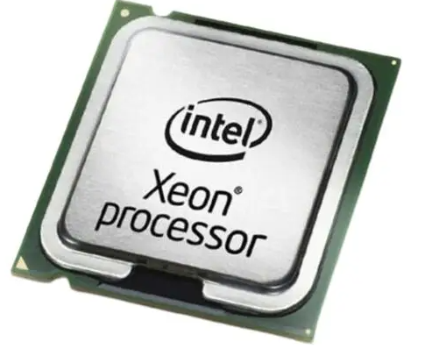
Modern DSAs
Domain-specific accelerators and domain-specific languages
General purpose
C, Java
Compiler
General-purpose CPU
Flexible but with moderate performance across all tasks
CPU
1970s
Notes:
Combination of high floating-point performance and programmability made GPUs with programmable shaders an attractive platform for scientific computing, the field of general-purpose GPU (GPGPU) programming emerged.

Slide 10
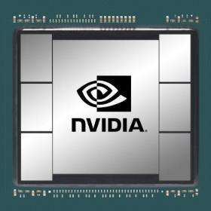
Modern DSAs
Domain-specific accelerators and domain-specific languages
General purpose
Graphics
C, Java
OpenCL
Compiler
Compiler
Graphics Processing Unit (GPU)
CPU
GPU
Instructions and architecture focused on graphics “only”, but very high performance on such applications
1970s 1990s
Notes:
Combination of high floating-point performance and programmability made GPUs with programmable shaders an attractive platform for scientific computing, the field of general-purpose GPU (GPGPU) programming emerged.

Slide 11
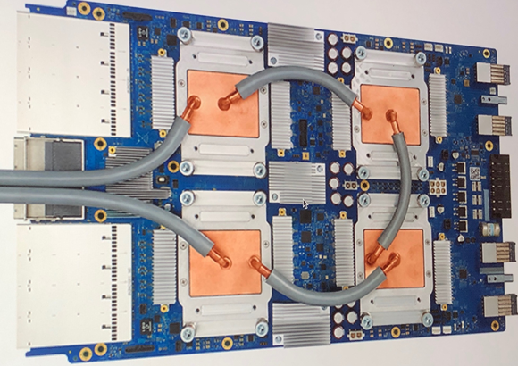
Modern DSAs
Domain-specific accelerators and domain-specific languages
General purpose
Graphics
Machine Learning
C, Java
OpenCL
Tensor Flow
Compiler
Compiler
Compiler
Tensor Processing Unit (TPU)
CPU
GPU
TPU
1970s 1990s 2010s
Notes:
Combination of high floating-point performance and programmability made GPUs with programmable shaders an attractive platform for scientific computing, the field of general-purpose GPU (GPGPU) programming emerged.

Slide 12
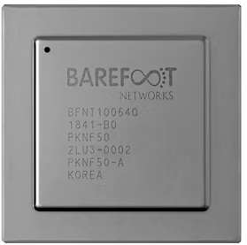
Modern DSAs
Domain-specific accelerators and domain-specific languages
General purpose
Graphics
Machine Learning
Networks
C, Java
OpenCL
Tensor Flow
P4
Compiler
Compiler
Compiler
Compiler
Packet Processing Accelerator (PPA)
CPU
GPU
TPU
PPA
1970s 1990s 2010s 2017
Notes:
Combination of high floating-point performance and programmability made GPUs with programmable shaders an attractive platform for scientific computing, the field of general-purpose GPU (GPGPU) programming emerged.

Slide 13
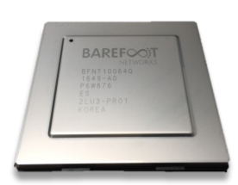
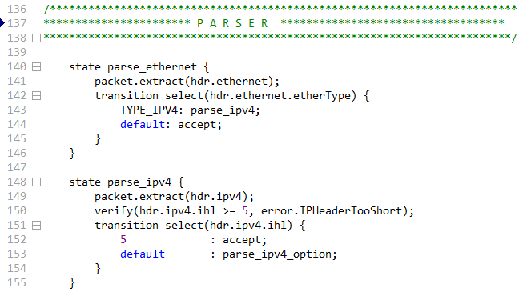
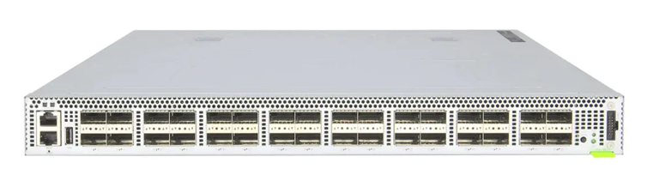
Modern DSAs (P4 Switch)
Programmable data plane switch, also referred to as P4 switch
Packet Processing Accelerator / Programming chip
P4 code
Programmable switch

Slide 14
Modern DSAs (SmartNIC / DPU)
Smart Network Interface Card (SmartNIC), also referred to as Data Processing Unit (DPU)
Smart Network Interface Card (SmartNIC)

Slide 15
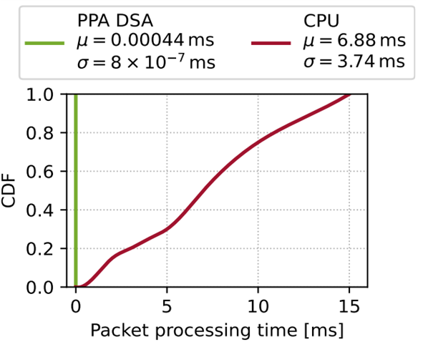
Advantages of DSAs
Orders of magnitude performance improvement with respect to general-purpose CPUs
Cumulative Distribution Function (CDF)
Parsing and processing L2-L5: Ethernet, IP, UDP, RTP, plus payload inspection
Kfoury et al., “Offloading media traffic to programmable data plane switches”, IEEE ICC 2020.

Slide 16
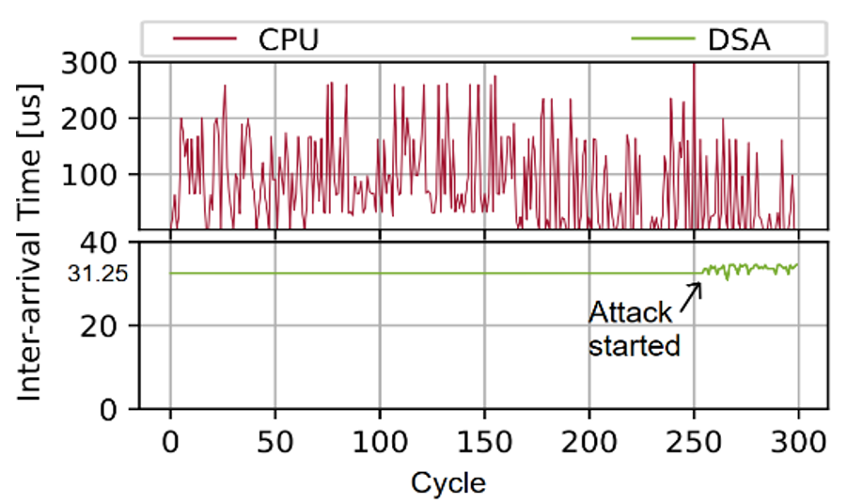
Advantages of DSAs
Orders of magnitude performance improvement with respect to general-purpose CPUs
Cumulative Distribution Function (CDF)
Parsing and processing L2-L5: Ethernet, IP, UDP, RTP, plus payload inspection
Synchronization between two manufacturing devices exchanging data every 31.25 µs
Attack at 250 cycle
Kfoury et al., “Offloading media traffic to programmable data plane switches”, IEEE ICC 2020.

Slide 17
Performance Bottleneck #2:
Packet Processing Overhead on End-hosts OS Stacks

Slide 18
Packet Processing
The NIC driver pre-allocates kernel memory buffers where the packets are stored
User space
Application
Kernel space
Memory buffers
NIC driver
Packet buffer
Packet buffer
Packet buffer
…
Packet buffer
  Rinku Shah and Priyanka Naik, Kernel-bypass techniques for high-speed network packet processing. https://tinyurl.com/3bzfehja

Slide 19
Packet Processing
The NIC driver pre-allocates kernel memory buffers where the packets are stored
The NIC driver pre-allocate the transmit (TX) and receive (RX) ring buffer in the memory
User space
Application
Kernel space
Memory buffers
NIC driver
Packet buffer
Packet buffer
Packet buffer
TX
RX
…
Packet buffer
NIC
  Rinku Shah and Priyanka Naik, Kernel-bypass techniques for high-speed network packet processing. https://tinyurl.com/3bzfehja

Slide 20
Packet Processing
The NIC driver pre-allocates kernel memory buffers where the packets are stored
The NIC driver pre-allocate the transmit (TX) and receive (RX) ring buffer in the memory
The ring buffers store the packet buffer pointer and its length
User space
Application
Kernel space
Memory buffers
NIC driver
Packet buffer
Packet buffer
Packet buffer
TX
RX
…
Packet buffer
NIC
  Rinku Shah and Priyanka Naik, Kernel-bypass techniques for high-speed network packet processing. https://tinyurl.com/3bzfehja
Notes:
The NIC driver pre-allocates kernel memory buffers where the packets are stored
The NIC driver pre-allocate the transmit (TX) and receive (RX) ring buffer in the memory
The ring buffers are circular queues shared between the NIC and the driver
The ring buffers store the packet buffer pointer and its length

Slide 21
Packet Processing
The NIC driver pre-allocates kernel memory buffers where the packets are stored
The NIC driver pre-allocate the transmit (TX) and receive (RX) ring buffer in the memory
The ring buffers store the packet buffer pointer and its length
The NIC copies the packet to the location using Direct Memory Access (DMA)
User space
Application
Kernel space
Memory buffers
NIC driver
Packet buffer
Packet buffer
TX
RX
…
Packet buffer
NIC
Hardware RX queue
  Rinku Shah and Priyanka Naik, Kernel-bypass techniques for high-speed network packet processing. https://tinyurl.com/3bzfehja

Slide 22
Packet Processing
The NIC driver pre-allocates kernel memory buffers where the packets are stored
The NIC driver pre-allocate the transmit (TX) and receive (RX) ring buffer in the memory
The ring buffers store the packet buffer pointer and its length
The NIC copies the packet to the location using Direct Memory Access (DMA)
The NIC triggers an interrupt
User space
Application
Kernel space
Memory buffers
NIC driver
Packet buffer
Packet buffer
TX
RX
…
Packet buffer
NIC
Hardware RX queue
  Rinku Shah and Priyanka Naik, Kernel-bypass techniques for high-speed network packet processing. https://tinyurl.com/3bzfehja

Slide 23
Packet Processing
Interrupt processing:
The CPU pauses the process in execution
  Rinku Shah and Priyanka Naik, Kernel-bypass techniques for high-speed network packet processing. https://tinyurl.com/3bzfehja

Slide 24
Packet Processing
Interrupt processing:
The CPU pauses the process in execution
Switch from user space to kernel space
  Rinku Shah and Priyanka Naik, Kernel-bypass techniques for high-speed network packet processing. https://tinyurl.com/3bzfehja

Slide 25
Packet Processing
Interrupt processing:
The CPU pauses the process in execution
Switch from user space to kernel space
Acknowledge and schedule bottom-half processing
  Rinku Shah and Priyanka Naik, Kernel-bypass techniques for high-speed network packet processing. https://tinyurl.com/3bzfehja

Slide 26
Packet Processing
Interrupt processing:
The CPU pauses the process in execution
Switch from user space to kernel space
Acknowledge and schedule bottom-half processing
Switch back to user space
  Rinku Shah and Priyanka Naik, Kernel-bypass techniques for high-speed network packet processing. https://tinyurl.com/3bzfehja

Slide 27
Packet Processing
Interrupt processing:
The CPU initiates the bottom-half when it is free
Switch from user space to kernel space
  Rinku Shah and Priyanka Naik, Kernel-bypass techniques for high-speed network packet processing. https://tinyurl.com/3bzfehja

Slide 28
Packet Processing
Interrupt processing:
The CPU initiates the bottom-half when it is free
Switch from user space to kernel space
Dynamically allocate packet data structure
Remove Ethernet header and pass to network stack
  Rinku Shah and Priyanka Naik, Kernel-bypass techniques for high-speed network packet processing. https://tinyurl.com/3bzfehja

Slide 29
Packet Processing
Interrupt processing:
The CPU initiates the bottom-half when it is free
Switch from user space to kernel space
Dynamically allocate packet data structure
For all packets in buffer
Remove Ethernet header and pass to network stack
  Rinku Shah and Priyanka Naik, Kernel-bypass techniques for high-speed network packet processing. https://tinyurl.com/3bzfehja

Slide 30
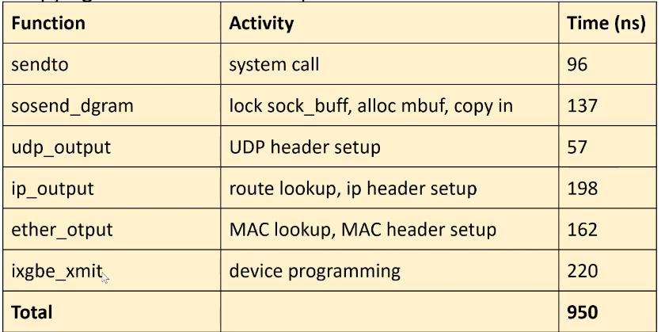
Packet Processing Overheads
Too many context switches, polluting CPU cache
Per-packet interrupt overhead
Dynamic allocation of packet data structure
Packet copy between the kernel and user space
  Rinku Shah and Priyanka Naik, Kernel-bypass techniques for high-speed network packet processing. https://tinyurl.com/3bzfehja

Slide 31
Packet Processing Overheads
Too many context switches, polluting CPU cache
Per-packet interrupt overhead
Dynamic allocation of packet data structure
Packet copy between the kernel and user space
Link Capacity | Packet Size | Time Budget per Packet
10 Mbps | 64 bytes | 51,200 ns
100 Mbps | 64 bytes | 5,120 ns
1 Gbps | 64 bytes | 512 ns
10 Gbps | 64 bytes | 51.2 ns
100 Gbps | 64 bytes | 5.12 ns
  Rinku Shah and Priyanka Naik, Kernel-bypass techniques for high-speed network packet processing. https://tinyurl.com/3bzfehja

Slide 32
Kernel-bypass
One approach to avoid the overhead is to bypass the kernel
DPDK is a set of optimized libraries for processing packets in the user space
DPDK bypasses the kernel
DPDK uses Poll Mode Drivers (PMD) which constantly poll the NICs for new packets
This avoids the overheads resulting from interrupts
User space
Application
DPDK Poll Mode Driver (PMD)
Kernel space
DPDK-supported NIC
DPDK: Data Plane Development Kit

Slide 33
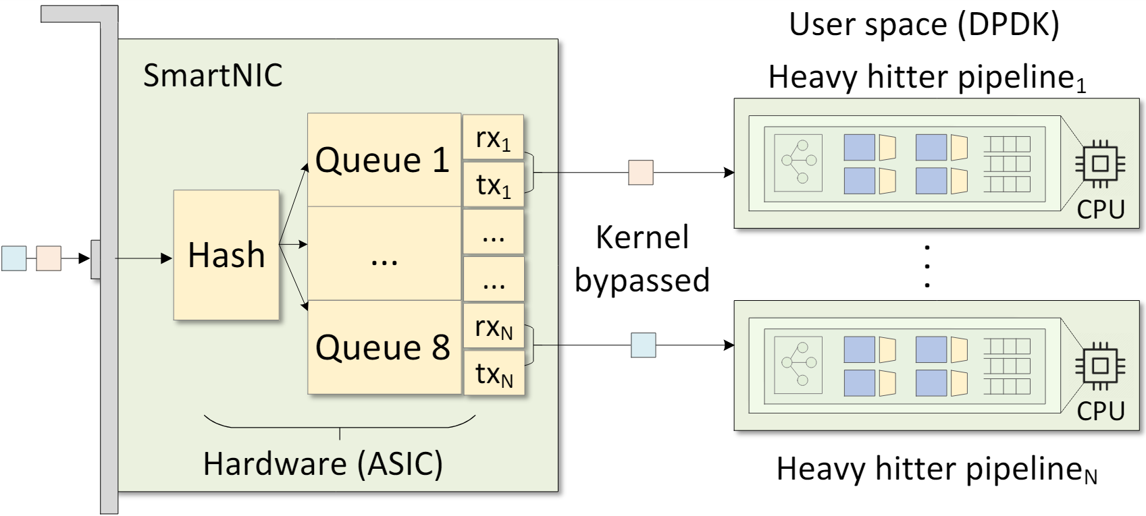
Multicore CPUs
DPDK enables packet processing on multicore CPUs
The Receive Side Scaling (RSS) technique is used to distribute the packets to the CPU cores
The CPU cores can run different packet processing pipelines

Slide 34
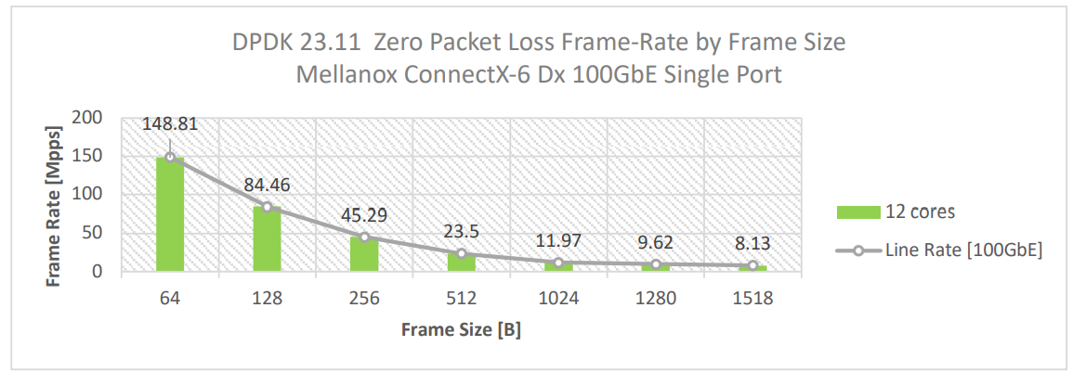
DPDK Performance
Layer-3 forwarding (l3fwd) is implemented in DPDK¹
100Gbps line rate for 64 bytes packets
¹NVIDIA NICs Performance Report with DPDK 23.11. https://fast.dpdk.org/doc/perf/DPDK_23_11_NVIDIA_NIC_performance_report.pdf

Slide 35
DPDK Challenges
DPDK is complex and required deep understanding of C and DPDK libraries
DPDK requires millions of lines of code in C to implement a software switch
Difficult to add new features to the large code

Slide 36
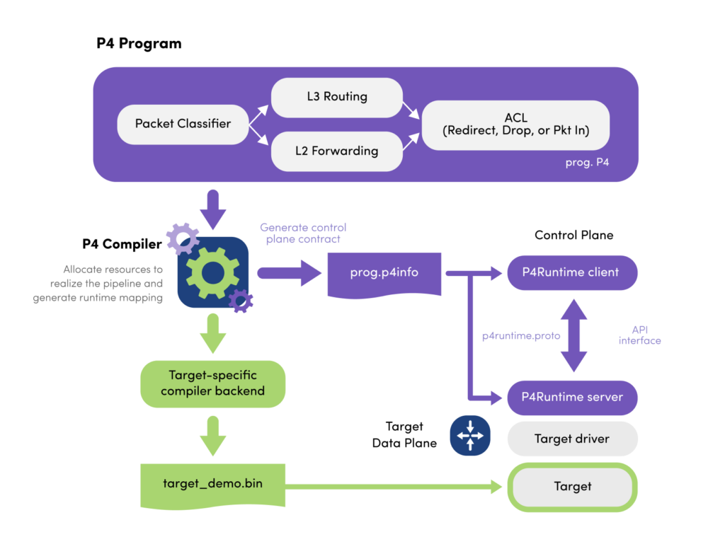
P4 Language
P4 emerged as domain-specific language to define packet processing:
  Define and parse new protocols
  Customize packet processing functions

Slide 37
PISA: Protocol Independent Switch Architecture
Match+Action
Stage
Memory
ALU
Programmable
Parser
Programmable Match-Action Pipeline
N. McKeown. Creating an End-to-End Programming Model for Packet Forwarding. Available: https://www.youtube.com/watch?v=fiBuao6YZl0&t=4216s

Slide 38
PISA: Protocol Independent Switch Architecture
N. McKeown. Creating an End-to-End Programming Model for Packet Forwarding. Available: https://www.youtube.com/watch?v=fiBuao6YZl0&t=4216s
38

Slide 39
Example P4 Program
Parser Program
Header and Data Declarations
Tables and Control Flow
parser parse_ethernet {
extract(ethernet);
return switch(ethernet.ethertype) {
0x8100 : parse_vlan_tag;
0x0800 : parse_ipv4;
0x8847 : parse_mpls;
default: ingress;
}
header_type ethernet_t { … }
header_type l2_metadata_t { … }
header ethernet_t ethernet;
header vlan_tag_t vlan_tag[2];
metadata l2_metadata_t l2_meta;
table port_table { … }
control ingress {
apply(port_table);
if (l2_meta.vlan_tags == 0) {
process_assign_vlan();
}
}
Memory
ALU
Programmable
Parser
Programmable Match-Action Pipeline
N. McKeown. Creating an End-to-End Programming Model for Packet Forwarding. Available: https://www.youtube.com/watch?v=fiBuao6YZl0&t=4216s
39

Slide 40
Why P4 for CPU?
Processing packets on the server is very similar to a switch pipeline
  Packets need to be parsed
  Match and action operations are performed on the packets
  Packets are sent to the network or the host
Memory
ALU
Programmable
Parser
Programmable
Deparser
Programmable Match-Action Pipeline

Slide 41
Why P4 for CPU?
The P4 description for a data plane is short
For example, a full implementation of a data center switch requires¹:
  ~5000 lines of code in P4
  Millions of lines of code in C with DPDK
Lines of code (LOC) for implementing defenses against common cyberattacks¹
Attack | DPDK | P4
DNS amplification | 898 | 255
HTTP flood | 1184 | 354
SlowLoris | 995 | 513
UDP flood | 911 | 376
Elephant flow (heavy hitter) | 903 | 373
  ¹Running P4 programs as DPDK applications - Cristian Dumitrescu & Han Wang – Intel. https://www.youtube.com/watch?v=xJR-5DcqhlY

Slide 42
Why P4 for CPU?
DPDK is complex and required deep understanding of C and DPDK libraries
P4’s high-level abstraction simplifies the development of complex packet processing
P4 quickly adapts and deploys new network functions to the data plane

Slide 43
Why P4 for CPU?
DPDK is complex and required deep understanding of C and DPDK libraries
P4’s high-level abstraction simplifies the development of complex packet processing
P4 quickly adapts and deploys new network functions to the data plane
Combining P4 with DPDK enables highly customizable, high-performance network applications that benefit from both the programmability of P4 and the efficiency of DPDK

Slide 44
P4-DPDK
P4-DPDK is an initiative that translates P4 code to DPDK

Slide 45
Examples of Research Projects Leveraging DSAs at USC

Slide 46
Self-driving Networks
(Acceleration through a P4 Switch)

Slide 47
USC Science DMZ
A portion of the campus network, tailored for high-performance data transfers
No firewalls or other appliances, avoid friction, packet drops
Limited to researchers, faculty (no regular traffic, web, YouTube, etc.)
Optical taps operate at the physical layer. A portion of the light is sent to the P4 switch while the rest continues along the main fiber.

Slide 48
USC Science DMZ
A portion of the campus network, tailored for high-performance data transfers
No firewalls or other appliances, avoid friction, packet drops
Limited to researchers, faculty (no regular traffic, web, YouTube, etc.)
Optical taps operate at the physical layer. A portion of the light is sent to the P4 switch while the rest continues along the main fiber.

Slide 49
USC Science DMZ
Optical taps provide a copy of packets to the P4 PPA switch

Slide 50
USC Science DMZ
Optical taps provide a copy of packets to the P4 PPA switch
P4 apps track connections and compute per-flow statistics, measurements

Slide 51
USC Science DMZ
Optical taps provide a copy of packets to the P4 PPA switch
P4 apps track connections and compute per-flow statistics, measurements
Statistics, measurements are used to create/update rules applied to the core switch

Slide 52
USC Science DMZ
Optical taps provide a copy of packets to the P4 PPA switch
P4 apps track connections and compute per-flow statistics, measurements
Statistics, measurements are used to create/update rules applied to the core switch
Updated (optimal) parameters (e.g., buffer size) lead to higher performance

Slide 53
Buffer Sizing
The size of the core switch’s buffer has implications on the network performance
Large buffer → excessive delays
Small buffer → packet losses, low link utilization
Optimal buffer size is a function of the # flows, average RTT, bandwidth
Notes:
The buffer size is typically hardcoded

Slide 54
Buffer Sizing
The PPA computes # flows, average RTT
An optimization algorithm finds the buffer size that minimizes delays and losses
E. Kfoury, J. Crichigno, and E. Bou-Harb, “P4BS: Leveraging Passive Measurements from P4 Switches to Dynamically Modify a Router’s Buffer Size”, IEEE Transactions on Network and Service Management, Vol. 21, Issue 1, February 2024.

Slide 55
Demo: Buffer Sizing

Slide 56

Demo

Slide 57
Results
Up to 500 flows
Core switch: Juniper MX-204
P4 switch: Wedge100BF-32X with Intel’s Tofino PPA ASIC
40 Gbps

Slide 58
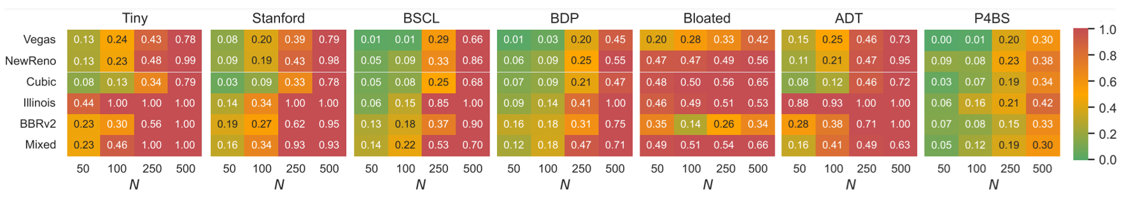
Results
Combined metric accounting for packet loss and delay [0, 1] (the lower, the better)
The Mixed scenario combines multiple congestion control algorithms
Multiple buffer-size approaches (Tiny buffer, Stanford, BSCL, …)
E. Kfoury, J. Crichigno, and E. Bou-Harb, “P4BS: Leveraging Passive Measurements from P4 Switches to Dynamically Modify a Router’s Buffer Size”, IEEE Transactions on Network and Service Management, Vol. 21, Issue 1, February 2024.

Slide 59
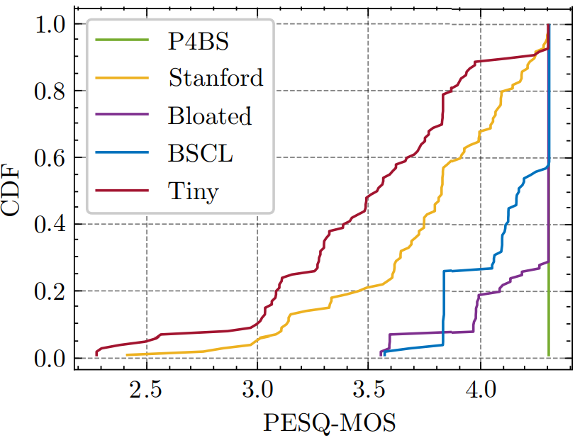
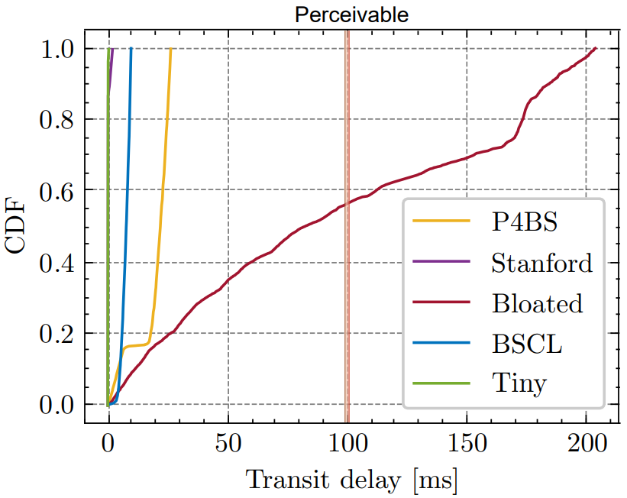
Results
100 VoIP calls playing 20 reference speech samples (G.711.a)
Perceptual Evaluation of Speech Quality (PESQ), Mean Opinion Score (MOS)
E. Kfoury, J. Crichigno, and E. Bou-Harb, “P4BS: Leveraging Passive Measurements from P4 Switches to Dynamically Modify a Router’s Buffer Size”, IEEE Transactions on Network and Service Management, Vol. 21, Issue 1, February 2024.

Slide 60
Encrypted Traffic Classification
(End-host with software acceleration - DPDK)

Slide 61
Motivation and Background on ETC
Network traffic has grown massively, driven by streaming, cloud, and IoT
Over 95% of web traffic is encrypted via HTTPS - up from 50% in 2014 (Google)¹
ETC is important for QoS, intrusion detection, network mgmt., and app. identification
Streaming, cloud, and IoT traffic carry sensitive user data and require encryption
Traffic encryption is constantly evolving, new protocols (QUIC, TLS 1.3) make classification increasingly harder over time
1. Google, “Google transparency report.” [Online], Available:https://tinyurl.com/marh7sv3, April 2025.

Slide 62
Traditional Methods for Traffic Classification
Early methods relied on port numbers to identify applications
Deep Packet Inspection (DPI) analyzes packet payload but fails with encrypted traffic
Shift toward flow-level statistics instead of payload
  Packet size
  Timing
  Flow duration
These patterns enable the use of machine learning (ML) for classification

Slide 63
ETC Issues in Programmable Networks
Software ETC suffers from kernel overhead (context switching, memory copies), increasing latency
BMv2 P4 switches are used for prototyping, but lack performance
P4 physical switches have limited on-chip memory, restricting the number of flows and model size

Slide 64
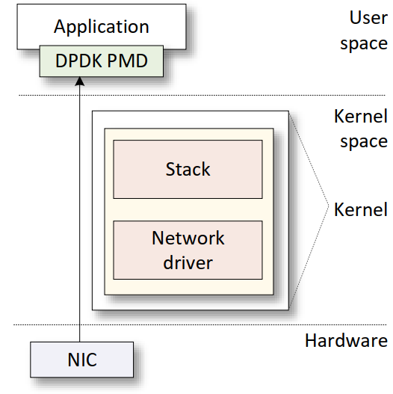
Kernel-Bypass Packet Processing using DPDK
DPDK is a library for accelerating packet processing
DPDK bypasses the kernel, uses Poll Mode Drivers (PMD) to avoid overhead
P4-DPDK
  P4 → flexibility to describe packet operations
  DPDK → performance in the user space

Slide 65
The P4-DPDK Workflow
The system is implemented in P4 using the Portable NIC Architecture (PNA)
The p4c-dpdk compiler accepts the P4 code as input
It generates a .spec representation file that aligns with the DPDK pipeline
The C code is compiled, and a shared object (.so) is generated
The application runs on a CPU core, bypassing the kernel

Slide 66
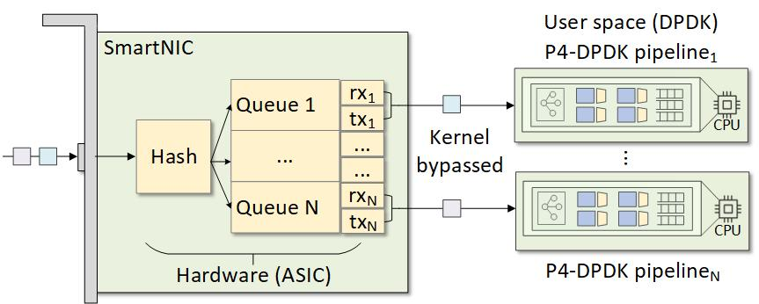
Offloading to the NIC and Multicore Processing
When a NIC receives packets, those are typically processed by a single CPU core
The CPU core is often the application’s bottleneck
A SmartNIC enables the developer:
  Offload processing from the host CPU core to the SmartNIC CPU cores and accelerators
  Distribute packets across multiple CPU cores, a process referred to as Receive Side Scaling (RSS)
66

Slide 67
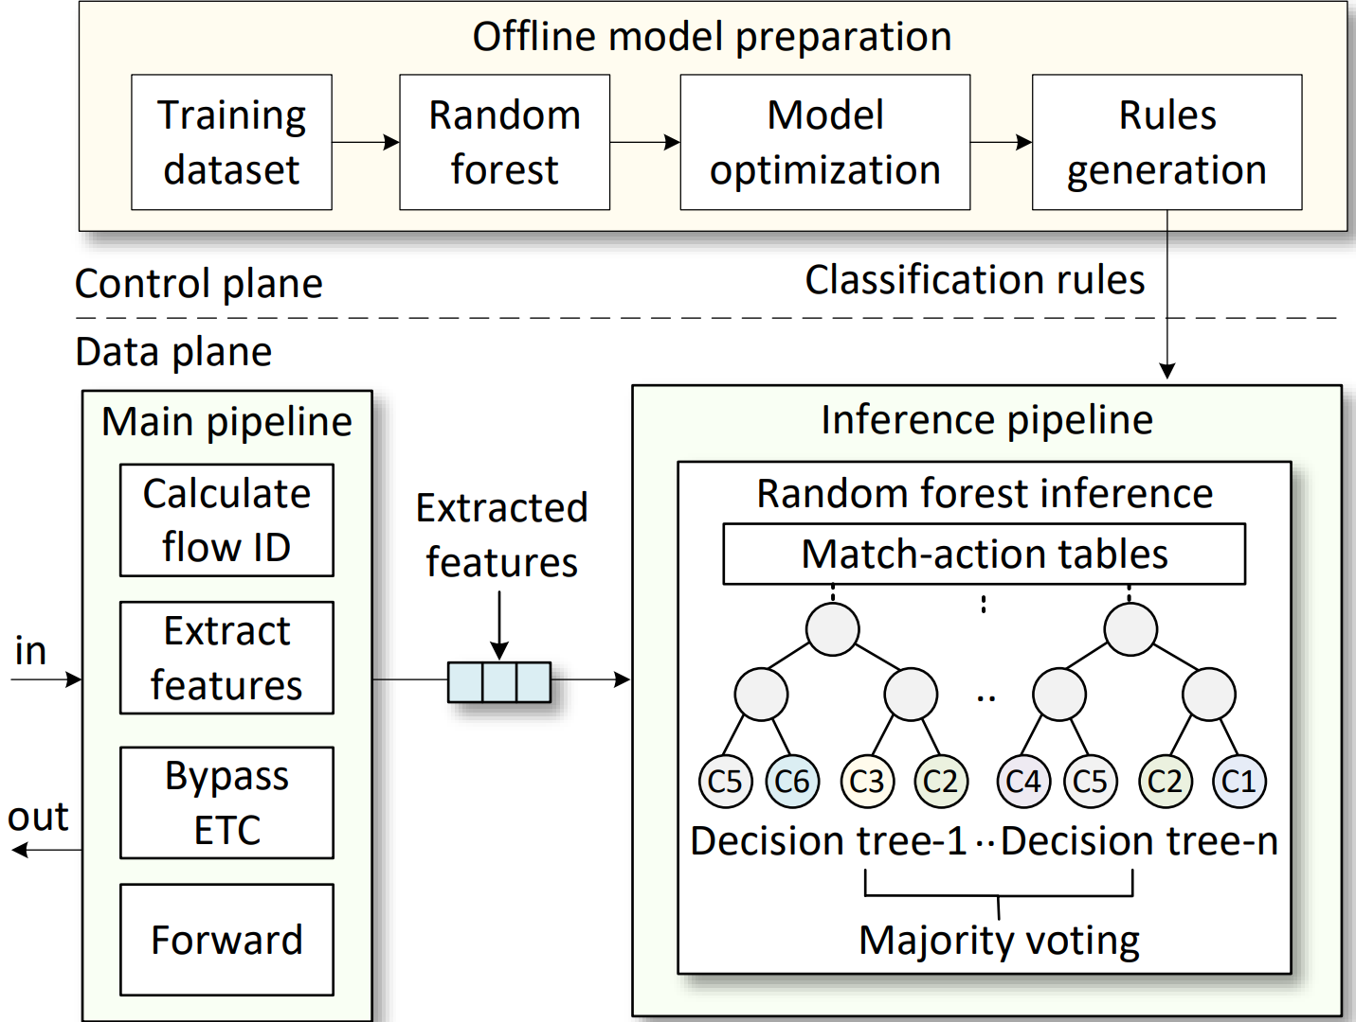
Proposed System Architecture
Traffic dataset is used to train an RF model
Model is converted into classification rules
Rules are deployed into match-action tables

Slide 68
Proposed System Architecture
Flow ID is computed and features are extracted
Non-encrypted traffic is bypassed
Features are extracted and sent to the inference pipeline
RF inference produces the final classification

Slide 69
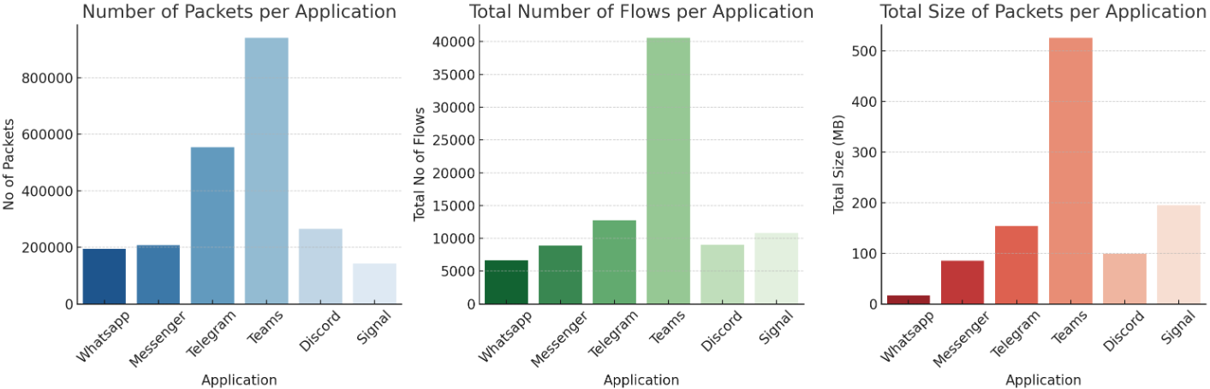
Dataset
Public dataset from IEEE DataPort for Encrypted Traffic Classification¹
Traffic from six apps: WhatsApp, Telegram, Signal, Teams, Discord, Messenger
It includes ~88K flows and ~1.5 GB of encrypted traffic
The dataset was balanced with the SMOTE technique²
Z. Erdenebaatar et al. "Encrypted Mobile Instant Messaging Traffic Dataset", IEEE Dataport, Jan 2023.
N. Chawla et al., “SMOTE: Synthetic Minority Over-sampling Technique,” Journal of Artificial Intelligence Research, Jun. 2002.
Notes:
Synthetic Minority Oversampling Technique (SMOTE)
Create synthetic samples
SMOTE is a popular machine learning method used to resolve data imbalance. It artificially generates new, synthetic examples of the minority class by interpolating between existing minority data points, rather than simply duplicating them
This avoids the classifier to be biased toward the majority class
Minority class prediction suffers from poor recall
https://www.youtube.com/watch?v=qgnrtl1TzMA
https://pub.towardsai.net/handling-imbalanced-datasets-in-machine-learning-smote-oversampling-undersampling-explained-6a86116c1f41

Slide 70
Feature Extraction and Model Training
Features are extracted from the first eight packets of each flow
Features are payload-independent, enabling analysis of encrypted traffic
RF classifier is trained on these flow-level features
# | Feature | Description
1 | Max Packet Length Difference | Maximum difference between successive packet lengths in a flow
2 | Min Packet Length Difference | Minimum difference between successive packet lengths in a flow
3 | Total Packet Length | Total sum of all packet lengths in a flow
4 | Max Inter-Arrival Time | Maximum time gap between successive packets in a flow
5 | Min Inter-Arrival Time | Minimum time gap between successive packets in a flow

Slide 71
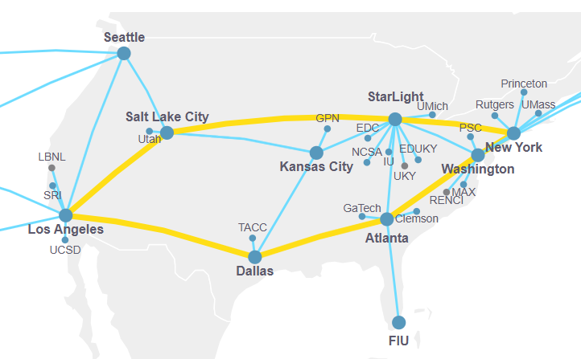
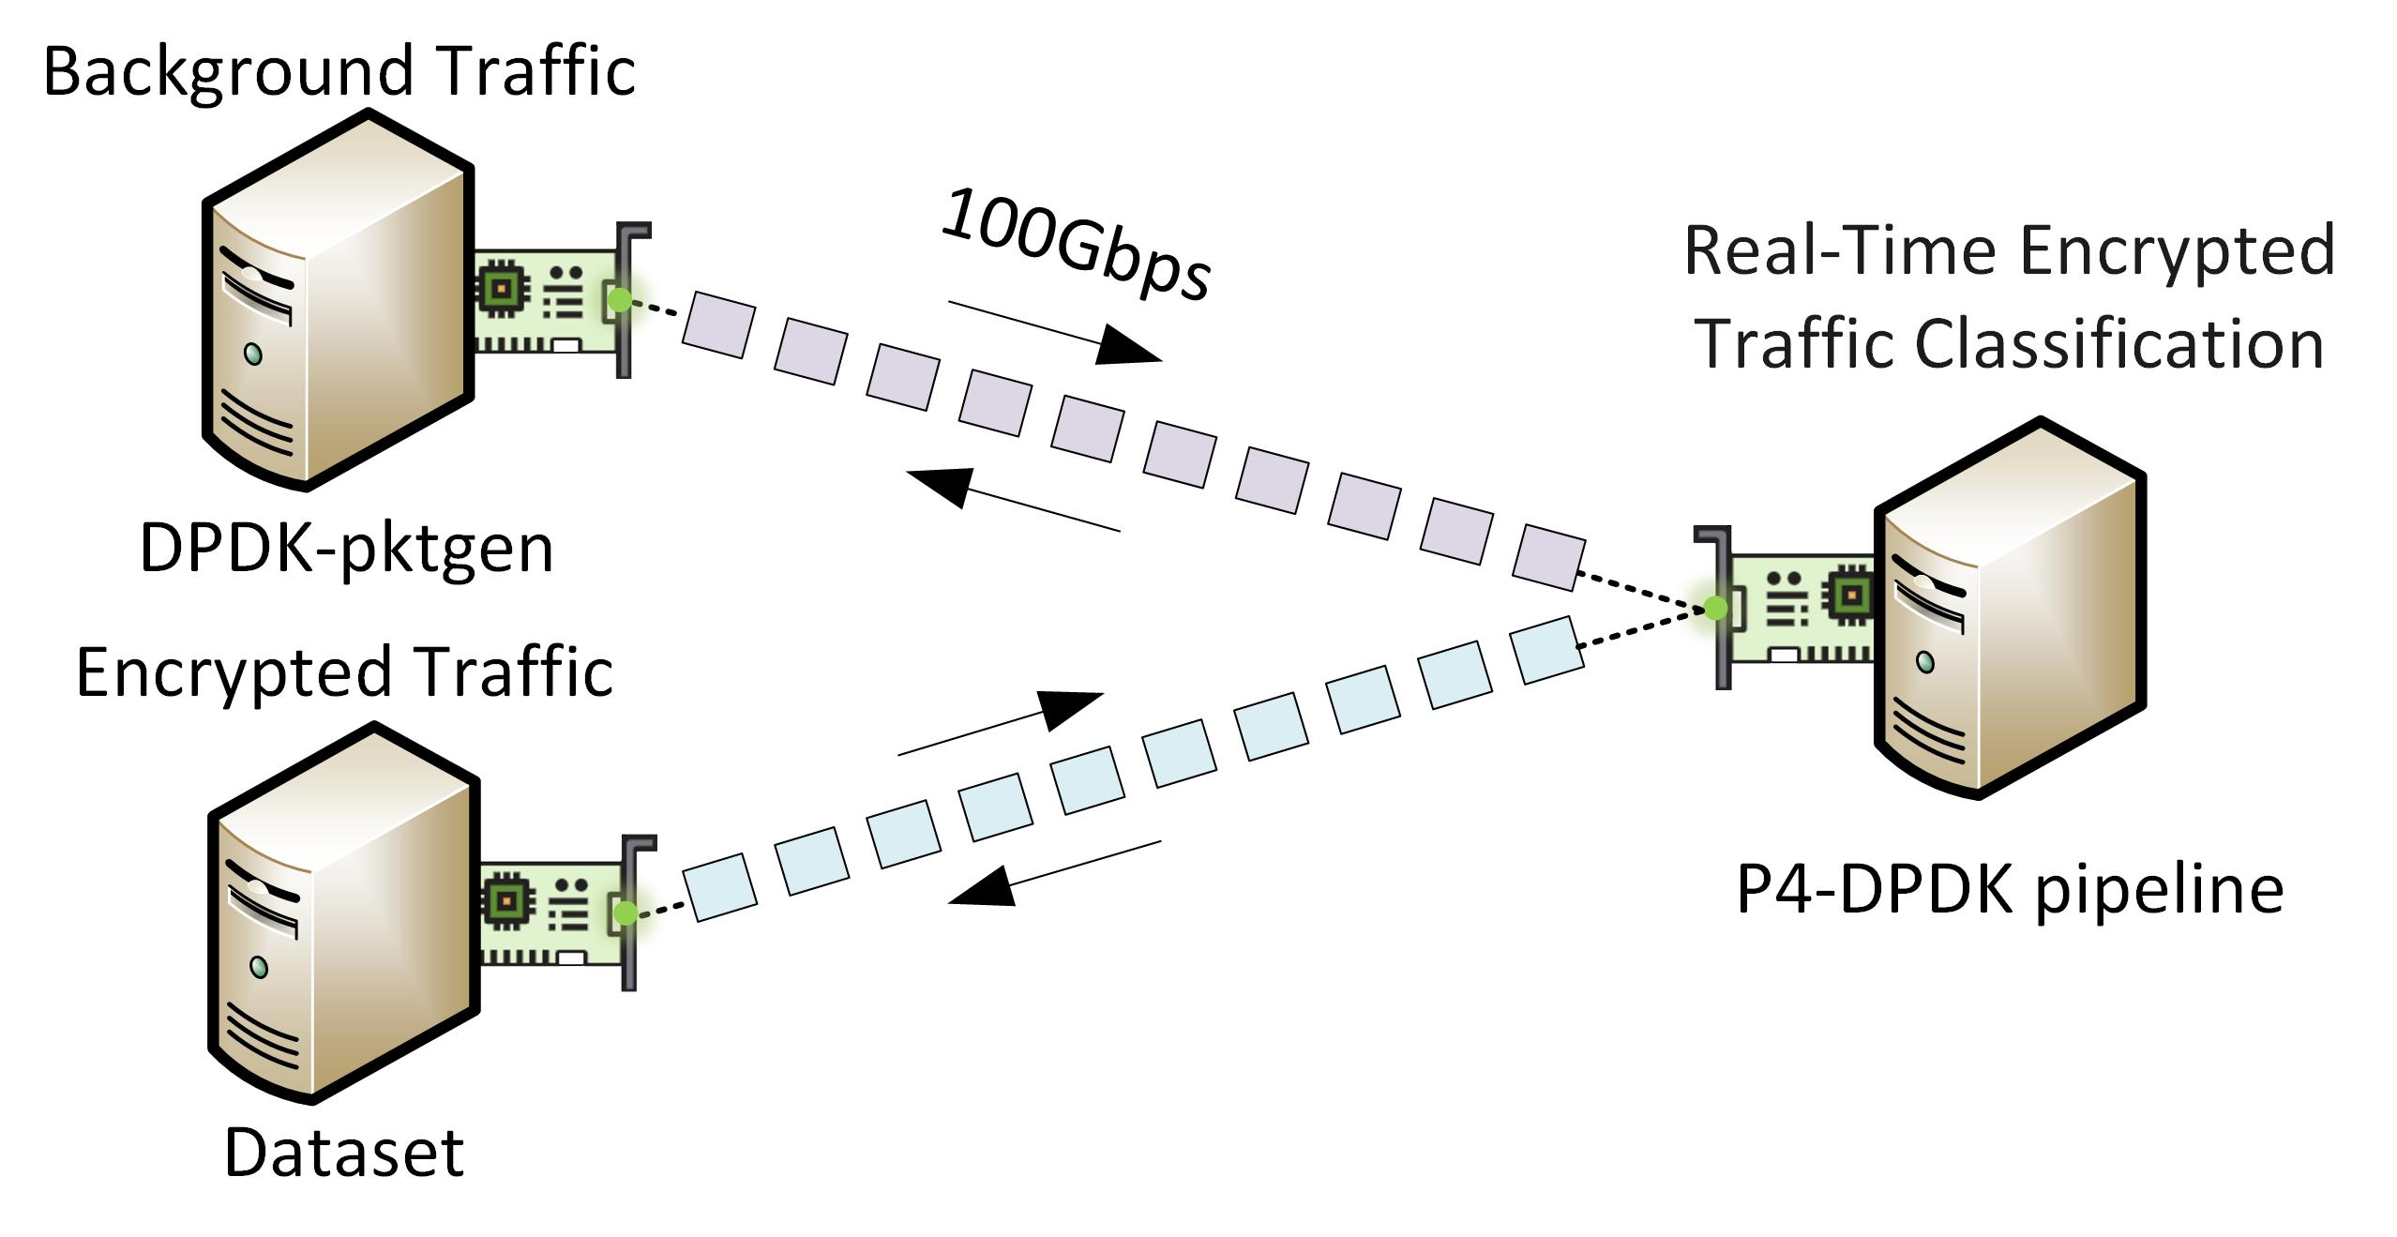
Experiment Topology
The topology consists of two nodes, equipped with an NVIDIA ConnectX-6 NIC (100Gbps). Nodes are deployed on FABRIC¹
DPDK-pktgen² is utilized for generating background traffic
Encrypted traffic is produced by replaying packets from the dataset
FABRIC testbed
Experimental Topology
I. Baldin et al., Fabric: A national-scale programmable experimental network infrastructure”, IEEE Internet Computing, Vol. 23, Issue 6, 2019.
https://pktgen-dpdk.readthedocs.io/en/latest/

Slide 72
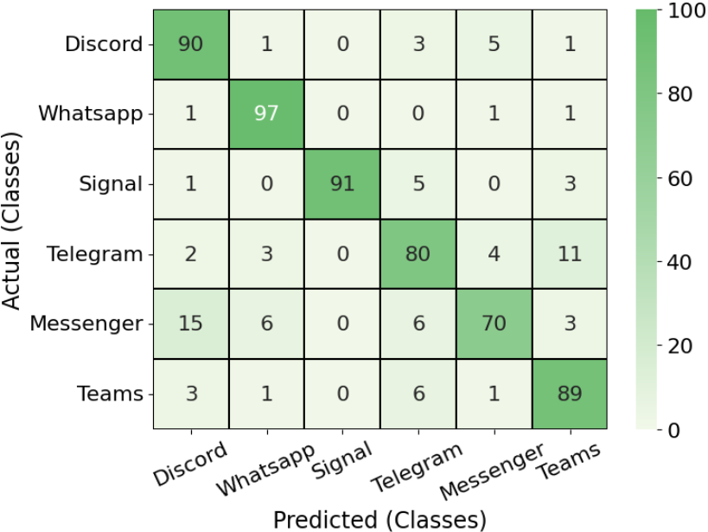
Test 1: Online Classification Accuracy
Model trained on 75% data, validated using k-fold cross-validation
Average accuracy is > 86% across the six applications
WhatsApp (97%) and Signal (91%) achieve the highest per-class accuracy
Messenger (70%) and Telegram (80%) suffer from overlapping feature distributions
Online model: P4-DPDK in the data plane
Notes:
The diagonal numbers are correct predictions.
Darker green means higher accuracy.
WhatsApp 98%, Signal 93% are the highest. Their dots in PCA are well separated from others.
Telegram 86%, Messenger 81% are the lowest.
Look at Telegram's row. 11% of Telegram flows were misclassified as Teams. 8% of Messenger flows were misclassified as Discord.
This tells us these apps behave similarly on the network. The model struggles to tell them apart.
K-foild
K-Fold Cross-Validation is a resampling technique used to evaluate machine learning models and estimate their ability to generalize to unseen data. It prevents overfitting and ensures that model performance isn't just a result of a lucky train-test split
The standard K-Fold process follows these exact steps:
Shuffle and Divide: Randomly shuffle your entire dataset and divide it into \(k\) equal-sized subsets (called "folds").
Train and Validate: Set aside \(1\) fold to use as the validation set. Train your model on the remaining \(k - 1\) folds.
Evaluate: Test the trained model on the unseen validation fold and record the performance metric (e.g., accuracy, mean squared error).
Repeat: Repeat the process \(k\) times, so that every fold acts as the validation set exactly once.Average: Calculate the average of the \(k\) recorded evaluation scores to get a robust estimate of the model's overall performance. [1, 2, 3]

Slide 73
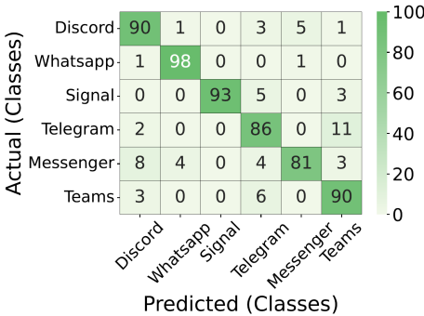
Test 2: Online vs Offline Classification Accuracy
Model trained on 75% data, validated using k-fold cross-validation
Average accuracy is > 86% across the six applications
WhatsApp (97%) and Signal (91%) achieve the highest per-class accuracy
Messenger (70%) and Telegram (80%) suffer from overlapping feature distributions
Online model: P4-DPDK in the data plane
Offline model: Python in the control plane
Notes:
The diagonal numbers are correct predictions.
Darker green means higher accuracy.
WhatsApp 98%, Signal 93% are the highest. Their dots in PCA are well separated from others.
Telegram 86%, Messenger 81% are the lowest.
Look at Telegram's row. 11% of Telegram flows were misclassified as Teams. 8% of Messenger flows were misclassified as Discord.
This tells us these apps behave similarly on the network. The model struggles to tell them apart.
K-foild
K-Fold Cross-Validation is a resampling technique used to evaluate machine learning models and estimate their ability to generalize to unseen data. It prevents overfitting and ensures that model performance isn't just a result of a lucky train-test split
The standard K-Fold process follows these exact steps:
Shuffle and Divide: Randomly shuffle your entire dataset and divide it into \(k\) equal-sized subsets (called "folds").
Train and Validate: Set aside \(1\) fold to use as the validation set. Train your model on the remaining \(k - 1\) folds.
Evaluate: Test the trained model on the unseen validation fold and record the performance metric (e.g., accuracy, mean squared error).
Repeat: Repeat the process \(k\) times, so that every fold acts as the validation set exactly once.Average: Calculate the average of the \(k\) recorded evaluation scores to get a robust estimate of the model's overall performance. [1, 2, 3]

Slide 74
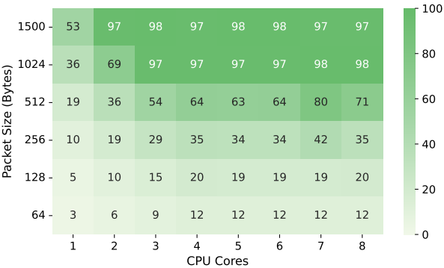
Test 3: Throughput Evaluation
Throughput increases with the packet size
W/ 64-byte packets, only 3Gbps is achieved w/ a single core and 12Gbps with 4 cores
W/ packet sizes ≥ 1024 bytes, ~100Gbps is achieved w/ sufficient cores
Throughput scales with number of CPU cores - DPDK leverages multicore parallelism
Beyond 4 cores, throughput plateaus for larger packets - diminishing returns
Throughput in Gbps

Slide 75
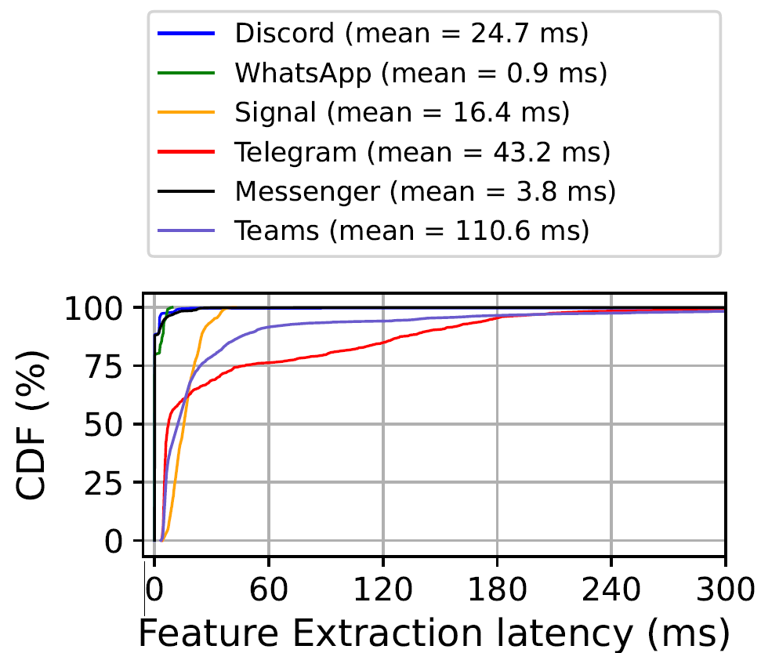
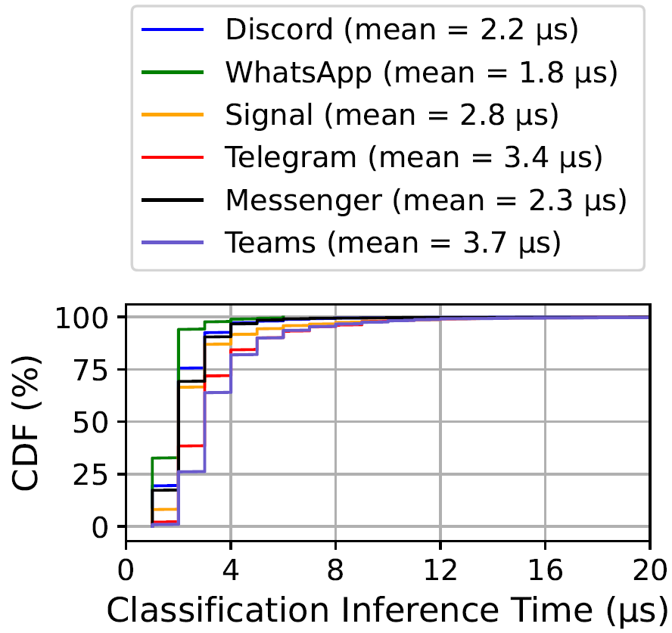
Test 4: Latency Evaluation
Feature extraction depends on packet arrival rate
Delay arises from waiting for the first 8 packets of a flow
Classification inference latency is very low (< 5 µs for most packets)
Inference adds minimal overhead to the pipeline
Total latency includes feature extraction + classification inference
The system demonstrates efficient real-time classification with low latency impact
Notes:
Total latency includes feature extraction + classification inference

Slide 76
State-of-the-Art Comparison
P4-DPDK (this work)
  100 Gbps inline ETC with ~86% accuracy - on commodity SmartNICs / multicore CPUs
  It supports millions of concurrent flows - orders of magnitude beyond prior work
Tofino ASIC (hardware P4 switch)¹
  Line-rate forwarding (Tbps), but limited on-chip SRAM (tens of MB)
  It supports ~2,048 concurrent flows - few for production networks
BMv2 (software switch)²
  Target: Software switch (prototyping only) - not deployable in real networks
  Simple decision tree classifier, limited feature support, no high-rate traffic
A. Akem, G. Fraysse, and M. Fiore, “Encrypted traffic classificationat line rate in programmable switches with machine learning,” inIEEE/IFIP Network Operations and Management Symposium, 2024.
H. N. Nguyen, M.-D. Nguyen, and E. Montes de Oca, “A frameworkfor in-network inference using p4,” in International Conference onAvailability, Reliability and Security, 2024

Slide 77
Accelerating Anomaly Detection in Industrial Control Systems Using SmartNICs and DPDK
(Acceleration on SmartNIC)

Slide 78
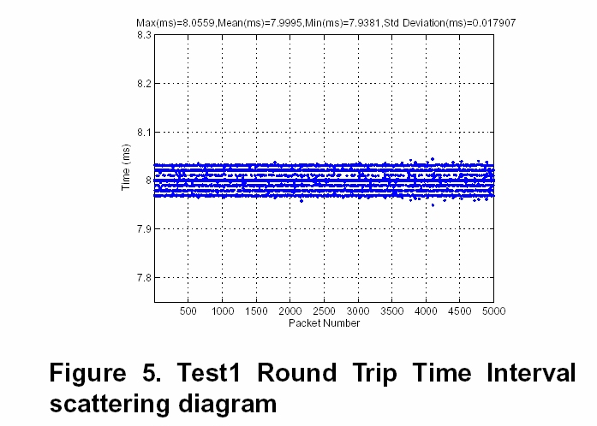
Motivation
Industrial Control Systems (ICSs) require real-time, low-latency communications
Cyberattacks and physical faults overlap, making detection more difficult
Traditional IDS is CPU-intensive and slow, unsuitable for ICS
Less than 100 µs jitter
(a) Round-trip time interval¹
[1] J. Moyne, Performance Metrics for Industrial Ethernet, NSF Engineering Research Center for Reconfigurable Manufacturing Systems, College of Engineering, University of Michigan, 2006.
Notes:
Figure shows characterization of Industrial ethernet (profinet) for a topology of 1 to 5 switches

Slide 79
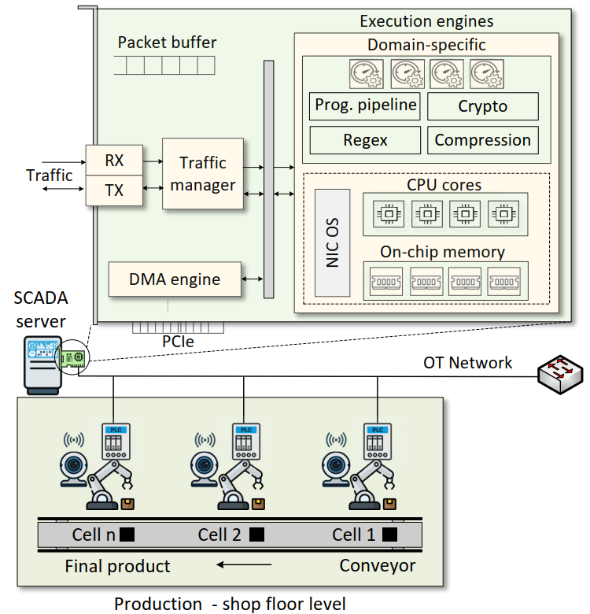
System Architecture
PLC-controlled industrial cells connected to a SCADA server equipped with a SmartNIC.
The SmartNIC includes programmable data-plane components used for fast packet processing.
The SmartNIC performs in-network ML inference using DPDK for real-time anomaly detection.

Slide 80
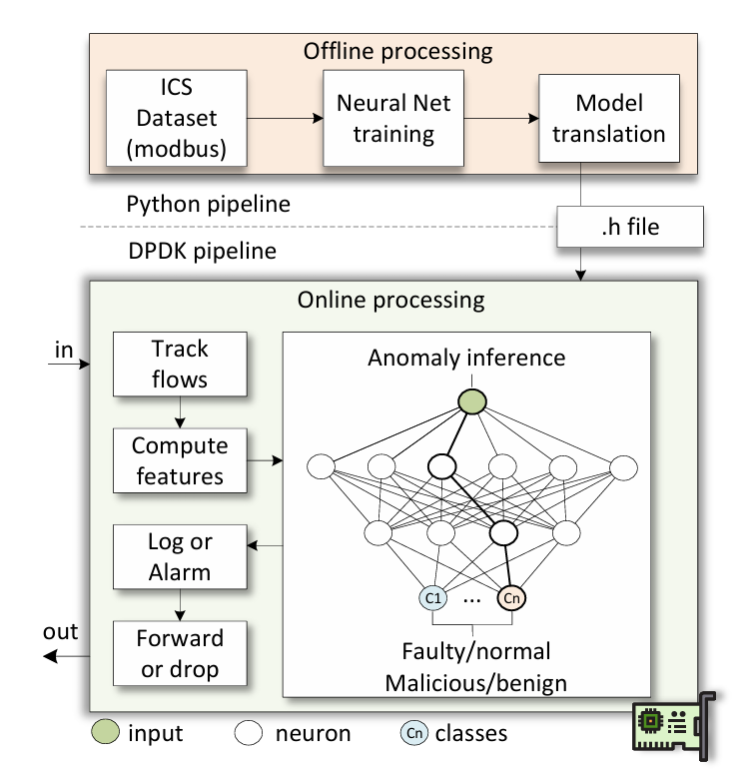
Proposed System
A fully connected neural network is trained and offloaded to the SmartNIC
The SmartNIC tracks network and sensor flows
After a window of N packets of sensor readings, inference is triggered
Based on the classification, an action is taken (e.g., forward or drop)

Slide 81
Proposed System
Features per sensor:
  Sensor value: minimum, maximum, average
  Modbus inter-arrival time: minimum, maximum, average
  Range of sensor values (max – min)

Slide 82
Proposed System
Features per flow (i.e., 5-tuple):
  IPv4 packet size: minimum, maximum, average
  Inter-arrival time: minimum, maximum, average
  Total bytes
  TCP SYN to ACK ratio

Slide 83
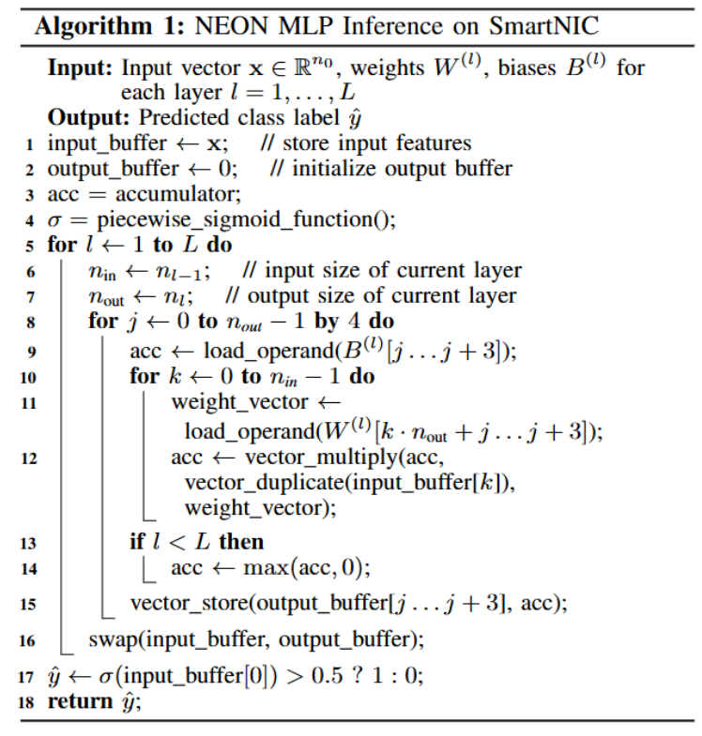
NEON acceleration
ARM’s NEON is a parallel arithmetic accelerator
  Single Instruction Multiple Data (SIMD) architecture
NEON processes 4 32-bits words per instruction
Notes:
Using multiple of 4 neuron count in each hidden layer avoids falling back to scalar for tail multiplications and pollute execution (e.g., branch misprediction)
multilayer perceptron (MLP)
NEON:
Single Instruction, Multiple Data (SIMD) Processing
To accelerate machine learning inference, this paper employs ARM’s NEON technology, a 128-bit SIMD extension that enables parallel arithmetic on data vectors. NEON is a coprocessor subsystem integrated into each ARM core and uses a pipelined architecture to operate on vector registers, supporting operations such as comparisons and multiplications on data up to 128 bits wide. NEON intrinsics are low-level C functions mapped directly to SIMD instructions and are used in this work to implement an MLP model, which is a feedforward neural network composed of an input layer, one or more hidden layers, and an output layer. Each layer performs weighted sums of its inputs, adds bias terms, and applies nonlinear activation functions.

Slide 84
NEON acceleration
Multilayer Perceptrons (MLPs) can be implemented with matrix–vector operations
  Parallelizable
  Deterministic
Inference with 8 inputs, a binary output, and hidden layers whose sizes are multiples of 4
Notes:
Using multiple of 4 neuron count in each hidden layer avoids falling back to scalar for tail multiplications and pollute execution (e.g., branch misprediction)
multilayer perceptron (MLP)
NEON:
Single Instruction, Multiple Data (SIMD) Processing
To accelerate machine learning inference, this paper employs ARM’s NEON technology, a 128-bit SIMD extension that enables parallel arithmetic on data vectors. NEON is a coprocessor subsystem integrated into each ARM core and uses a pipelined architecture to operate on vector registers, supporting operations such as comparisons and multiplications on data up to 128 bits wide. NEON intrinsics are low-level C functions mapped directly to SIMD instructions and are used in this work to implement an MLP model, which is a feedforward neural network composed of an input layer, one or more hidden layers, and an output layer. Each layer performs weighted sums of its inputs, adds bias terms, and applies nonlinear activation functions.

Slide 85
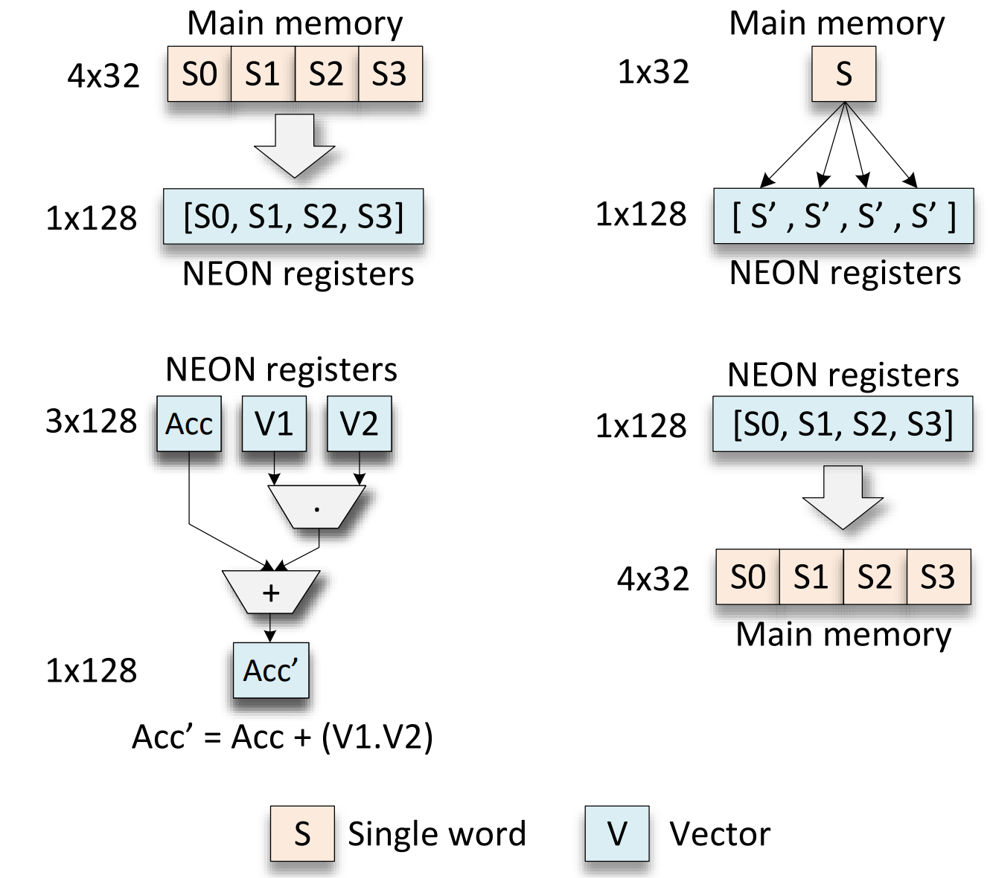
NEON acceleration
NEON intrinsic operations:
  load_operand(): vld1q_f32()

Slide 86
NEON acceleration
NEON intrinsic operations:
  load_operand(): vld1q_f32()
  vector_duplicate(): vdupq_n_f32()

Slide 87
NEON acceleration
NEON intrinsic operations:
  load_operand(): vld1q_f32()
  vector_duplicate(): vdupq_n_f32()
  vector_multiply(): vfmaq_f32()

Slide 88
NEON acceleration
NEON intrinsic operations:
  load_operand(): vld1q_f32()
  vector_duplicate(): vdupq_n_f32()
  vector_multiply(): vfmaq_f32()
  vector_store(): vst1q_f32()

Slide 89
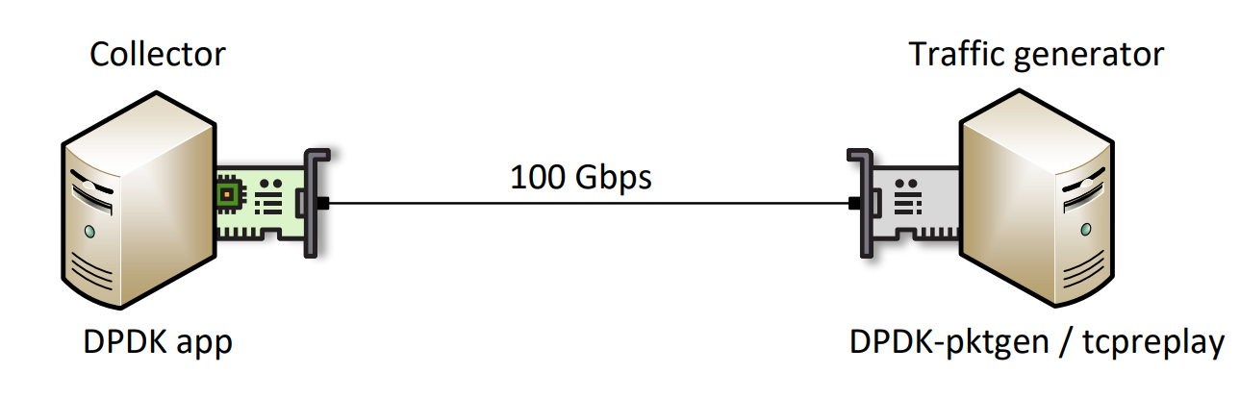
Experiment Topology and Dataset
The topology consists of two nodes:
  Collector node, equipped with an NVIDIA BlueField (BF)
  Traffic generator node, equipped with an NVIDIA ConnectX-6
Dataset¹:
  Emulated industrial process with PLCs and HMIs
  Synchronized sensor, log, and network data
  Normal, fault, and cyber-attack scenarios
Sudyana, D. (2025). ICS Dataset [Data set]. Zenodo. https://doi.org/10.5281/zenodo.17165850

Slide 90
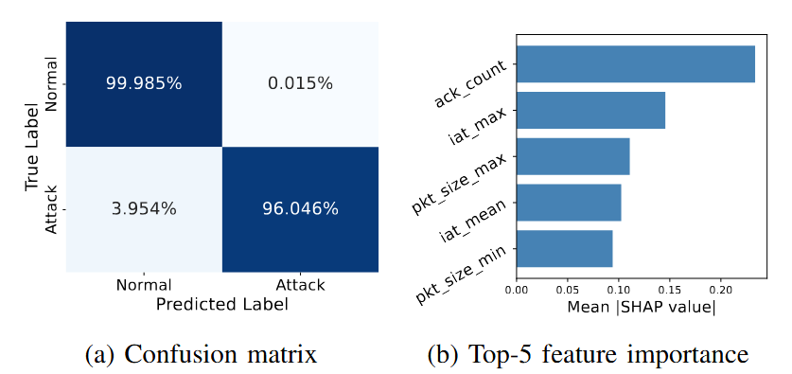
Results: Cyberattack detection
We trained an MLP model using per-flow metrics
All attacks are included under the malicious class
The size of the MLP is (32,16) with 8 inputs
Notes:
The 8 features capture 96% of the attacks
Top feature is ack count, which measures the ratio of ack and syn packets in a given window

Slide 91
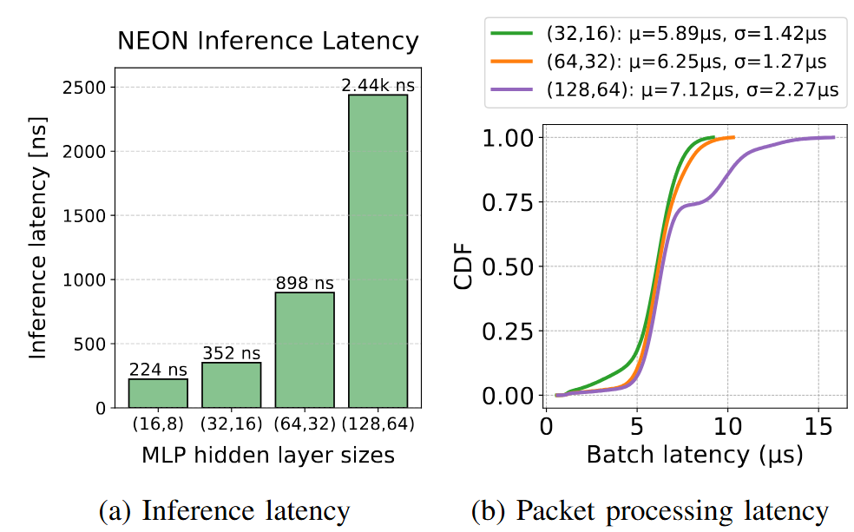
Performance
This experiment characterizes the Modbus pipeline in DPDK
NEON inference in the Bluefield-3 costs less than 2.5 µs
Total latency per batch is less than 7µs
Notes:
Not all packets trigger inference. This shows that most packets are processed and emitted without paying penalties for the ML monitoring

Slide 92
Training on Accelerators
(DPUs, P4 Switches, DPDK, P4-DPDK)

Slide 93

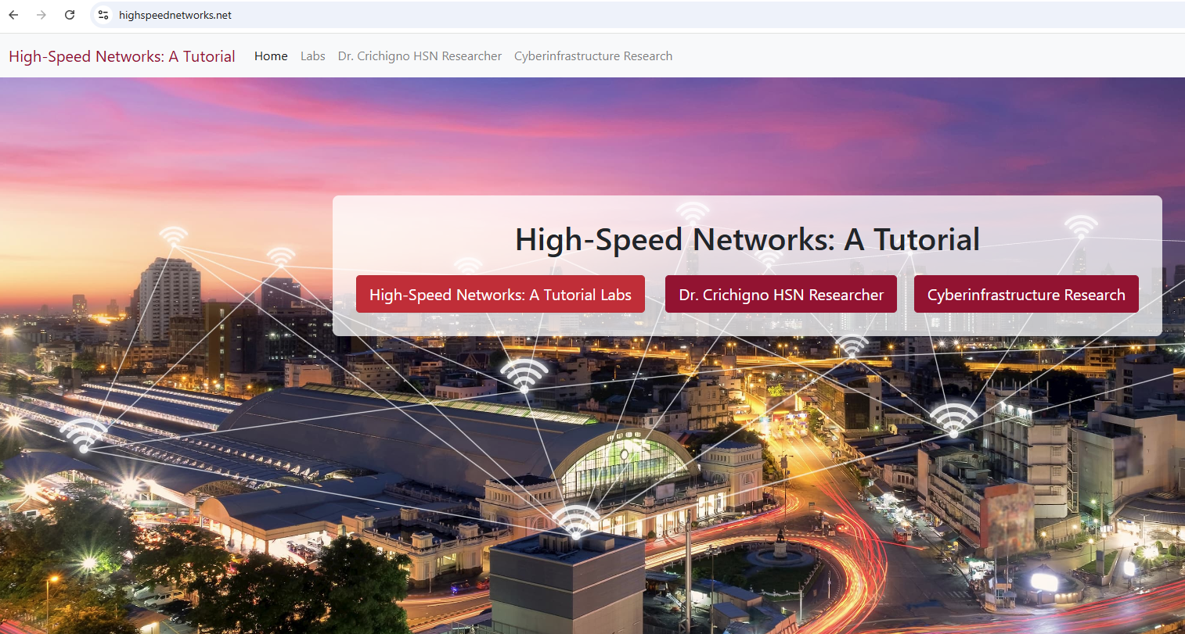
Virtual Lab Libraries
Information about libraries is available at https://research.cec.sc.edu/cyberinfra/cybertraining
Programmable data plane / accelerators
DPU Programming using P4
DPU Programming using DOCA
P4-DPDK Security
Introduction to P4-DPDK
Cybersecurity Applications with P4 Switches
P4 Programmable Data Planes: Apps, Custom Packet Processing
Introduction to P4 Switches
Introduction to P4 Switches with Intel’s Tofino
P4 Monitoring Applications
Traditional Protocols
Software-defined Networking (SDN)
Open vSwitch
Network Tools and Protocols
Introduction to IPv6
Open Shortest Path First (OSPF)
Introduction to BGP
MPLS and Advanced BGP
Cybersecurity, Management
Zeek IDS/IPS
Cybersecurity Fundamentals
perfSONAR 5
P4-perfSONAR
Network Management Tools
High-speed Networks: A Tutorial
https://highspeednetworks.net/

Slide 94
Virtual Lab Libraries
Library Example: “Cybersecurity Applications on P4 Programmable Data Planes”
Lab | Topic
Lab 1 | Introduction to Mininet
Lab 2 | Introduction to P4 and BMv2
Lab 3 | P4 Program Building Blocks
Lab 4 | Parser Implementation
Lab 5 | Introduction to Match-action Tables
Lab 6 | Implementing a Stateful Packet Filter for the ICMP Protocol
Lab 7 | Implementing a Stateful Packet Filter for the TCP Protocol
Lab 8 | Detecting and Mitigating the DNS Amplification Attack
Lab 9 | Identifying Heavy Hitters using Count-min Sketches (CMS)
Lab 10 | Limiting the Impact of SYN Flood by Probabilistically Dropping Packets
Lab 11 | Blocking Application Layer Slow DDoS Attack (Slowloris)

Slide 95

Demo

Slide 96
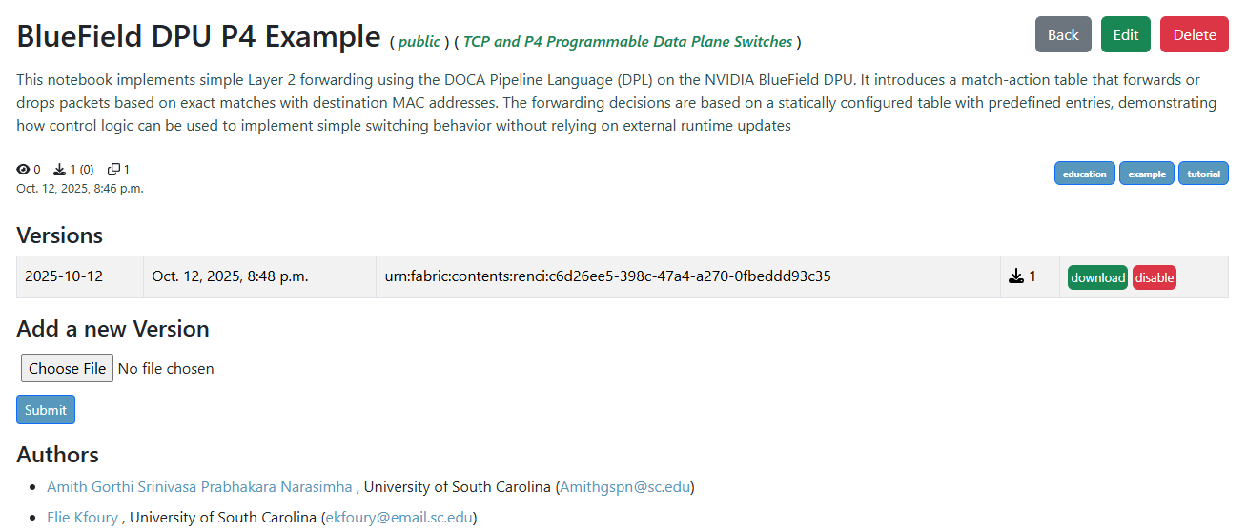
P4 DPU Example on Artifact Manager
Simple L2 forwarding example available on Artifact Manager

Slide 97
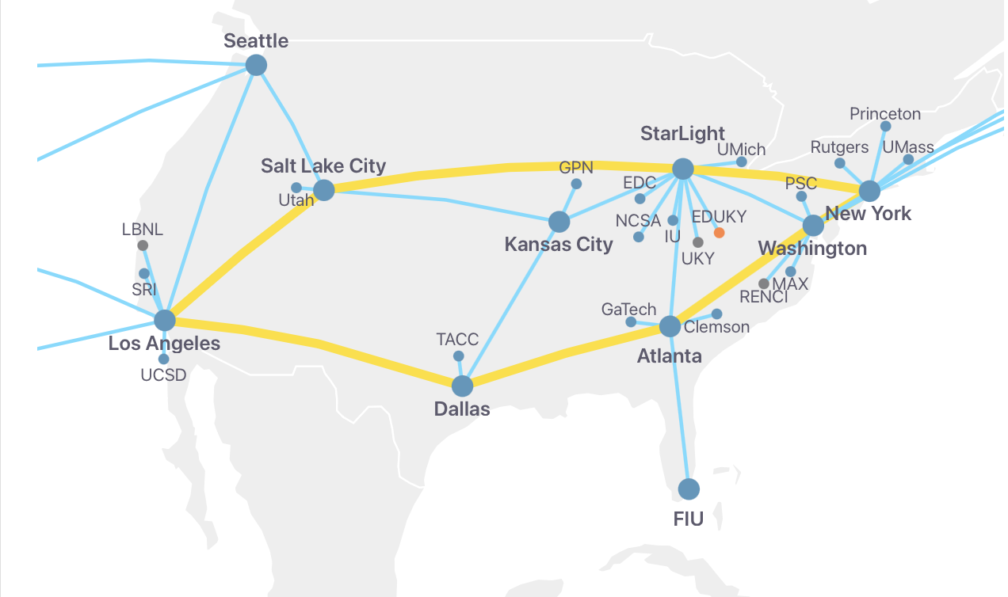
DPUs on FABRIC
BlueField-3 DPUs are being installed on various FABRIC sites
Currently the following sites have DPUs installed (more will be available soon):
  MASS, DALL, SALT, FIU, LOSA, NEWY, ATLA, HAWI
These sites are available to the users (and projects that have the permissions)
97

Slide 98
Conclusion
The computing industry is increasingly developing and adopting DSAs
There are unique opportunities in computer networks to
  Address problems using DSAs
  Improve performance
  Create new applications

Slide 99
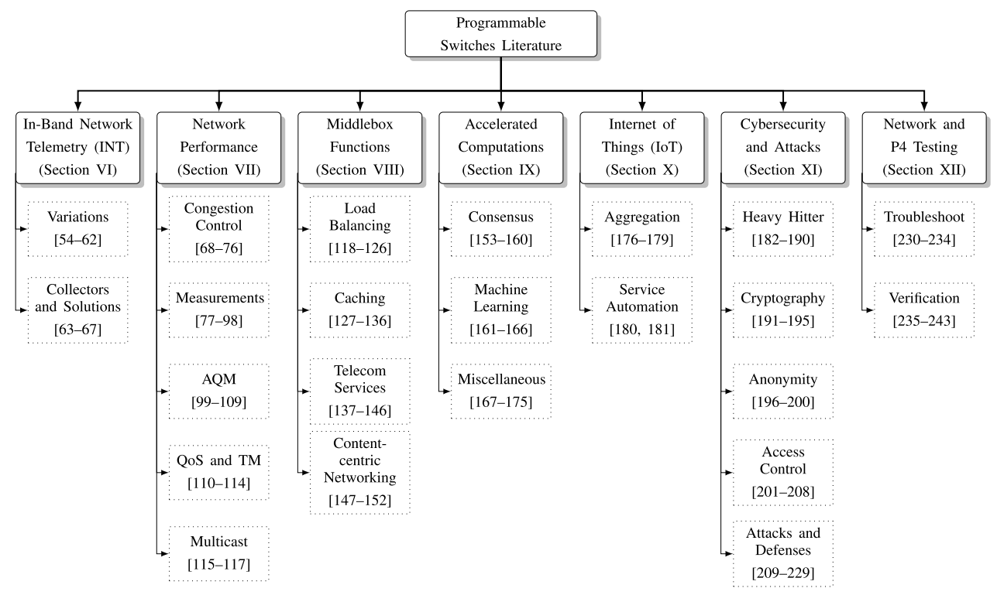
Conclusion
E. F. Kfoury, J. Crichigno, and E. Bou-Harb, “An exhaustive survey on p4 programmable data plane switches: Taxonomy, applications, challenges, and future trends”, IEEE Access, Vol. 9, June 2021

Slide 100
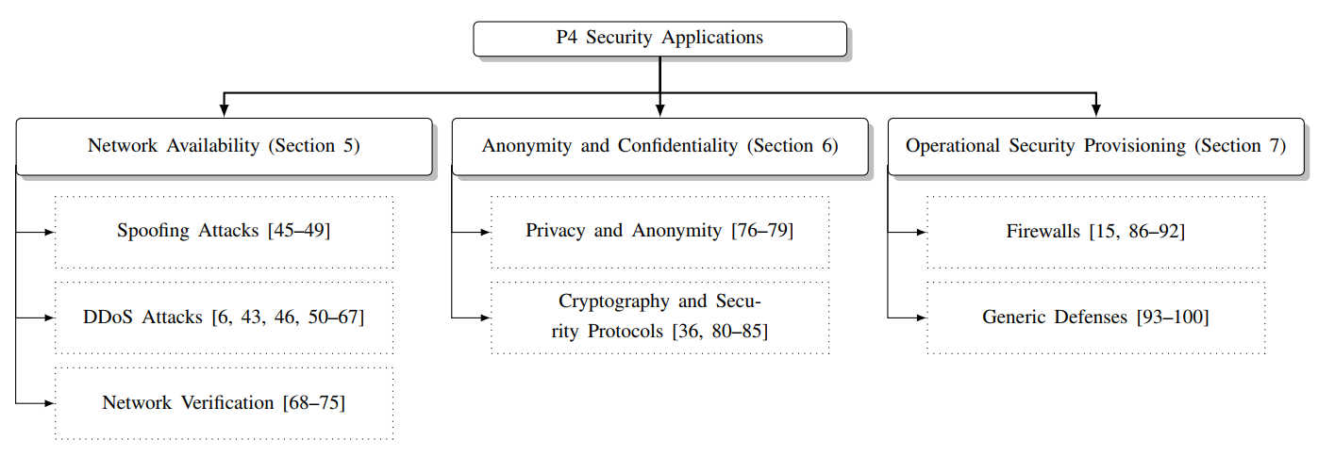
Conclusion
A. AlSabeh, J. Khoury, E. Kfoury, J. Crichigno, and E. Bou-Harb, “A survey on security applications of P4 programmable switches and a STRIDE-based vulnerability assessment”, Computer Networks, Vol. 207, April 2022.

Slide 101
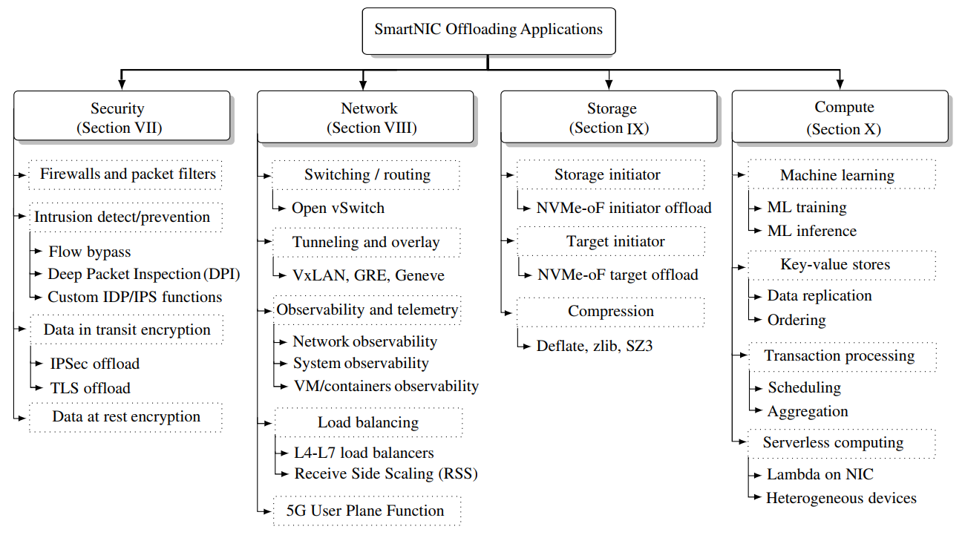
Conclusion
E. F. Kfoury, S. Choueiri, A. Mazloum, A. AlSabeh, J. Gomez, and J. Crichigno, “A Comprehensive Survey on SmartNICs: Architectures, Development Models, Applications, and Research Directions”, IEEE Access, Vol. 12, August 2024.

Slide 102
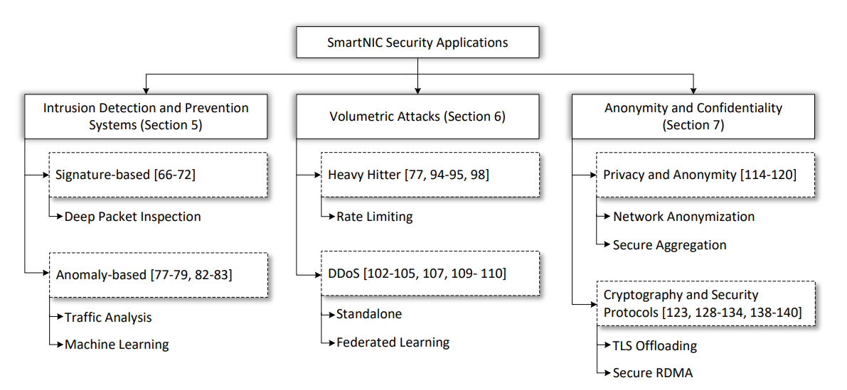
Conclusion
S. Elizalde et al., “A Survey on Security Applications with SmartNICs: Taxonomy, Implementations, Challenges, and Future Trends”, in Journal of Network and Computer Applications, Vol. 242, October 2025.

Slide 103
Conclusion
A challenge is the limited access to DSAs and training materials
USC is leading training and education efforts on DSAs to
  Reduce the learning curve
  Lower the entry barrier for students, researchers, and practitioners

Slide 104


Acknowledgement
This work was supported by the U.S. National Science Foundation (NSF), under awards 2417823 and 2346726
The authors would also like to acknowledge the FABRIC team.

