Slide 1
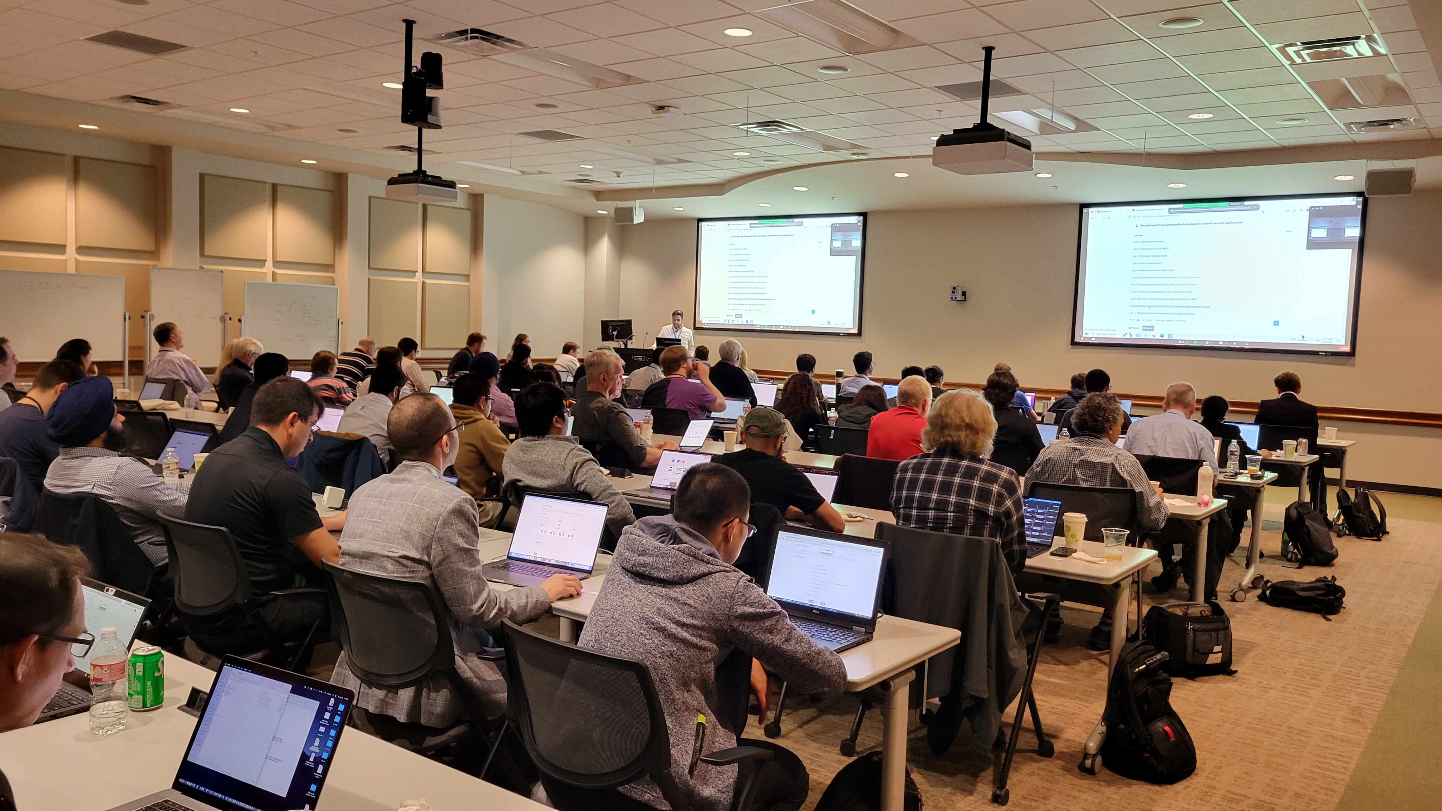
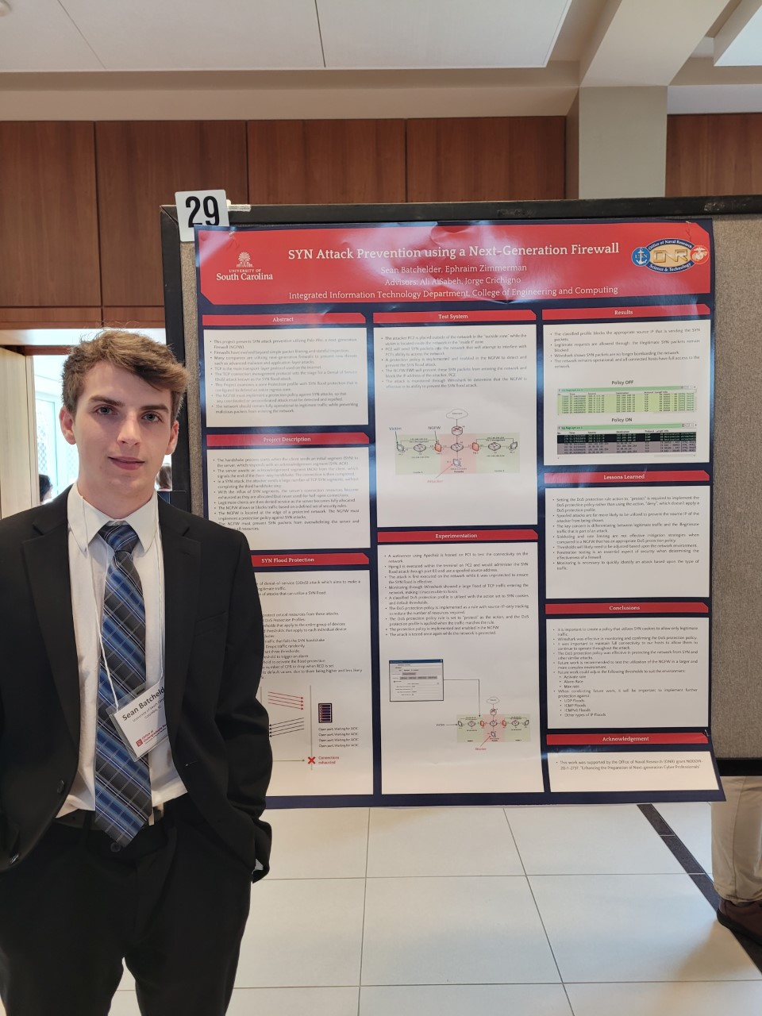
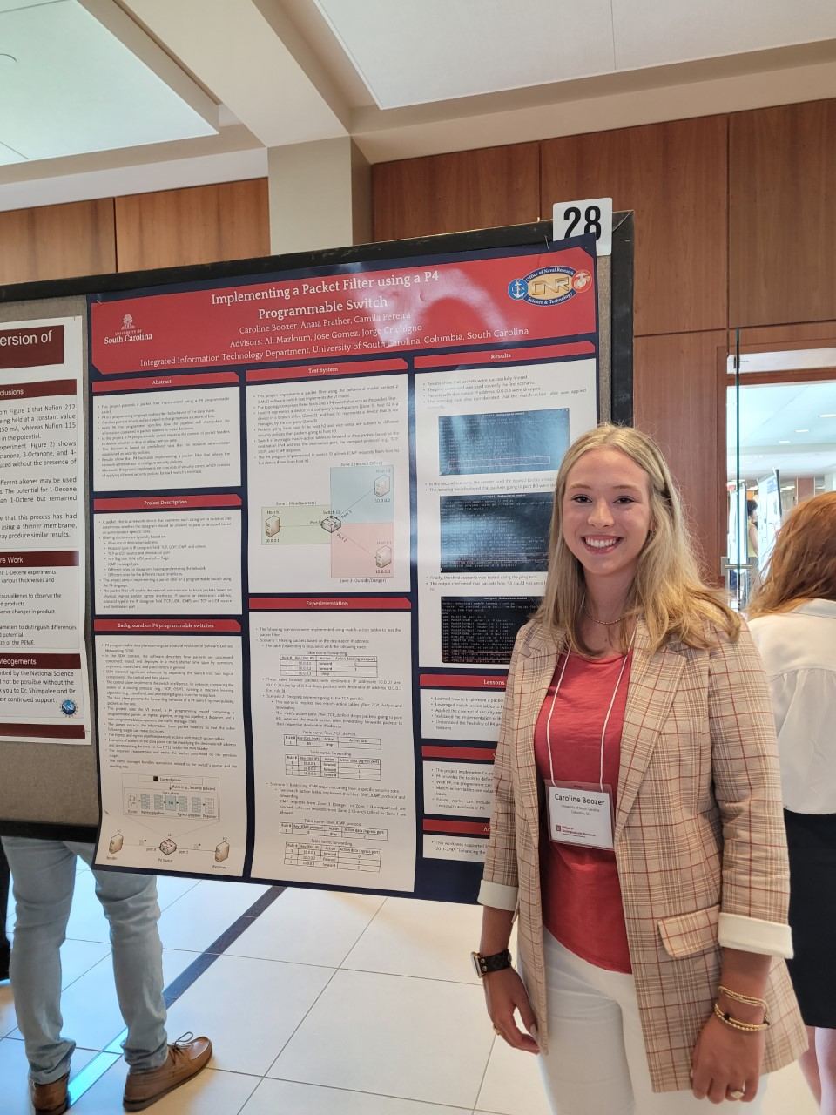
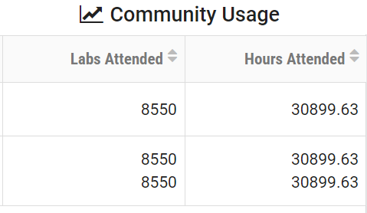
Preparing Cyber Warfare Professionals by Integration of Curriculum, Experiences, and Internships
Jorge Crichigno (PI) - University of South Carolina (USC), UT San Antonio (UTSA), SC State University (SCSU)
Project website: https://research.cec.sc.edu/cyberinfra/projects/ONR
Motivation and Goals
Informal Communities
Motivation
Shortage of professionals with cybersecurity skills.
Goals
Advance formal and informal cyber communities.
Develop a multi-state internship program.
Expand the Academic Cloud to support large-scale learning and research nationwide on C4ISR.
1- to 3-day workshops have been organized, online & in-person.
5 hands-on workshops in 2023, over 160+ IT professionals/ educators were trained.
Multiple universities adopted the material.
8,550 lab experiments - 30,899 hours, Feb 1, 2023-Jan 31, 2024
Workshop details: https://tinyurl.com/yennduua
Students who completed the C4ISR training are working on a DARPA project developing new C4ISR techniques.
C4ISR Undergraduate Research and Formal Courses
Over 30 students specialized in C4ISR topics per year.
Virtual lab libraries on C4ISR incorporated in courses at institutions in TX (UTSA) , SC, LA, NC, CA, and other states.
Over 60 U.S. National Guard trained per year in cyber warfare-IT.
< Workshop, Apr. ‘23, Texas Advanced Supercomputing Center, Austin, TX.
Community usage – Academic Cloud. > Feb. 1, 2023 – Jan. 31, 2024

