Slide 1
  Cyberinfrastructure Lab
  Meeting on Advanced Manufacturing
  October 8, 2025
  11:30-12:30 - Online
Notes:
Also work on Cybertraining – virtual platforms

Slide 2
  Cyberinfrastructure Lab
Notes:
Also work on Cybertraining – virtual platforms

Slide 3
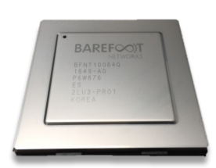
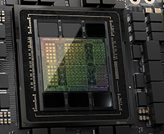
DSAs
Research
  Domain-specific Accelerators (DSAs), cybersecurity, high-performance networks, IoT
  Smart → programmable
Solving a Dynamic Programming Problem
DSA for packet processing –P4 switch (Barefoot Networks)
DSA for Dynamic Programming (NVIDIA)
Notes:
Also work on Cybertraining – virtual platforms

Slide 4
IT/OT Cyber
Notes:
Flexible scheduling, evening/weekend and hybrid/online WITHOUT COMPROMISING HANDS-ON -- CLOUD

Slide 5
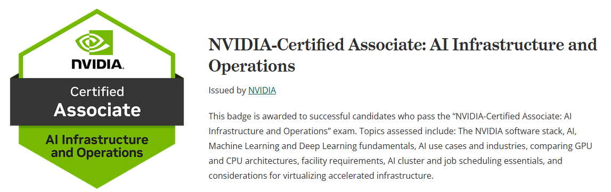
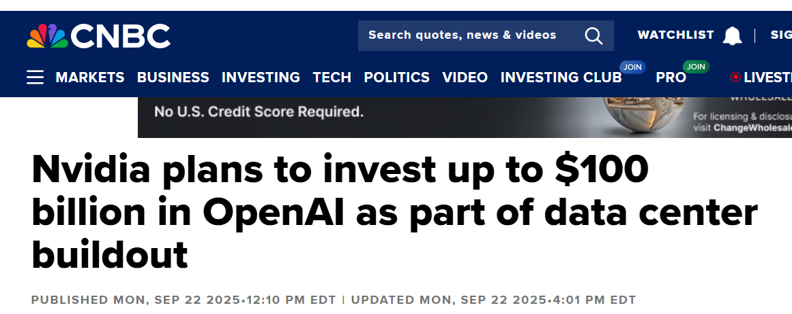
IT/OT Cyber
  AI Infrastructure and Operations
NVIDIA badge

Slide 6
DSA Applications
  McNAIR Center
Future Factories Lab (FF-Lab)

Slide 7
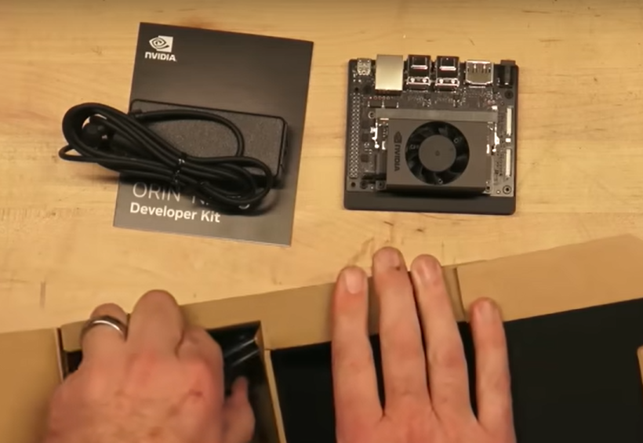
DSA Applications
  McNAIR Center
Nano DSA for AI workloads
Future Factories Lab (FF-Lab)
Notes:
NNSA NA115
https://www.osti.gov/biblio/1756584

