Slide 1
Cyberinfrastructure Lab Department of Integrated Information Technology
College of Engineering and Computing
Jorge Crichigno
jcrichigno@cec.sc.edu
Meeting University of South Carolina - National Center for Credibility Assessment (NCCA) - Defense Counterintelligence and Security Agency (DCSA)
USC AI Institute - November 8, 2022

Slide 2
College of Engineering and Computing
The University of South Carolina is a National Center of Academic Excellence (CAE) for Cyber Defense Education (CAE-CDE), and a CAE for Research (CAE-R)
Designation made by the National Security Agency (NSA)
Computer Science and Engineering (CSE) is the primary unit
IIT is the main department supporting CSE
The College of Engineering and Computing offers ABET Accredited Programs
B. Sc. Computer Science (CSE)
B. Sc. Information Technology (IIT)
Multiple minors; e.g., Cybersecurity Operations, Networks (IIT)

Slide 3
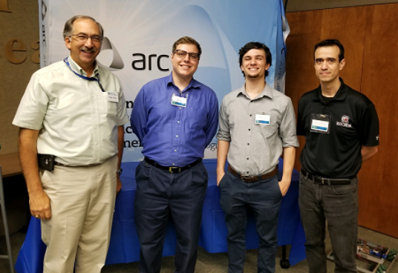
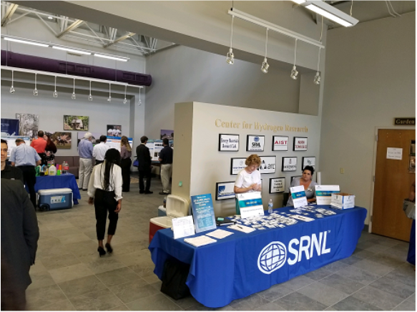
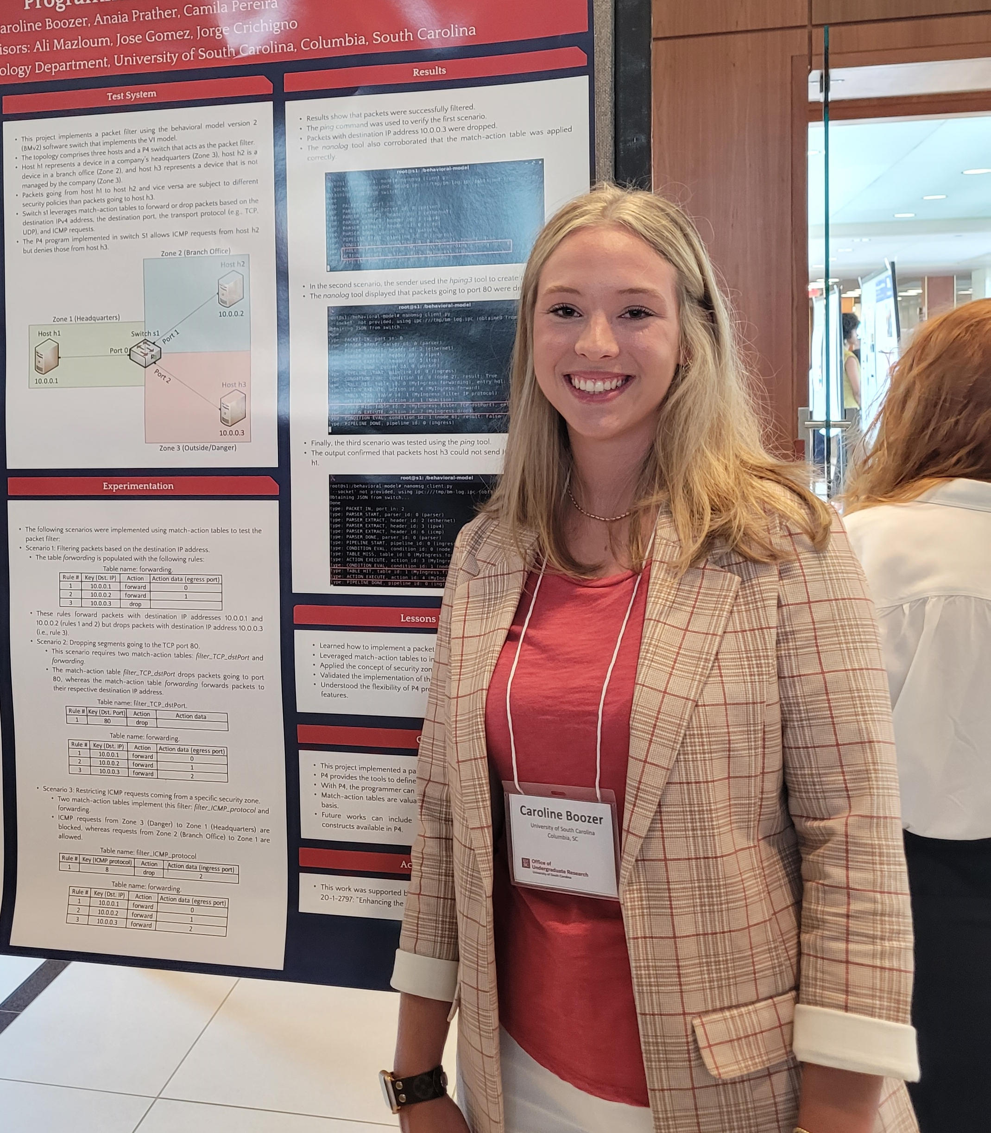
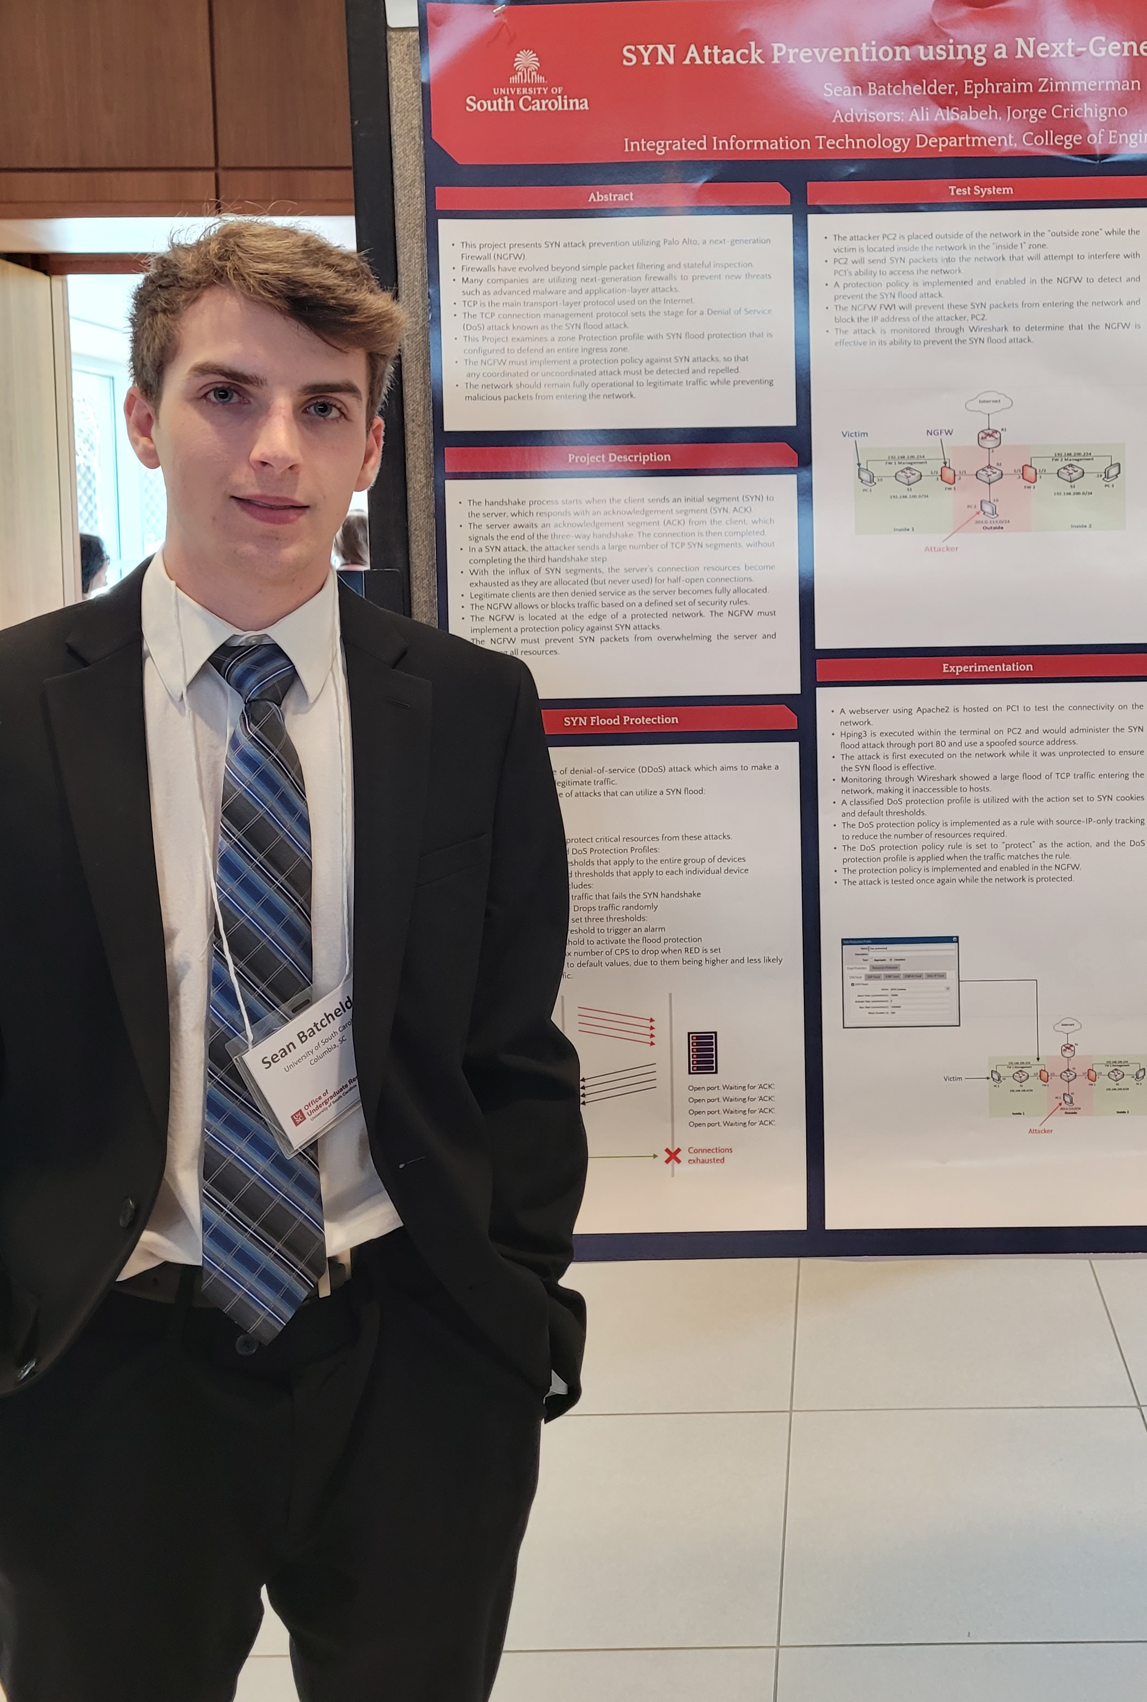
College of Engineering and Computing
Partnerships
Undergraduate research in cyber
Internships at national labs, private companies, agencies
USC supports training programs in cyber; e.g., U.S. National guard, U.S. Army Cyber-center of Excellence, Lawrence Berkeley National Laboratory (LBNL), National Research and Education Networks
LBNL / USC training workshops
Internships, undergraduate research
CIO Savannah River National Laboratory (SRNL), interns
Undergraduate researchers

Slide 4
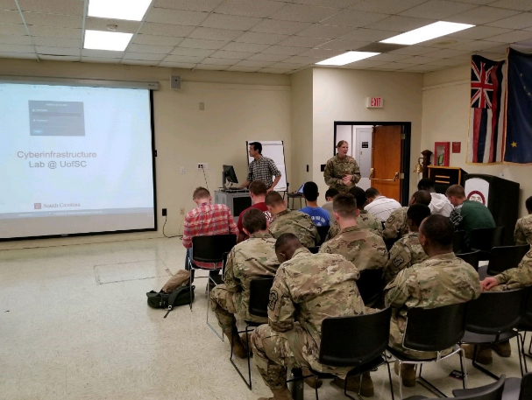
College of Engineering and Computing
Partnerships
Undergraduate research in cyber
Internships at national labs, private companies, agencies
USC supports training programs in cyber; e.g., U.S. National guard, U.S. Army Cyber-center of Excellence, Lawrence Berkeley National Laboratory (LBNL), National Research and Education Networks
ROTC cybersecurity training, ONR undergraduate research

Slide 5
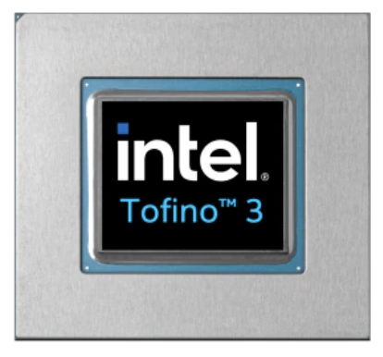
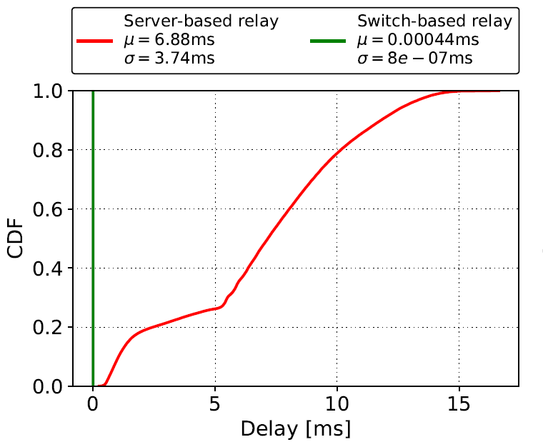
College of Engineering and Computing
Development of apps running on domain-specific (network) processors for packets
Network processors provider granular visibility of events (nanosecond resolution)
They can detect /process events much faster than general-purpose CPUs
Collaboration / agreement with Intel
Application example: voice processing¹
 | Network Processor | General-purpose CPU
Cost | $6,000 | $ 10,000 - 25,000
Capacity | ~35M connections/switch | ~500 connections/core
Latency | 400 nanoseconds | Tens-hundreds of msec
¹E. Kfoury, J. Crichigno, E. Bou-Harb, V. Gurevich, “Offloading Media Traffic to Programmable Data Plane Switches,” IEEE ICC, June 2020.

Slide 6
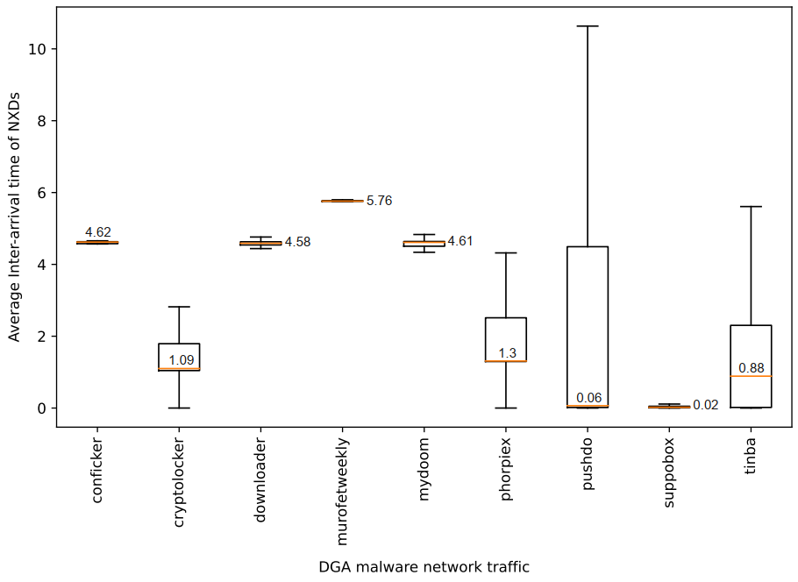
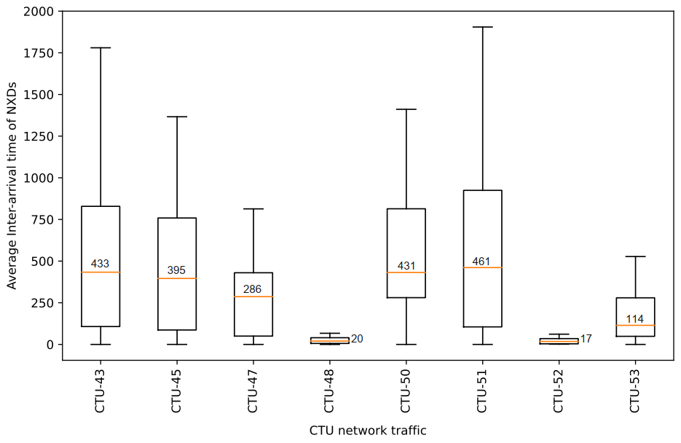
College of Engineering and Computing
Development of apps running on domain-specific (network) processors for packets
Network processors provider granular visibility of events (nanosecond resolution)
They can detect /process events much faster than general-purpose CPUs
Collaboration / agreement with Intel
Application example: malware detection based on non-existing domain (NXD) packets²
²A. AlSabeh, E. Kfoury, J. Crichigno, E. Bou-Harb, "P4DDPI: Securing P4-Programmable Data Plane Networks via DNS Deep Packet Inspection", NDSS, Apr 2022.

