Slide 1
Researcher / Team Introduction
David W. Matolak
Professor
Department of Electrical Engineering
University of South Carolina
Aircraft Maintenance Hangar
Path 3
Path 1
Rx
Path 4
Tx
Path 2
Research Group Overview: Wireless Science & Engineering (WiSE) Lab investigates
Wireless channel characterization: analysis, measurements, simulations, & modeling for variety of environments (terrestrial, air-ground, V2V,…VHF – mmWave (so far!))
Modulation & detection: adaptive PHY, DLL techniques for dependable mobile links, including high-mobility platforms, and low probability of detection (LPD) and anti-jam (AJ) communications

Slide 2
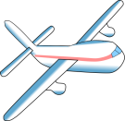
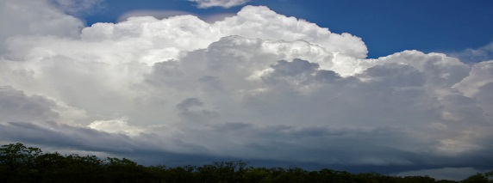
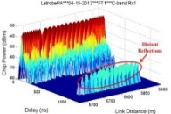
NASA University Leadership Initiative Project
Multi-Band Communications & Networking: simultaneously and/or alternately employ different spectral bands for successful transmissions
Band differences can adjust latency, reduce interference, offload congested bands, improve reliability & resilience to disruption⇒Safer!
Hyper-spectral: HF - VHF - L-band, C-band, K-bands, & mmWave bands
Storm
Channel Type 1
Channel
Type 5
Interferer
Channel Type 3
En-route
Channel Type 2
Takeoff
(σ_{τ2},f_{D2})
Channel
Type 4
Landing
Taxi
Taxi
Ground Site Type 1
Interferer
Ground Site Type 2

Slide 3
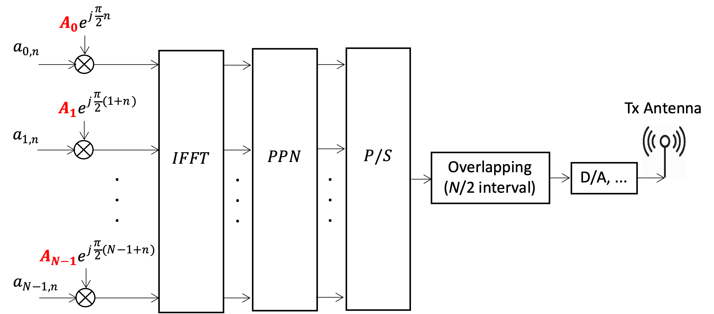
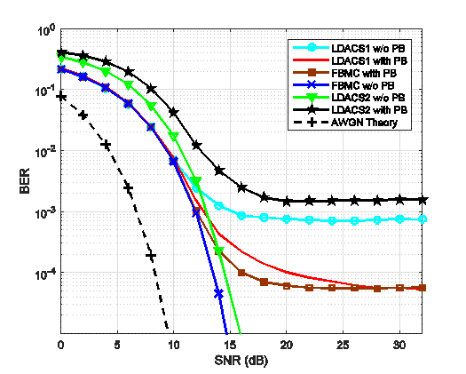
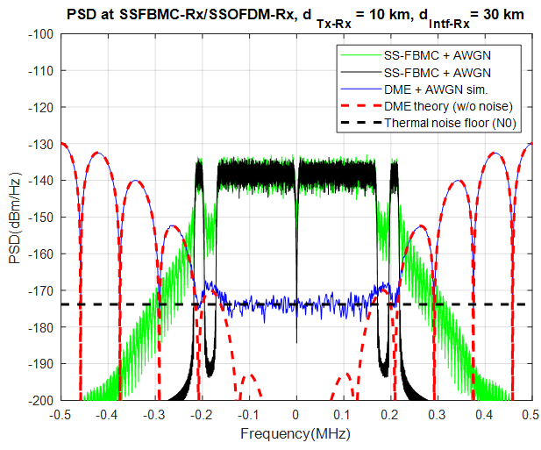
Spectrally-Shaped Filterbank Multicarrier (FBMC)
Design→Lab Tests → Drive Tests→Flight Tests
Over-sea channel
Ss-FBMC & DME Power Spectra
LDACS1
(OFDM)
FBMC
Ss-FBMC Transmitter
Ss-FBMC Bit Error Ratio vs. received signal-to-noise ratio

Slide 4
Radio Diagram: Ground Station (GS)
2 antennas for each band yields spatial diversity
Single broadband HPA
Multiple RF filters to meet spectral mask, spurious emission suppression

Slide 5
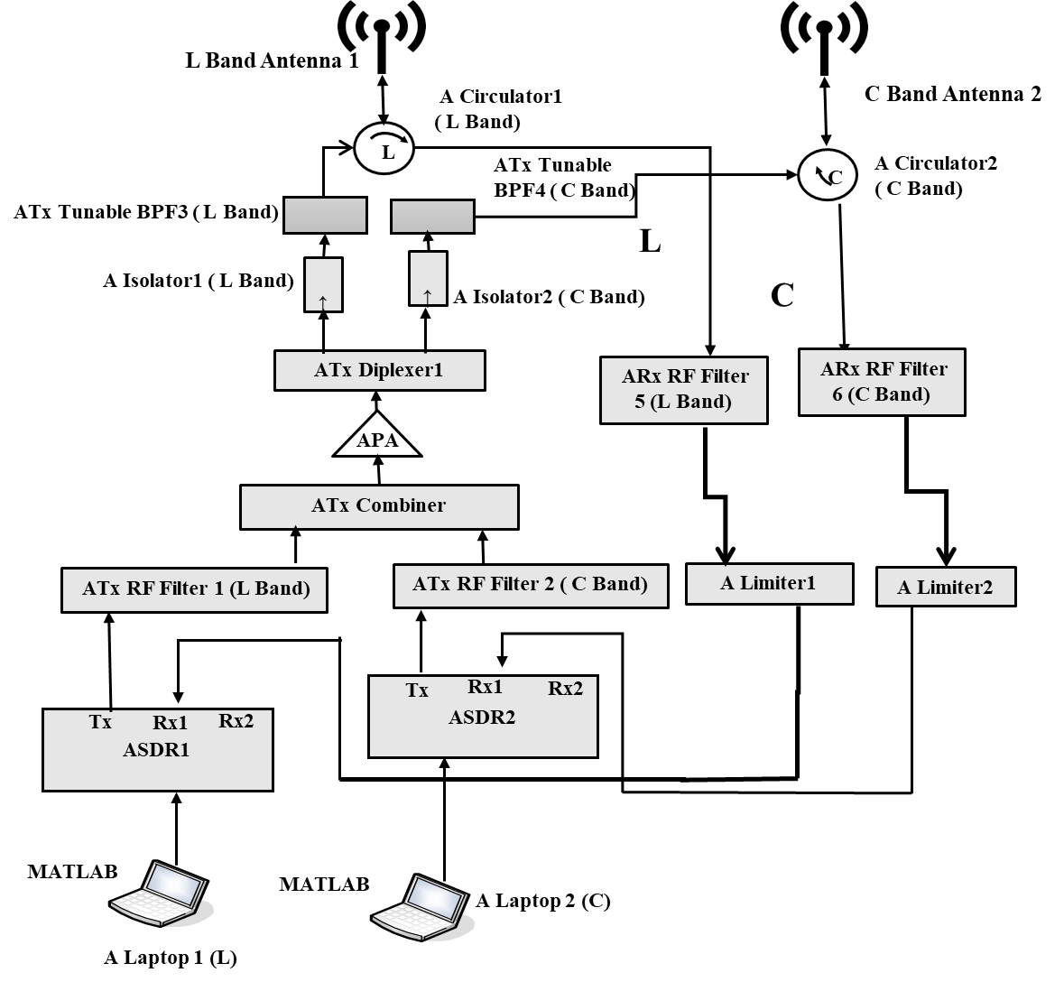
Radio Diagram: Aircraft
Aircraft=Air Station (AS)
Single antenna for each band
Otherwise design identical to GS

Slide 6
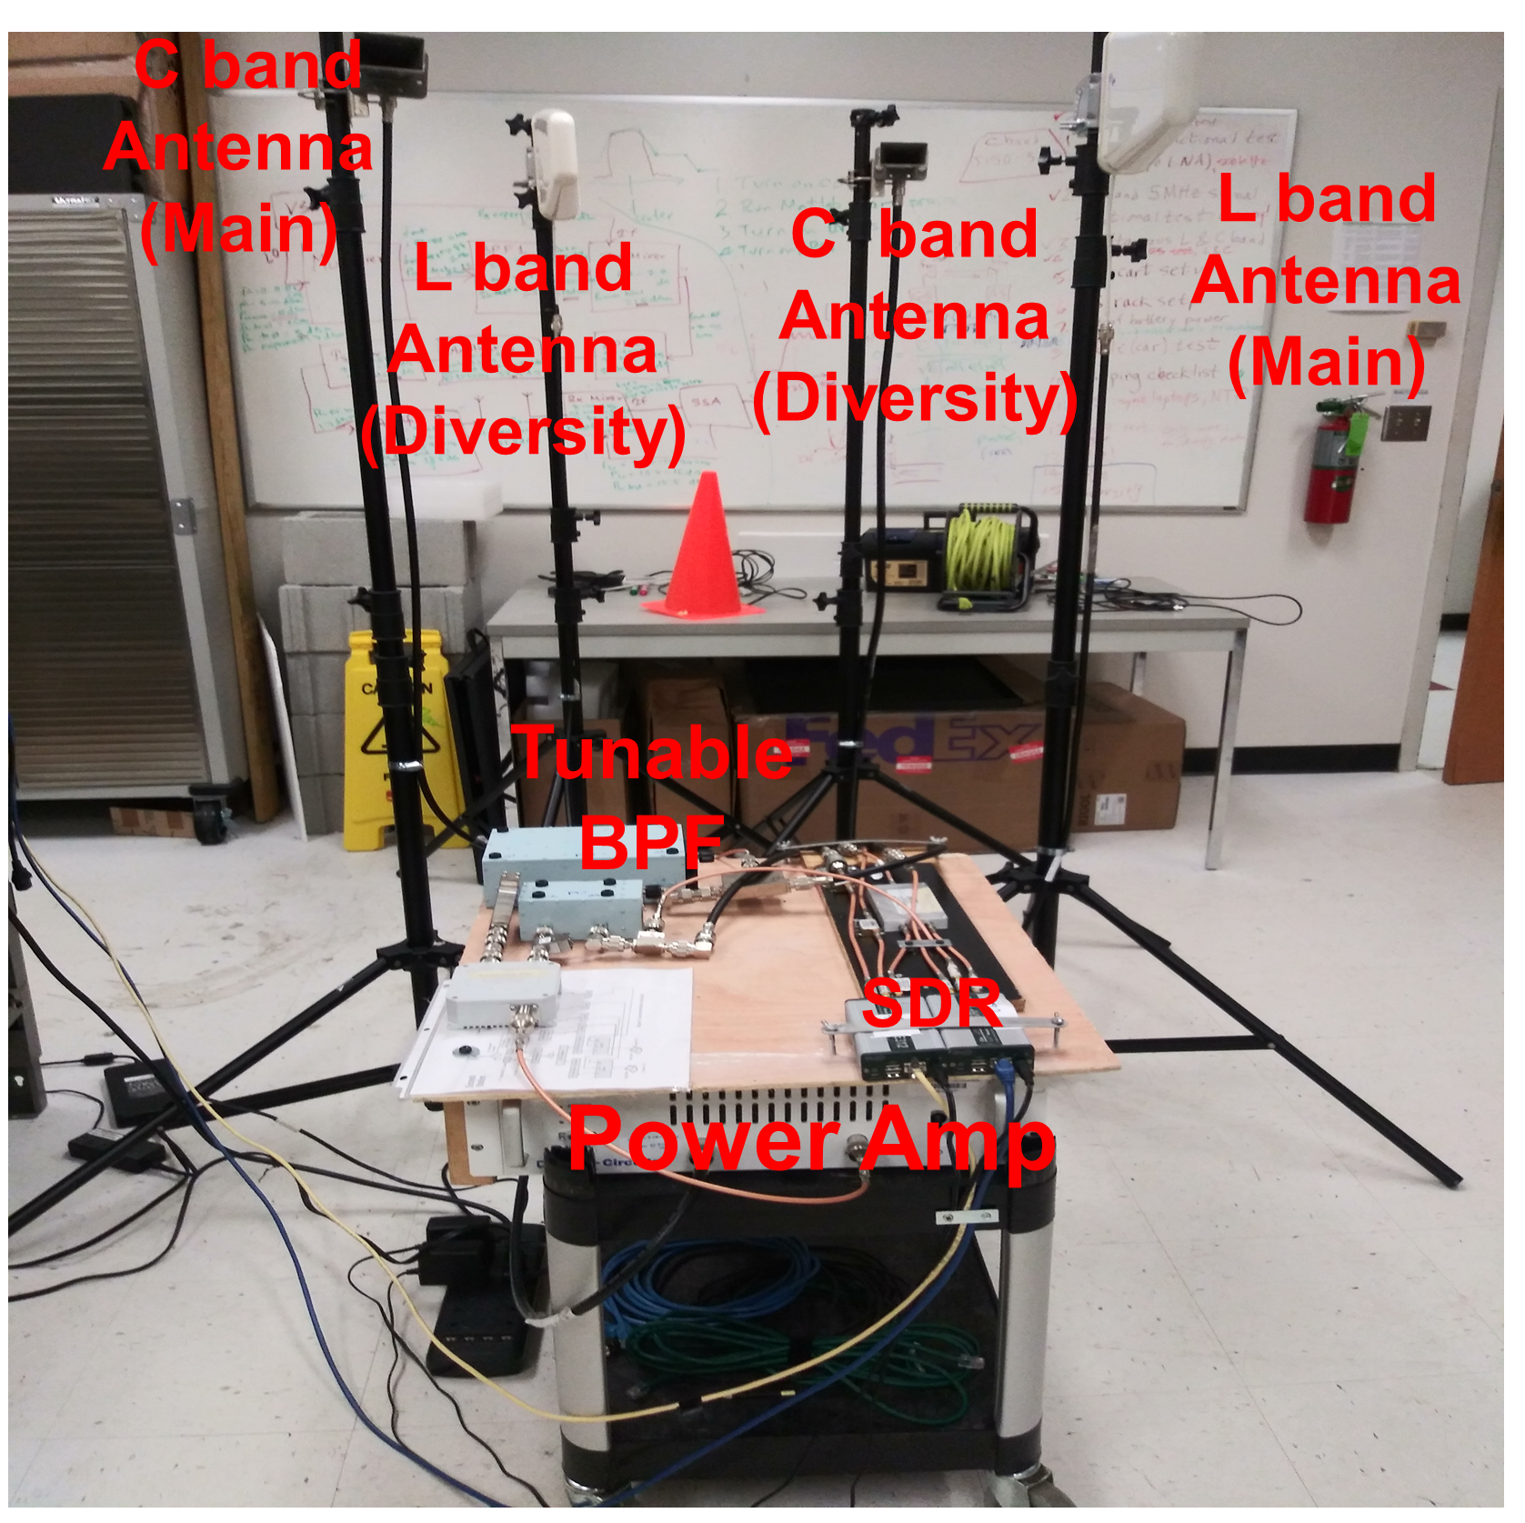
Radio System: Ground Station
Broadband (700-6000 MHz) HPA, max power 47 dBm
Dual diversity: 2 L-band & 2 C-band GS antennas
L-band log-periodic antennas w/90-degree HPBW, G=10 dBi
C-band horn antennas w/60 degree HPBW, G=10 dBi
GS Configuration in Lab

Slide 7
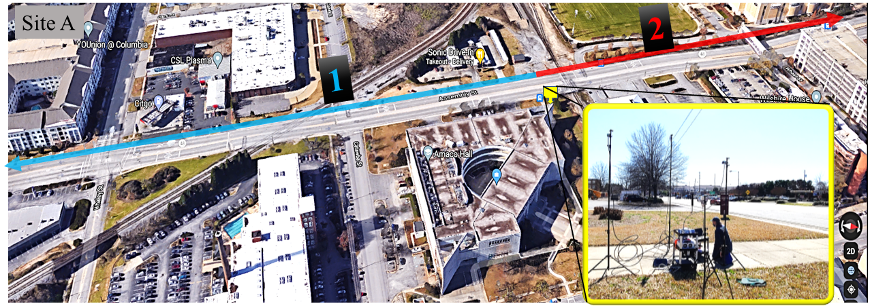
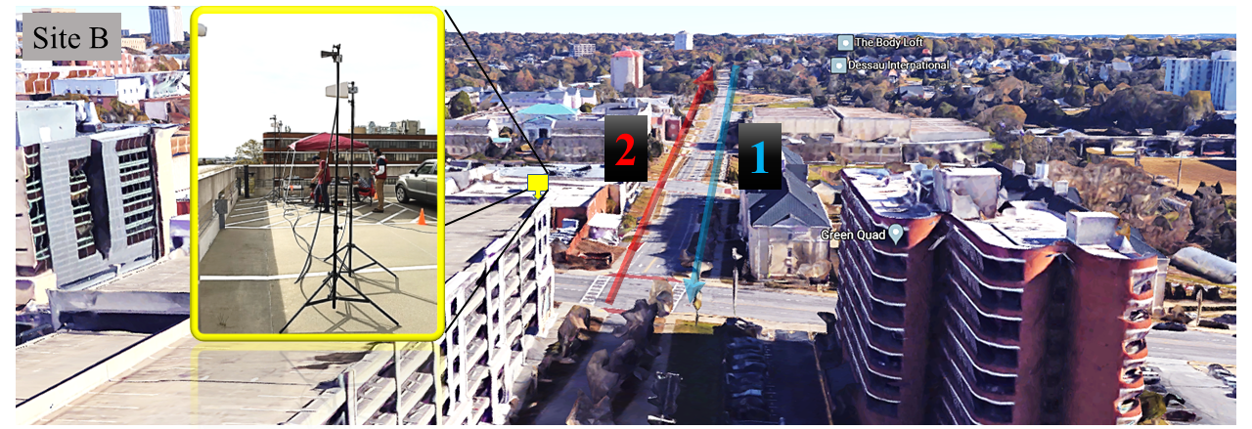
Terrestrial Drive Test Measurement Sites
At each site had small (~1 km) region around GS where line of sight (LoS) to GS could be maintained
Beyond those small areas, LoS obstructed by trees, buildings, or vehicles
Thus, we measured some good performance, & some outages due to obstructions & multipath propagation
Top Assembly St.; Bottom, Horizon parking garage
Numbered paths 1 & 2 denote car travel path. Insets: GS at each location

Slide 8
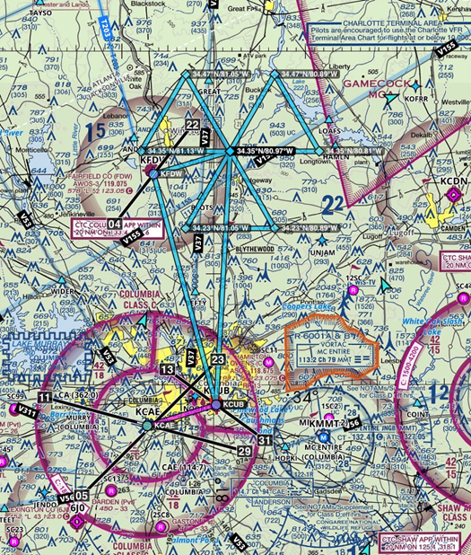
Flight Test Plan: SC Civil Air Patrol (CAP)
CAP’s Gippsland G8 Airvan
Trajectory provided mix of line of sight & below-horizon paths
Relative aircraft to GS orientation varied
Two flights on each of 2 days (4 flights total)
Planned flight path for CAP flight tests; from Foreflight © software

Slide 9
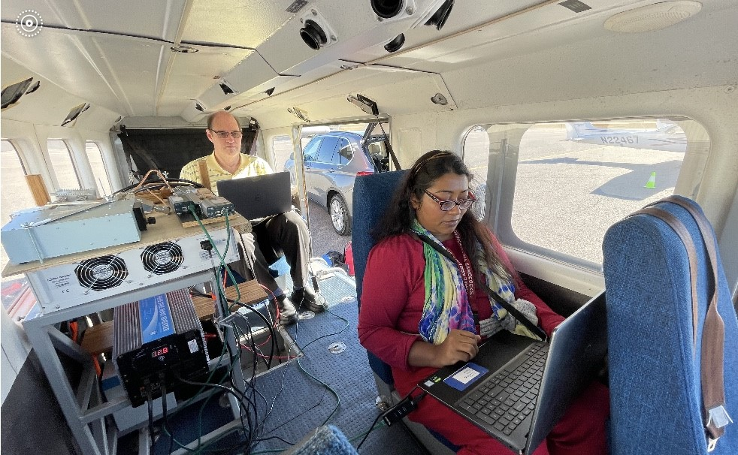
SC-CAP Flight Test Preparation
Team member & pilot Eddie King
Multiple new radio modes tested
GS spatial antenna diversity
Adaptive modulation
Simultaneous L-band & C-band communications
Wideband (5 MHz) C-band transmissions
RF
Ph.D. student Zeenat Afroze
SDRs
Filter (L)
HPA
Antennas
Power
(inverter)
Power
(batteries)

Slide 10
NASA ULI: Millimeter Wave (mmWave) Comm.
mmWave systems expanding (e.g., 5G, 6G)
Offer VERY high data rates, for short range networks
Require directional antennas
Accurate models of mmWave channels vital for link design
We measured/modeled in indoor, outdoor, & airport settings in two bands: 30 GHz, 90 GHz
Atlanta
Hartsfield
Columbia Metro Airport

Slide 11
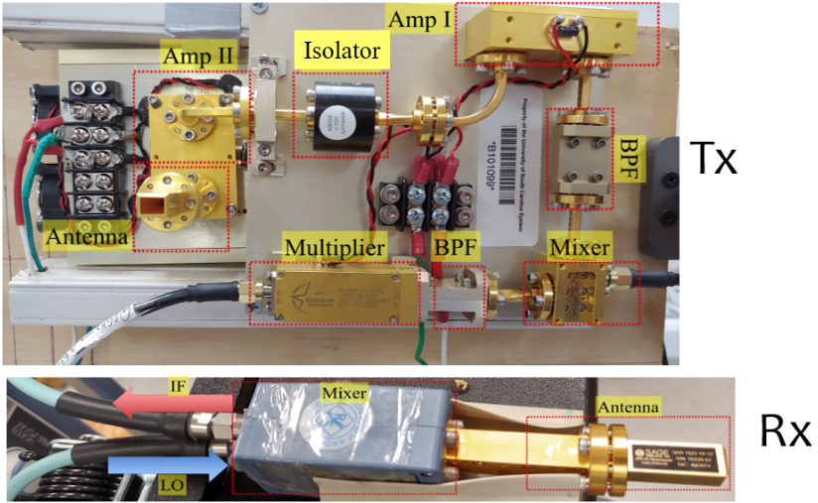
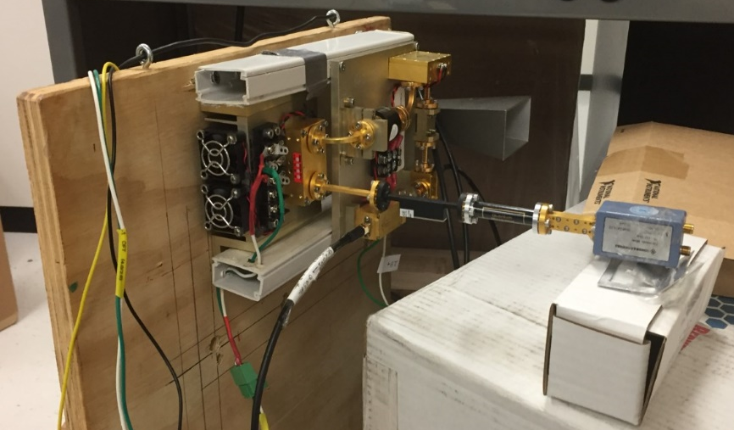
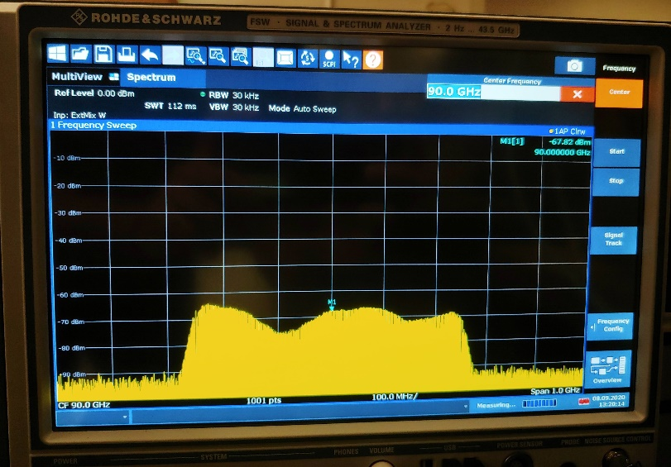
90 GHz Measurement Equipment
R&S Signal Generator (Tx), Analyzer (Rx)
Quinstar up/downconverters, amps, horn antennas
attenuators
measured (lab) power spectrum
500 MHz BW, showing multipath distortion effect

Slide 12
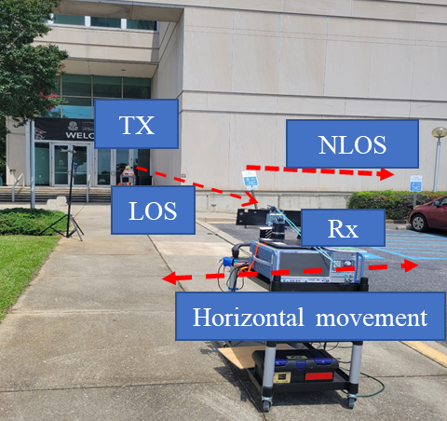
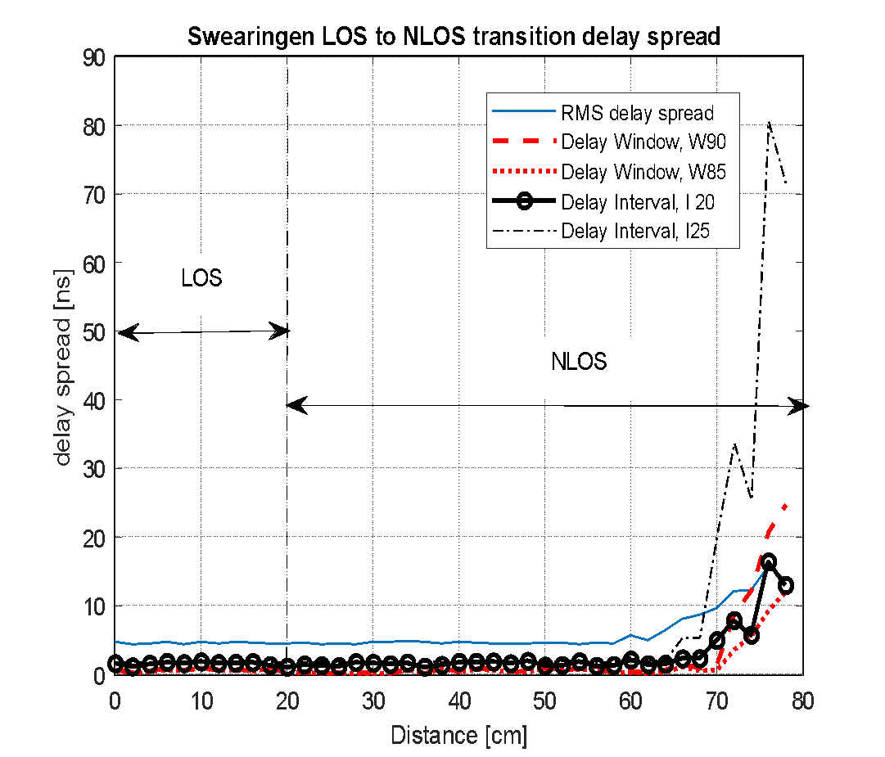
90 GHz Outdoor mmWave Measurements
Outdoor line-of-sight (LOS)-to-non-LOS (NLOS) transition
Measure increase in attenuation, change in angular direction of strongest signal, & change in delay dispersion
RMS Delay Spread vs. distance into NLOS region (RMS-DS quantifies channel delay dispersion)

Slide 13
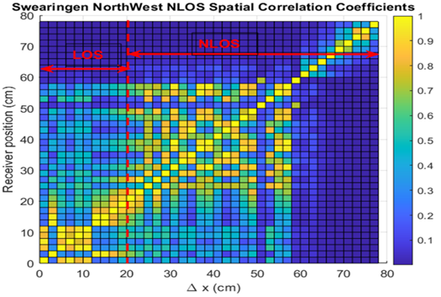
90 GHz LOS to NLOS Transition
For threshold c(Δx,x_{i})≥0.7
stationarity distance in NLOS region ranges from 2 cm - 12 cm
The NLOS stationarity distance < LOS stationary distance by factor of more than 100
Spatial PDP correlation coefficient vs. spatial separation (abscissa) & distance (ordinate) along LOS-to-NLOS transition for Swearingen NW outdoor

Slide 14
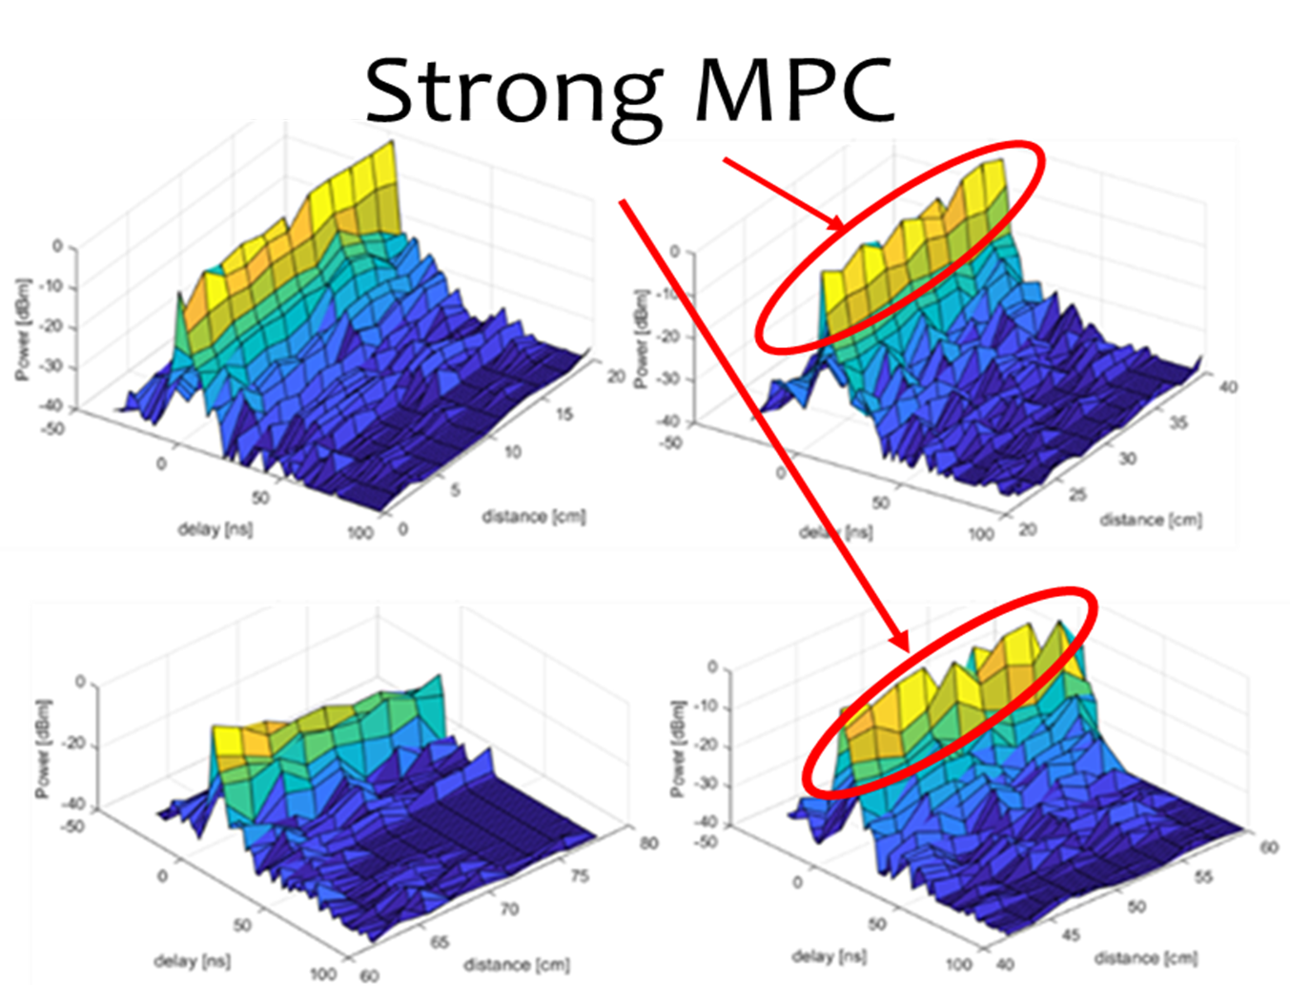
Power Delay Profiles for LOS to NLOS Transition
Transition around corner of concrete building
Pedestrian-level antenna heights
Large # multipath components (MPCs) up to 55 cm
Power delay profiles vs. distance for Swearingen NW outdoor LOS-to-NLOS transition, clockwise from upper left: 0 to 20 cm, 22 to 40 cm, 42 to 60 cm, & 62 to 78 cm

Slide 15
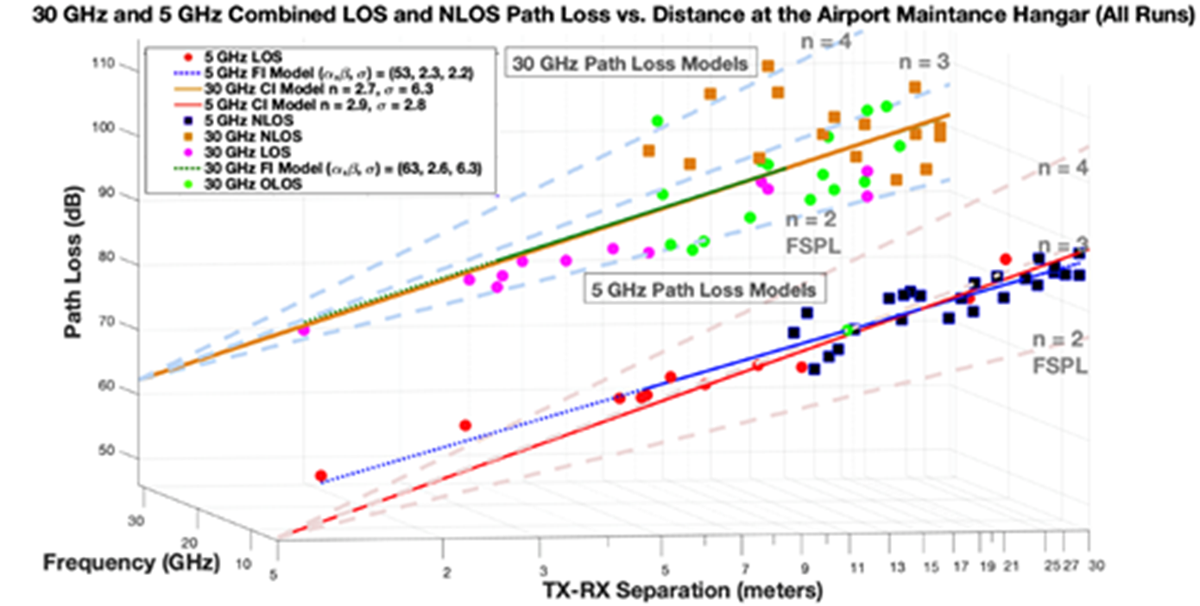
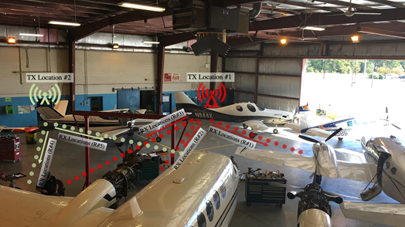
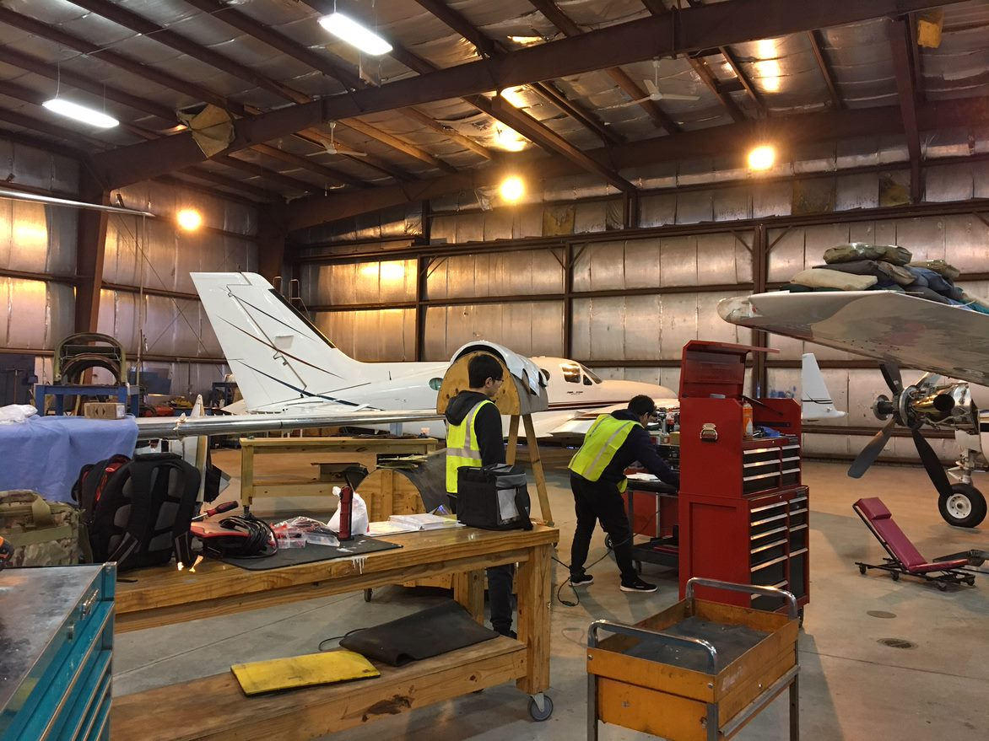
mmWave Measurements at Small Airport: 30 GHz
Path Loss (dB) vs. distance (m) & fits, mixed LOS/NLOS
airport maintenance hangar

Slide 16
…

Slide 17
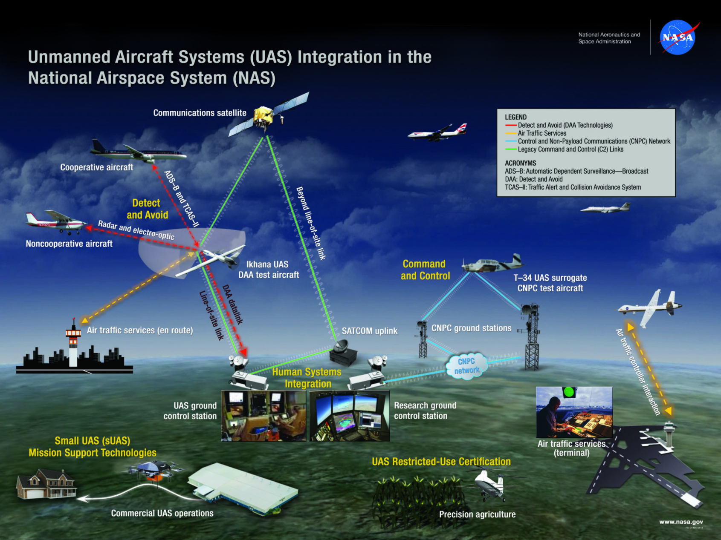
Prior NASA Project: UAS in the NAS
Explored/ validated technologies for reliable CNPC (C2)
Medium/large aircraft
U. South Carolina PHY/MAC
Air-ground (AG) channel measurements and models
Radio mod/demod
Networking

Slide 18
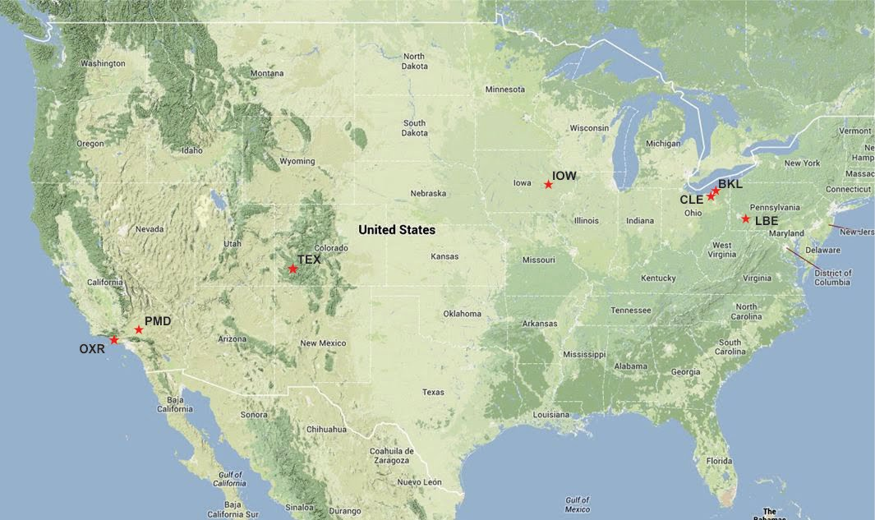
NASA Air-Ground (AG) Channel Measurements
Simultaneous dual-band 1 x 2 measurements
Seven distinct environments
CIRs for estimating (SIMO)
Path loss, small-scale fading
Delay dispersion
Doppler
Correlations
Telluride, CO

Slide 19
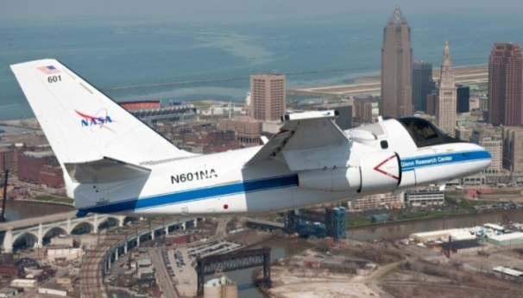
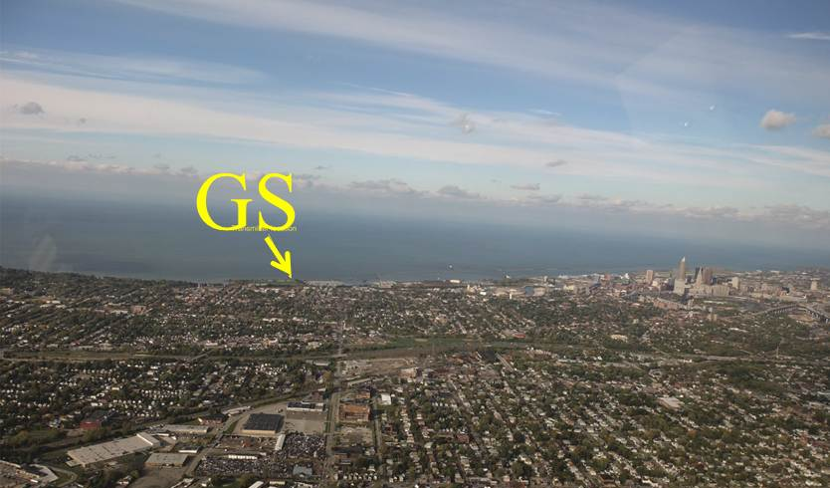
NASA: AG Channel Measurements→Models
Lake Erie
Downtown
Cleveland
NASA Glenn Research Center AG channel measurements
Time-varying channel impulse response (CIR) models for over-water, suburban desert & hilly, mountainous, & near urban
L- and C-bands, ~970 and 5030 MHz
20 m GS antenna height, aircraft altitude ~400 to 1700 m

Slide 20
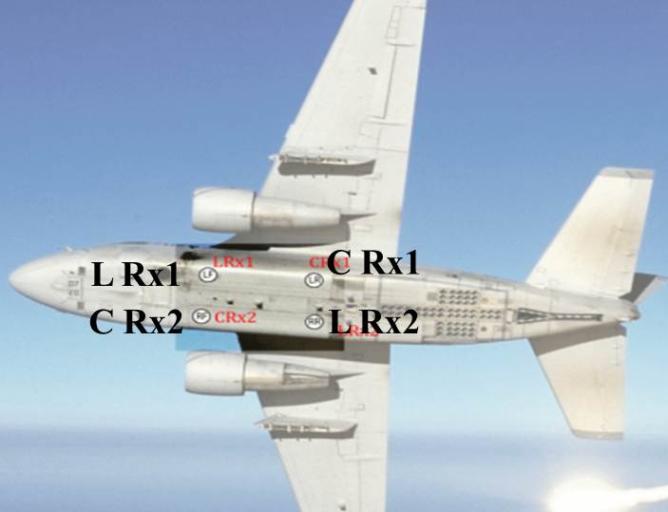
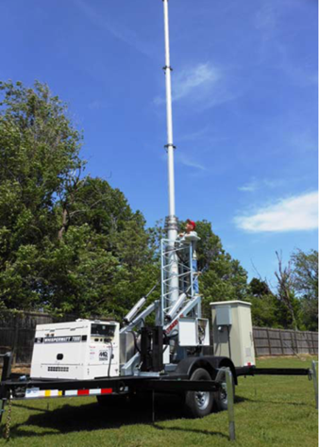
Measurement Equipment
DS-SS Stepped Correlator
Dual-Band SIMO
~ 3000 Power Delay Profiles (PDPs)/sec
Transportable GS with 20 m tower
Band | Signal Bandwidth (MHz) | Frequency Span (MHz) | Maximum Delay Span (μs) | Transmit Power (W) | Tx Amplifier (dB) | Rx LNA Gain (dB) | Cable Loss (dB)
L | 5 | 960-977 | 204.6 | 10 | -- | 15.5 | 4
C | 50 | 5000-5150 | 20.46 | 10 | 7 | 30 | 7.5

Slide 21
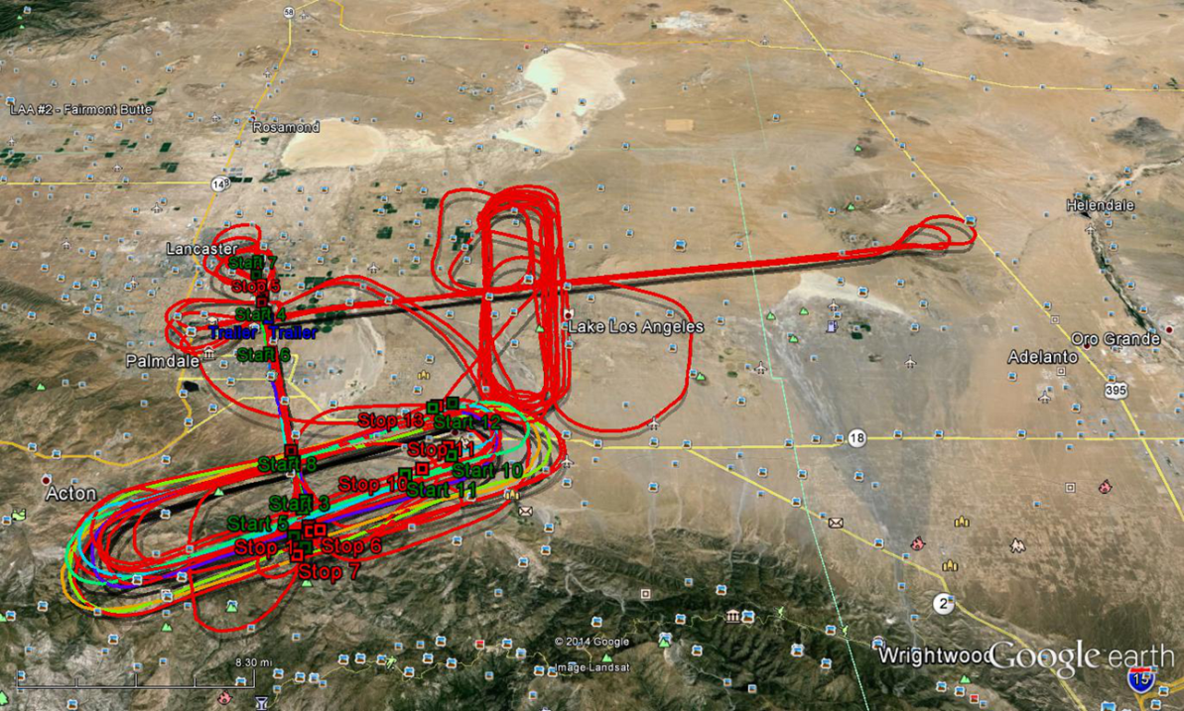
Example Measurement Environments
Desert, hilly/suburban, Palmdale, CA, & Lake Erie, 2013
G_{C}=6 dB, G_{L}=5 dB
h_{GS} = 20 m
El/Az beamwidths
35°/180 ° for C
60°/120 ° for L
Aircraft antennas: omni
monopoles (“blades”)
Both straight & oval-shaped flight tracks (FTs)
Over 42 GB data (>106 million PDPs) gathered
Downtown Cleveland
Over 11 GB data (>25 million PDPs) gathered
Aircraft view east

Slide 22
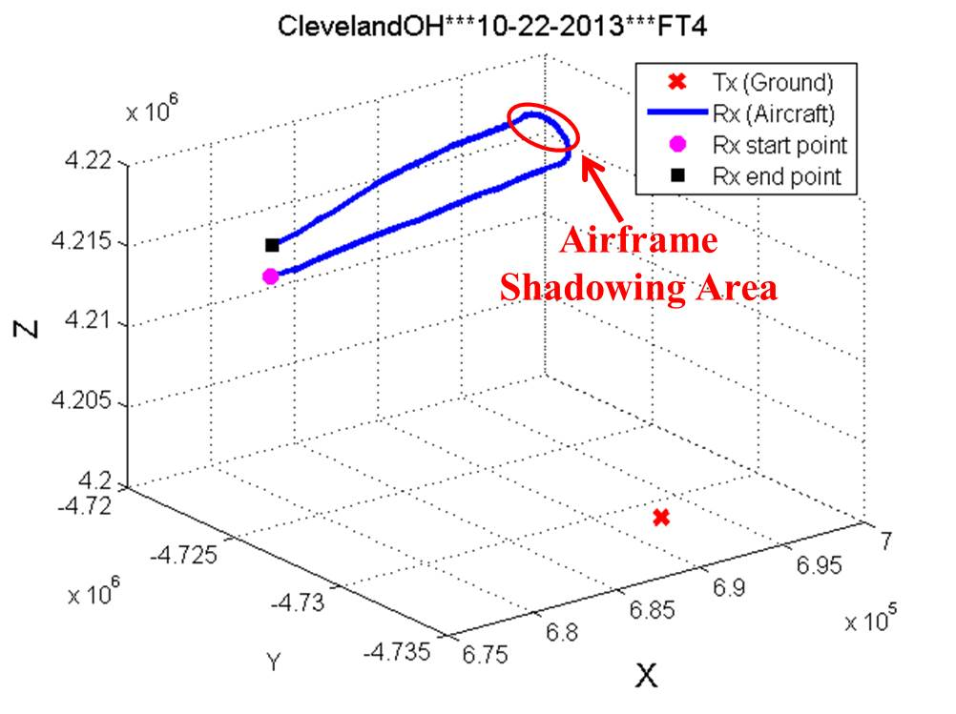
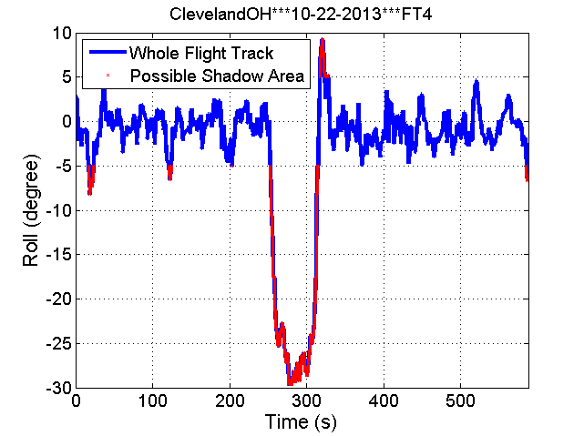
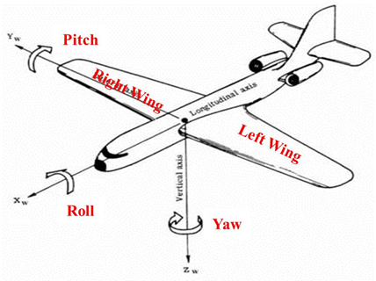
Large Scale Attenuation: Airframe Shadowing
LOS Blockage: aircraft-specific (S-3B)
Applicable for similar-sized aircraft
Shadowing data for all GS environments
Flight path in ECEF coordinates

Slide 23
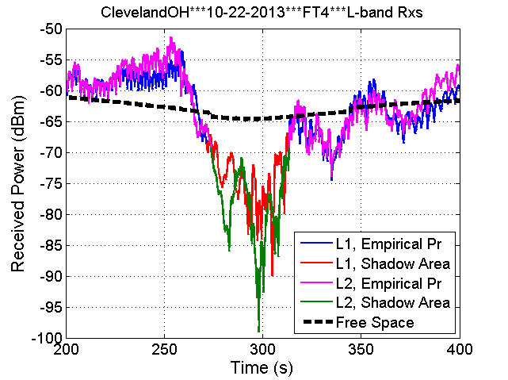
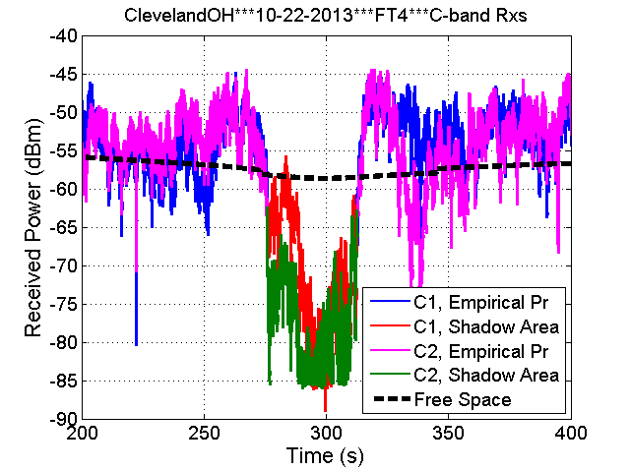
Airframe Shadowing (2)
Example shadowing events (P_{Rx} vs. t), statistics
Over-Freshwater Statistics |  | C-band |  | L-band
 |  | Rx1 | Rx2 | Rx1 | Rx2
Shadow Duration (s) |  | 36.5 | 37.3 | 41.9 | 39.8
Shadow Loss (dB) | Max | 30.4 | 27.5 | 25.5 | 34.4
 | Min | 0 | 4.2 | 2.6 | 5.0
 | Mean | 9.1 | 17.2 | 10.3 | 14.2
 | Median | 6.3 | 16.9 | 9.6 | 12.9
 | Standard Deviation | 7.4 | 6.4 | 4.4 | 5.9
Distance (km) | Max | 21.8 | 21.8 | 21.8 | 21.8
 | Min | 20.5 | 20.5 | 20.1 | 20.3

Slide 24
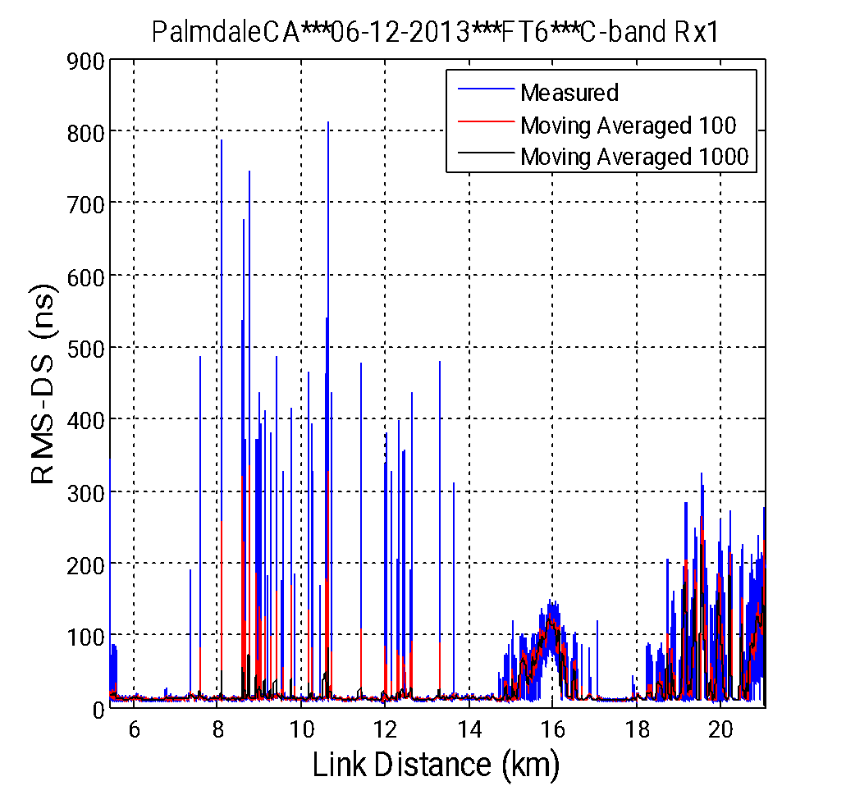
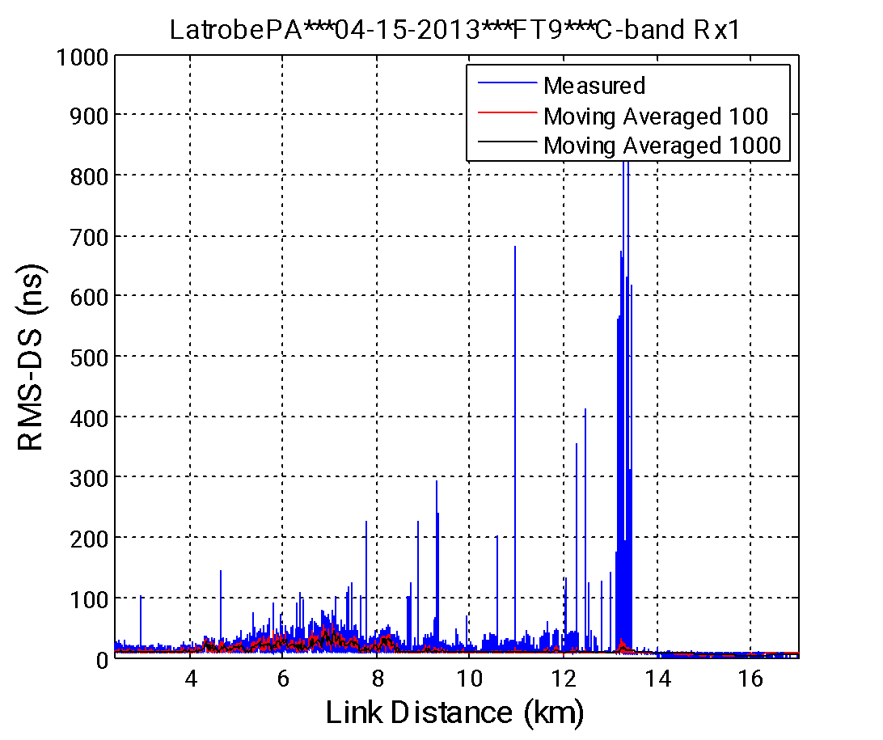
Channel Dynamics: Hilly Terrain RMS-DS
RMS-DS vs. distance
RMS-DS “spikes” are not anomalies/noise: they are intermittent MPCs due to terrain, buildings, etc.

Slide 25
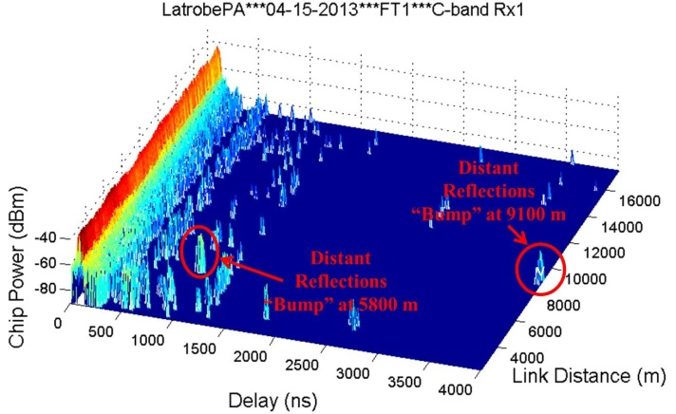
Hilly Terrain PDPs, RMS-DS Statistics
RMS Delay Spread |  | Mean (ns) | Median (ns) | Max (ns) | Standard Deviation (ns)
FT1 | Original | 12.9 | 10.9 | 267.2 | 9.8
 | Moving Averaged, 100 PDPs |  | 11.1 | 87.0 | 6.6
 | Moving Averaged, 1000 PDPs |  | 11.2 | 57.0 | 5.7
FT6 | Original | 35.7 | 10.9 | 995.7 | 55.7
 | Moving Averaged, 100 PDPs |  | 18.6 | 371.8 | 42.9
 | Moving Averaged, 1000 PDPs |  | 19.3 | 349.2 | 40.4

Slide 26
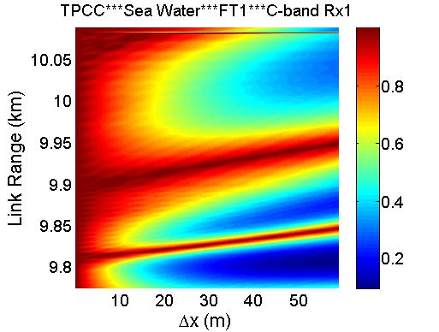
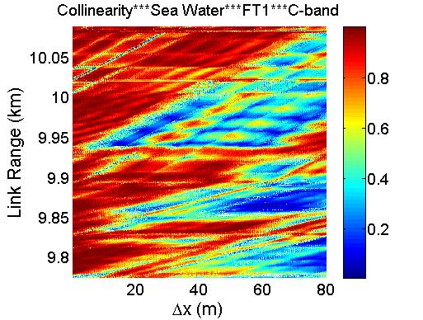
AG Channel Stationarity Distance Example
Example over-sea SD measured results (Oxnard, CA, FT1)
c(Δx,d)
coll(Δx,d)
LOTS of stats gathered for c & coll
Over-water: median SD(c)~15 m, median SD(coll)~6.4 m

Slide 27
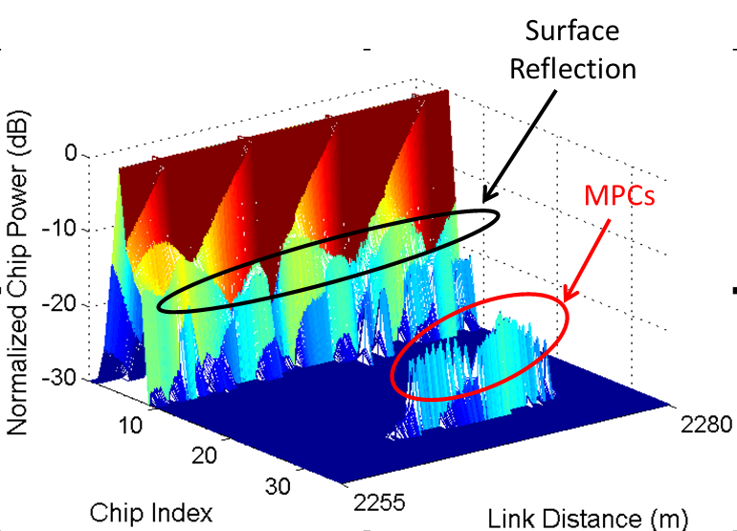
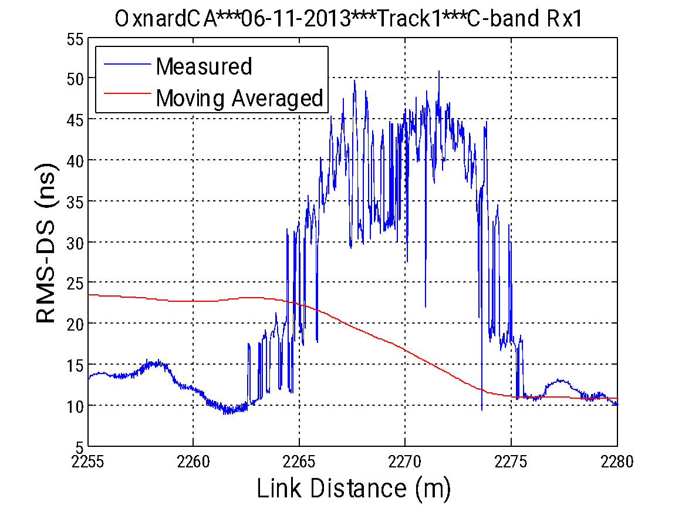
Over-Sea: Delay Dispersion Example
Looking more closely at RMS-DS & PDPs
Straight
MPC
PDP#4652
d~1.5 km
Oval

Slide 28
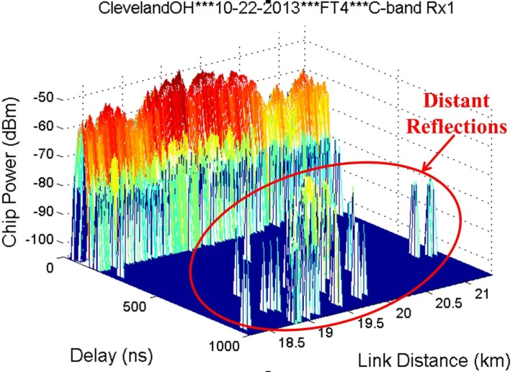
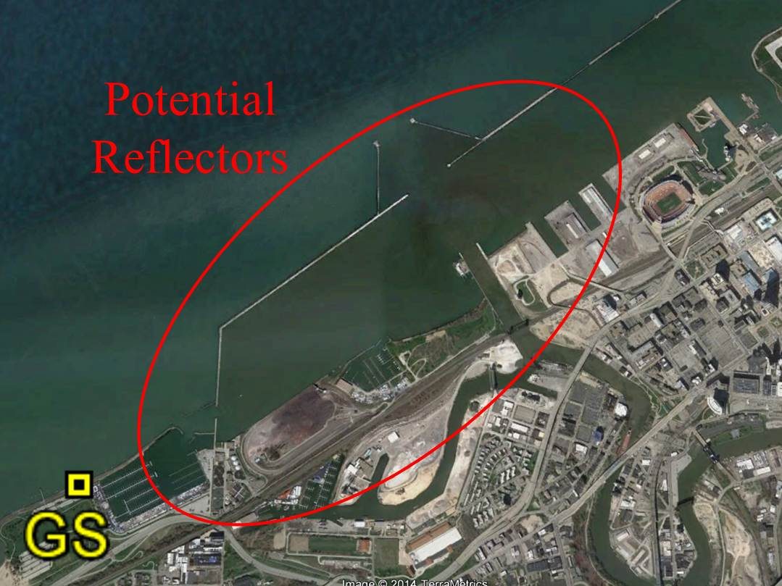
Fresh H₂O: Delay Dispersion
Scrutinizing RMS-DS & PDPs
Near-Shore
Reflectors
Several large buildings, 3 harbors w/watercraft, water barriers, light houses & oil tanks present
Geometry indicates these obstacles create MPCs

Slide 29
…

Slide 30
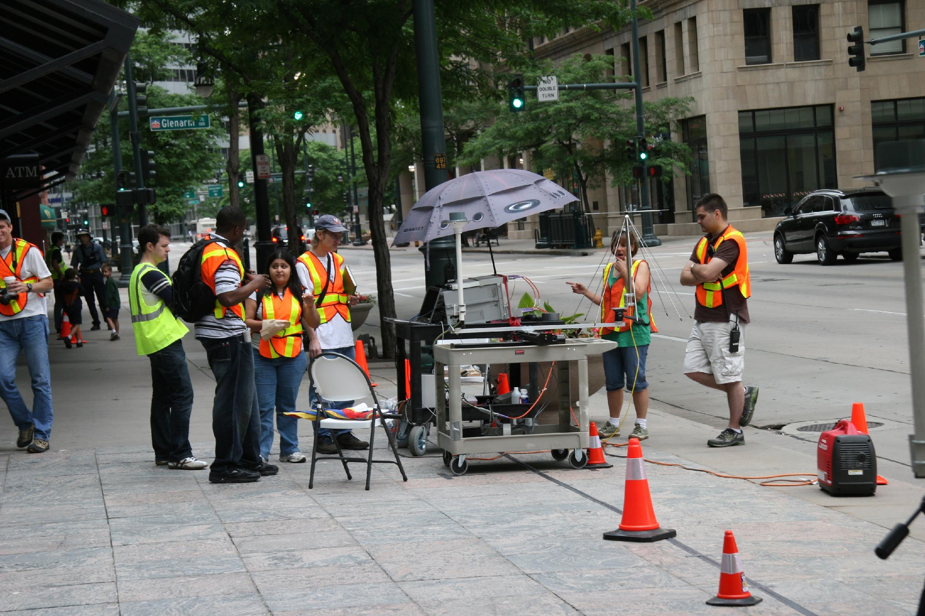
Prior Project: Urban Channel Measurements
Collaboration with National Institute of Standards & Technology (NIST)
Urban measurements of path loss & delay dispersion in Denver, CO, with multiple antennas, in multiple frequency bands

Slide 31
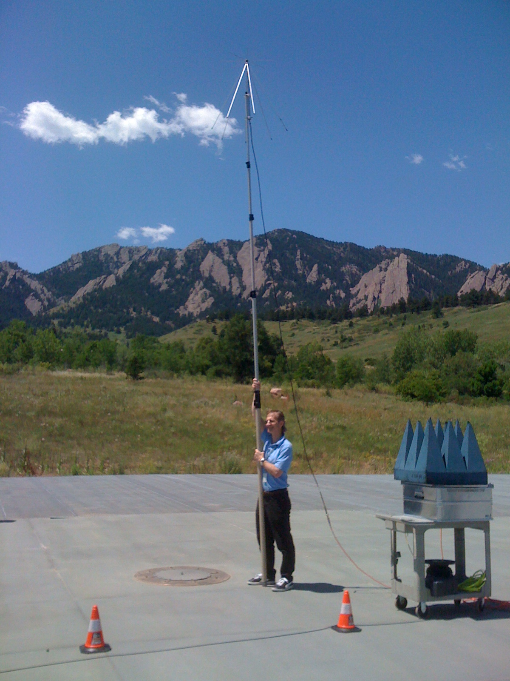
NIST Channel Measurements: Calibration
NIST outdoor test facility, Boulder, CO
Calibrating antennas, transmitter, & receiver in deterministic two-path channel
Used in urban, outdoor, & indoor measurements for Public Safety communications

Slide 32
…

Slide 33
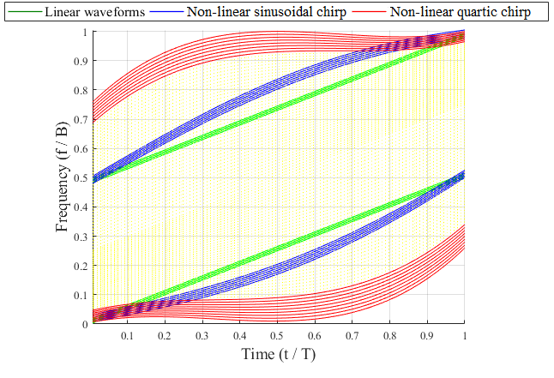
New Project: Contested Environment Communications
Time-frequency (TF) processing for new adaptive LPD signaling schemes, more sensitive detectors
TF analysis for spread-spectrum signaling types
TF geometric processing, extreme-value distribution mapping, Renyi entropy for weak signal ID
LPD for dispersive channels
Game-theoretic analyses for optimal AJ strategies
Noise & ambient signal characterization for LPD
Wideband measurements of both internal (system) and external (environment) signals, noise & TF representations
non-linear chirp spread spectrum
MC-DS-SS
spectrum
Signal
spectrum
SC-DS-SS spectrum
f_{c}
f

